Slide 1
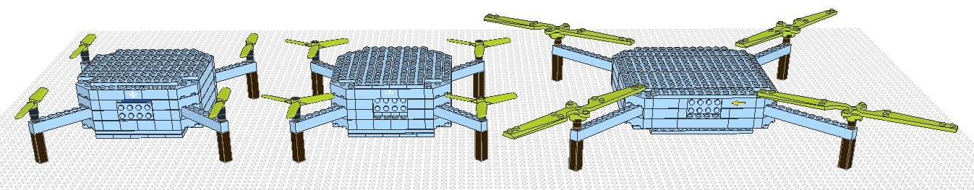
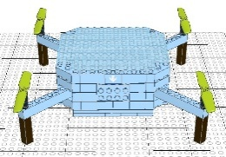
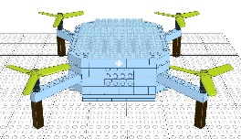
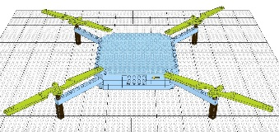


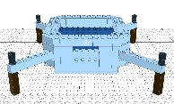


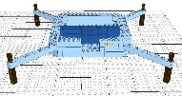
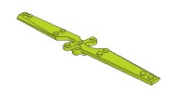

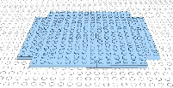

MAIN MODEL
SUBMODELS
Ultralight
drone
Freestyle
drone
Long-range
drone
MODULES
Small
Battery
Small
Propeller
Small
Frame
Small
Cover
Medium
Propeller
Medium
Battery
Large
Frame
Large
Propeller
Large
Battery
Large
Cover

