Slide 1
Computer Graphics Lab
Prepared By
Dr. Liyakathunisa Ansari
Department of Computer Science
Taibah University

Slide 2
Lab Requirements
Software Tools Required
Netbeans framework
JDK , JAVAFX
Hardware Required
Standalone desktops

Slide 3
Objectives:
Understand the need of developing graphics application
Learn algorithmic development of graphics primitives like: line,
circle, polygon etc.
Learn the representation and transformation of graphical images and pictures

Slide 4
Learning Outcomes
At the end of this course student will:
CLO 1: Draw Geometric primitives such as line, circles, polygons
CLO 2: Implement basic 2D transformations on objects
CLO 3: Implement clipping algorithm on lines
CLO 4: Apply Lighting / Shading on 3D scene
CLO 5: Design, implement and demonstrate Computer Graphics Application using 2D graphics, 3D graphics, Texture mapping, Lighting and Animation techniques

Slide 5
Lab1. Basic Graphics Functions
Learning Outcome:
Design and develop simple graphics programs using basic graphics functions
Lines
Circles
Triangles
Polygons
Rectangle

Slide 6
2D - Graphics Programs for Simple Geometric Shapes :
The drawLine( ) displays a line in the current drawing color that begins at startX, startY and ends at endX, endY
Syntax:
drawLine(int startX, int startY, int endX, int endY )
E.g: drawLine(40, 25, 250, 80)

Slide 7
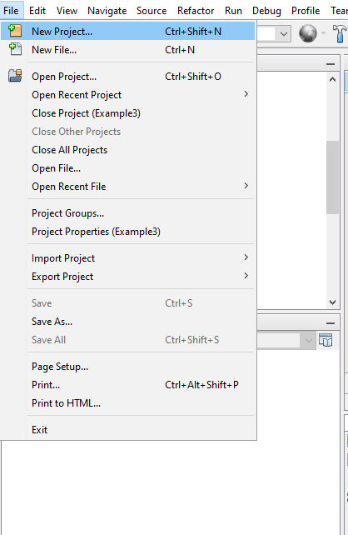
Program Setup
Open Netbeans
Start New Project

Slide 8
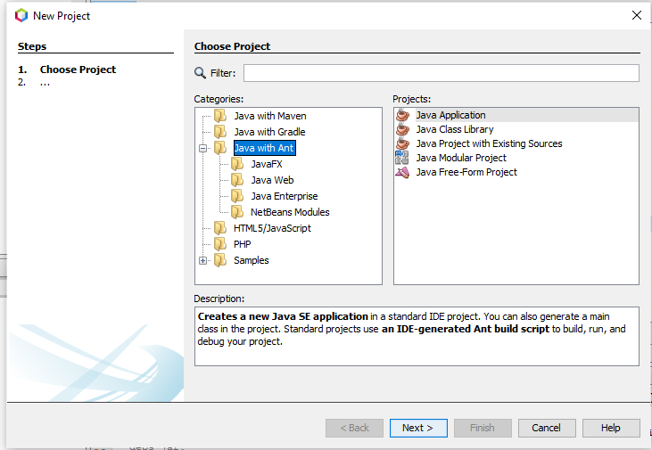
Select Java Application

Slide 9
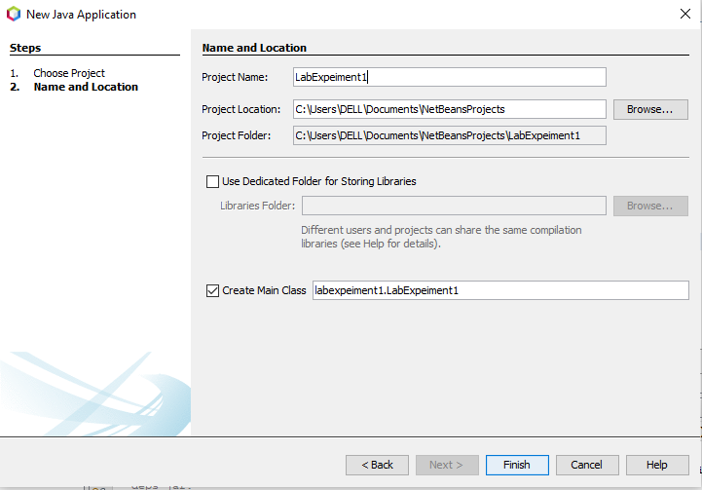
Provide the Project Name e.g: LabExperiment1
Click Finish

Slide 10
Lab 1: Program
//Add the below code in Main class
public class LabExpeiment1 {
public static void main(String[] args) {
// TODO code application logic here
MyFrame myFrame = new MyFrame();
}
}

Slide 11
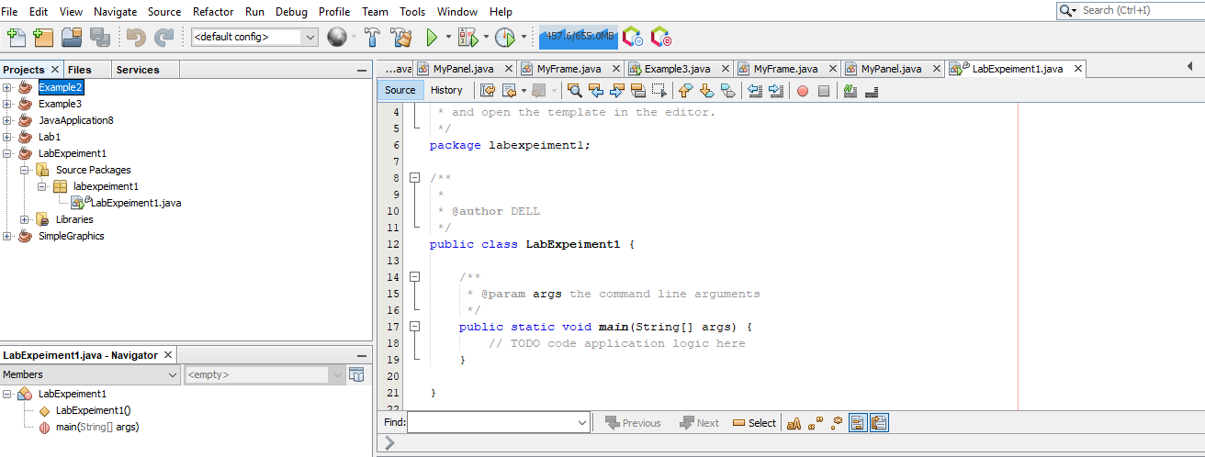
Lab 1: Program
Main Class

Slide 12
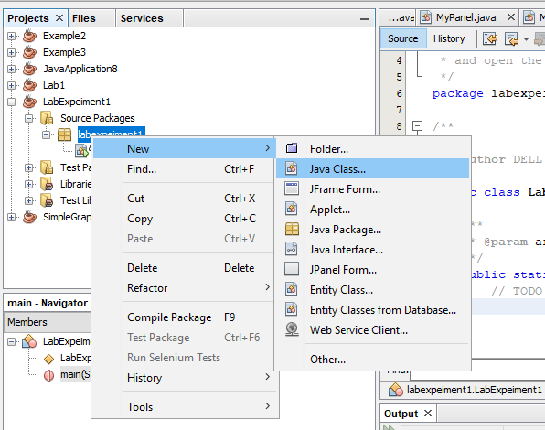
Lab 1: Program to DrawLine
Create a new class –MyFrame
To set the frame size for drawing
objects

Slide 13
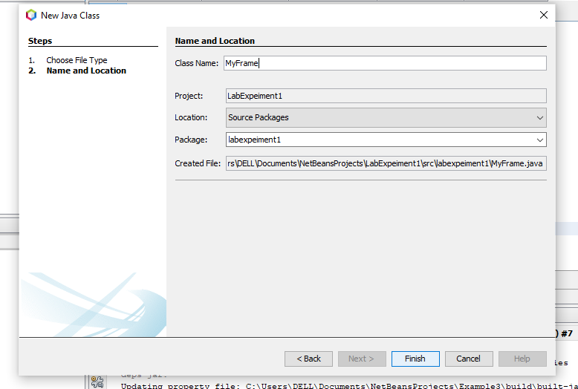
Lab 1: Program to DrawLine

Slide 14
Lab 1: Program to DrawLine
//Enter the below code in MyFrame class
import java.awt.*;
import javax.swing.*;
public class MyFrame extends JFrame{
MyFrame(){
MyPanel panel = new MyPanel();
this.setDefaultCloseOperation(JFrame.EXIT_ON_CLOSE);
this.add(panel);
this.setLocationRelativeTo(null);
this.setVisible(true);
}
}

Slide 15
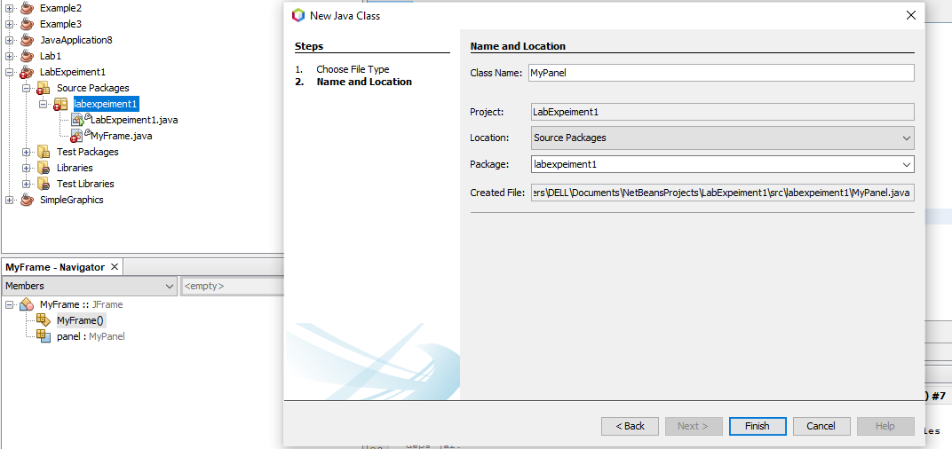
Lab 1: Program to DrawLine

Slide 16
MyPanel class code
//Enter the below code to draw line
import java.awt.Color;
import java.awt.BasicStroke;
import java.awt.Dimension;
import java.awt.Graphics;
import java.awt.Graphics2D;
import javax.swing.JPanel;
public class MyPanel extends JPanel {
MyPanel(){
this.setPreferredSize(new Dimension(500,500));
}
}
constructor
Size of the drawing panel

Slide 17
Lab 1: Program to DrawLine
@Override
public void paint(Graphics g) {
Graphics2D g2D = (Graphics2D) g;
g2D.setPaint(Color.blue);
g2D.setStroke(new BasicStroke(5));
g2D.drawLine(0, 0, 500, 500);
}
Override paint method
Graphics 2D instance created
Drawline function

Slide 18
Lab 1: Program to DrawLine
Update MyFrame , with below code
panel = new MyPanel();
this.add(panel);
Update Main class, add MyFrame class
new MyFrame();
Compile and Run

Slide 19
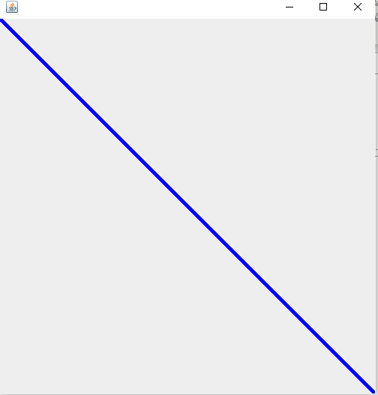
Output

Slide 20
Drawing Rectangles
The drawRect( ) and fillRect( ) methods display an outlined and filled rectangle, respectively
void drawRect(int left, int top, int width, int height)
void fillRect(int left, int top, int width, int height)
The upper-left corner of the rectangle is at left, top. The dimensions of the rectangle are specified by width and height.
drawRect(10, 150, 60, 50);
g.fillRect(100, 150, 60, 50);

Slide 21
Main class
package labexpeiment1;
public class LabExpeiment1 {
public static void main(String[] args) {
// TODO code application logic here
MyFrame myFrame = new MyFrame();
}
}

Slide 22
Rounded Rectangle
To draw a rounded rectangle, use drawRoundRect( ) or fillRoundRect( )
void drawRoundRect(int left, int top, int width, int height, int xDiam, int yDiam)
void fillRoundRect(int left, int top, int width, int height,int xDiam, int yDiam)
A rounded rectangle has rounded corners. The upper-left corner of the rectangle is at left, top.
The dimensions of the rectangle are specified by width and height.
The diameter of the rounding arc along the X axis is specified by xDiam.
The diameter of the rounding arc along the Y axis is specified by yDiam
E.g: drawRoundRect(190, 150, 60, 50, 15, 15)
g.fillRoundRect(280, 150, 60, 50, 30, 40)

Slide 23
MyFrame class
import java.awt.*;
import javax.swing.*;
public class MyFrame extends JFrame{
MyPanel panel;
MyFrame(){
panel = new MyPanel();
this.setDefaultCloseOperation(JFrame.EXIT_ON_CLOSE);
this.add(panel);
this.pack();
this.setLocationRelativeTo(null);
this.setVisible(true);
}
}

Slide 24
MyPanel class to DrawRectangle
public class MyPanel extends JPanel {
MyPanel(){
this.setPreferredSize(new Dimension(500,500));
}
@Override
public void paint(Graphics g) {
Graphics2D g2D = (Graphics2D) g;
g2D.setPaint(Color.pink);
g2D.drawRect(0, 0, 100, 200);
g2D.fillRect(0, 0, 100, 200);
}
}

Slide 25
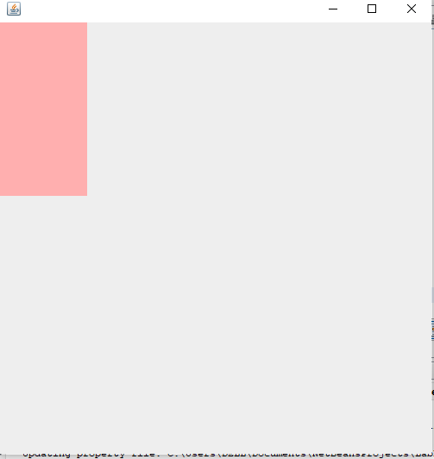
Output

Slide 26
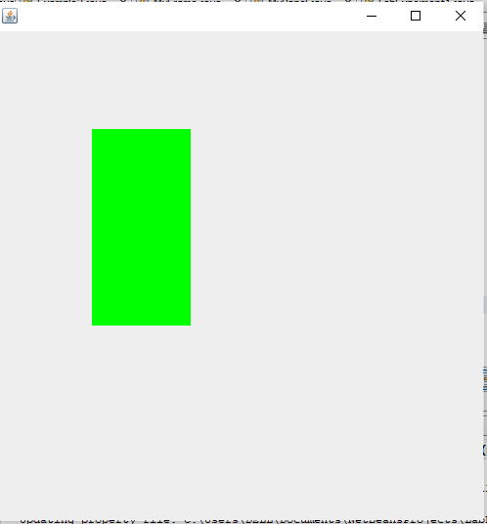
Code updated with coordinates value changed
public class MyPanel extends JPanel {
MyPanel(){
this.setPreferredSize(new Dimension(500,500));
}
@Override
public void paint(Graphics g) {
Graphics2D g2D = (Graphics2D) g;
g2D.setPaint(Color.green);
g2D.drawRect(100, 100, 100, 200);
g2D.fillRect(100, 100, 100, 200);
} }

Slide 27
Drawing Ellipses and Circles
To draw an ellipse, use drawOval( ). To fill an ellipse, use fillOval( ).
void drawOval(int left, int top, int width, int height)
void fillOval(int left, int top, int width, int height)
The ellipse is drawn within a bounding rectangle whose upper-left corner is specified by left, top and whose width and height are specified by width and height.
To draw a circle, specify a square as the bounding rectangle.
e.g: drawOval(10, 250, 50, 50);
fillOval(90, 250, 75, 50);
Note: If the width and height are the same, the oval becomes a circle.

Slide 28

public class MyPanel extends JPanel {
MyPanel(){
this.setPreferredSize(new Dimension(500,500));
}
@Override
public void paint(Graphics g) {
Graphics2D g2D = (Graphics2D) g;
g2D.setPaint(Color.orange);
g2D.drawOval(0, 0, 100, 100);
g2D.fillOval(0, 0, 100, 100);
}
}

Slide 29
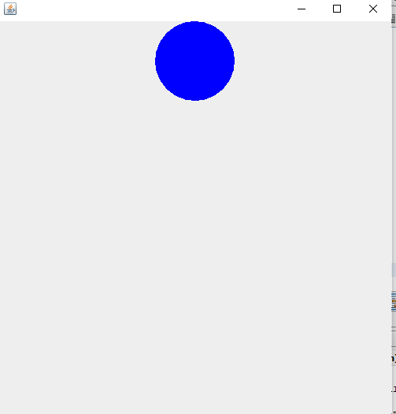
Code updated with coordinates value changed
public class MyPanel extends JPanel {
MyPanel(){
this.setPreferredSize(new Dimension(500,500));
}
@Override
public void paint(Graphics g) {
Graphics2D g2D = (Graphics2D) g;
g2D.setPaint(Color.blue);
g2D.drawOval(200, 0, 100, 100);
g2D.fillOval(200, 0, 100, 100);
} }

Slide 30
Drawing Arcs
Arcs can be drawn with drawArc( ) and fillArc( ), shown here:
void drawArc(int left, int top, int width, int height, int startAngle,int sweepAngle)
void fillArc(int left, int top, int width, int height, int startAngle,int sweepAngle)
The arc is bounded by the rectangle whose upper-left corner is specified by left, top and whose width and height are specified by width and height.
The arc is drawn from startAngle through the angular distance specified by sweepAngle.
e.g: drawArc(10, 350, 70, 70, 0, 180);
fillArc(60, 350, 70, 70, 0, 75);

Slide 31
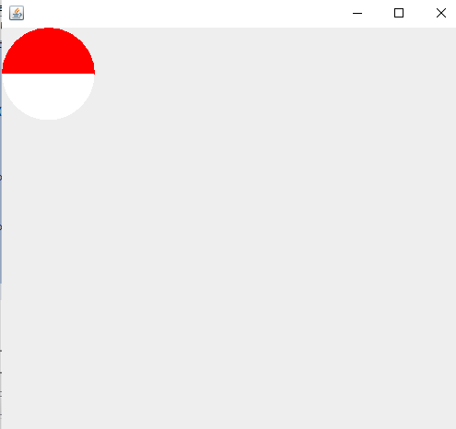
Example 3: Program to Draw Arc
public class MyPanel extends JPanel {
MyPanel(){
this.setPreferredSize(new Dimension(500,500));
}
public void paint(Graphics g) {
Graphics2D g2D = (Graphics2D) g;
g2D.setPaint(Color.red);
g2D.drawArc(0, 0, 100, 100, 0, 180);
g2D.fillArc(0, 0, 100, 100, 0, 180);
g2D.setPaint(Color.white);
g2D.fillArc(0, 0, 100, 100, 180, 180);
}
}

Slide 32
Drawing Polygons
It is possible to draw arbitrarily shaped figures using drawPolygon( ) and fillPolygon( ),
void drawPolygon(int x[ ], int y[ ], int numPoints)
void fillPolygon(int x[ ], int y[ ], int numPoints)
The polygon’s endpoints are specified by the coordinate pairs contained within the x and y arrays.
The number of points defined by these arrays is specified by numPoints.
E.g: int xpoints[] = {10, 200, 10, 200, 10};
int ypoints[] = {450, 450, 650, 650, 450};
int num = 5;
drawPolygon(xpoints, ypoints, num);

Slide 33
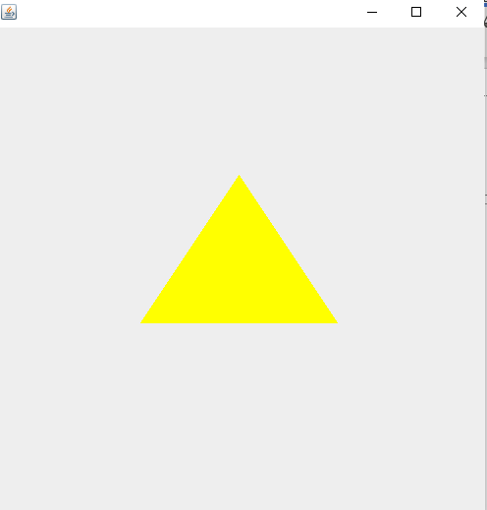
Example 4: To draw Triangles
public class MyPanel extends JPanel {
MyPanel(){
this.setPreferredSize(new Dimension(500,500));
}
public void paint(Graphics g) {
Graphics2D g2D = (Graphics2D) g;
int[] xPoints = {150,250,350};
int[] yPoints = {300,150,300};
g2D.setPaint(Color.yellow);
g2D.drawPolygon(xPoints, yPoints, 3);
g2D.fillPolygon(xPoints, yPoints, 3);
} }

Slide 34
Example 5: All shapes
public void paint(Graphics g)
{
Graphics2D g2D = (Graphics2D) g;
g2D.setPaint(Color.blue);
g2D.setStroke(new BasicStroke(5));
g2D.drawLine(200,200, 500, 500);
g2D.setPaint(Color.pink);
g2D.drawRect(100,100, 100, 200);
g2D.fillRect(100,100, 100, 200);
g2D.setPaint(Color.orange);
g2D.drawOval(400,400, 100, 100);
g2D.fillOval(400,400, 100, 100);

Slide 35
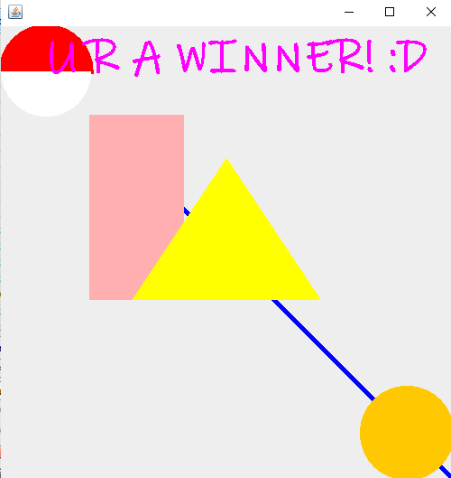
g2D.setPaint(Color.red);
g2D.drawArc(0, 0, 100, 100, 0, 180);
g2D.fillArc(0, 0, 100, 100, 0, 180);
g2D.setPaint(Color.white);
g2D.fillArc(0,0, 100, 100, 180, 180);
int[] xPoints = {150,250,350};
int[] yPoints = {300,150,300};
g2D.setPaint(Color.yellow);
g2D.drawPolygon(xPoints, yPoints, 3);
g2D.fillPolygon(xPoints, yPoints, 3);
g2D.setPaint(Color.magenta);
g2D.setFont(new Font("Ink Free",Font.BOLD,50));
g2D.drawString("U R A WINNER! :D", 50, 50);
}
}

Slide 36
What Next? Lab 2: Designing Complex 2D objects

