Slide 1

--------------------------------------------------------------------------------------------- FACULTY OF COMPUTER AND INFORMATION TECHNOLOGY SOFTWARE ENGINEERING DEPARTMENT COURSE NAME : SYSTEM ANALYSIS AND DESIGN DISASTER MANAGEMENT APPLICATION SUPERVISED BY DR. MALIK QASAIMEH

Slide 2
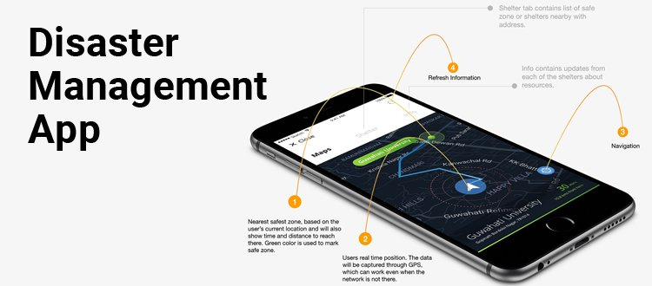

Slide 3
PARTICIPENTS:
Student Name | ID
Ghada Ziad Musallam || Section 1 | 144155
Rama Omar Dalgamouni || Section 1 | 140119
Rana Ahmed Hazaimeh || Section 1 | 145419
Shefa'a Elayan Alkhatib || Section 2 | 144751

Slide 4
Table of contents:
1.planing phase1:
1-1.Scope...........................................4
1-2.Context Diagram..........................6
1-3.Risks.............................................7
1-4.Feasibility Study...........................8
1-5.Sechedules.................................16

Slide 5
1-1.Scope of Disaster Management Application
Disasters are something that we cannot stop. However, with the help of cutting-edge technology we can very well predict it and reduce the destruction caused by it. Moreover, we can save lives with the help of a warning. So, we work to develop a mobile app that automatically gives alerts to its users warning them of a possible natural disaster. Moreover, the app also helps its users who are stuck in a perilous situation. The users simply must send a request stating information like location, and other important details. The request will be received by the operator who will assign the rescue duty to the nearest disaster management executive. The executive will then go to the location and rescue the user.

Slide 6
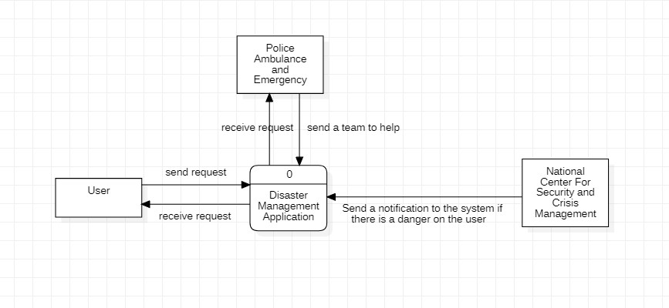
1-2.Context Diagram

Slide 7
1.3. Risks:
1-Lack of experience, which leads to many errors
2-Continuous climate change
3-The presence of the application user in a mountainous area that does not contain a signal, which affects the use of the device
4-The occurrence of disasters in a residential area, which leads to the difficulty of evacuating the area
5-Potential Risk of Security Violation.
6-The conflict among stakeholders regarding the functionality.
7-Changes are inevitable.

Slide 8
Feasibility Study:
ONE-TIME costs worksheet:
________________________________________________Year 0__ 1.Devlopment costs $ 15,000 2.New hardware 5,000 3.New (purchased)software, if any *Packaged applications software 4,500 *Other_______________________________ ____0 4.User training___________________________ ____ 0 5.Site Preparation 2,000 6.Others________________________________ ____0 Total one-time costs $ 26,500

Slide 9
Tangible benefits worksheet:
________________________________________Year 1 through 5__ Cost reduction or avoidance $ 4,000 Error reduction 2,300 Increased flexibility 7,350 Increased speed of activity 9,900 Improvement in management planning or control 26,000 Other________________________________ _____0 Total tangible benefits $ 49,550

Slide 10
Feasibility Study
Recurring costs worksheet:
________________________________________year 1 through 5___ 1.Applicayion software maintenance $ 20,000 2.Incremental data storage required: 20GB * $50 (estimated/MB = $50) 1,000 3.Incremental communications (lines, messages, …) 1,500 4.New software or hardware leases 1,000 5.Supplies 890 6.Other________________________ ___0 Total recurring costs $ 24,390

Slide 11
NPV: Net Present Value:
Month | Cash flow
0 | $ 1,000,000
1 | $ 75,000
2 | $ 85,000
3 | $ 95,000
4 | $ 100,000
5 | $ 1,100,000
6 | $ 1,200,000
Discount rate | 8.00%
NPV | $ 4,846,997.538
After we saw the NPV is positive, and the value is bigger the present value that means there is a profit from the project we would accept it

Slide 12
ROI:
ROI = (235,000-210,000)/210,000
= 11.90%
Cost |  | Benefit
Category | Amount in $ | Category | Amount in $
Work effort | 100,000 | Improved cycle time | 95,0000
Training | 25,000 | Refactor and rework | 140,000
Structure implementation | 50,000
New software or hardware leases | 35,000
total | 210,000 |  | 235,000

Slide 13
Feasibility study:
Operational Feasibility:
Our application will solve a big problem in the industry by showing new ways to protect their users from any crisis that can happen to then at any time.
On the one hand, it will tell the user about the weather conditions such as if there will be a heavy rain or a tornado can happen in their region.
On the other hand, the user can call the police or the emergency to help then in any possible way if they are in danger a robber or an accident etc.
Therefore, our application is a must on ever cell phone any one can have, to survive and save them self from any circumstances.

Slide 14
Feasibility study:
Technical feasibility:
Due to the large number of disasters that can occur in a particular area, we have developed an application that deals with news platforms responsible for predicting and publicizing these disasters to warn people of them.
A notification is sent to system users. This notification conveys news of the disaster that will occur in the area where the system user is located. The user of the system can also request the help he wants through this system, and this help will be about the damage that may result from the disaster that occurred. So that the user of the system determines the place and type of assistance he wants to reach the appropriate party.

Slide 15

Feasibility study:
Economic feasibility:
Developing the system will be easy , that's why we don't need any training sessions.
In addition to that the system developers have sufficient skills, we do not need any other developers.
Most important of all, its development does not require a lot of resources.

Slide 16
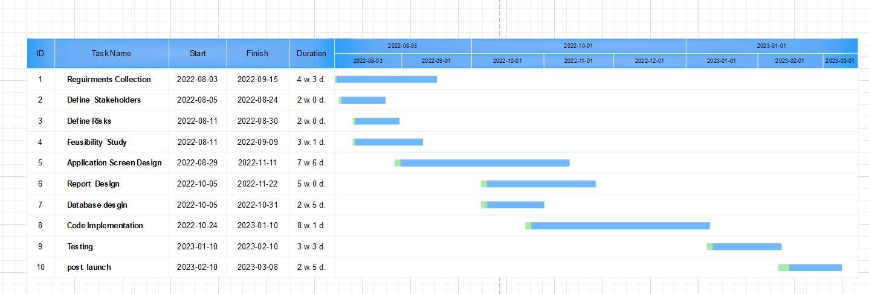
Gantt Chart:

Slide 17
Pert Calculation :
ACTIVITY | TIME ESTIMATE o r p | EXPECTED TIME(ET) O+4r+p
Requirement Collection Define Stakeholders Define Risks Feasibility study Application Screen Design Report Design Database Design Code Implementation Testing Post launch | 1 4 7 1 2 6 1 2 4 1 3 9 4 7 12 2 5 10 1 2 8 3 8 11 2 3 5 2 2 4 | 24 15 13 18 44 32 17 46 19 14

Slide 18
PERT Chart:
Te=6
Tl=7
Te=16
Tl=16
3
6
Te=0
Tl=0
Te=4
Tl=4
Te=9
Tl=9
Te=21
Tl=21
Te=29
Tl=29
Te=32
Tl=32
Define Risks
5
Report Design
8
9
10
1
2
Te=16
Tl=19
Define Stakeholders
Te=6
Tl=6
Application Screen Design
Code Implementation
Testing
post launch
Requirements collection
4
7
Feasibility Study
Database design
Critical path
Noncritical path

Slide 19

6 | 3 | 8
7 | 2 | 9
16 | 6 | 21
16 | 5 | 21
9 | 5 | 16
9 | 7 | 16
21 | 8 | 29
21 | 8 | 29
29 | 9 | 32
29 | 3 | 32
32 | 10 | 34
32 | 2 | 34
0 | 1 | 4
0 | 4 | 4
4 | 2 | 6
4 | 2 | 6
6 | 4 | 9
6 | 3 | 9
16 | 7 | 18
19 | 2 | 21

Slide 20
Activity | TE | TL | SLACK TL-TE | ON CRITICAL PATH
1 | 0 | 0 | 0 | YES
2 | 4 | 4 | 0 | YES
3 | 6 | 7 | 1 | NO
4 | 6 | 6 | 0 | YES
5 | 9 | 9 | 0 | YES
6 | 16 | 16 | 0 | YES
7 | 16 | 19 | 3 | NO
8 | 21 | 21 | 0 | YES
9 | 29 | 29 | 0 | YES
10 | 32 | 32 | 0 | YES

Slide 21
2. Analysis phase2:
2.1. Techniques.........................................................22
2.2.functional and non-functional requirements.....23
2.3. Context Diagram.................................................28
2.4. Data Flow Diagram (DFD)...................................29
2.5. Decision Table.....................................................31

Slide 22
2.1. Techniques:
Technique #1: Interviewing:
The project manager interviews the stakeholders about their needs in the project.
Technique #2: Observation:
A potential user of the product is watched to identify requirements.
Technique #3: Prototypes:
A model of the proposed product is developed and then this model is presented to stakeholders for feedback.

Slide 23
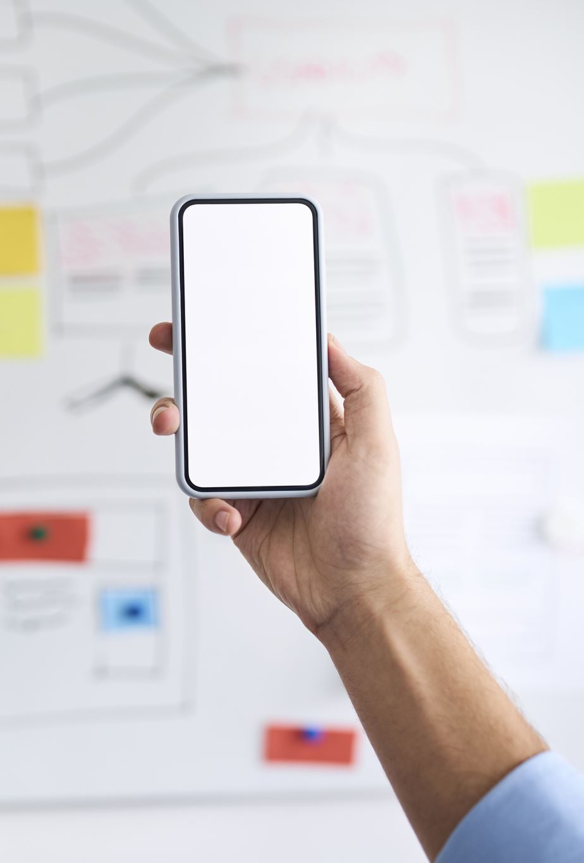
2.2. functional requirements:
1- User:
The user has to enter his/her information and verify it.
When a user enters data, the system should send an approval request.
The application will be also able to tell the user when will the help come to his location and how much it will take.
The user can choose the application language.

Slide 24
2.2. functional requirements:
2-National center for security and crisis management:
The application will be able to notify the user with every possible disaster that could happen in their place.
Giving information about track of storms and intensity of rains and any possible weather conditions.
The system will keep running even if there is a problem in the center because it will have an existing data about the weather in advance.

Slide 25
2.2. functional requirements: 3- Police and the Ambulance Emergency:
They will be able to come to the user under any circumstances.
They will be free to the user 24/7.
They will have the access of the user information.
They will have a phone number of the user's relatives if they cannot reach the user by his phone.

Slide 26

2.2. non-functional requirements:
Availability:
a. The application will be always available 24/7 and under any conditions.
b. The application will always have connection with user anywhere.
Security:
User information are secure, and no one will be able to access it.
Safety:
User info are also safe from any viruses and hackers.

Slide 27
2.2. non-functional requirements:
Useability:
The system shall be easy to use for any age.
Reliability:
The system is supported by data security and by main server in the application.
Scalability :-
The App should be able to adopt itself to increased usage or able to handle more data as time progress.

Slide 28
2.3. Context Diagram:

Slide 29
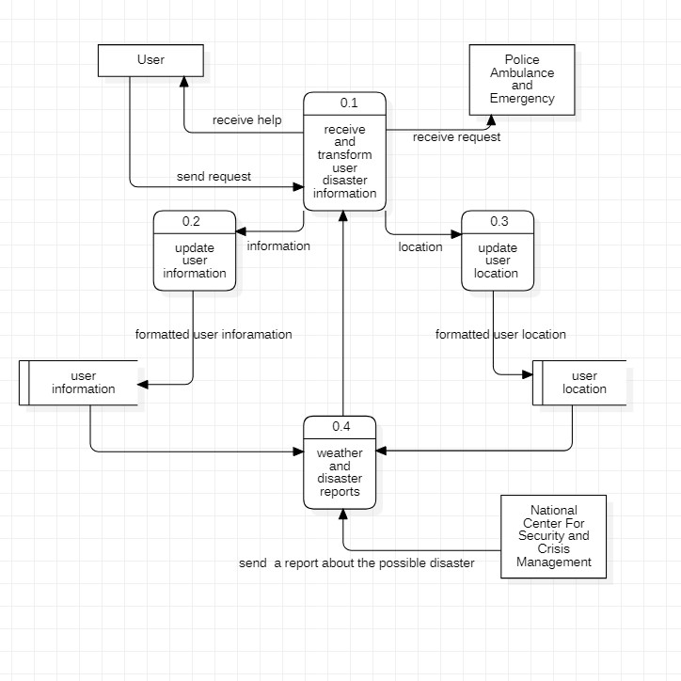
2.4. Dfd level-0:

Slide 30
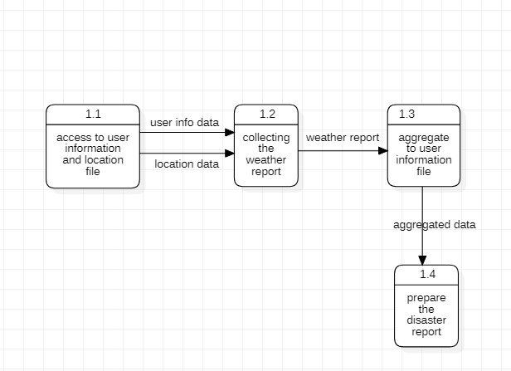
2.4. Dfd level-1:

Slide 31
2.5. Decision Table:
Conditions/ Courses of Action | Rules
 | 1 | 2 | 3 | 4 | 5
Requester is authorized | F | T | T | T | T
Police is available | - | F | T | T | T
Emergency is available | - | - | F | T | T
National center is working | - | - | - | F | T
Action
Accept request |  |  | X | X | X
Reject request | X | X

Slide 32
Phase 3 :
3- Design and implementation
3.1 ER Diagram...............................................33
3.2 The type of testing in the program.………….34

Slide 33
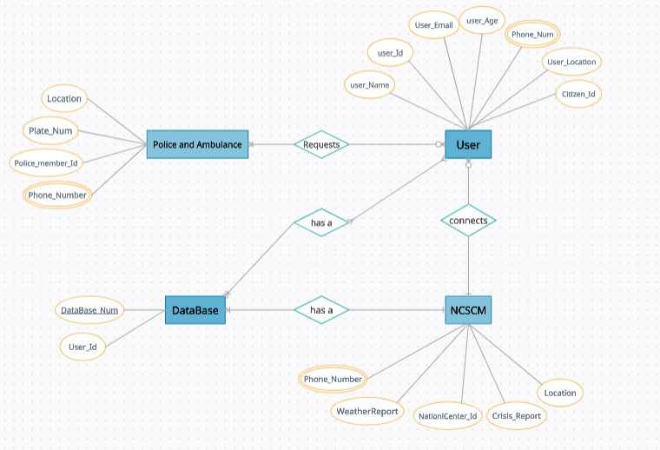
ER diagram:

Slide 34
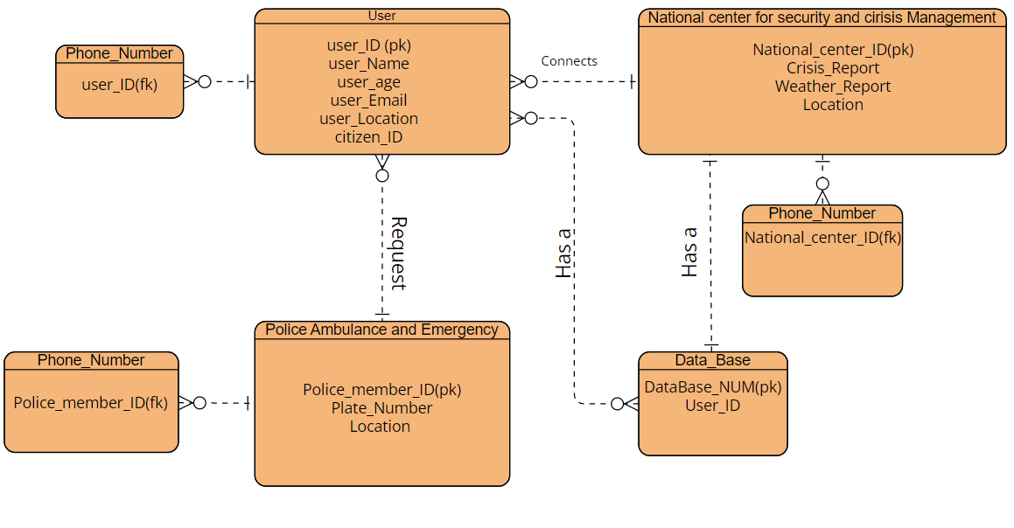
ER Diagram:

Slide 35
3.2. Type of testing:
1-Testing Non-Functional Requirements:
Ease to use: Test by asking several people to use the features of the system.
2- Security & Privacy:
Try hacking into the system's database and extracting user information.
3-Reliability:
Making a huge number of requests to the system at same time

Slide 36
3.2. Type of testing:
4- Testing Functional Requirements:
-Test if the system will be able to take the weather report as an input or not.
-Check if the system be able to notify the police ambulance and emergency.
-be able to notify the user about any possible conditions.

Slide 37

Thank You

