Slide 1
Enhancing DevOps: Our CI/CD Pipeline Journey
DevOps Assessment Presentation
Start Now
Ghada Yousuf
12/05/2023

Slide 2



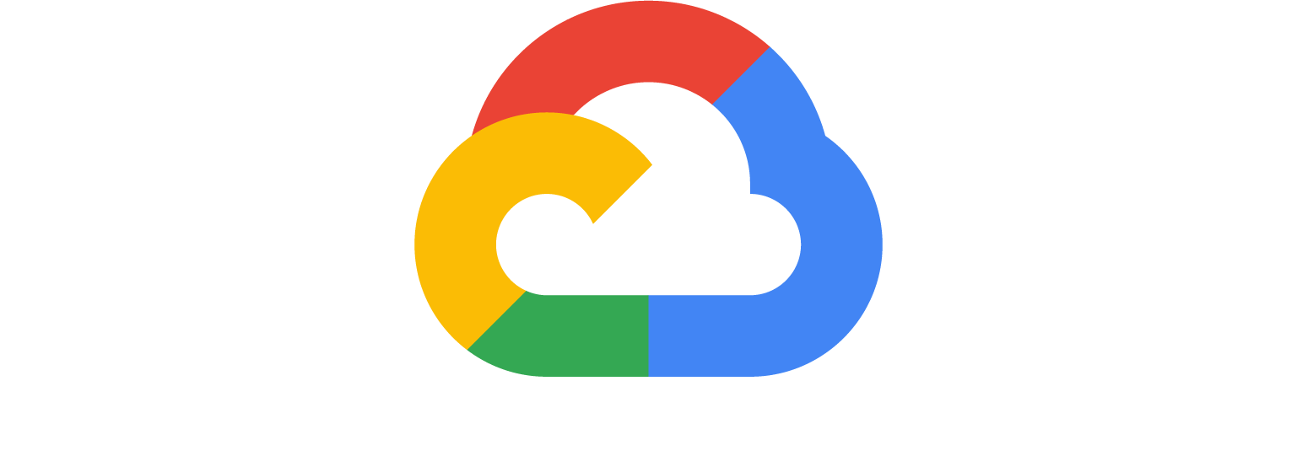
Hello, Welcome
Sr. Cloud Engineer
More
For More Information Visit Us Here :
https://www.linkedin.com/in/ghadayiabushawish/

Slide 3
Agenda
01. Introduction
02. Understanding Our CI/CD Pipeline
05. Optimizing with Google Cloud Platform
03. Managing High Traffic
04. Streamlining Debugging Processes
06. Evolving Our Pipeline: Beyond MVP

Slide 4
Introduction

Slide 5
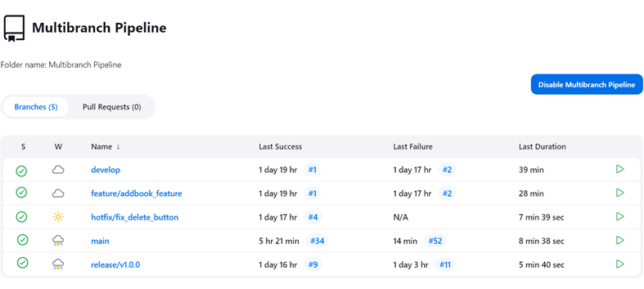

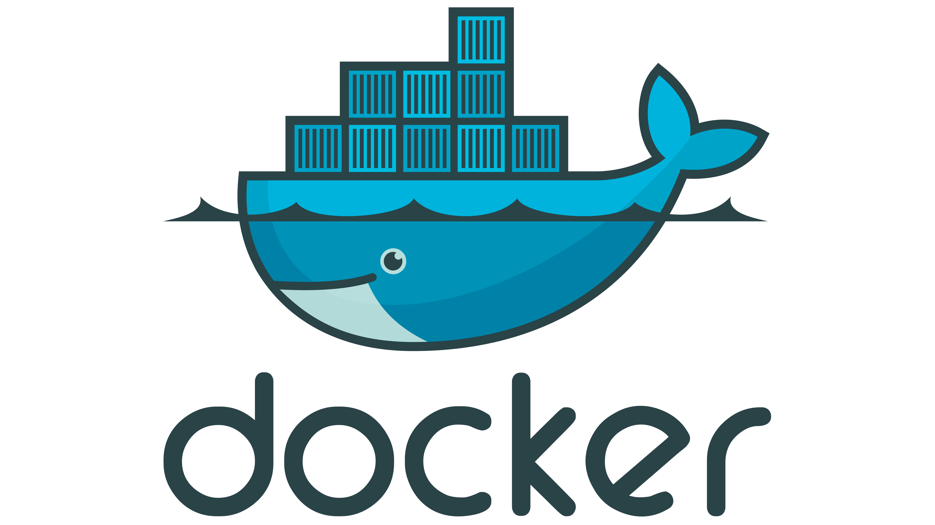
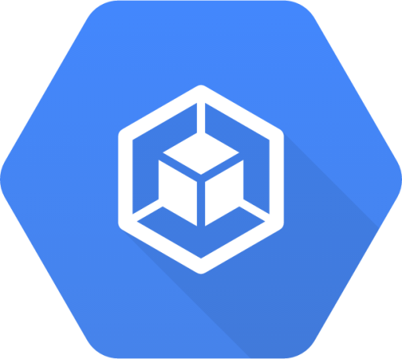
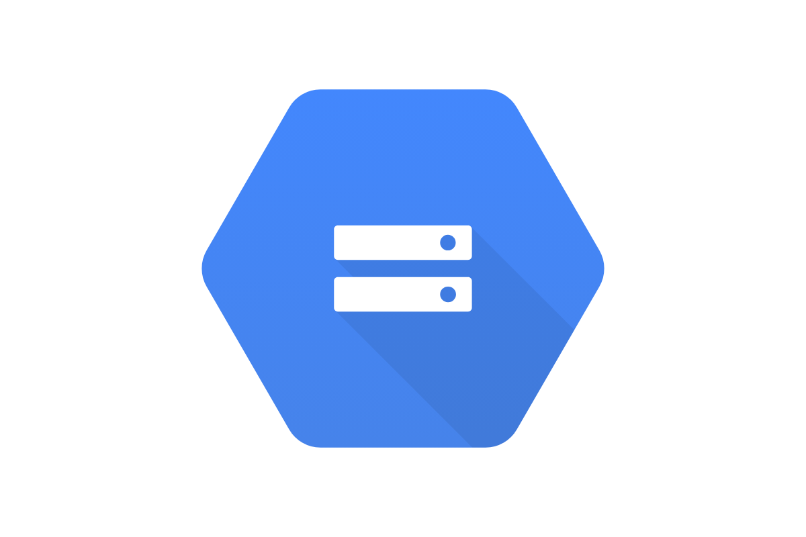
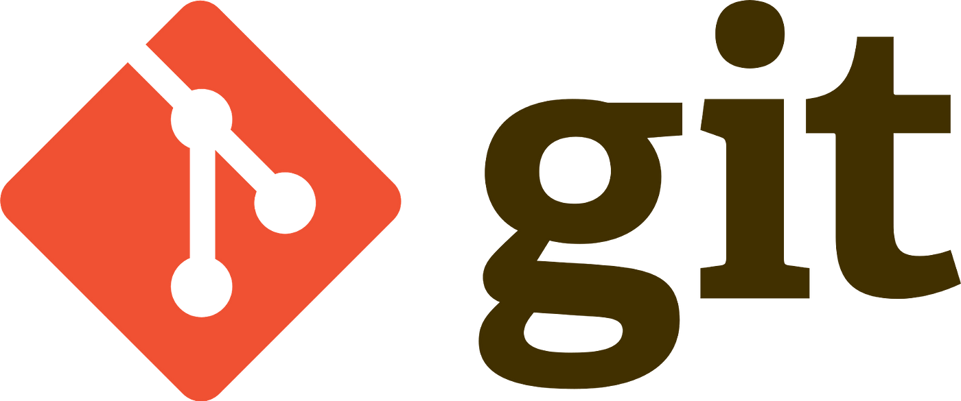
Understanding Our CI/CD Pipeline
Integration of Jenkins
Utilization of Docker
Deployment with GKE
Google Cloud Storage
Multi-Branch Strategy
Automated Testing and Quality Assurance
Go To Next Slide
Notes:
Pipeline Overview:
"Our CI/CD pipeline is structured to automate the entire software delivery process, from code integration to deployment."
Integration of Jenkins:
"Jenkins orchestrates the pipeline, automating tasks like building, testing, and deploying the application."
Utilization of Docker:
"Docker is employed for containerizing the application, ensuring consistency and reliability across different environments."
Deployment with GKE:
"Google Kubernetes Engine (GKE) is utilized for deploying the containerized application, offering scalable and resilient infrastructure."
Multi-Branch Strategy:
"Our pipeline employs a multi-branch strategy, handling different branches for features, development, releases, and hotfixes, streamlining development and release cycles."
Automated Testing and Quality Assurance:
"Automated tests, including unit and integration tests, are integral to our pipeline, ensuring code quality and functionality with each iteration."

Slide 6
Scaling for Success: Managing High Traffic
Current Scalability Approach
Load Balancing and Resource Management
Automated Scaling with GKE
Improvements for High Traffic Handling
Enhanced Container Orchestration
Optimizing Build Processes
Notes:
Current Scalability Approach:
"Our pipeline is currently designed to efficiently handle moderate traffic loads, ensuring quick build and deployment cycles."
Load Balancing and Resource Management:
"Utilizes load balancing within GKE to evenly distribute traffic and optimize resource usage, crucial for handling increasing user requests."
Automated Scaling with GKE:
"GKE's automated scaling feature dynamically adjusts resources based on traffic, enhancing our ability to manage sudden spikes in usage."
Improvements for High Traffic Handling:
"Proposing the integration of advanced monitoring tools to predict and prepare for traffic surges, allowing proactive scaling."
Enhanced Container Orchestration:
"Consider adopting more sophisticated container orchestration strategies to improve deployment frequency and minimize downtime during high loads."
Optimizing Build Processes:
"Streamlining and optimizing the build process to reduce build times, facilitating quicker updates and releases during peak traffic periods."

Slide 7
Streamlining Debugging Processes
Current Debugging Approach
Tools for Debugging
Challenges in Debugging
Improving Debugging Efficiency
Advanced Monitoring Integration
Notes:
Current Debugging Approach:
"Our CI/CD pipeline incorporates several checkpoints for debugging, utilizing logging and automated test results to identify issues."
Tools for Debugging:
"We leverage tools like Jenkins Console Output and Docker logs for real-time debugging. Additionally, GKE's built-in logging aids in monitoring container health and performance."
Challenges in Debugging:
"Despite effective tools, isolating issues in a multi-service architecture can be complex and time-consuming."
Improving Debugging Efficiency:
"Integrating centralized logging solutions for aggregated logs from various services, facilitating faster issue identification."
Advanced Monitoring Integration:
"Implementing more advanced monitoring tools, such as Prometheus or Grafana, for in-depth analysis and quicker resolution of issues."

Slide 8
Optimizing with Google Cloud Platform
GKE for Container Orchestration
Load Balancing in GKE
Artifact Management with Google Cloud Storage
Enhanced Logging, Monitoring and Alerting
Notes:
GKE for Container Orchestration:
"Our CI/CD pipeline capitalizes on GKE's robust container orchestration, ensuring efficient deployment and management of our Docker containers."
Load Balancing in GKE:
"GKE's load balancing capabilities allow us to distribute application traffic evenly, enhancing performance and reliability during varying load conditions."
Artifact Management with Google Cloud Storage:
"Google Cloud Storage is pivotal in securely storing our build artifacts, providing accessibility and scalability for our deployment needs."
Enhanced Logging and Monitoring:
"We utilize Google Cloud's logging and monitoring services for real-time insights into our application's performance and health."
Proactive Alerting:
"Leveraging GCP's alerting mechanisms to proactively manage and respond to potential issues, ensuring high availability and minimal downtime."

Slide 9
Evolving Our Pipeline: Beyond MVP
Advanced Scalability Solutions
Enhanced Security Measures
01
02
Incorporate auto-scaling groups in GKE
Integrate more robust security scanning tools
Debugging and Monitoring Upgrades
Impact of Enhancements
03
04
Explore advanced logging solutions, like Stackdriver
These enhancements will lead to a more resilient, secure, and responsive pipeline
Notes:
Advanced Scalability Solutions:
"Incorporate auto-scaling groups in GKE to dynamically adjust resources in response to traffic changes, enhancing our ability to handle peak loads."
"Implement container cluster management optimizations for more efficient resource utilization."
Enhanced Security Measures:
"Integrate more robust security scanning tools for early detection of vulnerabilities in our code and Docker images."
"Plan to adopt network security policies and encryption standards to protect sensitive data throughout our pipeline."
Debugging and Monitoring Upgrades:
"Explore advanced logging solutions, like Stackdriver, for deeper insights and streamlined analysis of application logs."
"Invest in AI-powered analytics tools for predictive monitoring and faster issue resolution."
Impact of Enhancements:
"These enhancements will lead to a more resilient, secure, and responsive pipeline, capable of supporting larger scale deployments and complex application ecosystems."

Slide 10
Questions & Answers
Thank You!

