Slide 1

ISTANBUL
GHADEER ABDULLA

Slide 2
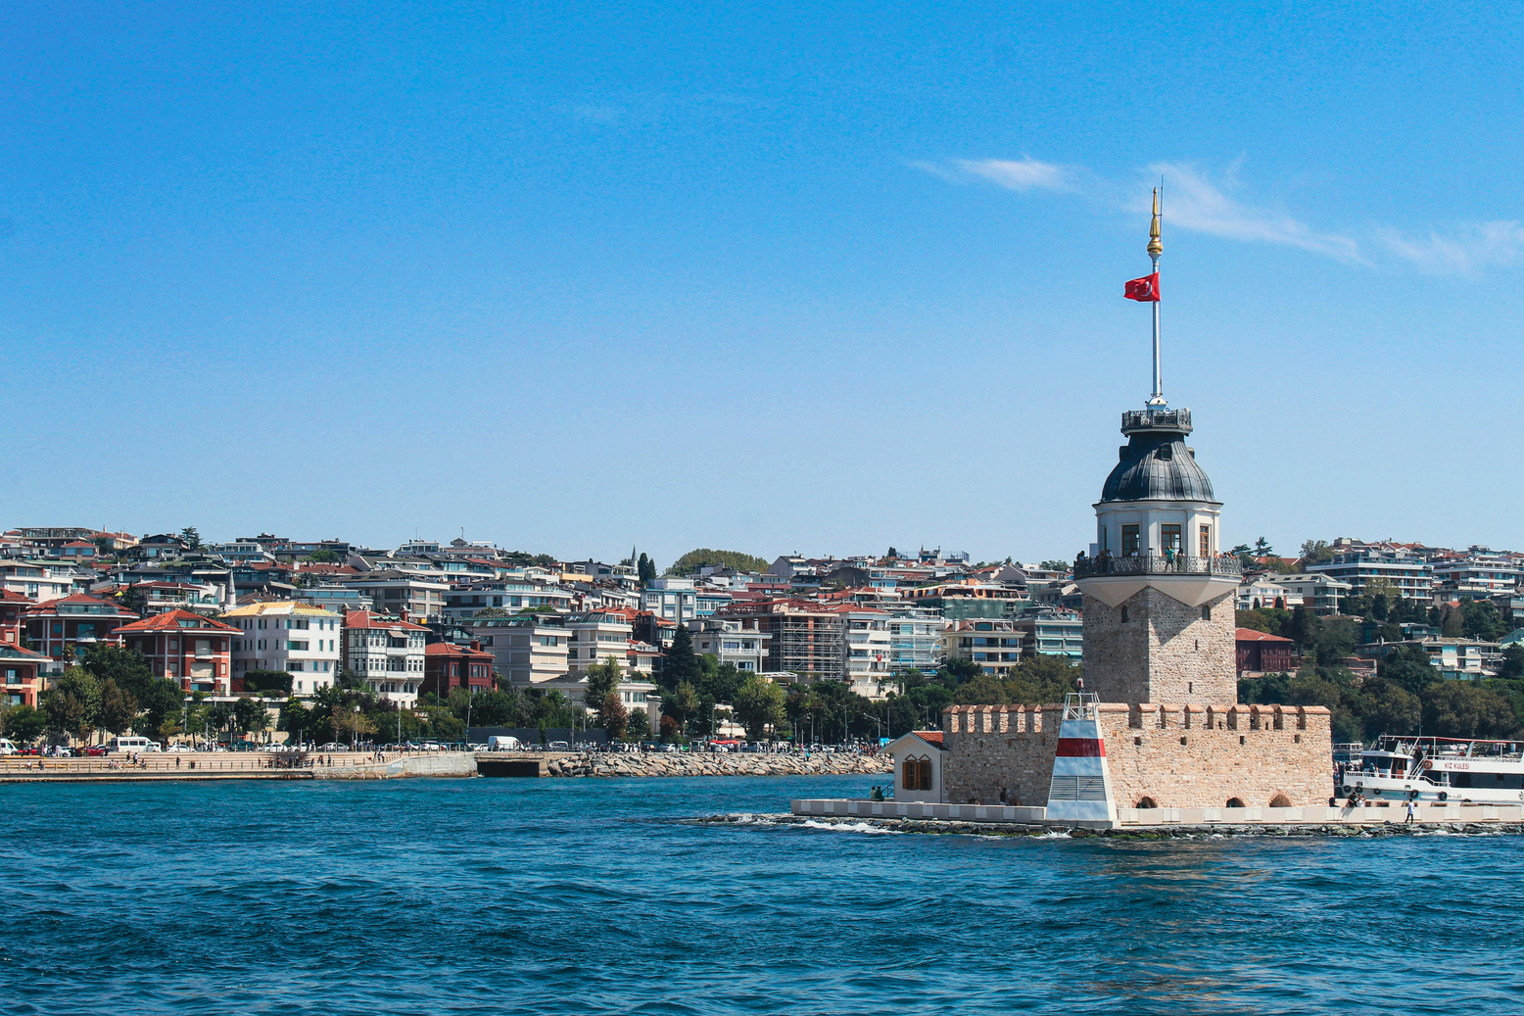
PROBLEM STATMENT
The Airbnb market in Istanbul, comprising 26,631 listings with prices ranging from $12 to $1,706,000, exhibits extreme price variation across four room types (Entire home/apt, Private room, Hotel room, Shared room). These types differ in terms of price, reviews, ratings, and accommodation capacity, creating an information gap for hosts and guests regarding pricing decisions.

Slide 3
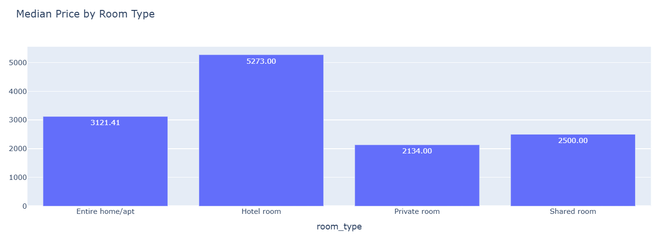
OBJECTIVES
By analyzing 26,631 Airbnb listings in Istanbul:
  Analyze differences in price across the four room types
  Analyze differences in reviews and ratings across the four room types.
  Explore how accommodation capacity varies by room type.

Slide 4
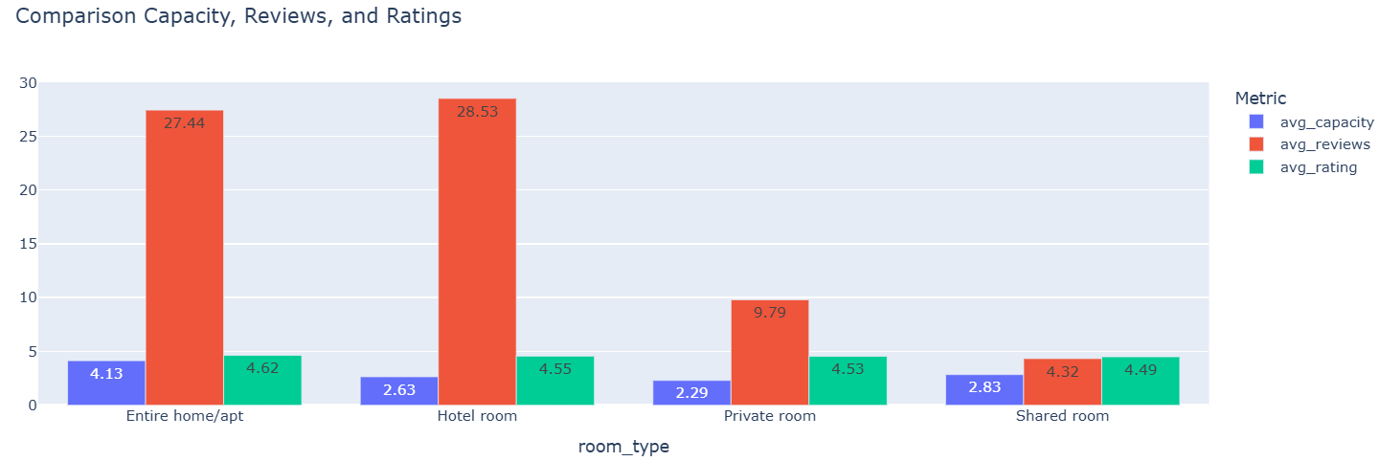
RECOMMENDATIONS
  Guests should compare room types based on capacity, reviews, and ratings.
  Hosts should improve listing quality through photos and detailed descriptions to attract more bookings
  Hosts should clearly identify the room type and included facilities and features.

Slide 5
LIMITATION
  missing values in some columns from 10% to 100%
  The data only covers one year (2026), so results may not apply to any other time periods.
  Some columns is in USD while others is in Lira, complicating direct price comparisons

