Slide 1
Non- recursive merge sort

Slide 2
The problem
The strategy
The algorithm
The implementation
The analysis

Slide 3
What is merge sort ?
It is a divide-and-conquer algorithm, it breaks down the problem into smaller sub-problems and then solves them to get the final solution.
Merge sort divides an array into two halves, recursively sorts each half, and then merges the sorted halves.
The process continues until the entire array is sorted.

Slide 4
Bottom-up merge sort
Non-recursive merge sort is a sorting algorithm that organizes elements in a list by repeatedly merging sublists to produce new sorted sublists until there is only one sublist remaining, which is the sorted list. It is a bottom-up approach that eliminates the need for recursive function calls.
The iterative algorithm is better because of its speed and memory saving.

Slide 5
10 | 3 | 19 | 7 | 18 | 4 | 15 | 5 | 12 | 1 | 16 | 2
Merge into pairs
3 | 10
7 | 19
4 | 18
5 | 15
1 | 12
2 | 16
Merge into fours
3 | 7 | 10 | 19
4 | 5 | 15 | 18
1 | 2 | 12 | 16
Merge into eights
3 | 4 | 5 | 7 | 10 | 15 | 18 | 19
1 | 2 | 12 | 16
Final merge
1 | 2 | 3 | 4 | 5 | 7 | 10 | 12 | 15 | 16 | 18 | 19

Slide 6
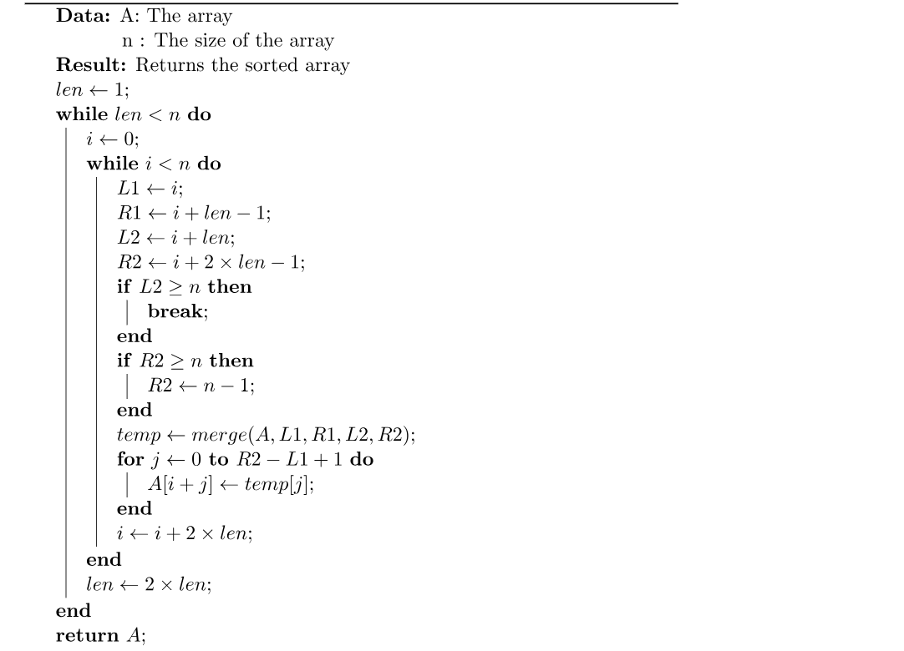

Slide 7
Analysis
The time complexity of non-recursive merge sort is O(n log n), where n is the number of elements to be sorted.
Non-recursive merge sort is stable; it preserves the input order of equal elements in the sorted output.

