Slide 1
Player Tracking Analysis
Practice Session Workload Report
4,841 yd
18.7 mph
112.2 min
217 yd
Total Distance
Max Speed
Duration
HSR Distance
Session Date: 2025-10-09 | QC Status: WARN | 10 Hz GPS | 65,410 samples

Slide 2
Session Overview & Data Quality
QC WARN
65,410
100%
6 gaps
0.809
GPS Samples
Cadence OK
Data Gaps
Speed-XY Corr
Definitions & Methodology
Speed Bands: Standing <1, Walking 1-4, Jogging 4-8,
Running 8-13, HSR 13-16, Sprint ≥16 mph
Distance: speed × dt (vendor dis rejected, -74% error)
Accel Threshold: ≥2.0 m/s² sustained ≥1s
Unit Conversions: yd/s × 2.04545 = mph,
yd/s² × 0.9144 = m/s²
Phase Segmentation: 2-min bins, merge adjacent
same-intensity → 29 phases
Peak Windows: rolling max over 15s, 30s, 1m, 2m, 5m
Early vs Late: session split at midpoint (56.1 min)
QC WARN: speed-XY corr 0.809 < 0.85 threshold
Data Gaps: 6 gaps, max 80.3s (continuity ok)

Slide 3
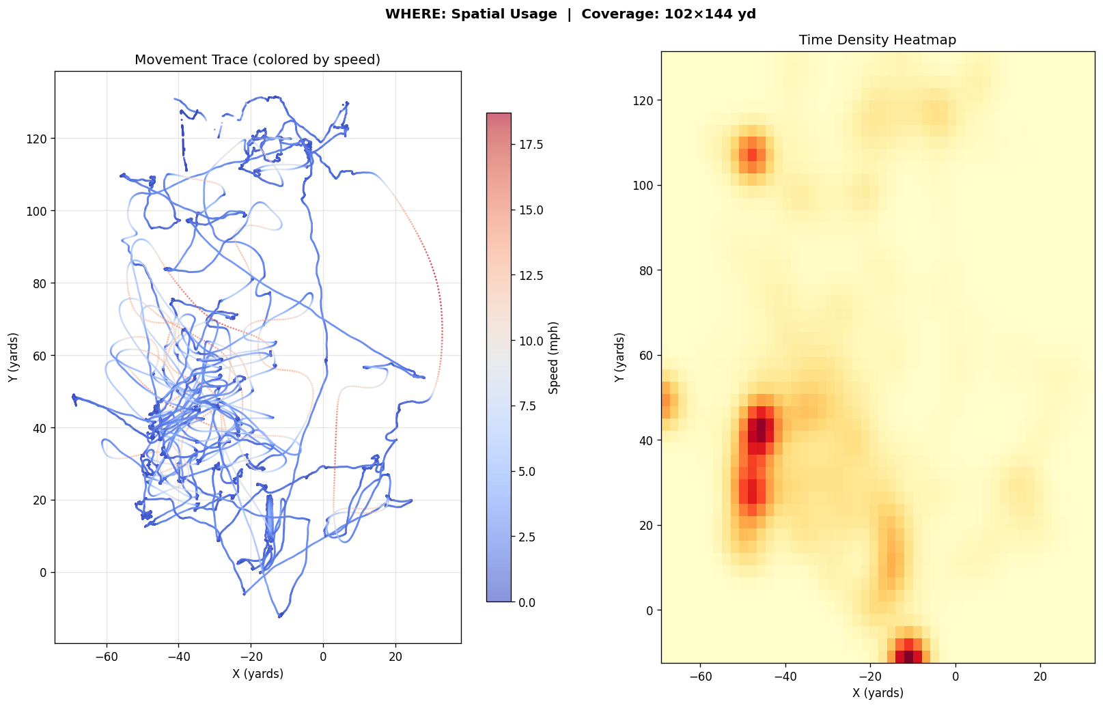
Where: Spatial Usage
Skill position pattern (WR/DB): 102 × 144 yd coverage with two primary station zones

Slide 4
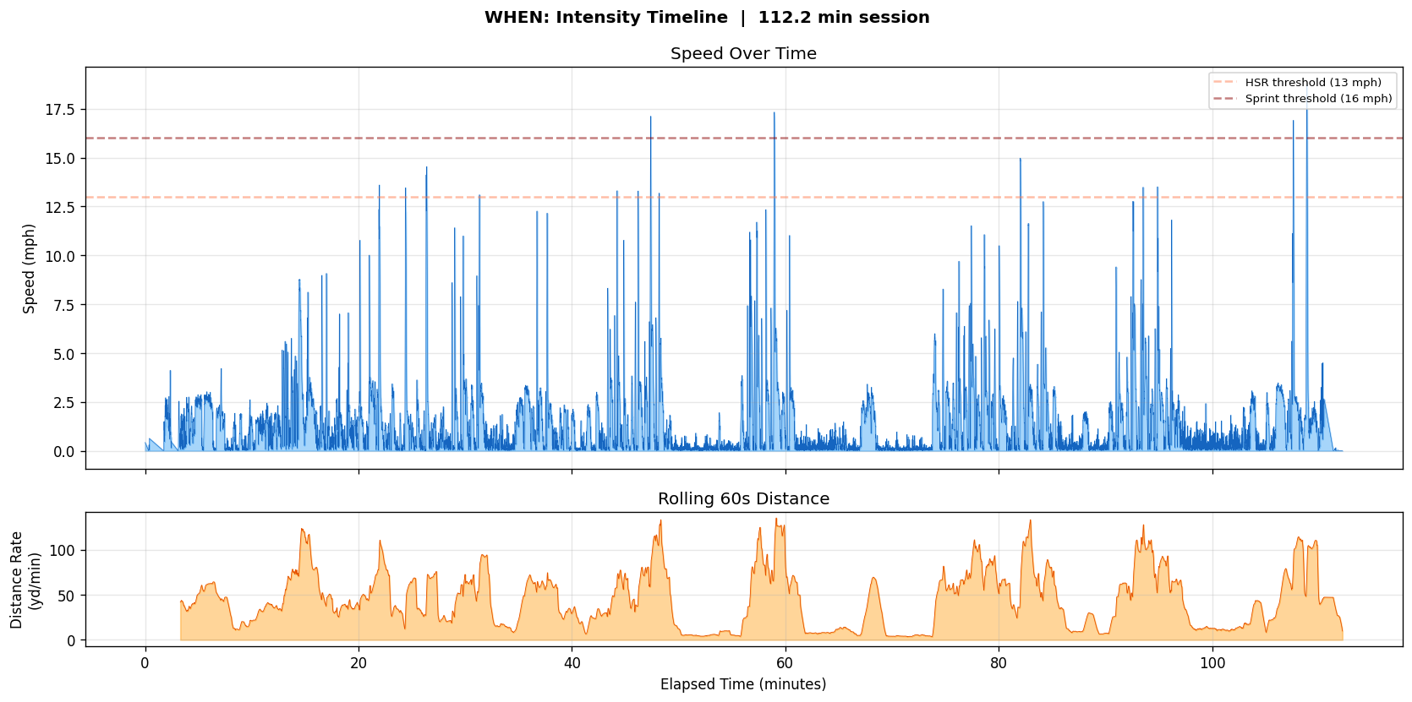
When: Intensity Timeline
Window | Distance (yd) | Intensity (yd/min) | Max Speed (mph) | Timing (min)
15s | 74.4 | 297.5 | 18.7 | 108.8–109.0
30s | 98.8 | 197.7 | 17.3 | 58.9–59.4
1min | 135.1 | 135.1 | 17.3 | 58.2–59.2
2min | 221.1 | 110.5 | 17.3 | 57.3–59.3
5min | 432.4 | 86.5 | 17.3 | 55.8–60.8

Slide 5
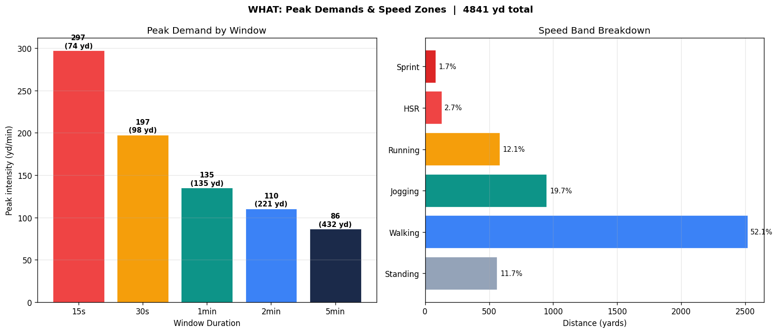
What: Peak Demands & Speed Zones
Best 1-min intensity: 135.1 yd/min → drill pacing target
Walking dominates (52.1%), HSR + Sprint combined 4.4% of total distance

Slide 6
Events & Early vs Late Comparison
7
HSR Events
4
Sprint Events
 | Early | Late | Delta
Distance (yd) | 2335 | 2506 | +171 (+7.3%)
Rate (yd/min) | 41.6 | 44.7 | +3.1
Max Speed (mph) | 17.1 | 18.7 | +1.6
HSR Dist (yd) | 72 | 145 | +73
17
Accel Events
3
Decel Events
No fatigue drop-off detected. Late-half HSR doubled (+73 yd). Validate against RPE / subjective load.
Session Structure
29 merged phases (2-min bins, intensity-based merging): 7 Rest, 13 Low, 6 Moderate. Practice well-distributed with work-rest cycling throughout.

Slide 7
Key Takeaways
1
Position Signature
18.7 mph max, 102 × 144 yd coverage → consistent with skill position (WR/DB)
2
Session Structure
29 phases with well-distributed work-rest cycling, no sustained fatigue pattern
3
Peak Demands
Best 1-min intensity 135.1 yd/min — use as drill pacing anchor
4
Late-Session Intensity
+7.3% distance, +73 yd HSR in second half — validate with RPE data
5
Data Quality
QC WARN (speed-XY corr 0.809). Vendor distance rejected (-74% error). Speed-integrated distance used.
Generated from 10 Hz GPS data | Session 2025-10-09 | Speed-integrated distance methodology

