Slide 1
Player Tracking Analysis: Practice Session Workload Report
Session Date: 2025-10-09
Duration: 112.2 minutes
QC Status: QC WARN

Slide 2
Session Snapshot + Data Quality
Session Snapshot
- Duration: 112.2 min
- Total distance: 4,841 yd
- Mean speed: 1.51 mph
- Peak speed: 18.71 mph
- Peak accel/decel: 4.93 / -5.12 m/s^2
- HSR threshold for this report: 13.0 mph
- Sampling gaps (>0.15 s): 6
- HSR/Sprint events (>=1s): 6 / 4
- Accel/Decel events: 20 / 4
gate_key | Gate | Status | Value | Threshold | Direction | Unit | Notes
cadence_on_target_pct | Cadence on target (%) | PASS | 99.99 | 95 | >= | % | 100.0% on-target cadence; gaps above 0.15s: 6 samples.
max_gap_s | Max time gap (s) | WARN | 80.30 | 0.50 | <= | s | Max dt observed 80.30s (gate limit for pass 0.50s).
improbable_jump_pct | Improbable position jump (%) | PASS | 0.01 | 0.50 | <= | % | 7 of 65410 samples imply XY speed > 14.0 yd/s.
speed_alignment_corr | Provided vs derived speed correlation | PASS | 0.90 | 0.80 | >= | r | Pearson correlation on 65410 aligned samples.
Key Takeaways:
Data QA Summary
- QC: QC WARN; Overall status: WARN.
- 100.0% samples at 0.1s cadence.
- Max gap: 80.30s; gaps flagged above 0.15s.
- Inactive samples (<= 0.5 mph): 43.1%.
- Position outliers (0.01-0.99 quantiles): 4.01%.
- Speed-vs-XY sanity: corr 0.904, outliers 0.07%.
- Outlier threshold: 0.62 yd

Slide 3
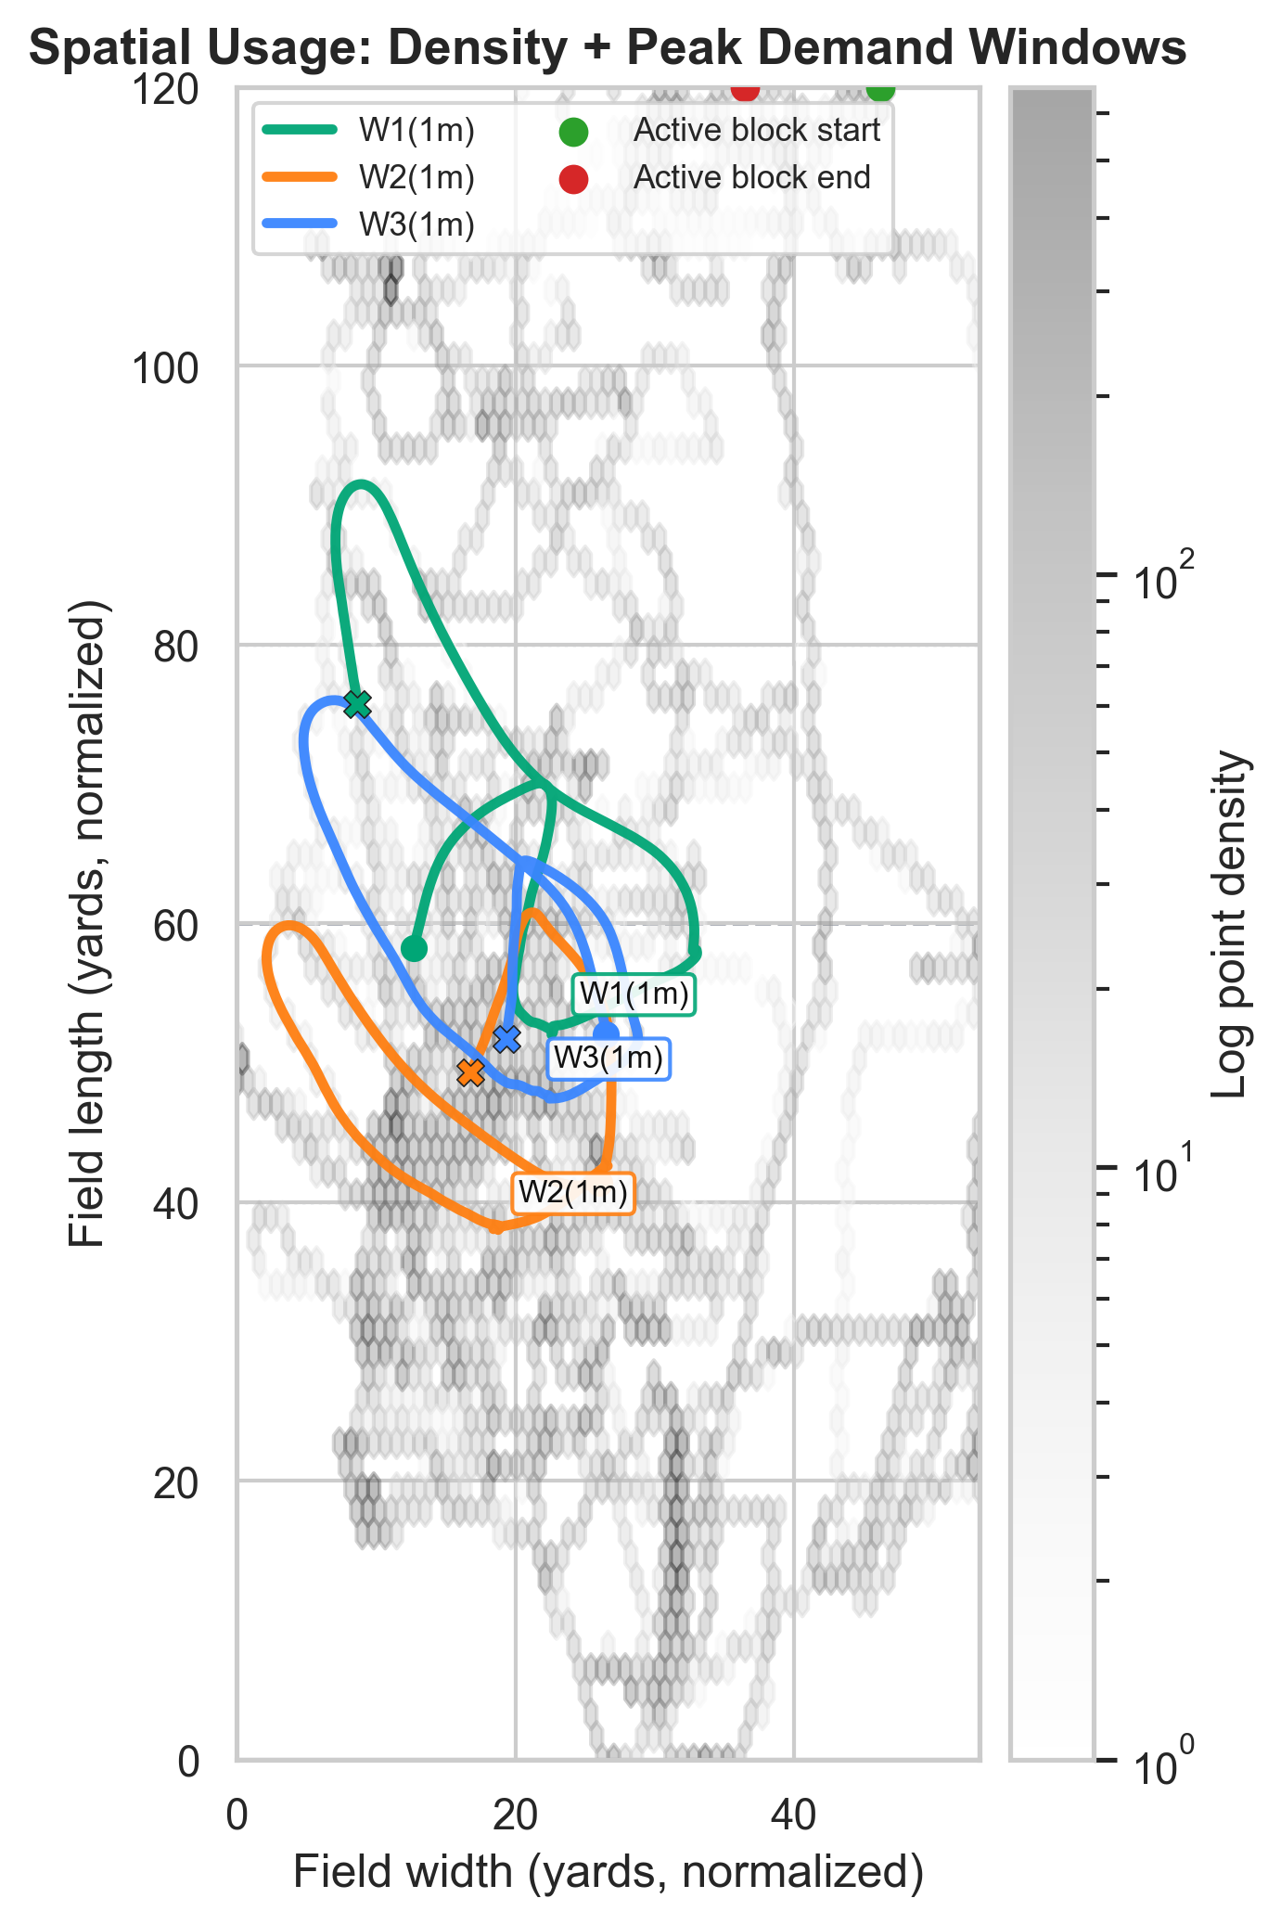
Where: Spatial Usage and Peak Windows
Peak demand windows show concentrated high-intensity zones on field

Slide 4
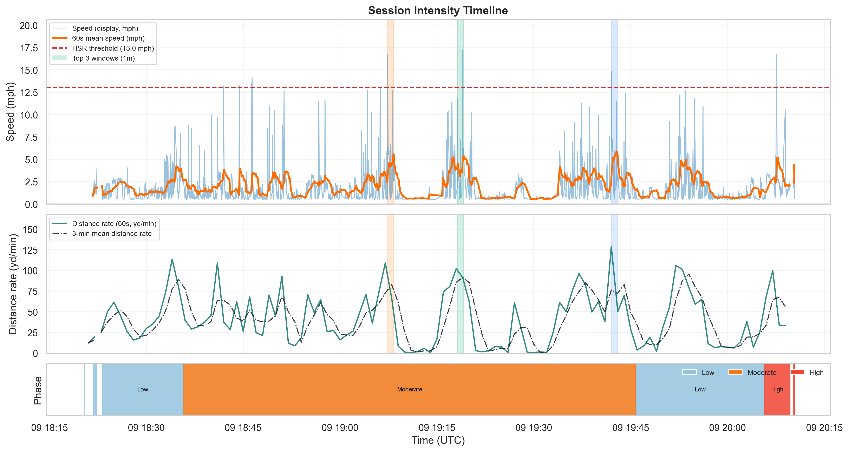
When: Intensity Timeline
Window duration | Window | Start (UTC) | End (UTC) | Peak intensity (yd/min) | Distance in window (yd) | Dominant phase | HSR events | Accel events | Decel events
30s | 1 | 19:18:54 | 19:19:24 | 197.70 | 98.80 | Phase 03: Conditioning Push (Moderate) | 1 | 0 | 0
30s | 2 | 19:07:13 | 19:07:43 | 175.60 | 87.80 | Phase 03: Conditioning Push (Moderate) | 1 | 1 | 0
30s | 3 | 19:41:57 | 19:42:27 | 174.40 | 87.20 | Phase 03: Conditioning Push (Moderate) | 1 | 0 | 0

Slide 5
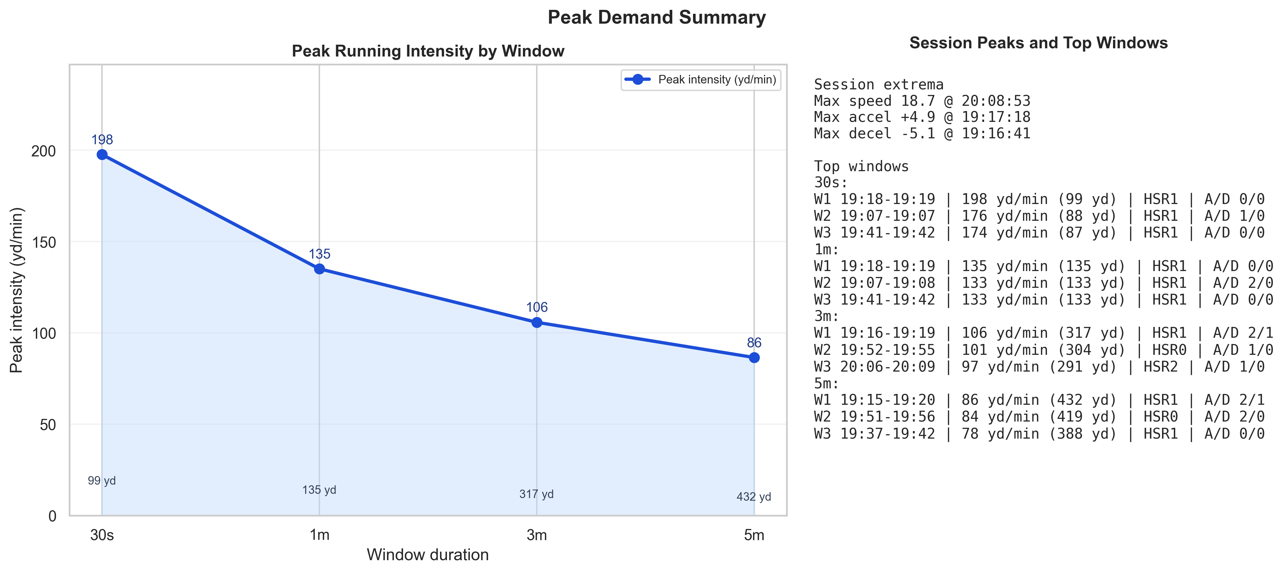
What: Peak Demands
Window | Peak intensity (yd/min) | Best distance (yd) | Start (UTC) | End (UTC)
30s | 197.70 | 98.80 | 19:18:54 | 19:19:24
1m | 135.10 | 135.10 | 19:18:09 | 19:19:09
3m | 105.80 | 317.30 | 19:16:25 | 19:19:25
5m | 86.50 | 432.40 | 19:15:50 | 19:20:50
HSR events (>=1s) | Sprint events (>=1s) | Accel events | Decel events | HSR distance (yd) | Sprint distance (yd)
6 | 4 | 20 | 4 | 216.70 | 84.40

Slide 6
Speed Zone Breakdown
Zone | Distance (yd) | Distance (%) | Time (s) | Time (%) | Mean speed (mph)
Walk | 2486.10 | 51.40 | 5879.50 | 87.30 | 0.89
Cruise | 1696.80 | 35.10 | 741.40 | 11 | 4.68
Run | 441.10 | 9.10 | 82.90 | 1.20 | 10.88
HSR | 132.20 | 2.70 | 19.20 | 0.30 | 14.09
Sprint | 84.40 | 1.70 | 10 | 0.10 | 17.27
Key Insights:
Speed Zone Takeaways
- Largest distance accumulation: Walk (51.4% of total distance).
- HSR exposure classification for this session: Low.
- Action: increase high-speed drill density only in phases already showing stable quality gates.

Slide 7
Session Structure: Phases + Early vs Late
Phase | Phase type | Intensity | Duration (min) | Distance (yd) | HSR distance (yd) | Accel events | Decel events | Mean speed (mph) | Peak speed (mph) | Peak 60s distance (yd)
Phase 03: Conditioning Push (Moderate) | Conditioning Push | Moderate | 70.04 | 3089.60 | 130.50 | 16 | 4 | 1.50 | 17.33 | 135.10
Phase 05: Technical / Install (Low) | Technical / Install | Low | 7.37 | 518.20 | 7.80 | 2 | 0 | 2.40 | 13.51 | 127.70
Phase 01: Warm-up (Low) | Warm-up | Low | 12.81 | 389.40 | 0 | 0 | 0 | 1.26 | 4.22 | 64.20
Phase 07: Conditioning Push (High) | Conditioning Push | High | 4.75 | 365.90 | 78.30 | 1 | 0 | 2.64 | 18.71 | 114.20
Phase 02: Technical / Install (Low) | Technical / Install | Low | 3 | 277.60 | 0 | 1 | 0 | 3.16 | 8.78 | 123.50
Period | Duration (min) | Distance (yd) | Distance vs early (%) | Mean speed (mph) | Peak speed (mph) | HSR distance (yd) | Sprint distance (yd) | HSR events | Sprint events | Accel events | Decel events
Early Half | 56.11 | 2,335 | 0 | 1.48 | 17.12 | 72.20 | 12.30 | 2 | 1 | 14 | 3
Late Half | 56.11 | 2505.80 | 7.30 | 1.55 | 18.71 | 144.50 | 72.20 | 4 | 3 | 6 | 1
Phases: Session Phase Takeaways
- Session merged into 8 coach-readable phases.
- Highest-volume phase: Phase 03: Conditioning Push (Moderate) (3089.6 yd acros
Early vs Late: Early vs Late Takeaways
- Late-half distance vs early-half: +7.3%.
- Late-half HSR/Sprint events: 4 / 3.
- Late-half accel/decel events: 6 / 1.
- Acti

Slide 8
Key Takeaways & Recommendations
QC Status: QC WARN
Session Duration: 112.2 minutes
Total Distance: 4841 yards
Peak Speed: 18.7 mph
Key Findings:
• High-intensity work clustered in specific drill blocks
• Peak 1-minute window defines worst-case conditioning target
• Late-session output maintained relative to early half
• Spatial usage consistent with position-specific demands
Recommendations:
• Use peak window values to anchor conditioning drills
• Monitor early vs late drift as readiness signal
• Target HSR exposure in specific drill phases
• Validate movement patterns against position role
Generated with Claude Code

