Slide 1

SUPPLIFY
STAKEHOLDER BRIEF
Stop running F&B supply
across chats, sheets, and guesswork.
Supplify is the operating platform for procurement and supply. One order, from the price you agree to the invoice you pay.
SOURCE
→
ORDER
→
FULFILL
→
DELIVER
→
RECEIVE
→
CONTROL
Built for restaurant teams and suppliers who need the work after checkout—not another catalog inbox.
October 2026
Product-ready platform · Pilot-ready conversation
Notes:
Open on the pain, then the category. Supplify is not a catalog with an inbox. It is the shared operating record for an F&B order.
Do not claim customers, revenue, or ROI. The product is ready to walk. A pilot is the proof.
If they ask “marketplace or ERP?”: both, in sequence. Discovery is the front door. Pricing, fulfillment, delivery, receiving, and finance are why the door is worth opening.

Slide 2
THE OPERATING PROBLEM
Every order still dies in a group chat.
Buying can start in a catalog. The truth scatters the moment the work begins.
01
Discovery
Who sells it, what it costs, and whether it is there live in different places.
THE REAL COST
Your team reconstructs yesterday instead of controlling tomorrow.
02
Terms
Contract price, quote, promotion, and minimum get reconciled by hand.
03
Execution
A thread, a call, and a spreadsheet become the operating system.
04
Close
What shipped, what arrived, what was accepted, and what was invoiced become four stories.
ONE ORDER · MANY VERSIONS OF TRUTH
SUPPLIFY · STAKEHOLDER BRIEF
02
Notes:
Stay on workflow, not market size. The cost is not “they lack software.” The cost is that one commercial event becomes several unofficial records.
Discovery, terms, execution, and close are the four places a stakeholder will recognize their own week. Do not invent hours saved or error rates.
Transition: Supplify does not add a fifth tool. It keeps those four stages on one order.

Slide 3
WHY THIS WINS
Where others stop at “order placed,” Supplify keeps going.
A marketplace introduces two parties. An operating platform keeps the order true after the handshake.
TYPICAL MARKETPLACE
SUPPLIFY
1
Discover
1
2
3
4
Find a supplier
→
→
→
SOURCE
PRICE
ORDER
FULFILL
2
Browse
See a catalog
5
→
6
→
7
→
8
3
Order
Submit demand
DELIVER
RECEIVE
RECONCILE
LEARN
VALUE STOPS AT THE HANDOFF
VALUE COMPOUNDS AFTER THE ORDER
SUPPLIFY · STAKEHOLDER BRIEF
03
Notes:
This is a category contrast, not a named competitor. Do not cite other vendors.
The line to land: a marketplace is paid for the introduction. Supplify is valuable because the order still has an owner after checkout—price, warehouse, driver, receiver, invoice.
LEARN means the accepted order feeds inventory, payables, and reporting. It does not mean autonomous replenishment. That is later.

Slide 4
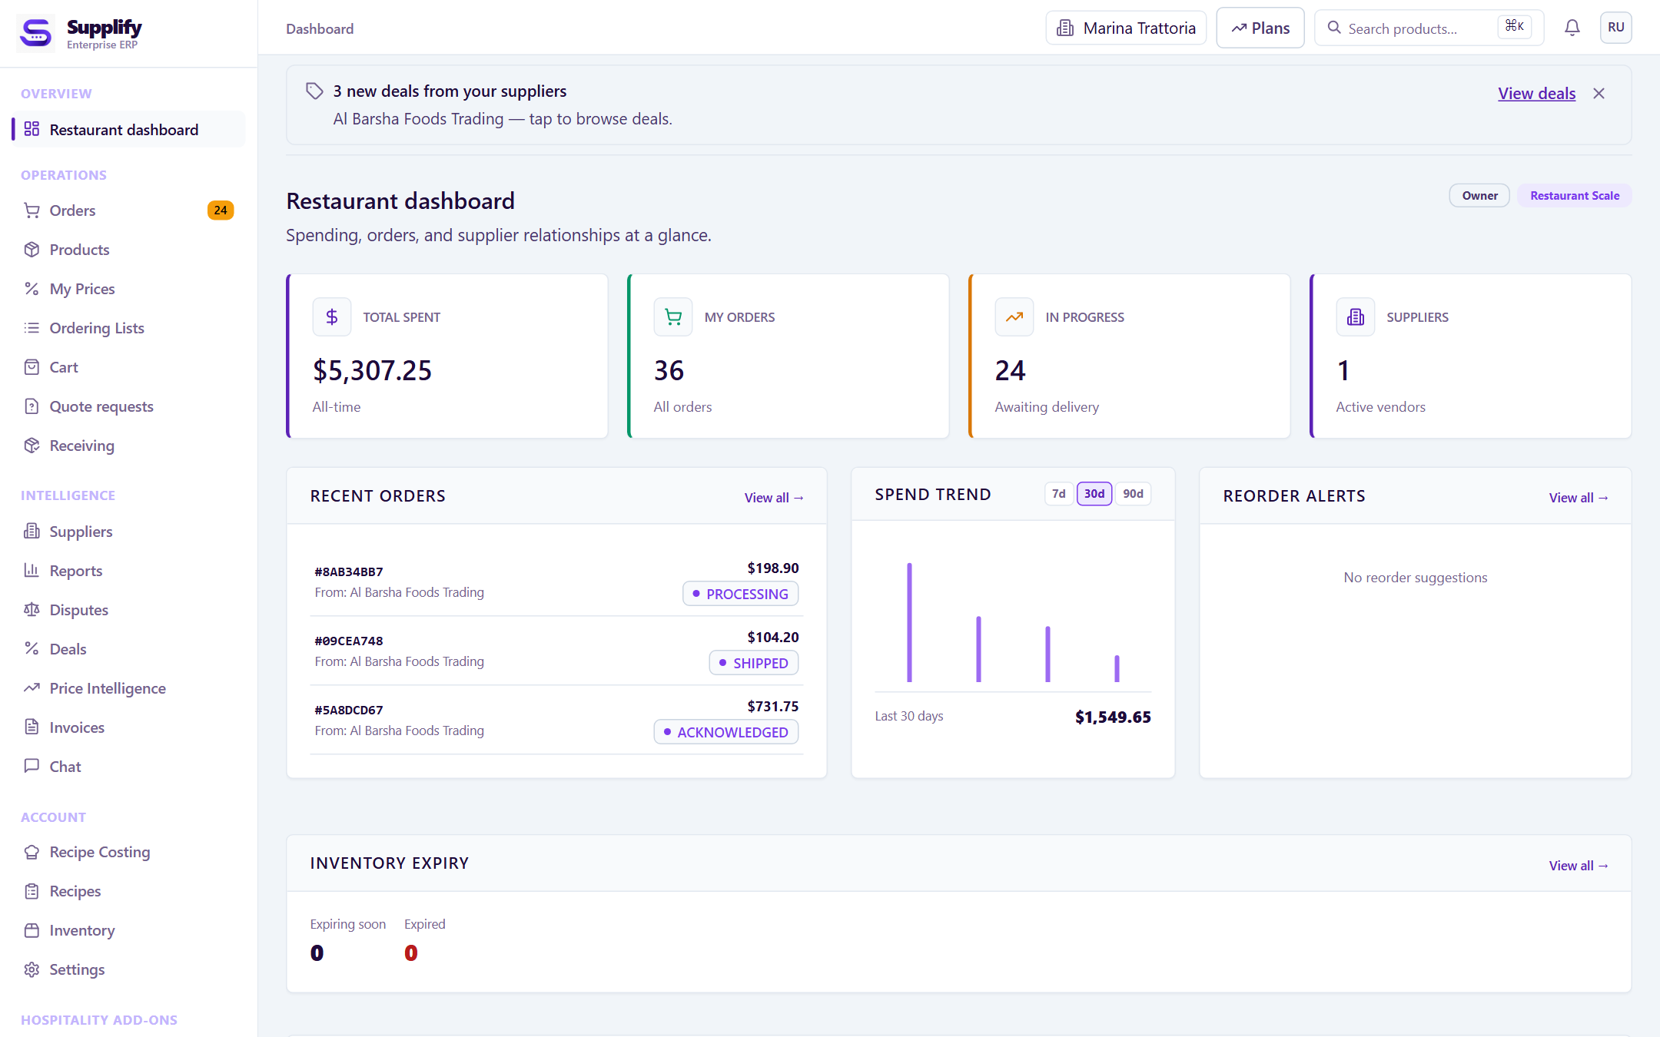
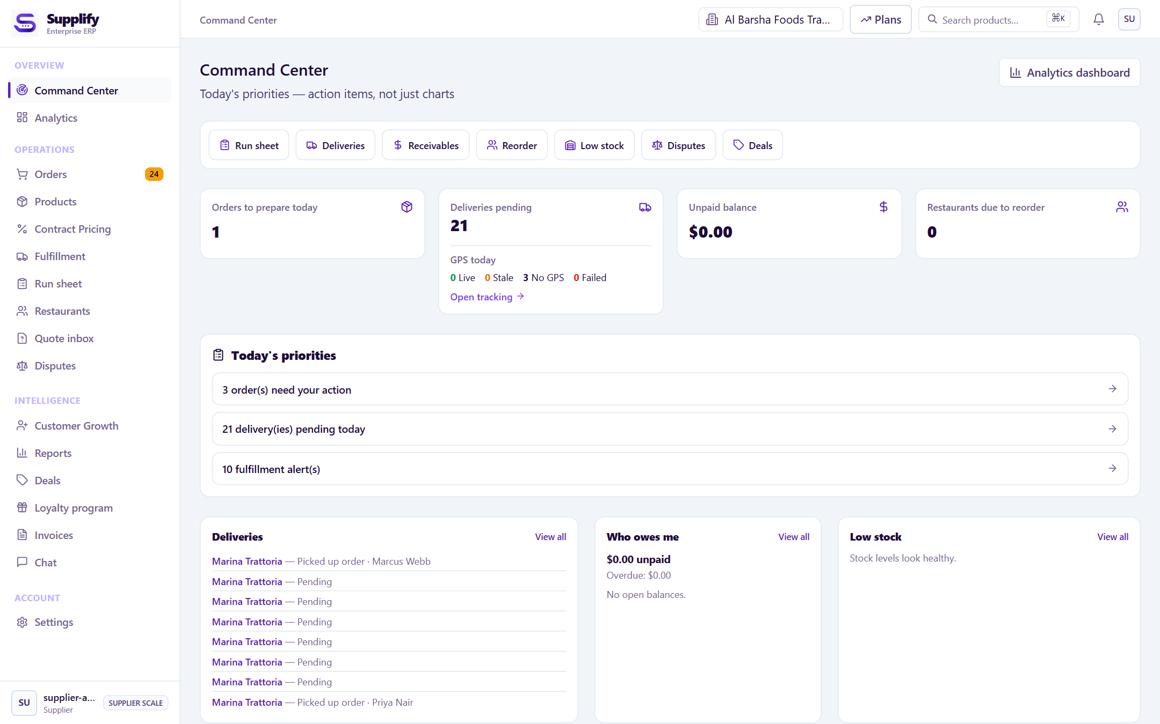
THE SAME ORDER
Restaurants get control. Suppliers get a plan they can run.
The buyer sees the relationship. The supplier sees the work. Both are looking at one transaction.
RESTAURANTS
Control—not another shopping cart.
SUPPLIERS
A plan—not another order inbox.
SEEDED DEMO UI
SEEDED DEMO UI
Purchasing, receiving, stock, and payables stay on one history.
Customer terms in. Warehouse, route, proof, and receivable out.
SUPPLIFY · STAKEHOLDER BRIEF
04
Notes:
Walk one order, not two products. Point at the restaurant dashboard as the buyer’s control layer, then the supplier command center as the same order turned into today’s work.
Say out loud that the screens are seeded demo data. Numbers on screen are illustrative.
Nuance if asked: a new basket resolves to one compatible supplier tenant and warehouse. Full central purchasing across every branch is not complete. Public menus and public catalogs exist; they are channels around this B2B core, not the story.

Slide 5
HOW THE RECORD STAYS TRUE
Delivered is not received. Invoiced is not paid.
Same order. Separate events. Mixing them is how disputes start.
1
2
3
4
5
SOURCE
COMMIT
FULFILL
DELIVER
RECONCILE
Catalog
Relationship
RFQ
→
Price resolves
Quote locks
Server rechecks
→
Reserve
Pick and pack
Assign
→
Route
Driver status
Proof
→
Receive
Dispute
Invoice and pay
THE PRICE LOCKS
INTELLIGENCE EXPLAINS
Checkout revalidates on the server. The order line becomes a snapshot—not a live link back to the catalog.
It is read-only. It does not place orders, move stock, set prices, or assign drivers.
SUPPLIFY · STAKEHOLDER BRIEF
05
Notes:
This is the trust slide. Land the inequality slowly: delivered, received, invoiced, and paid are different events. Invoices follow accepted quantities.
Pricing: catalog, then relationship price, then a committed quote. The server rechecks at checkout. After that, the line is history.
If they ask about AI: current intelligence calculates and explains inside the user’s permissions. Action-taking AI is roadmap. Do not demo it as an agent that buys.

Slide 6
HOW YOU START
Pay for operating depth, not a longer menu.
Thirty days to try it. Then the plan follows branches, active customer locations, and how deep you run.
RESTAURANTS
SUPPLIERS
Growth
Intelligence
Scale
Growth
Scale
$49
$149
$349
$149
$349
per month
per month
per month
per month
per month
1 active branch
3 active branches
Multi-branch
50 customer locations
200 customer locations
Core purchasing
and operations
Operational
intelligence
Advanced controls
and assistant
Core sales
and operations
Multi-warehouse
and intelligence
ANNUAL
IN THE PRODUCT
NOT IN THIS RELEASE
Pay for ten months. The year is covered.
Web, Android, and iOS. The order runs through to finance.
Live recurring billing, action-taking AI, full central purchasing.
SUPPLIFY · STAKEHOLDER BRIEF
06
Notes:
Prices are the current configured public catalog, after a 30-day trial.
Restaurants: Growth $49 / 1 branch, Intelligence $149 / 3 branches, Scale $349 / multi-branch.
Suppliers: Growth $149 / 50 active ordering customer locations a month, Scale $349 / 200. Scale can add location, branch, and warehouse capacity.
Annual base price is monthly times ten. Say the billing truth in the same breath as the price: the product can record a subscription; live recurring payment-provider charging is external production work, not something to promise in a pilot.
Do not pick a “best plan” for them on this slide. Ask how many branches or active customer locations they run, then point.

Slide 7
Let’s put one connected operating layer
under your F&B supply.
RESTAURANTS
SUPPLIERS
WAREHOUSES
DRIVERS
Control
Execution
Coordination
Connection
SOURCE. ORDER. FULFILL. DELIVER.
Next step: walk one live order, end to end
The workflow is in the product. A pilot is the proof.
SUPPLIFY
Notes:
Close on a choice, not a feature recap. Ask which room they want to walk first: restaurant control, supplier execution, the commercial model, or a pilot on one real order.
The ask is a live journey—one order from price to proof to invoice—not a second presentation.
Hold the line on evidence. Implemented means it is in the product and can be shown. It is not a claim of live customers, production billing, or an AI that acts.
Leave them with four verbs: source, order, fulfill, deliver.

