Slide 1

SUPPLIFY
STAKEHOLDER OVERVIEW
Stop running F&B supply
across chats, sheets, and guesswork.
Supplify is the connected operating platform for procurement and supply—one shared workflow from discovery and pricing through fulfillment, delivery, receiving, and financial control.
SOURCE
ORDER
FULFILL
DELIVER
RECEIVE
CONTROL
Built for restaurant teams and suppliers who need execution depth—not another catalog inbox.
September 2026
Product-ready platform • Pilot-ready conversation
Notes:
EMPHASIZE: Open with the pain, then position Supplify as the shared operating layer—not only a marketplace.
NUANCE: This is a product and operating-model overview, not a claim of customer traction. UI screenshots use isolated seeded demo data.
TRANSITION: Start with the fragmented reality the platform is designed to replace.

Slide 2
THE OPERATING PROBLEM
Every order still dies in a group chat
Buying may start digitally—but price, stock, delivery, and payment truth scatter the moment the work begins.
01
Discovery
Supplier contacts, catalogs, and availability live in different places.
THE REAL COST
Your team reconstructs yesterday instead of controlling tomorrow.
02
Commercial terms
Prices, quotes, promotions, and minimums are hard to reconcile.
03
Execution
Calls, WhatsApp, and spreadsheets become the real operating system.
04
Reconciliation
Delivery, receiving, disputes, invoices, and payment records drift apart.
ONE ORDER • MANY VERSIONS OF TRUTH
SUPPLIFY • STAKEHOLDER OVERVIEW
02
Notes:
EMPHASIZE: The core problem is not lack of screens; it is the absence of one connected operational record across both sides of the transaction.
NUANCE: Avoid unsupported market-size or efficiency statistics. Keep the point grounded in workflow fragmentation.
TRANSITION: Supplify connects those stages into one shared flow.

Slide 3
THE PLATFORM
One order. One timeline. One source of truth.
A marketplace at the front—with the operational depth to finish the job after checkout.
RESTAURANT
SUPPLIFY
SUPPLIER
Demand & control
Shared operating record
Sell & execute
1
2
3
4
5
6
SOURCE
ORDER
FULFILL
DELIVER
RECEIVE
MANAGE
Discover • compare
Price • quote
Reserve • pick
Route • proof
Accept • dispute
Stock • finance
NO RE-KEYING. NO PARALLEL TRUTH. NO “WHAT ACTUALLY HAPPENED?”
SUPPLIFY • STAKEHOLDER OVERVIEW
03
Notes:
EMPHASIZE: The differentiated value is continuity: the same order moves through pricing, fulfillment, delivery, receiving, and finance without being re-created.
NUANCE: The six stages simplify a wider platform for business communication.
TRANSITION: That shared flow serves a multi-actor ecosystem, not one persona.

Slide 4
WHO SUPPLIFY SERVES
One ecosystem, role-aware experiences
Each actor sees the workflow they need; the platform keeps the shared commercial and operational context connected.
R
Restaurant organization
S
Supplier organization
Owners • buyers • finance • branch teams
Sales • pricing • finance • operations
SUPPLIFY
Identity • rules • events • records
B
Restaurant branches
W
Warehouses & drivers
Delivery context • stock • receiving • staff
Stock • fulfillment • routes • proof
OPTIONAL PUBLIC CHANNELS
Consumer ordering • public supplier catalog
SUPPLIFY • STAKEHOLDER OVERVIEW
04
Notes:
EMPHASIZE: Restaurant teams, supplier teams, warehouse operators, and drivers get purpose-built experiences tied to the same transaction.
NUANCE: Public restaurant ordering and supplier public catalog are optional channels around the core B2B workflow.
TRANSITION: First, see the restaurant experience as a control layer.

Slide 5
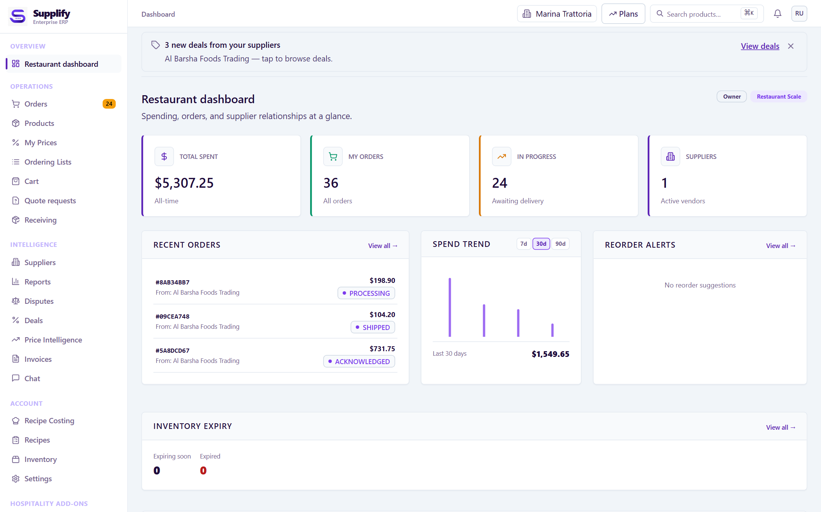
RESTAURANT EXPERIENCE
Give restaurant teams control—not another shopping cart
Source, buy, receive, and manage with branch-aware visibility and a shared transaction history.
SOURCE
Suppliers, catalogs, deals, and RFQs
PURCHASE
Contract pricing, quotes, cart, and quick lists
TRACK
Order status, delivery progress, and exceptions
RECEIVE
Accepted quantities, discrepancies, and disputes
CONTROL
Inventory, invoices, costs, staff, and reporting
LIVE PRODUCT UI • SEEDED DEMO DATA
WHY IT WINS
Purchasing, receiving, stock, and payables stay connected—so the branch never rebuilds the story after delivery.
SUPPLIFY • STAKEHOLDER OVERVIEW
05
Notes:
EMPHASIZE: Supplify starts with easier sourcing and ordering but extends into the disciplines that determine margin and consistency.
NUANCE: Dashboard values are seeded demo data. Full centralized purchasing across every branch remains a future capability.
TRANSITION: The supplier receives the same order as an executable operational commitment.

Slide 6
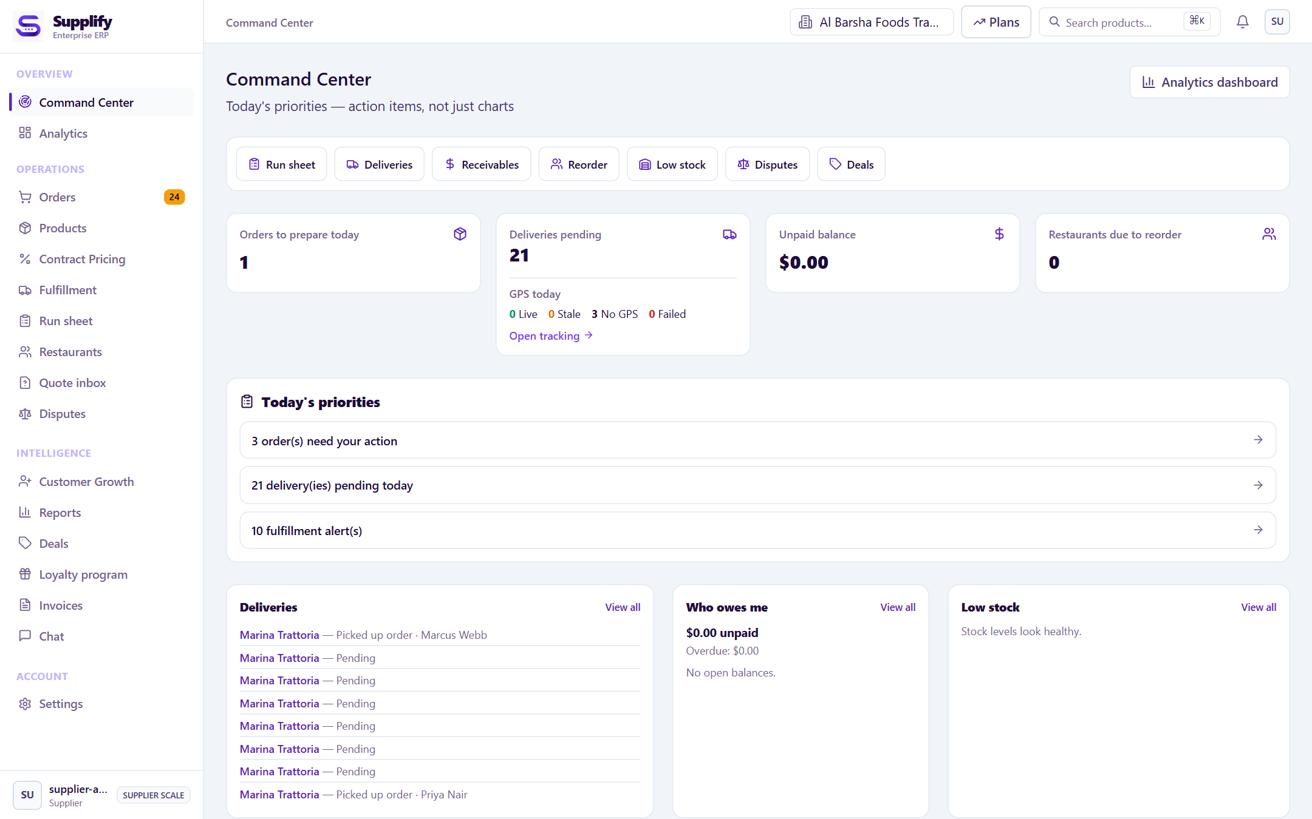
SUPPLIER EXPERIENCE
Turn every order into an executable operating plan
Sell with customer-specific terms, then coordinate warehouse, delivery, receivables, and growth.
SELL
Catalogs, customer pricing, quotes, and promotions
FULFILL
Acknowledge, reserve, pick, pack, and assign
DELIVER
Routes, drivers, live status, and proof
MANAGE
Inventory, disputes, invoices, and receivables
GROW
Customer acquisition and operational intelligence
LIVE PRODUCT UI • SEEDED DEMO DATA
INCOMING ORDER → OPERATIONAL QUEUE → PROOF → RECEIVABLE
SUPPLIFY • STAKEHOLDER OVERVIEW
06
Notes:
EMPHASIZE: Supplify gives suppliers an operational command center—not merely a seller listing or order inbox.
NUANCE: Inventory remains controlled by the operating supplier tenant and warehouse.
TRANSITION: The common thread is one order lifecycle with clear state and ownership.

Slide 7
HOW THE WORKFLOW FITS TOGETHER
One order lifecycle—five moments of control
Commercial intent, physical execution, acceptance, and financial closure remain connected—but distinct.
1
2
3
4
5
SOURCE
COMMIT
FULFILL
DELIVER
RECONCILE
Catalog
Relationships
RFQ
Price resolve
Quote lock
Checkout
Reserve
Pick & pack
Assign
Route
Driver status
Proof
Receive
Dispute
Invoice & pay
DELIVERED ≠ RECEIVED ≠ INVOICED ≠ PAID
Clarity buyers and suppliers can trust.
SUPPLIFY • STAKEHOLDER OVERVIEW
07
Notes:
EMPHASIZE: Physical delivery, receiving acceptance, invoicing, and payment are separate milestones—not one vague “complete” status.
NUANCE: Invoices are grounded in accepted receiving quantities. Server-side state transitions and snapshots preserve the record.
TRANSITION: This lifecycle stays coherent across branches and warehouses.

Slide 8
MULTI-BRANCH OPERATING MODEL
Built for organizations—not isolated locations
Commercial visibility rolls up while execution stays attached to the branch, tenant, and warehouse that own it.
RESTAURANT SIDE
SUPPLIER SIDE
Restaurant organization
Supplier organization
THE RULE
Visibility rolls up.
Operational ownership stays explicit.
Branch A
Branch B
Branch C
OpCo A
OpCo B
Central visibility
Branch delivery context
Branch stock & receiving
NO ARBITRARY CROSS-TENANT FULFILLMENT
WH 1
WH 2
WH 3
Customer sees the organization.
Stock and fulfillment retain explicit ownership.
SUPPLIFY • STAKEHOLDER OVERVIEW
08
Notes:
EMPHASIZE: Supplify separates the customer relationship from the tenant and warehouse that operationally own inventory and fulfillment.
NUANCE: A new basket resolves to one compatible supplier tenant and warehouse. Full central-purchasing orchestration is not complete.
TRANSITION: The same discipline applies to price resolution.

Slide 9
COMMERCIAL CONTROL
Pricing follows the relationship—then becomes immutable
Applicable terms are resolved at checkout and the result is snapshotted onto the order.
DEFAULT CATALOG PRICE
Supplier standard sell price
SERVER-SIDE
GUARDRAILS
ACTIVE CONTRACT / CUSTOMER PRICE
Date- and quantity-valid relationship terms
Re-resolve at checkout
ACCEPTED QUOTE LOCK
Committed quote overrides the contract for that line
MOQ & order multiple
Scope & expiry checks
ELIGIBLE PROMOTION
Applied after the base price, subject to rules
No client price trust
ORDER SNAPSHOT
Price, quantity, and context preserved for audit
SUPPLIFY • STAKEHOLDER OVERVIEW
09
Notes:
EMPHASIZE: Supplify supports the real B2B hierarchy: catalog, relationship pricing, committed quotes, and promotions.
NUANCE: Checkout revalidates on the server. The order line becomes a historical snapshot, not a live reference.
TRANSITION: Once committed, the order becomes a controlled fulfillment job.

Slide 10
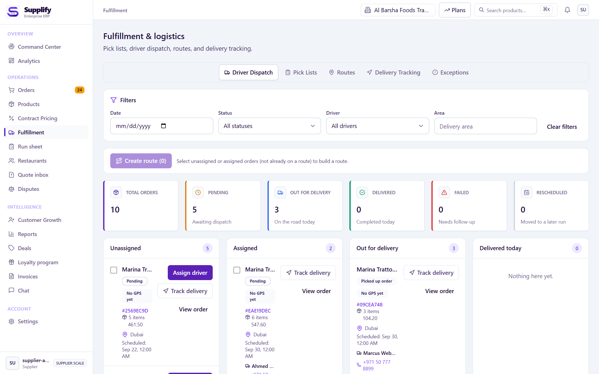
FULFILLMENT & DELIVERY
The marketplace continues into the warehouse and onto the road
The order remains connected while each role works from its own queue and permissions.
01
ORDER
Committed demand
02
WAREHOUSE
Stock owner
03
PICK / PACK
Executable queue
04
ROUTE
Stops & sequence
05
DRIVER
Mobile status
06
POD
Evidence captured
LIVE PRODUCT UI • SEEDED DEMO DATA
07
RECEIVING
Accepted truth
ROUTING BOUNDARY
Each new basket is fulfilled by one compatible supplier tenant and one warehouse; it is not silently split across operators.
SUPPLIFY • STAKEHOLDER OVERVIEW
10
Notes:
EMPHASIZE: Warehouse ownership, fulfillment queues, driver workflow, and proof are part of the product.
NUANCE: New baskets do not arbitrarily split across tenants or warehouses; legacy assignments can still be read.
TRANSITION: Receiving turns physical delivery into accepted operational truth.

Slide 11
BEYOND PROCUREMENT
The order becomes an operating data flywheel
Accepted supply activity feeds the modules that help restaurants control stock, cost, people, and service.
I
Inventory
T
Staff
On-hand • lots • expiry • waste
Roles • schedules • labor operations
$
Finance
G
Guest operations
Invoices • payables • credits • aging
ACCEPTED
ORDER TRUTH
Reservations • waitlist • ordering
C
Recipes & cost
R
Reports & relationships
Ingredients • yield • cost impact
Performance • suppliers • disputes
Implemented as product modules; several cross-module automation loops remain partial.
SUPPLIFY • STAKEHOLDER OVERVIEW
11
Notes:
EMPHASIZE: Strategic value compounds when accepted order data improves inventory, payables, recipe costs, staffing context, and reporting.
NUANCE: These modules exist, but not every cross-module loop is fully automated.
TRANSITION: Selected offers can also extend beyond the authenticated B2B network.

Slide 12
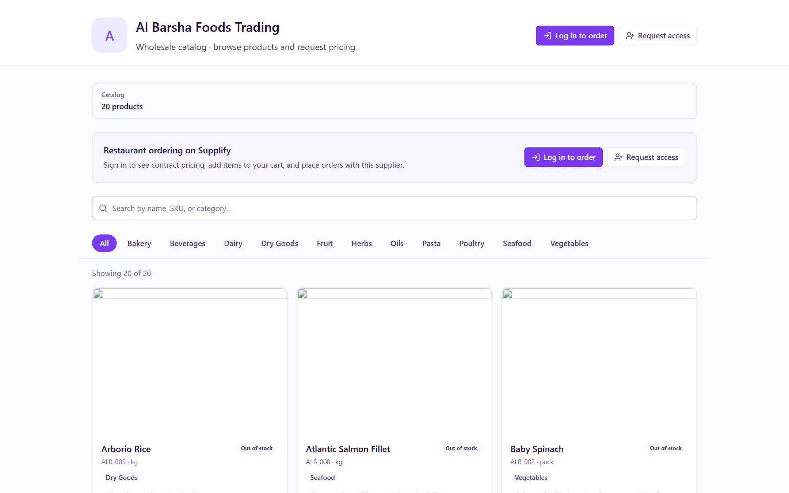
CHANNEL EXPANSION
A B2B core—with optional public demand channels
Selected catalog and ordering experiences can be exposed publicly without replacing the operating system behind them.
CORE
Authenticated B2B network
1
Restaurant procurement
Relationships and negotiated terms
2
Supplier operations
Catalog, fulfillment, delivery, receivables
3
Shared controls
Identity, permissions, audit, notifications
LIVE PRODUCT UI • SEEDED DEMO DATA
ADDITIONAL CHANNELS
Public supplier catalog & ordering
Restaurant consumer ordering
SUPPLIFY • STAKEHOLDER OVERVIEW
12
Notes:
EMPHASIZE: Public channels widen demand capture while existing operational infrastructure supports downstream handling.
NUANCE: Restaurant consumer ordering is a separate B2C hospitality loop and remains secondary to the B2B story.
TRANSITION: The intelligence layer explains and prioritizes without uncontrolled action.

Slide 13
DECISION SUPPORT
Intelligence that explains the operation before it automates it
Deterministic services calculate; the assistant reads and explains within the user’s permissions and plan.
WHAT IT DOES TODAY
GUARDRAILS
1
Read-only assistant
Answers from live, tenant-scoped operational data.
The assistant does not…
×
Place or approve an order
2
Operational intelligence
Demand, expiry, waste, stockout, customer, and warehouse signals.
Change stock or pricing
×
×
Assign a driver or route
3
Reorder assistance
Deterministic baseline; AI explanation when entitled.
×
Bypass tenant permissions
4
Human review
Recommendations remain reviewable before action.
×
Present heuristic fallback as AI
Availability is gated by tenant type, plan, feature flags, permissions, provider configuration, and quota.
SUPPLIFY • STAKEHOLDER OVERVIEW
13
Notes:
EMPHASIZE: Current intelligence is deliberately safe: deterministic calculations and a permission-aware, read-only assistant.
NUANCE: It cannot place orders, mutate stock, set prices, or assign drivers. Action-taking AI is roadmap.
TRANSITION: The event system gets the right signals to the right people and channels.

Slide 14
NOTIFICATION FABRIC
Events become coordinated action—not more noise
A single event can fan out by actor, preference, feature entitlement, and channel configuration.
ORDER
Acknowledged
IN-APP
REALTIME
Default record
Live updates
FULFILLMENT
Ready / delayed
DELIVERY
Arriving / proof
EMAIL
WHATSAPP
EVENT ROUTER
When configured
When configured
RECEIVING
Accepted / disputed
ACTOR
PREFERENCE
FEATURE
CHANNEL
PUSH
WEBHOOK
FINANCE
Invoice / overdue
Web & native
Signed event
Some delivery milestones intentionally remain in-app only.
SUPPLIFY • STAKEHOLDER OVERVIEW
14
Notes:
EMPHASIZE: Recipients, preferences, plan features, and configured channels all shape operational communication.
NUANCE: In-app and realtime are core. External channels depend on environment and configuration.
TRANSITION: This workflow depth depends on a deliberate trust layer.

Slide 15
SECURITY & GOVERNANCE
Trust is designed into the operating layer
Controls protect tenant boundaries, privileged actions, documents, identities, and the historical record.
01
Tenant isolation
02
Roles & permissions
03
Identity
Business data is scoped to the organization and server-resolved context.
RBAC, feature entitlements, and plan limits shape every experience.
Keycloak-backed sessions and guarded role-aware routes.
04
Private files
05
Auditability
06
Admin safeguards
Signed access, validation, quarantine, and malware scanning when configured.
Commercial, admin, security, and status actions retain history.
Time-limited impersonation blocks sensitive mutations.
Application controls, platform configuration, and deployment operations work together.
SUPPLIFY • STAKEHOLDER OVERVIEW
15
Notes:
EMPHASIZE: Trust layers tenant context, permissions, private asset access, validation, audit, rate limits, and privileged-action safeguards.
NUANCE: Production security also depends on deployment configuration, credentials, monitoring, and operations.
TRANSITION: The same model is delivered through web, mobile, and public channels.

Slide 16
PLATFORM ARCHITECTURE
One platform, multiple role-aware surfaces
Channel-specific experiences sit on shared domain services, controls, and infrastructure.
WEB ERP
MOBILE
PUBLIC
Restaurant • supplier • admin
Restaurant • supplier • driver
Supplier catalog • consumer ordering
SHARED PLATFORM DOMAINS
IDENTITY & TENANCY
CATALOG & PRICING
ORDERS & QUOTES
INVENTORY & RECEIVING
FULFILLMENT & DELIVERY
FINANCE & DISPUTES
NOTIFICATIONS & AUDIT
INTELLIGENCE & REPORTING
PostgreSQL • Redis • object storage • Keycloak • realtime & integrations
SUPPLIFY • STAKEHOLDER OVERVIEW
16
Notes:
EMPHASIZE: Web, Android, and iOS use the same domain model while giving each role an appropriate experience.
NUANCE: Android and iOS source coverage is structurally aligned. Deployment services remain configuration-dependent.
TRANSITION: This architecture enables workflow depth beyond a thin catalog marketplace.

Slide 17
WHY SUPPLIFY WINS
Where others stop at “order placed,” Supplify keeps going
A marketplace helps two parties meet. An operating platform helps them execute, reconcile, and improve together.
TYPICAL MARKETPLACE
SUPPLIFY
1
DISCOVER
Find a supplier
1
2
3
4
SOURCE
PRICE
ORDER
FULFILL
2
BROWSE
See a catalog
5
6
7
8
3
ORDER
Submit demand
DELIVER
RECEIVE
RECONCILE
LEARN
VALUE STOPS AT THE HANDOFF
VALUE COMPOUNDS AFTER THE ORDER
SUPPLIFY • STAKEHOLDER OVERVIEW
17
Notes:
EMPHASIZE: Defensibility comes from connecting the operational steps after discovery and checkout—where complexity and data value accumulate.
NUANCE: This is a category comparison, not a named competitor benchmark.
TRANSITION: The commercial model maps that depth to each tenant’s operating complexity.

Slide 18
COMMERCIAL MODEL
Subscriptions scale with operating complexity
A 30-day trial leads into tenant-specific plans. Prices shown are the current configured public catalog.
RESTAURANTS
SUPPLIERS
Growth
Intelligence
BEST FIT FOR GROWTH
Growth
BEST FIT FOR GROWTH
Scale
Scale
$49
$149
$349
$149
$349
/ month
/ month
/ month
/ month
/ month
1 active branch
3 active branches
Multi-branch
50 active customer locations / month
200 active customer locations / month
Core purchasing & operations
Operational intelligence
Advanced controls + assistant
Core sales & operations
Multi-warehouse + intelligence
ANNUAL
10× monthly price
SCALE ADD-ONS
Supplier location, branch & warehouse capacity
BILLING
Manual/stub capable; live recurring PSP integration remains external work
SUPPLIFY • STAKEHOLDER OVERVIEW
18
Notes:
EMPHASIZE: Restaurant tiers scale by branch and intelligence depth; supplier tiers scale by active ordering customer locations and operating depth.
NUANCE: Configured monthly prices are $49/$149/$349 for restaurants and $149/$349 for suppliers. Live recurring PSP automation is not production-complete.
TRANSITION: The final question is what is ready now and what remains roadmap.

Slide 19
CURRENT STATE & ROADMAP
Ready enough to win—honest about what comes next
The end-to-end workflow exists today. Next work hardens production connections and closes the highest-value loops.
NOW
Ship & demo
NEXT
Harden & connect
LATER
Expand the moat
B2B ordering, pricing & quotes
Production deployment configuration
Closed-loop replenishment
Fulfillment, routes, drivers & POD
Channel provider credentials
Human-approved action-taking AI
Receiving, disputes & finance
Live recurring billing integration
Full central purchasing
Multi-branch / warehouse foundations
Finance reconciliation workflows
PSP & accounting reconciliation
Role-aware web + mobile
Canonical timeline polish
Road / capacity optimization
Read-only operational intelligence
Cross-module operating loops
Deeper ecosystem integrations
SUPPLIFY • STAKEHOLDER OVERVIEW
19
Notes:
EMPHASIZE: Supplify has credible end-to-end breadth. Readiness work is focused on production connections and closing selected loops.
NUANCE: Implemented means present in the audited codebase and local demo path; it is not a claim of live customer adoption or third-party provider activation.
TRANSITION: Close on one connected operating layer for the whole supply relationship.

Slide 20
Let’s put one connected operating
layer under your F&B supply.
RESTAURANTS
SUPPLIERS
WAREHOUSES
DRIVERS
Control
Execution
Coordination
Connection
SOURCE. ORDER. FULFILL. DELIVER.
Next step: walk a live pilot journey together
SUPPLIFY
Notes:
EMPHASIZE: Close with invitation: choose the audience’s priority—restaurant control, supplier execution, commercial model, or pilot readiness—and schedule a live walkthrough.
NUANCE: Keep claims product-true; invite a demo/pilot conversation rather than promising traction metrics.
TRANSITION: End on the four verbs: Source. Order. Fulfill. Deliver.

