Slide 1
Shell model project: GUMShell
ECT* Talent School, 3rd July – 21st July, Trento (IT)
Udo, Masaaki, Guillaume

Slide 2
NushellX
GUMShell

Slide 3
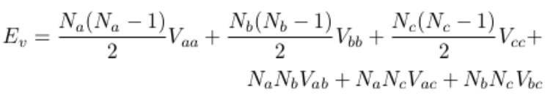
Monopol term
a,b,c: single-particle orbits (0d5/2,0d3/2,1s1/2)
Na,Nb,Nc: occupation numbers (from *.occ file)

Slide 4
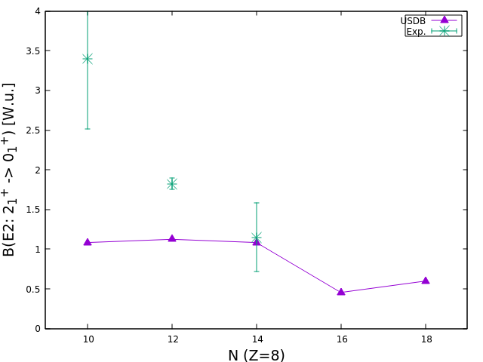
Gamma decay: B(E2) values

Slide 5
Gamma decay: 22-O

Slide 6

Netorun decay width
23-O (J=5/2+)
= 1.269 MeV * 0.0590 = 75 keV
den: 1
wspot
Experiment: 100 keV (N. Frank et al.)

Slide 7

Magnetic Moment
23-O (J=1/2+, g.s.)
SM: M1 moment = -1.052 mu_N
Schmidt value:
Single-particle like structure of 23-O: filled 0d5/2 + 1 neutron

