Slide 1
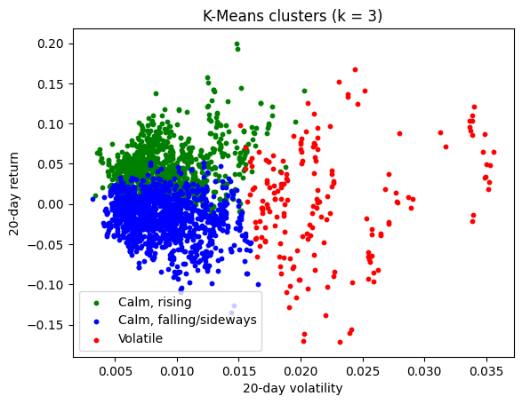
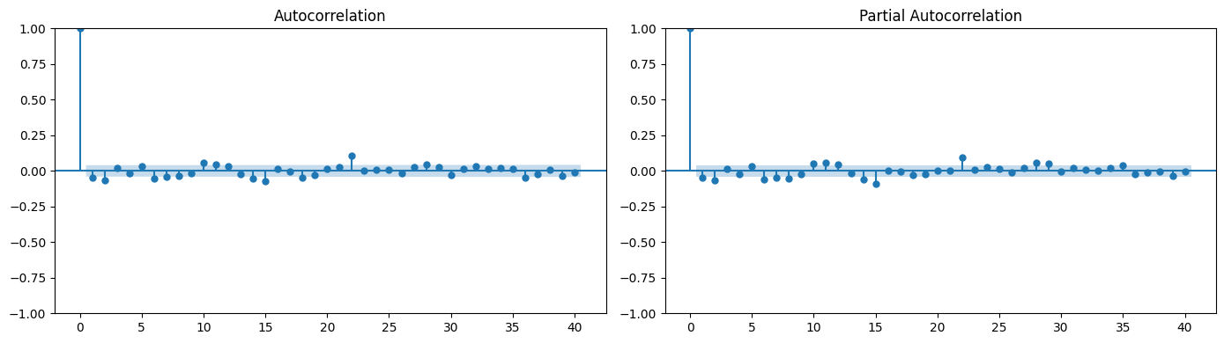
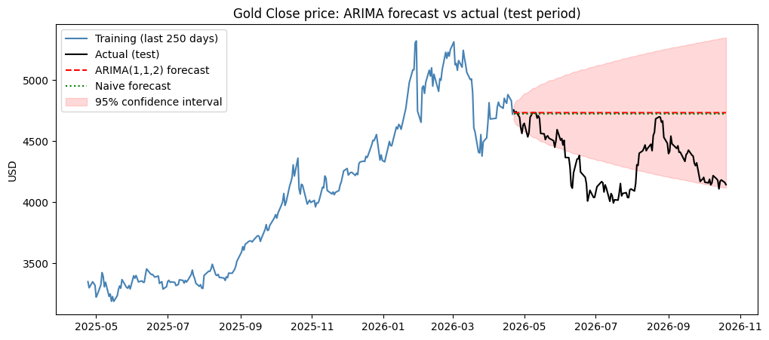
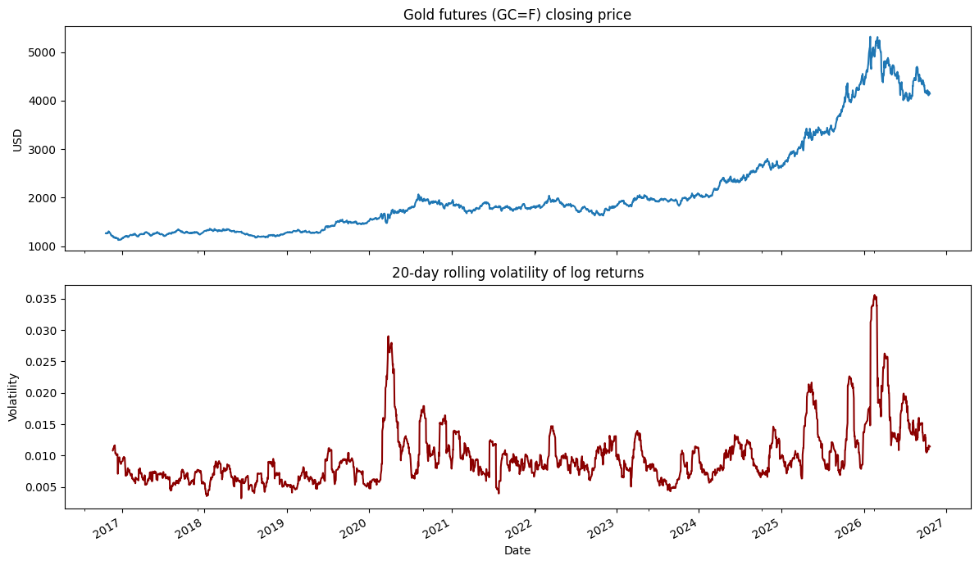
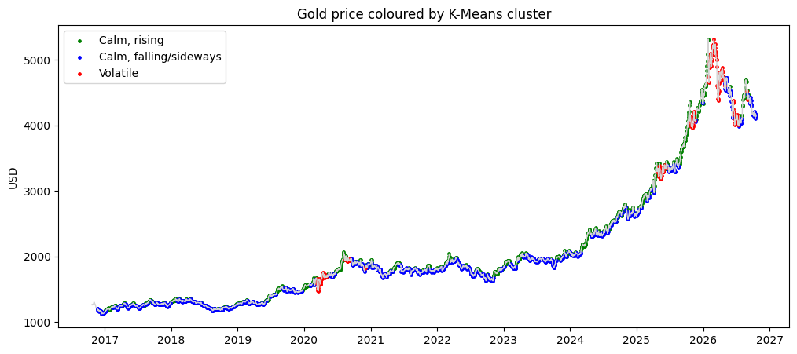
Gold Futures: Market Conditions and Price Forecasting
[Student name]
[Student number]
Can daily gold futures trading days be grouped into market conditions, and can ARIMA forecast the gold price better than a naïve forecast?
Machine Learning for Business · HDip in Science in Data Analytics for Business · CCT College Dublin
Data: Yahoo Finance, GC=F · 21 Oct 2016 – 20 Oct 2026
1
Introduction
3
Clustering trading days
4
Time series & ARIMA
5
When is forecasting hardest?
Gold is one of the most followed financial assets. In the last ten years the gold futures price rose from about 1,128 to 5,318 USD, with calm and very turbulent periods. For a business, knowing when the market is calm or nervous and whether past prices can forecast future prices helps with planning and risk management.
Scaling: StandardScaler, because both methods use Euclidean distance.
k = 3: elbow, silhouette, Davies–Bouldin and the dendrogram's largest gap.
Ward linkage: single and average linkage scored silhouette 0.69 only by isolating 1 day.
Split: train to 21 Apr 2026, test = last 126 days (no shuffling).
ADF: price p = 1.0 (not stationary); 1st difference p < 0.0001, so d = 1.
ACF/PACF: all values very small; no seasonality at 5, 21, 63, 126 or 252 days → ARIMA, not SARIMA.
AIC: ARIMA(1, 1, 2) lowest (23,080.98); random walk highest.
Objectives
Clean and explore 10 years of daily gold data
Find market conditions with K-Means and Agglomerative clustering
Compare them with silhouette and Davies–Bouldin
Test ARIMA against a naïve forecast
ACF and PACF of the daily price changes (training data)
About 50% larger errors on volatile days. ARIMA ≈ naïve in every condition (descriptive only).
2
Data & preparation
6
Conclusions
K-Means: calm rising, calm falling/sideways, volatile
Three market conditions: calm rising (40%), calm falling/sideways (52%) and volatile (7%) days, found by both algorithms.
K-Means preferred (silhouette 0.270, Davies–Bouldin 1.250), but the clusters are weakly separated.
Random walk: ARIMA(1,1,2) did not beat "tomorrow = today", over 6 months or one day.
Link: clusters show when forecasting is hardest; changing volatility breaks ARIMA's assumptions.
Limitations: pre-2020 data issue, k = 3 is a judgement, no outside data (rates, US dollar, news). Future work: log price, volatility models.
Source: Yahoo Finance, GC=F: COMEX gold futures in USD (not the shop price of gold), via yfinance.
Period: last ten years, 21 Oct 2016 – 20 Oct 2026.
Data issue: Volume, High and Low were recorded differently before 2020, so clustering uses only log return, 20-day volatility and 20-day return.
Heavy tails: biggest fall −11.4% on 30 Jan 2026.
k = 3 | K-Means | Ward
Silhouette ↑ | 0.270 | 0.246
Davies–Bouldin ↓ | 1.250 | 1.278
Smallest cluster | 183 days | 99 days
Same condition in both | 89.5% of days
6-month forecast: ARIMA ≈ naïve, a flat line
Test MAE (USD) | ARIMA(1,1,2) | Naïve
6 months ahead | 385.16 | 374.08
One day ahead | 46.82 | 46.86
Inside 95% interval | 64.3% of test days
Preferred: K-Means. Better on both metrics and stable across random starts. Silhouette < 0.3: conditions are not clearly separated.
Residuals: no autocorrelation left, but heavy tails and changing variance, so the interval is too narrow.
Why is ARIMA no better than naïve?
The AR and MA terms almost cancel out (AR1 = −0.59, MA1 = +0.55), and the daily price changes have almost no autocorrelation. Gold behaves like a random walk, so the best forecast is close to the last price.
References
Iqbal, M. (n.d.) Machine Learning for Business. CCT College Dublin.
Yahoo Finance (2026) Gold Dec 26 (GC=F) historical data. Accessed 22 Oct 2026.
Volatile days only in 2020 (20%), 2025 (20%) and 2026 (41%)
Close price and 20-day volatility: calm until 2019, spikes in 2020 and 2026

