Slide 1
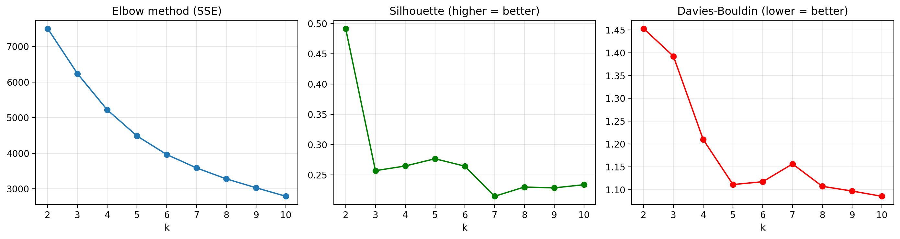
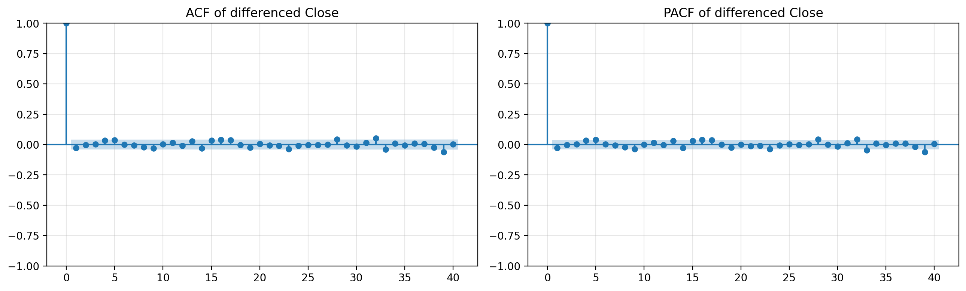
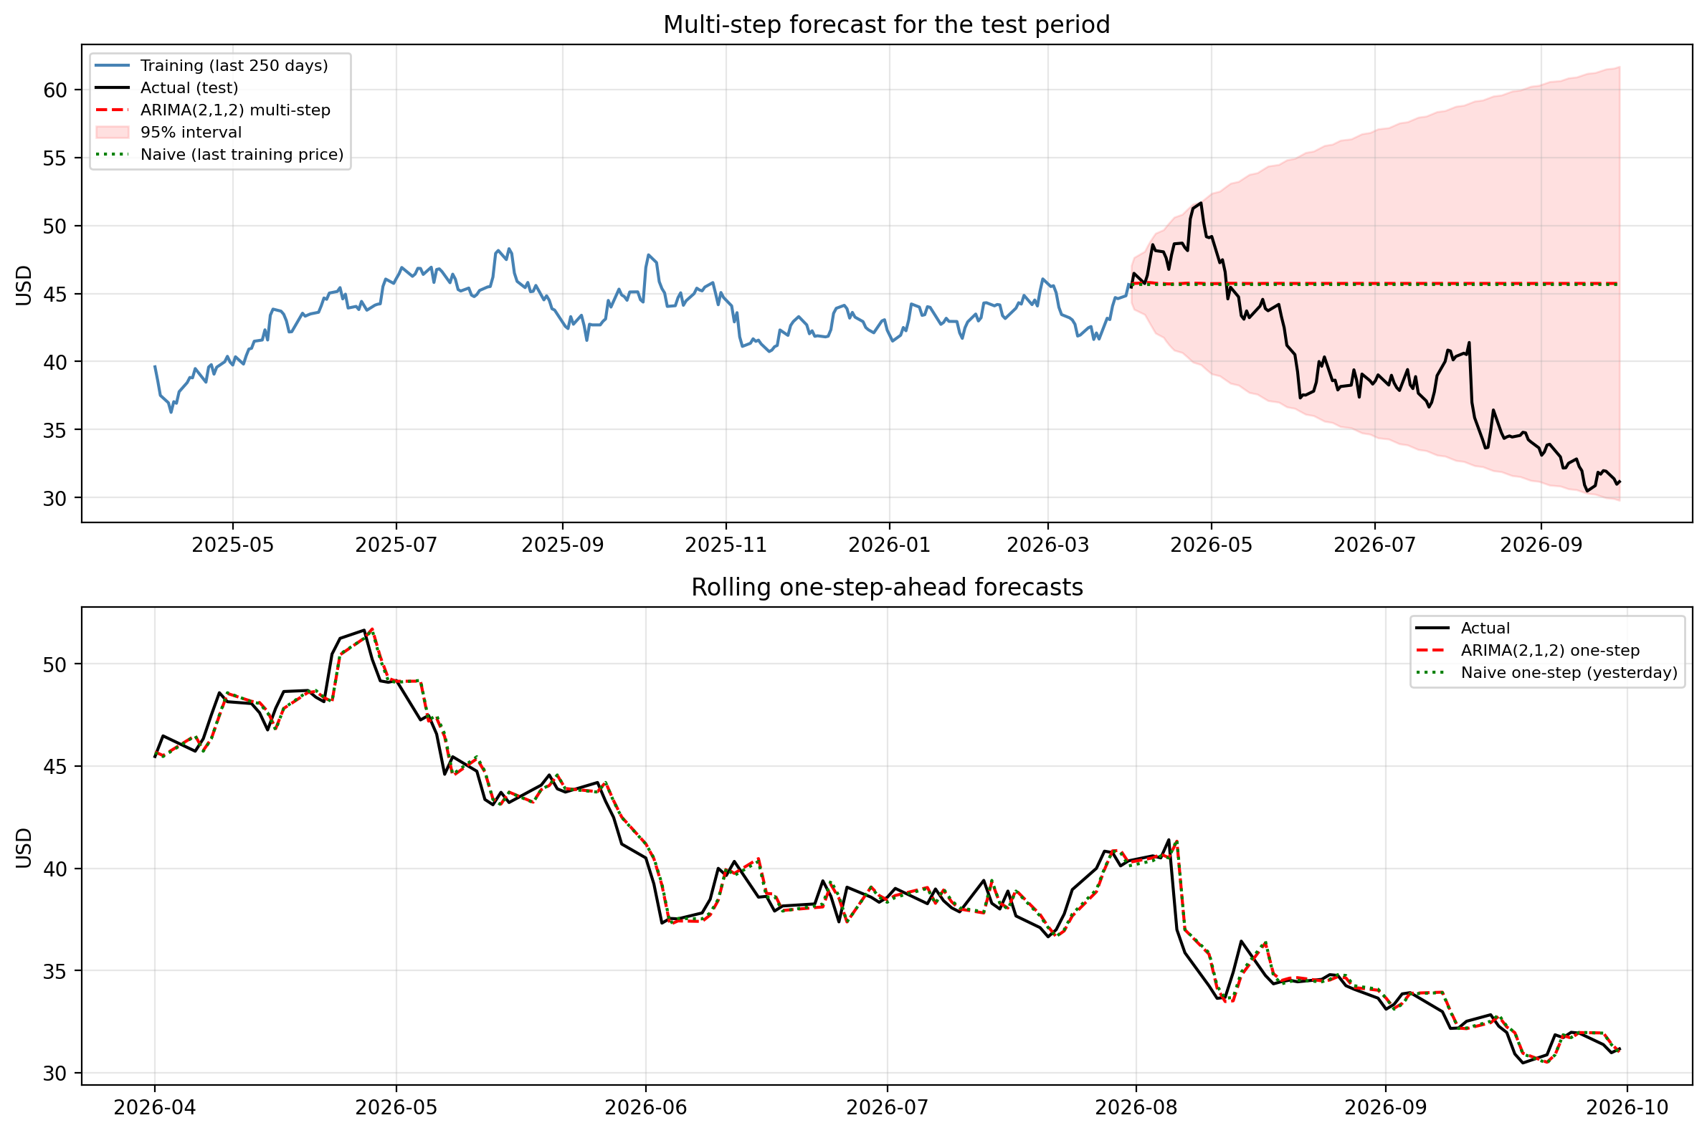
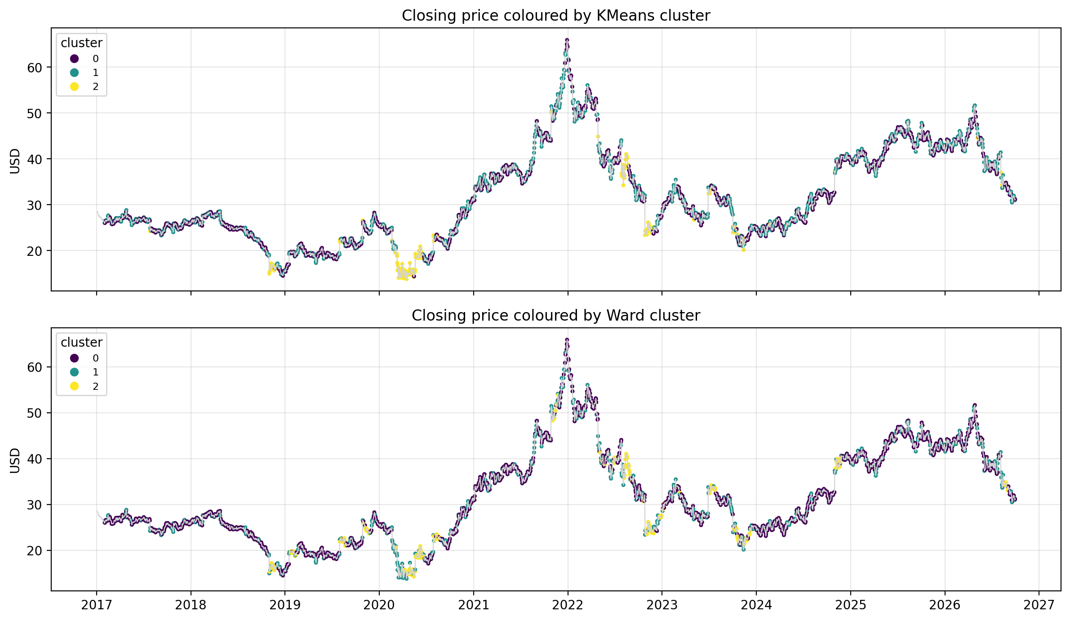
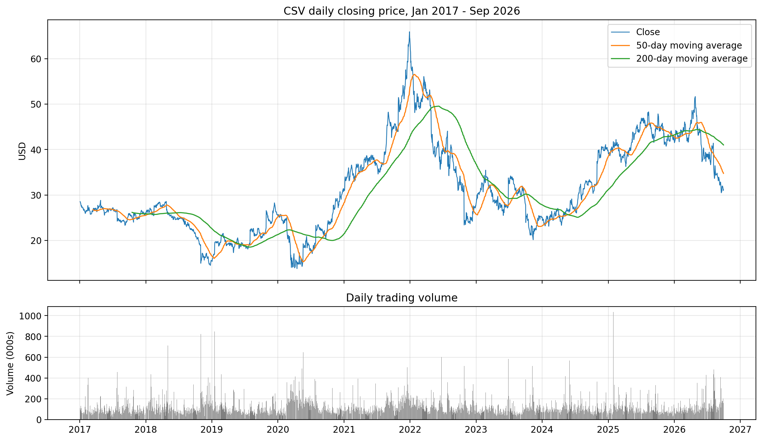
Market Conditions and Price Forecasting for Carriage Services (CSV)
[Student name]
[Student number]
Can daily trading days be grouped into meaningful market conditions, and can ARIMA forecast the closing price better than a naïve forecast?
Machine Learning for Business · HDip in Data Analytics for Business · CCT College Dublin
Data: Yahoo Finance, ticker CSV · 3 Jan 2017 – 30 Sep 2026 · downloaded 21 Oct 2026
1
Introduction
3
Clustering trading days
4
Time series & ARIMA
5
Is ARIMA better than naïve?
Carriage Services (CSV) is a US funeral and cemetery company listed on the NYSE. Its daily trading data is both a set of multivariate records (open, high, low, close, volume) and a time series. We use clustering to find market conditions without labels, and ARIMA to test whether past prices help forecast future prices.
Features: the 4 derived features, scaled with StandardScaler (Euclidean distance).
K-Means and Agglomerative (Ward) tested for k = 2–10.
Single / complete / average linkage scored up to 0.87 silhouette only by isolating 1–10 outlier days, so they were rejected.
Target: daily Close. Train Jan 2017 – Mar 2026, test Apr – Sep 2026 (126 days).
ADF: level p = 0.59 (not stationary); 1st difference p < 0.001, so d = 1.
ACF/PACF: no significant lags 1–27; no spikes at seasonal lags 5–252, so no SARIMA.
AIC grid (p, q ≤ 3): ARIMA(2,1,2) best AIC; ARIMA(0,1,0) best BIC.
Objectives
Clean and document 10 years of daily data
Compare K-Means and Agglomerative clustering (silhouette, Davies–Bouldin)
Select ARIMA/SARIMA orders with evidence
Test forecasts out of sample against naïve baselines
K-Means: SSE, silhouette and Davies–Bouldin for k = 2–10
ARIMA wins 2 windows, loses 2, by at most 0.005 USD: effectively no better than naïve.
k = 3 chosen: k ≥ 4 gives clusters under 1% of days; DBI favours 3 over 2; at k = 3 both algorithms separate activity and volatility.
ACF and PACF of the differenced Close (training data)
6
Discussion & conclusions
2
Data & preparation
k = 3 | K-Means | Ward
Silhouette ↑ | 0.257 | 0.312
Davies–Bouldin ↓ | 1.392 | 1.481
Stability (ARI, 80% samples) | 0.877 | 0.476
Smallest cluster | 7.1% | 11.0%
Three market conditions: calm (57%), busy high-volume (35%) and high-volatility days (7%). The volatile days cluster in 2018, 2020, 2022 and 2023, although no dates were used.
K-Means preferred: better DBI, far more stable, easier to explain. Ward has the higher silhouette. Separation is weak overall.
Forecasting: the price behaves like a random walk; ARIMA did not beat "tomorrow = today".
Link: residuals are heavy-tailed with changing variance, the same volatility regimes the clusters show, so ARIMA intervals are unreliable.
Limitations: one stock, no external data, k is a judgement, one main split. Not investment advice.
2,449
0
6 + 4
trading days
rows removed (no missing / invalid)
original + derived variables
Source: Yahoo Finance via yfinance; dated CSV snapshot; 3 rows checked against the web page.
Original: Date, Open, High, Low, Close, Adj Close, Volume.
Derived: log return, intraday range, 20-day volatility, relative volume.
Returns have heavy tails (excess kurtosis 27.4).
Test period: multi-step (top) and rolling one-step forecasts (bottom)
Test MAE (USD) | ARIMA(2,1,2) | Naïve
One-step ahead | 0.684 | 0.679
Six months ahead | 7.13 | 7.08
Close price coloured by cluster (0 calm · 1 busy · 2 high volatility)
Residual diagnostics (training)
No autocorrelation left (Ljung–Box p ≥ 0.61)
Not normal: heavy tails (kurtosis 26.6)
Variance not constant (H = 2.47, p < 0.01)
95% interval covered every test day only because it is very wide
References
Hyndman, R.J. and Athanasopoulos, G. (2018) Forecasting: principles and practice. 2nd edn. OTexts.
Iqbal, M. (n.d.) Machine Learning for Business lecture slides (Lectures 1, 2, 3, 5, 6). CCT College Dublin.
Pal, A. and Prakash, P.K.S. (2017) Practical Time Series Analysis. Packt.
Pedregosa, F. et al. (2011) 'Scikit-learn', JMLR, 12, pp. 2825–2830.
Yahoo Finance (2026) Carriage Services, Inc. (CSV) historical data. Accessed 21 Oct 2026.
K-Means cluster | Days | Range | 20d vol. | Rel. vol.
0 Calm | 57% | 2.2% | 1.8% | −0.40
1 Busy | 35% | 3.2% | 1.8% | +0.35
2 High volatility | 7% | 6.4% | 5.4% | +0.08
Close price with 50/200-day moving averages, and daily volume

