Slide 1
STARTUP SUCCESS PREDICTION USING SUPERVISED LEARNING MODELS
Presented By : Ghaida Ben Salah - Nada Haddad
Group : LSI-A3-03-01

Slide 2

TABLE OF CONTENTS
1
Introduction
2
Algorithms Overview
3
Data Overview
4
Data Preprocessing
5
Models Training and Evaluation
6
Results and Key Insights
7
Conclusion

Slide 3

INTRODUCTION

Slide 4
PROBLEM STATEMENT
BACKGROUND
Startups play a critical role in driving innovation and economic growth. However, the path to success is incredibly challenging, with data showing that around 90% of startups fail within their first few years. Factors such as poor market fit, inadequate funding and operational inefficiencies often contribute to these failures.
MOTIVATION
Given the high risks involved, entrepreneurs and investors need tools to assess the viability of startups early on. By leveraging machine learning, we can uncover patterns in historical data that predict a startup's likelihood of success. Such insights empower stakeholders to make more informed decisions, minimizing risks and maximizing potential.
4

Slide 5
PROJECT GOALS
This project focuses on :
Building predictive models using supervised machine learning techniques :
K-Nearest Neighbors (KNN)
Logistic Regression
Naive Bayes
Decision Tree
Evaluating model performance to identify the most accurate approach
Providing actionable insights into the key factors driving startup success
5

Slide 6

2. ALGORITHMS OVERVIEW

Slide 7
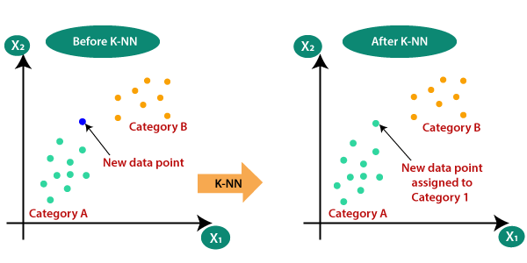
KNN (K-NEAREST NEIGHBORS)
KNN is a simple, non-parametric algorithm used for classification tasks. It works by predicting the label of a data point based on the majority label of its nearest neighbors in the feature space. The algorithm's performance is influenced by the number of neighbors (K) and the choice of distance metric (Euclidean or Manhattan distance) used to measure similarity.
7

Slide 8
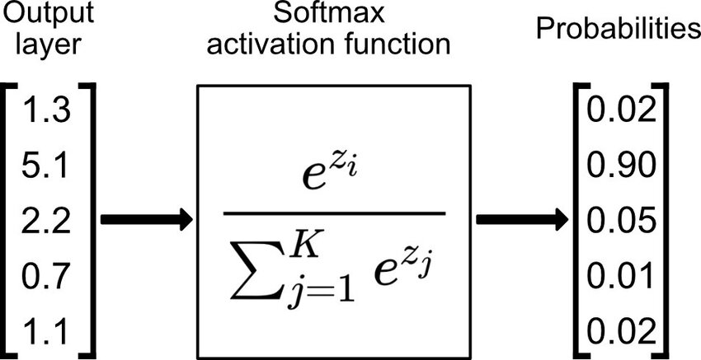
LOGISTIC REGRESSION
Logistic regression is a method used to model categorical target variables, including those with multiple classes. When dealing with multiclass classification, we use multinomial logistic regression, which employs techniques such as the softmax function. The softmax function transforms the model's raw outputs into probabilities that sum to 1 across all classes.
This enables multinomial logistic regression to predict the probability that an observation belongs to each of the possible classes.
8

Slide 9

NAIVE BAYES
A Naive Bayes classifier is a probabilistic machine learning model that’s used for classification tasks. It is based on Bayes' theorem with the assumption of independence between features.
9

Slide 10
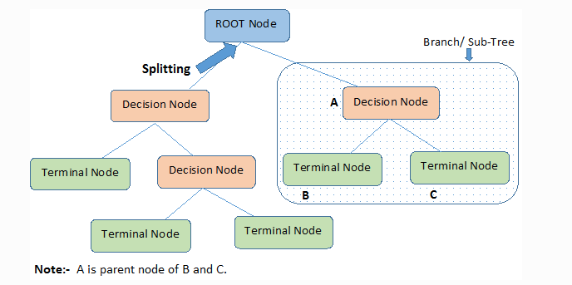
DECISION TREES
Decision Trees are models that divide data into smaller subsets based on specific feature values to make predictions. At each node, the dataset is split according to the feature that best separates the data. This process continues until each subset is as homogeneous as possible, with the final leaves representing the model's predictions.
10

Slide 11
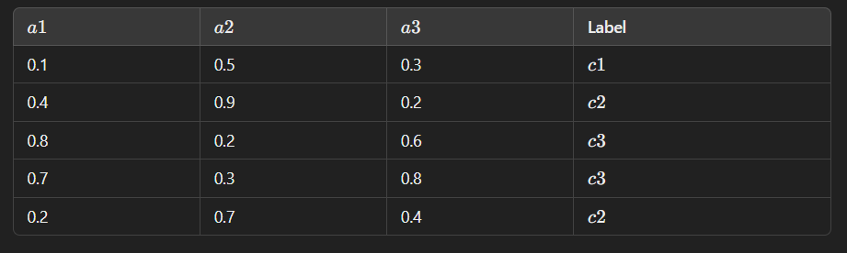
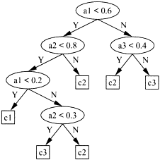
HOW DECISION TREES WORK ?
At first, the algorithm determines the best feature and threshold to split the dataset into subsets. This decision is based on a metric such as Information Gain, Gini Impurity and Entropy.
The algorithm calculates the metric for splits on a1, a2 and a3 at various thresholds (a1<0.6 , a2<0.8, ..). It selects the split that provides the most significant reduction in impurity (makes subsets more homogenous with respect to class labels).
For each subset, it repeats the feature selection process to find the best split for that subset.
Continue splitting the data until one of the stopping criteria is met:
Pure subsets: All data points in a subset belong to the same class.
Maximum tree depth: A predefined maximum depth of the tree is reached.
11

Slide 12

3. DATA OVERVIEW

Slide 13
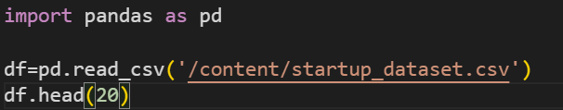
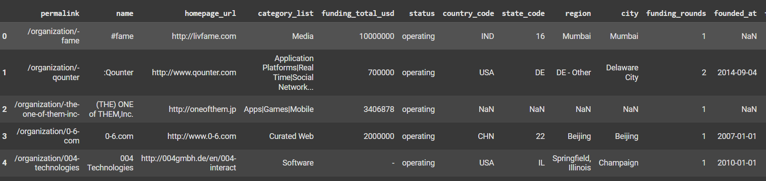
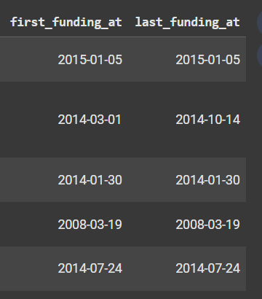
EXPLORING THE DATASET
13

Slide 14

EXPLORING THE DATASET
The operational status of the startup could be :
Operating : The startup is still running and actively conducting business.
Acquired : The startup has been bought by another company.
IPO (Initial Public Offering) : The startup has gone public, allowing its shares to be traded on a stock exchange.
Closed : The startup has ceased operations.
14

Slide 15
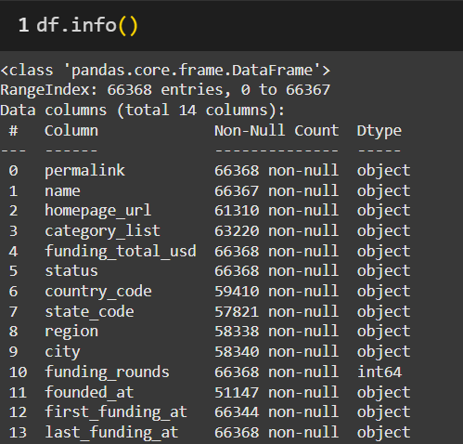
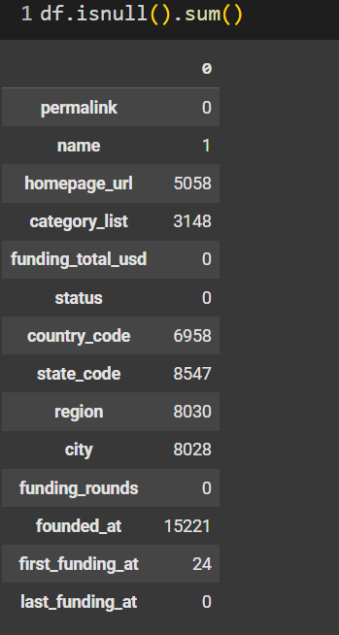
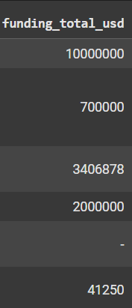
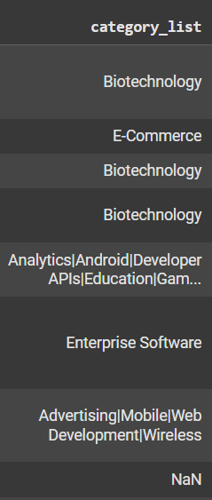
EXPLORING THE DATASET
15
Notes:
funding_total_usd is not float type.
Missing data regarding startup category, funding, location and founding date
For the columns related to location, we can see that when data is missing in one, data is almost always missing in the others.

Slide 16
PREPARING THE DATA FOR LEARNING
Converting funding data to numerical format
Normalizing and scaling funding data
Handling missing data of :
Funding
Location
Foundation date
Startup category data simplification
Encoding categorical data
16

Slide 17

4. DATA PREPROCESSING

Slide 18
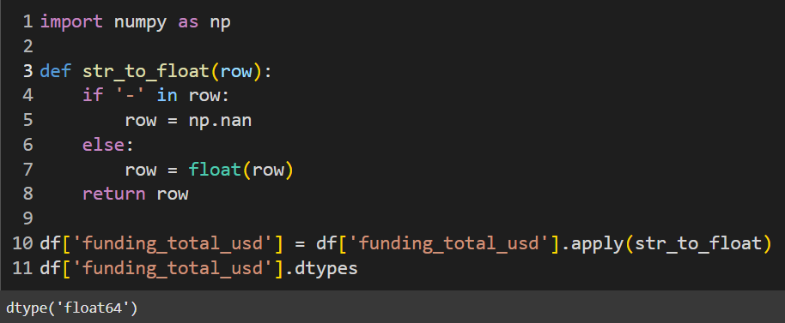
CONVERTING THE FUNDING_TOTAL_USD COLUMN
TO NUMERICAL FORMAT
The dash symbol present in some rows is interpreted as a string and not as an invalid or empty value. To standardize the data, we need to replace it with NaN (Not a Number), which is the standard representation for missing data.
Transforming the column from object type to float.
18

Slide 19
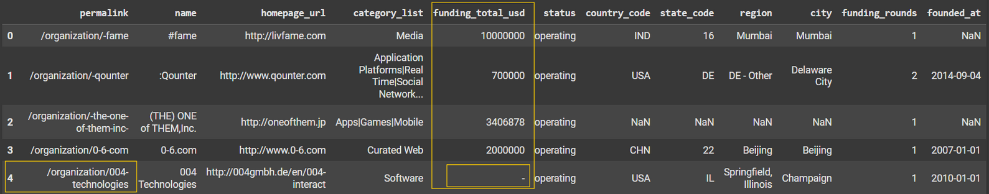
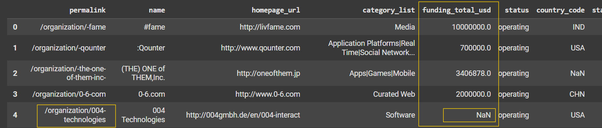
CONVERTING THE FUNDING_TOTAL_USD COLUMN
TO NUMERICAL FORMAT
Before
After
19

Slide 20
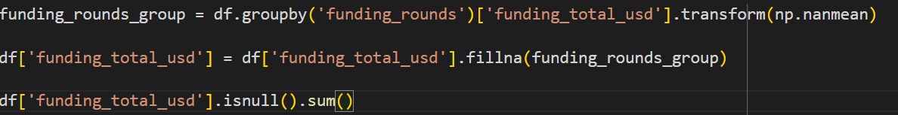
FILLING MISSING DATA IN THE FUNDING_TOTAL_USD COLUMN
Grouping data by funding_rounds and calculate the mean funding amount for each group.
Replacing missing values with the mean of their respective group.
20

Slide 21
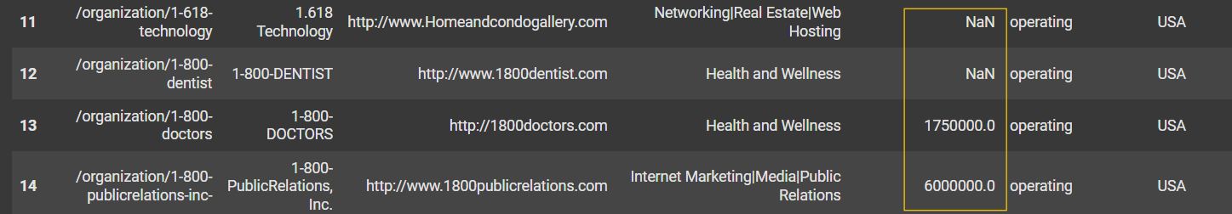
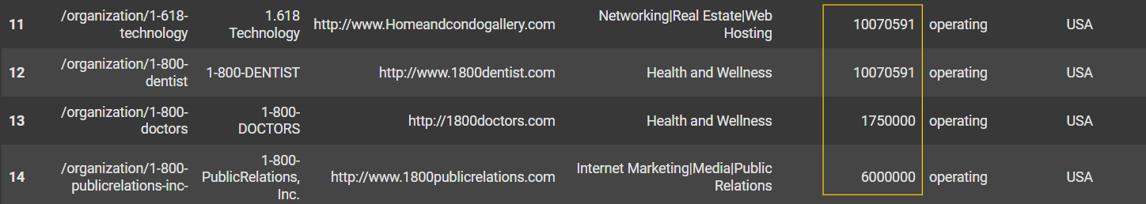
FILLING MISSING DATA IN THE FUNDING_TOTAL_USD COLUMN
Before
After
21

Slide 22
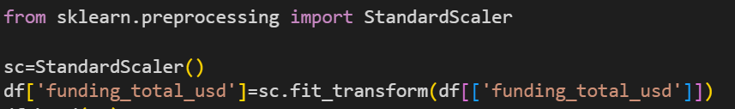
SCALING THE FUNDING_TOTAL_USD COLUMN
The fit_transform method calculates the mean and standard deviation of the column funding_total_usd and then transforms the data based on these statistics.
22

Slide 23
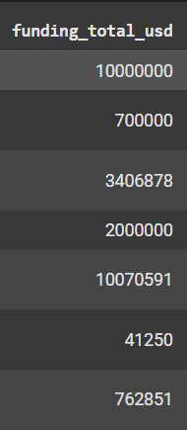
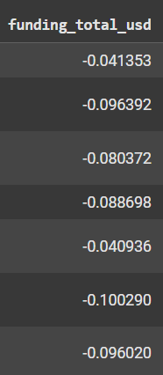
SCALING THE FUNDING_TOTAL_USD COLUMN
Before
After
23

Slide 24
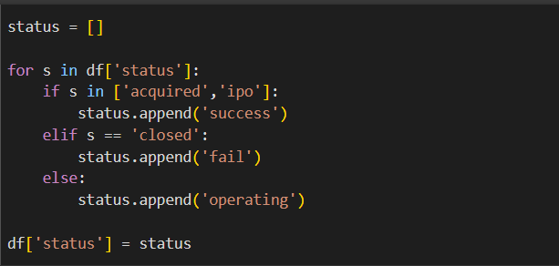
RECLASSIFYING THE STATUS COLUMN INTO 3 KEY CATEGORIES
Success : Represents companies that have been acquired or gone public.
Fail : Represents companies that have closed down.
Operating : Represents companies still in operation.
24

Slide 25
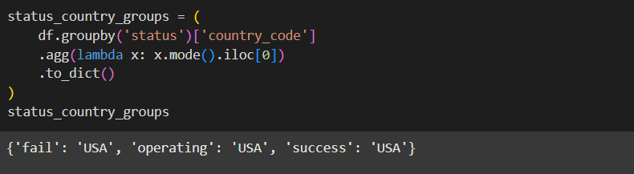
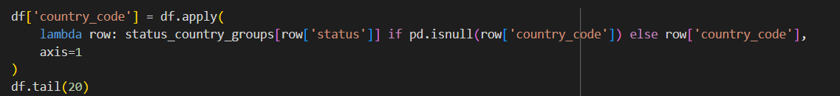
FILLING MISSING DATA IN THE COUNTRY_CODE COLUMN
Find the most common country_code for each status.
Replace missing country_code values with the most common value for the corresponding status.
25

Slide 26
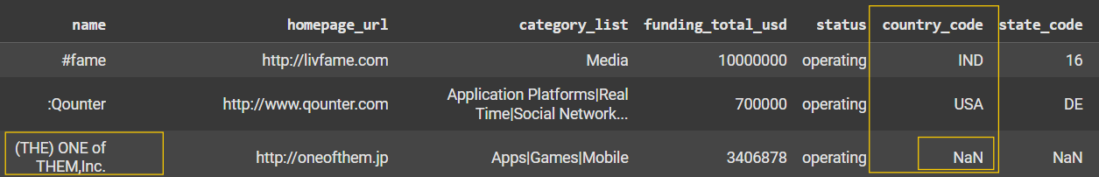
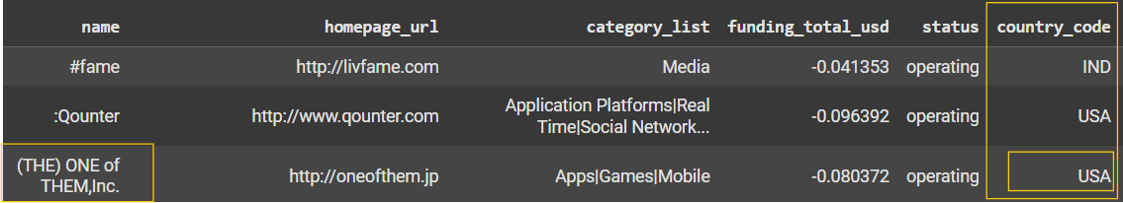
FILLING MISSING DATA IN THE COUNTRY_CODE COLUMN
Before
After
26

Slide 27
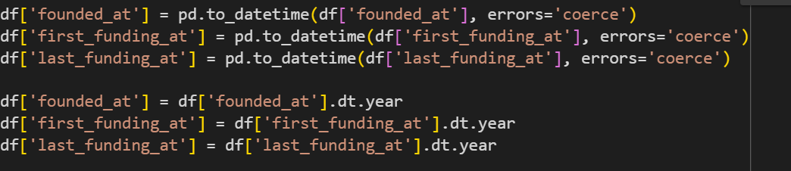
EXTRACTING THE YEAR FROM DATETIME COLUMNS
Converts the founded_at, first_funding_at, and last_funding_at columns to datetime format. Any invalid or unconvertible values are replaced with NaT (Not a Time) using errors='coerce'.
Extracts only the year part of the dates for further analysis.
27

Slide 28
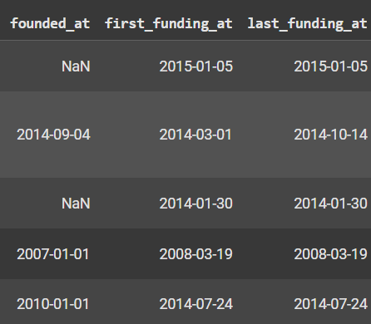
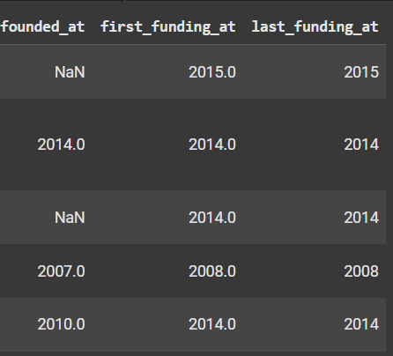

EXTRACTING THE YEAR FROM DATETIME COLUMNS
Before
After
28

Slide 29
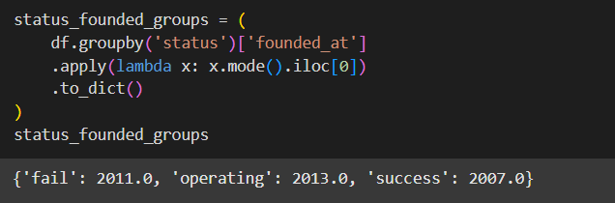
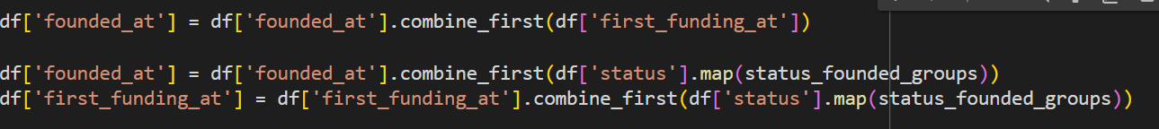
FILLING MISSING DATA IN DATETIME COLUMNS
Filling missing founded_at years using :
first_funding_at values if available.
Filling remaining missing values with the most common founded_at date for their corresponding status.
29
Notes:
The combine_first() method in pandas is used to combine two Series (or DataFrames) by filling missing values (NaN) in the first Series with corresponding values from the second Series.

Slide 30
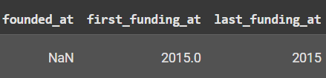
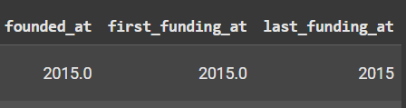
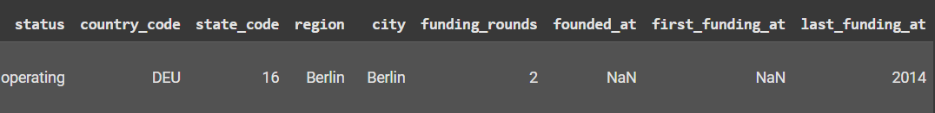

FILLING MISSING DATA IN DATETIME COLUMNS
Before
After
Before
After
30

Slide 31
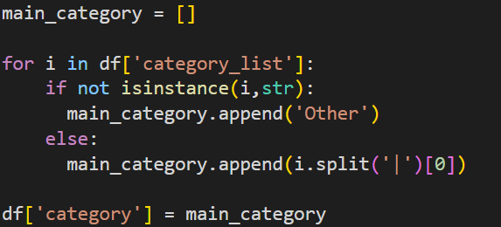
SIMPLIYING CATEGORY_LIST COLUMN
31

Slide 32
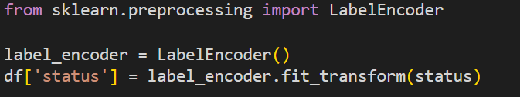
ENCODING CATEGORICAL DATA
Staus data : LabelEncoder maps each status class to a unique number which is sufficient for the target variable as it doesn't introduce additional dimensions and does not imply any relationship among the classes to the model.
Country and Category data : Unlike Label Encoding, One-Hot Encoding prevents the model from interpreting the categorical values as ordinal (e.g: country_code 2 > country_code 1).
32

Slide 33
DROPPING UNECCESARY COLUMNS
33
Notes:
inplace=True parameter modifies the DataFrame directly without creating a new one. When you set inplace=True, the operation is performed on the existing df object

Slide 34
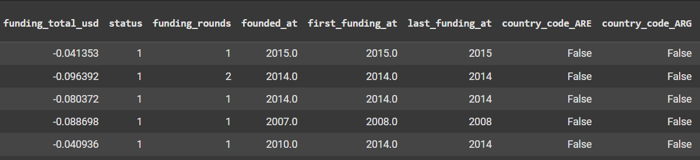
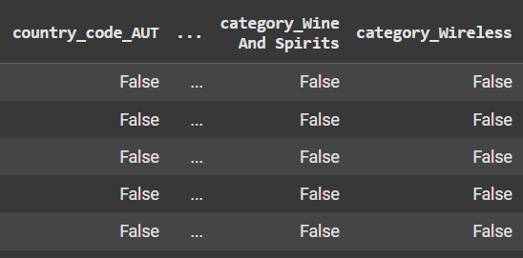
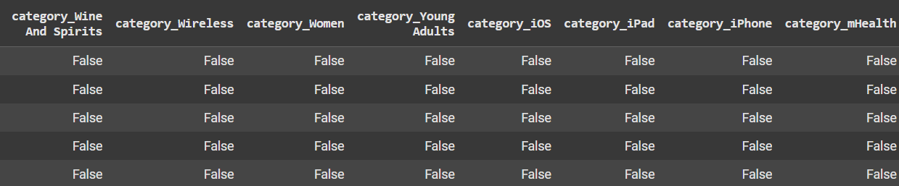
FINAL DATASET
34

Slide 35

5. MODELS TRAINING AND EVALUATION

Slide 36
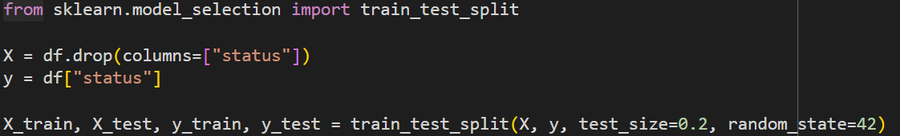
DATA SPLITTING : TRAINING AND TESTING SETS
36
Notes:
setting random_state=42 ensures that every time you run this code, the split between training and testing data will be the same. If you omit the random_state, the split will be random each time you execute the code, which may lead to slightly different results with each run.

Slide 37
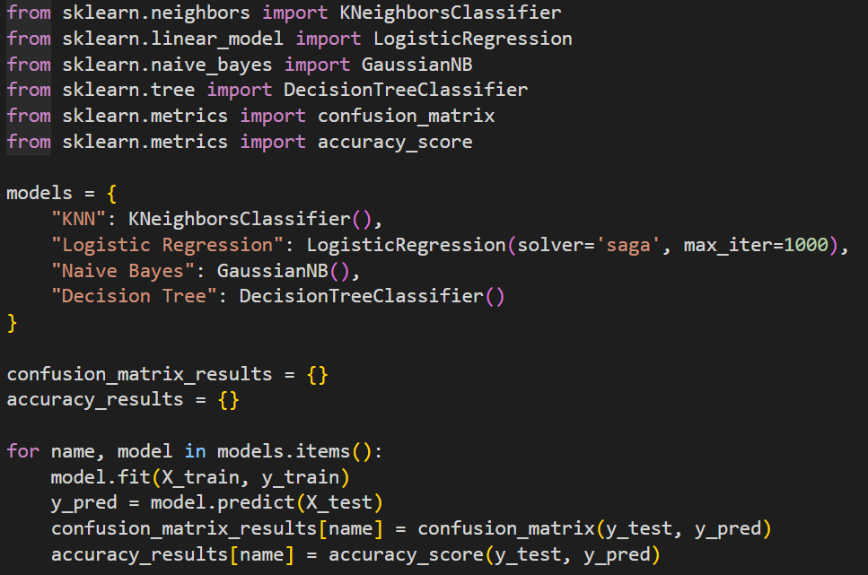
DATA TRAINING AND PREDICTING PHASE
The saga solver (optimization algorithm) is more suited for large-scale datasets then the default solver lbfgs.
Increasing max_iter from 100 to 1000 ensures the algorithm has enough iterations to converge particularly for complex data.
37

Slide 38
6. RESULTS
AND KEY INSIGHTS

Slide 39
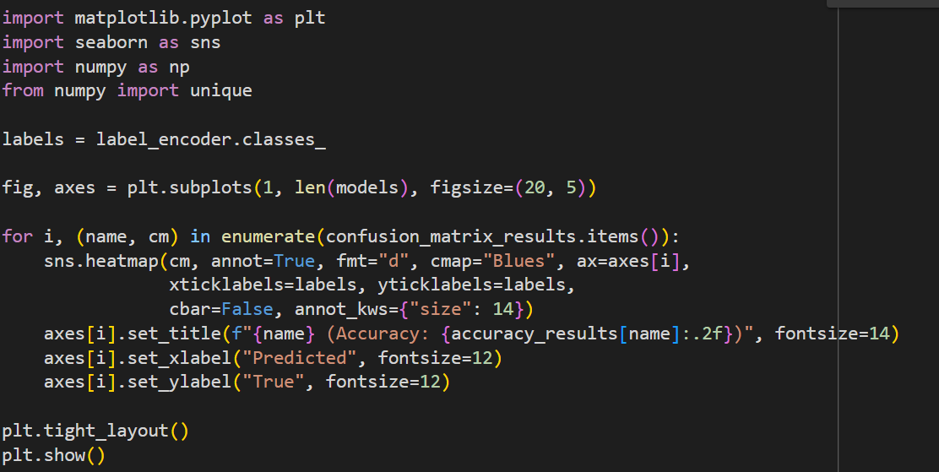
MODELS PERFORMANCE COMPARISON
39

Slide 40
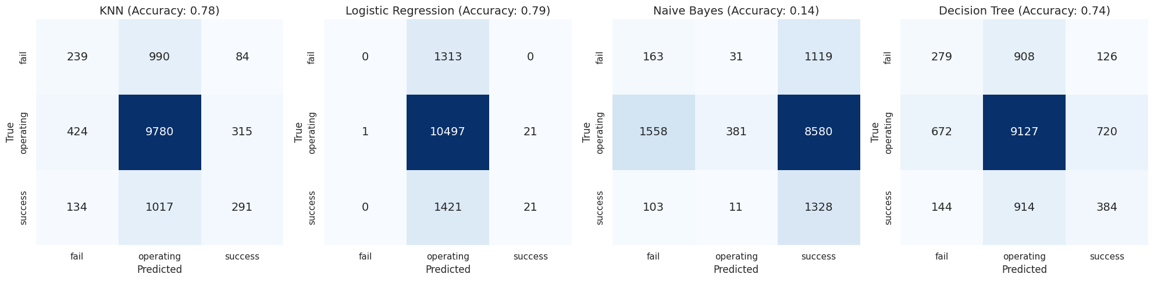
MODELS PERFORMANCE COMPARISON
40

Slide 41

INTERPRETATION
Data Independence Assumption in Naive Bayes : Naive Bayes assumes that the features in the dataset are independent of each other. However, the success of startups often depends on multiple correlated factors, such as funding, year and location. This assumption of independence makes it challenging for Naive Bayes to accurately model these relationships, resulting in suboptimal performance.
Complexity of the Dataset : KNN, Logistic Regression and Decision Trees are more flexible in handling complex relationships between features. KNN can capture non-linear relationships by considering proximity, Logistic Regression can model interactions between features especially with regularization and Decision Trees can capture hierarchical, non-linear patterns through splits on features.
41

Slide 42
INTERPRETATION
Data Quality and Size : With a large, well-cleaned dataset, models like KNN, Logistic Regression and Decision Trees can all perform well because they have more data to learn complex patterns. Naive Bayes, on the other hand, is relatively simple and may not be powerful enough for complex datasets, especially when there are feature dependencies.
42

Slide 43
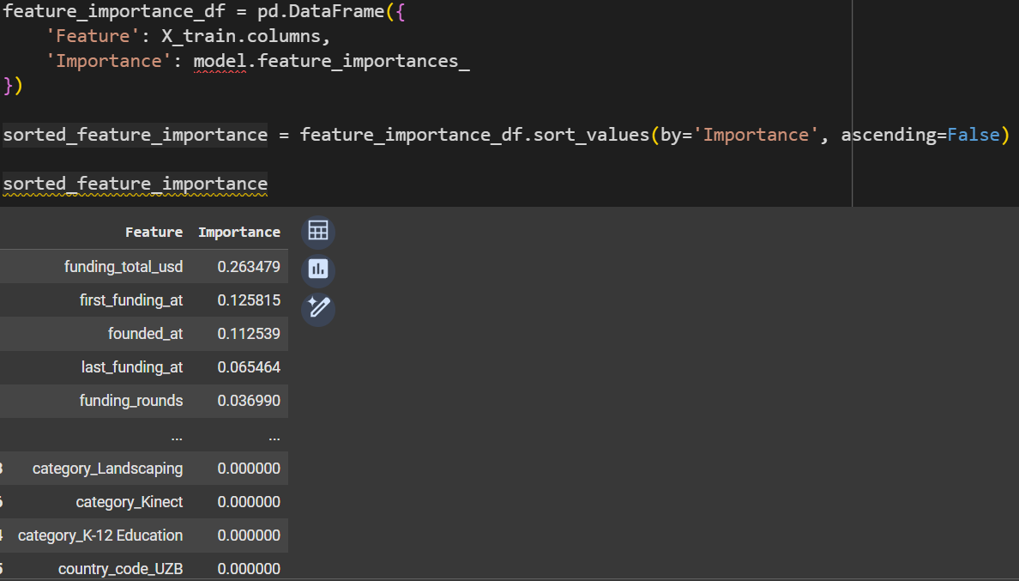
FEATURES IMPORTANCE WITH DECISION TREES
Decision Trees are particularly useful for understanding feature importance because they can assign a score to each feature based on how important it is in making predictions.
43

Slide 44

7. CONCLUSION

Slide 45
SUMMARY OF FINDINGS
Our project aimed to predict the success of startups using supervised learning models.
After evaluating KNN, Logistic Regression, Naive Bayes and Decision Tree, we found that KNN
and Logistic Regression performed the best achieving the highest accuracy ≈ 80%.
Additionally, with the help of Decision Tree, we identified that the most influential factors contributing to a startup’s success were the total funding received and the date of first funding. This insight emphasizes the critical role that financial backing and timing play in a startup’s potential for success.
By applying machine learning, we provided valuable insights that can help entrepreneurs and investors make informed decisions based on predictive analytics.
45

Slide 46
THANK YOU !

