Slide 1
Mini-Project 3 Word Embeddings By: Gaith Asubbagh 40042207 Mohammad Amin Solki 25544394

Slide 2
Models Used
word2-google-news-300
glove-wiki-gigaword-50
glove-twitter-50
glove-twitter-100
glove-twitter-200

Slide 3
Analysis
Model | Vocab Size | Correct Labels (C) | Number of questions without guessing (V) | Accuracy
word2vec-google-news-300 | 3000000 | 70 | 79 | 0.886075949
glove-twitter-50 | 1193514 | 35 | 69 | 0.507246377
glove-wiki-gigaword-50 | 400000 | 56 | 78 | 0.717948718
glove-twitter-100 | 1193514 | 36 | 69 | 0.52173913
glove-twitter-200 | 1193514 | 42 | 69 | 0.608695652

Slide 4
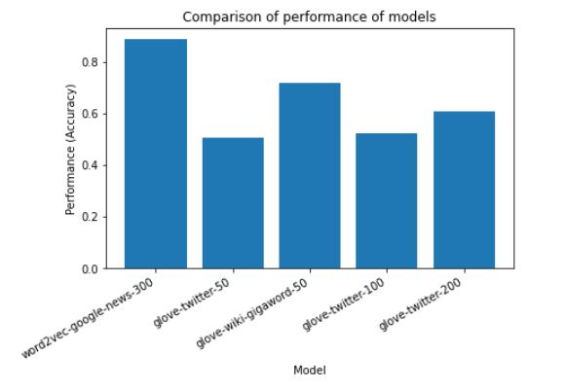
Performance of Models
88.6%
71.79%
60.87%
50.72%
52.17%

Slide 5
Comparing models with different corpus but same embedding sizes
Model | Correct Labels | Without guessing | Accuracy
glove-twitter-50 | 35 | 69 | 0.507246377
glove-wiki-gigaword-50 | 56 | 78 | 0.717948718
Comparison between glove-twitter-50 and glove-wiki-gigaword-50
As the analysis shows, models with certain corpora perform better than other corpora. In this case, the wiki-gigaword-50 has significantly higher accuracy than the glove-twitter-50.
Wiki-gigaword-50 has a higher number of questions without guessing compared to twitter-50.

Slide 6
Comparing models with same corpus but different embedding sizes
Model | Correct Labels | Without guessing | Accuracy
glove-twitter-100 | 36 | 69 | 0.52173913
glove-twitter-200 | 42 | 69 | 0.608695652
Comparison between glove-twitter-100 and glove-twitter-200
Both models have the same number of questions without guessing (69)
The accuracy of the 200 embedding size is higher than the accuracy of the 100-embedding size

Slide 7
Comparison to human gold-standard
The crowdsourced distribution of grades had an average performance: 85.57%.
A random baseline would have had an accuracy around 25%.
Compared to the models, the AI had a higher accuracy, significantly the word2vec-google-news-300 which had a higher accuracy than the Gold-Standard. And based on what we saw, if we had a higher embedding size for the gigaword corpus, we would have seen a high accuracy.
Gold-Standard
Average Performance = 85.57%
88.6%
71.79%
60.87%
50.72%
52.17%

Slide 8
Ways to Improve the Models
Having a larger embedding size for the models.
We saw that the word2vec-google-news-300 had the highest accuracy since it also had the highest embedding size. The model with the second highest accuracy was the glove-wiki-gigaword-50, and if we were to use a larger embedding size for this corpus, we would have had higher accuracy.
Selection of a corpus
As the analysis shows, models with certain corpora perform better than others. Gigaword-50 and “twitter-50” for example have the same embedding size but have accuracies of 71.79% and 50.72% respectively, this shows that the gigaword-50 model is the better corpora to use.

