Slide 1
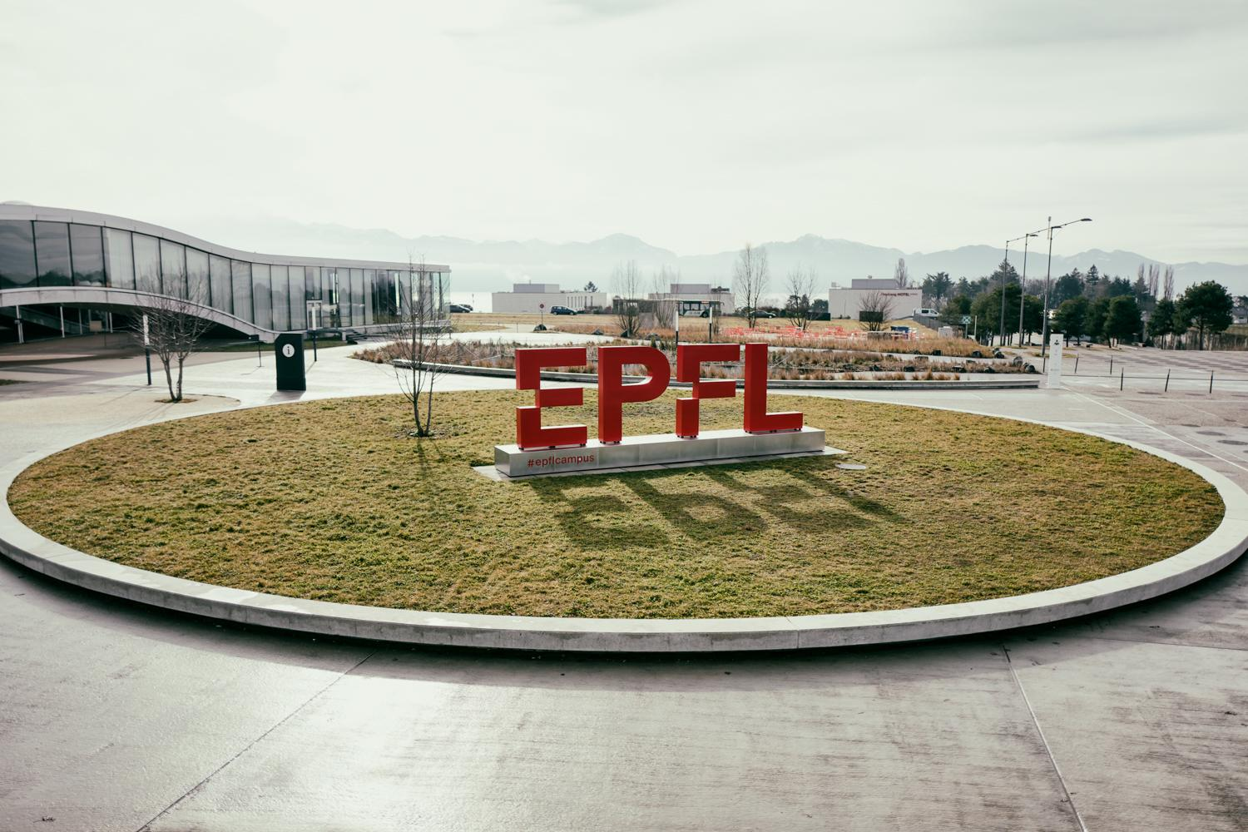
GRASPE: Adaptive Grading Support for Persuasive English Essays
Faten Ghali
supervised by
Thiemo Wambsganss
08.02.2023

Slide 2




Situation
x
300 essays per year
20 - 30 min per essay
+
100 - 150 hours
consolidation exercises

Slide 3
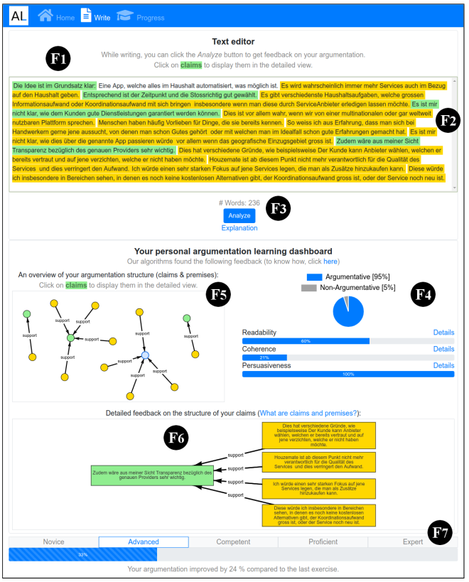
Related Work
NLP-based automated corrections: Improve BERT to outperform LSTM, create context-aware GEC… Yuan et al., Wang et al. [6]-[8]
Applications for learners: AL and ALEN help students improve their writing skills. Wambsganss et al. [4]-[5]
Support for teachers: Write & Improve from Cambridge [9]
Human + automated scoring techniques: Veloo et al., Sevcikova [2]-[3]
Notes:
Add references exlicitly

Slide 4
Research Gap
Manually grading
Time consuming
Hard and not engaging
Follow-up activities according to students’ levels
Advanced language models
Argumentation mining
Helping applications
Automated teaching supports
→ How to leverage language models to speed up the process of grading?
→ How to make follow-up activities more adapted to the students’ problems?
→ How to help the teachers grade without excluding their input? ^{[2]}
→ How to merge all the above in one tool, specifically designed for teachers?
[2] Beata Lewis Sevcikova. “Human versus Automated Essay Scoring: A Critical Review”. In: Arab World English Journal 9 (2018), pp. 157–174.

Slide 5
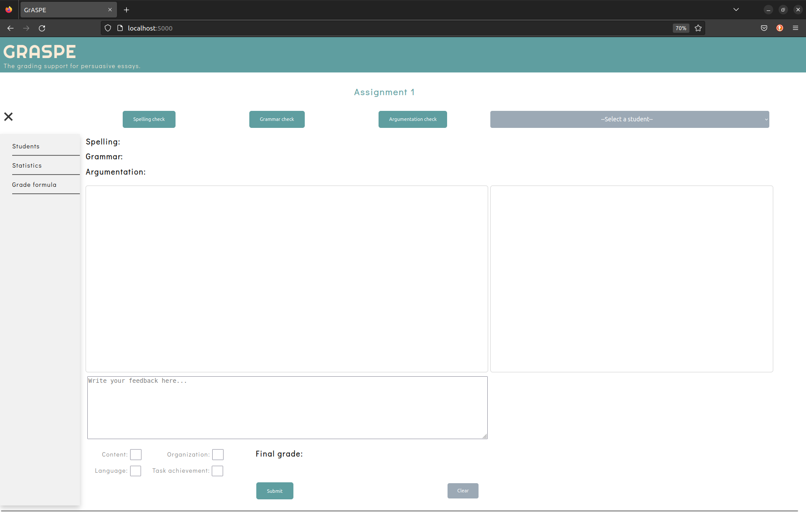
Solution: GRASPE
An adaptive grading support to help teachers grade persuasive essays

Slide 6
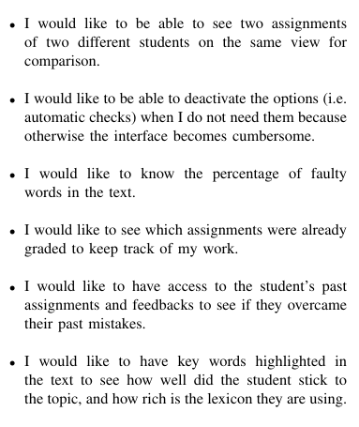
Methodology
Interviews with teachers
Introductory questions
Grading habits
Aims, wishes..
Situation-specific questions
→ User stories
Literature

Slide 7
Methodology
Features
Spelling check
Grammar check
Argumentation check
Comparison between 2 essays
Feedback span
Adjustable grading section
Statistics

Slide 8
Methodology
Features
Spelling check
Grammar check
Argumentation check
Comparison between 2 essays
Feedback span
Adjustable grading section
Statistics

Slide 9







Architecture + Demo
Spelling check
Neuspell (by Jayanthi et al. [1])
Context-aware
The fastest among tested models
Doesn’t correct punctuation errors
Text
corrected text
Neuspell
compare
Original text with uncommon words highlighted
nbr of mistakes

Slide 10

Architecture + Demo
Grammar check
Grammar checker
Sequence classification based on BERT
Trained on the CoLA dataset
Text
Bert
[(sent1, 0), (sent2, 1), …]
count and highlight the sentences labeled 0

Slide 11

Architecture + Demo
Argumentation check
Claim-premise classifier
Text classification based on Distilbert
Trained on the feedback-prize dataset
Accuracy: 0.87, F1-score: 0.89
Text
Distilbert
[{‘label’: “PREMISE”, ‘sentence’: “…” }, …]
count claims and premises and highlight accordingly

Slide 12
Demo
More features: Comparison, grading and feedback

Slide 13

GRASPE
Argumentation structure detection
Spelling check
Context-aware grammar check
Comparison between two assignments for fairness
Free space for written feedback
Analytic grading
Positive feedback on first draft from a teacher at Cambridge
Notes:
Grading section: Define final grade formula, make it adjustable (add, edit and remove sub-grades)

Slide 14
GRASPE
Next steps
Implement the statistics view
Make the grading section adjustable
Gather more feedback from teachers
Evaluate the tool through a real-life exercise
Limitations
For English teachers only
Access to teachers’ feedbacks on the tool
Cannot be universal: different grading techniques, different needs
Notes:
Grading section: Define final grade formula, make it adjustable (add, edit and remove sub-grades)

Slide 15
References
[1] Sai Muralidhar Jayanthi, Danish Pruthi, and Graham Neubig. “NeuSpell: A Neural Spelling Correction Toolkit”. In: Proceedings of the 2020 Conference on Empirical Methods in Natural Language Processing: System Demonstrations. Online: Association for Computational Linguistics, 2020, pp. 158–164. DOI: 10.18653/v1/2020.emnlp-demos.21. URL: https://aclanthology.org/020.emnlp-demos.21.
[2] Beata Lewis Sevcikova. “Human versus Automated Essay Scoring: A Critical Review”. In: Arab World English Journal 9 (2018), pp. 157–174.
[3] Arsaythamby Veloo, Noor Hashima Abd Aziz, and Aizan Yaacob. “The Most Suitable Scoring Method to Assess Essay Writing in ESL Classrooms”. In: Advances in Language and Literary Studies (2018).
[4] Thiemo Wambsganß, Andrew Caines, and Paula Buttery. “ALEN App: Argumentative Writing Support To Foster English Language Learning”. In: Jan.2022, pp. 134–140. DOI: 10.18653/v1/2022.bea-1.18.
[5] Thiemo Wambsganss et al. “AL: An Adaptive Learning Support System for Argumentation Skills”. In: Proceedings of the 2020 CHI Conference on Human Factors in Computing Systems. CHI ’20. Honolulu, HI, USA: Association for Computing Machinery, 2020, pp. 1–14. ISBN:9781450367080. DOI: 10.1145/3313831.3376732. URL: https://doi.org/10.1145/3313831.3376732.
[6] Yongjie Wang et al. “On the Use of Bert for Automated Essay Scoring: Joint Learning of Multi-Scale Essay Representation”. In: Proceedings of the 2022 Conference of the North American Chapter of the Association for Computational Linguistics: Human Language Technologies. Seattle, United States: Association for Computational Linguistics, July 2022, pp. 3416–3425. DOI: 10.18653/v1/2022.naacl-main.249. URL: https://aclanthology.org/2022.naacl-main.249.
[7] Alex Warstadt, Amanpreet Singh, and Samuel R Bowman. “Neural Network Acceptability Judgments”. In: arXiv preprint arXiv:1805.12471 (2018).
[8] Zheng Yuan and Christopher Bryant. “Document-level grammatical error correction”. In: Proceedings of the 16th Workshop on Innovative Use of NLP for Building Educational Applications. Online: Association for Computational Linguistics, Apr. 2021, pp. 75–84. URL: https://aclanthology.org/2021.bea-1.8.
[9] https://writeandimprove.com/

Slide 16
Merci
Faten Ghali

