Slide 1





Prediction of Employee Attrition Rate using Machine Learning
Team Members: GEETHA N G Guide: SHILPA HARIRAJ
GHANASHREE B N
KARUNA N
VIMALA K V
GEEETHA S V
Disclaimer: The content is curated for educational purposes only.

Slide 2
OUTLINE
Abstract
Problem Statement
Aims, Objective & Proposed System/Solution
System Design/Architecture
System Development Approach (Technology Used)
Algorithm & Deployment
Conclusion
Future Scope
References
Video of the Project
Notes:
These are the list of chapters that we are going to cover in these foundation codes. Those are chapter one what are AI and ML? chapter 2 applied Python programming in AI, and chapter 3 is exploratory data analysis for ML.

Slide 3
Abstract In this section, we provide a brief overview of our research on predicting employee attrition rate using machine learning techniques. Discover how our solution can help organizations proactively manage their workforce.

Slide 4
Problem Statement Identifying and addressing employee attrition is a crucial challenge that many organizations face. Learn about the key issues and potential consequences of high attrition rates in this section.

Slide 5
Aim and Objective Aim: Our aim is to develop a predictive model that accurately forecasts employee attrition. Objective: 1. Collect and analyze relevant data 2. Train and evaluate machine learning models 3. Develop a reliable attrition prediction system

Slide 6
Proposed Solution We propose using machine learning algorithms to predict employee attrition based on various factors such as performance, satisfaction, and tenure.

Slide 7
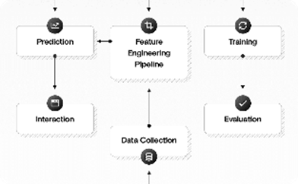

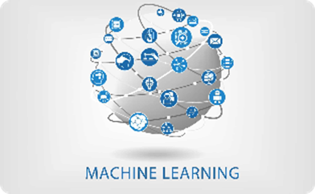
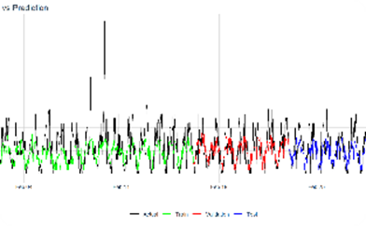
System Architecture
Overall Architecture
Our system follows a modular architecture, consisting of data collection, preprocessing, model training, and prediction modules.
Data Collection Module
We gather relevant employee data from HR systems, performance evaluations, surveys, and other sources to build our dataset.
Prediction Module
Our system provides real-time attrition predictions, empowering organizations to take proactive measures to retain their valuable employees.
Model Training Module
Using various machine learning algorithms, we train the models on historical employee data to understand patterns and predict attrition.

Slide 8
System Deployment Approach 1.Technology Stack - Python for data preprocessing and model training - Scikit-learn and SVC, Kneighbors Classifier, Logistic Regression algorithms 2. Development Methodology Our team follows an agile development approach, ensuring continuous collaboration, flexibility, and iterative improvements throughout the project.

Slide 9
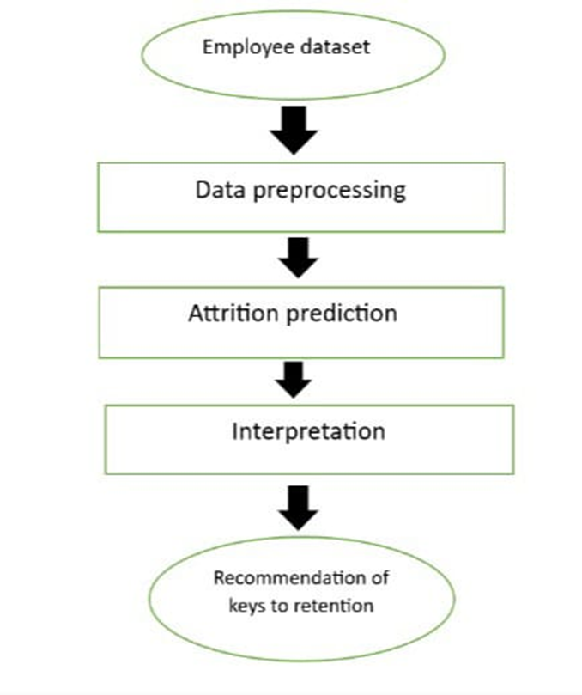
Algorithm & Deployment
Machine Learning Algorithms:
We employ a combination of decision trees, random forests, and logistic regression algorithms to build our attrition prediction models
Model Deployment:
The trained models are deployed using a cloud-based service, allowing organizations to seamlessly integrate the attrition prediction system into their existing infrastructure

Slide 10
Conclusion In conclusion, our research demonstrates the effectiveness of machine learning in accurately predicting employee attrition. By leveraging this technology, organizations can make data-driven decisions and implement targeted strategies to reduce attrition rates.

Slide 11
Future Scope We envision expanding our research to explore additional factors influencing attrition, such as company culture, work-life balance, and career advancement opportunities. Furthermore, we aim to develop personalized retention strategies based on individual employee profiles.

Slide 12
Reference
https://www.researchgate.net/publication/326029536_Employee_Attrition_Prediction
https://link.springer.com/article/10.1007/s42452-020-2519-4
https://www.researchgate.net/publication/364322002_EMPLOYEE_ATTRITION_PREDICTION_USING_MACHINE_LEARNING_ALGORITHMS
https://ieeexplore.ieee.org/document/8605976
Notes:
Reference
These are the references for this session.
12

Slide 13
Thank you!
Notes:
thank you very much for joining this PPT, keep learning.
13

