Slide 1
SmartShelfX: AI-Based Inventory Forecast & Auto
Restock
Transforming inventory management through intelligent automation and predictive analytics
By:
Ghanaswamy V N

Slide 2
The Inventory Challenge Today
Inaccurate Records
Massive Financial Impact
System Limitations
60% of inventory records contain errors, leading to lost sales opportunities and costly excess stock accumulation
Walmart lost $3B in 2013 due to stockouts alone, despite continuously growing inventory levels
Traditional static systems struggle to adapt to rapidly changing demand patterns and supply chain disruptions

Slide 3

Why AI is the Game-Changer
95%
Forecast Accuracy
100%
Real-Time Adaptation
AI boosts demand forecasting precision from 63% to 95-99%, according to IBM and McKinsey research
Self-learning systems instantly adjust to market shifts and emerging trends
Automated restock capabilities dramatically reduce stockouts while minimizing holding costs, creating faster fulfillment cycles and improved customer satisfaction.

Slide 4


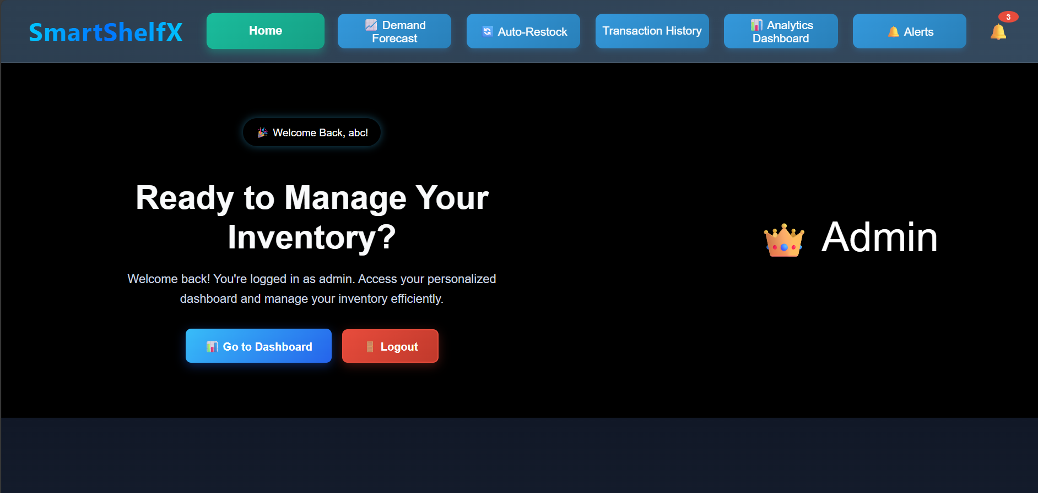
SmartShelfX - Solution Overview
Real-Time Tracking
Auto Restock Intelligence
AI-Driven Forecasting
Triggers orders automatically based on dynamic thresholds considering seasonality, trends, and supplier lead times
Provides complete visibility across all warehouses, sales channels, and distribution points
Predicts what products will sell, when demand will peak, and where inventory is needed most

Slide 5


Tech Stack: Modern & Scalable
Frontend: React.js
Responsive, intuitive user interface built with React Hooks, Router, and modern component architecture for seamless user experience
Backend: Java Spring Boot
Robust REST API delivering secure business logic, efficient data processing, and enterprise-grade reliability
Database: Relational DB 3 PostgreSQL
PostgreSQL is used as the primary relational database to store all inventory and
transactional data, providing strong ACID compliance, scalability, and reliable performance for large-scale restaurant operations.

Slide 6




How It Works: From Data to Decision
Data Collection
Continuously gathers historical sales data, supplier information and external factors
AI Analysis
Machine learning models analyze patterns, identify trends, and update forecasts in real-time
Auto Restock Trigger
Backend automatically generates purchase orders when inventory reaches AI-optimized reorder points
Live Dashboard
Frontend provides real-time visibility, actionable alerts, and comprehensive insights for managers

Slide 7


Real-World Impact & Benefits
Reduce Stockouts by 25%
Improve customer satisfaction and capture more sales opportunities with optimal inventory availability
Slash Excess Costs
Eliminate wasteful holding costs with intelligent stock level optimization and predictive replenishment
Accelerate Fulfillment
Speed up order processing and warehouse efficiency with automated workflows and smart routing
Effortless Scaling
Grow seamlessly from small business operations to enterprise- level inventory management

Slide 8

Competitive Edge & Market Opportunity
30%
Annual Growth Rate
AI inventory management market expansion
The AI inventory management market is projected to reach $9.6 billion in 2025, growing at an impressive 30% annually. Industry leaders like Zara have already cut their logistics turnaround time to just 48 hours using AI-driven systems.
SmartShelfX positions your business at the forefront of this AI-driven transformation, giving you the competitive advantage needed to thrive in modern retail.

Slide 9
Demo & Deployment Highlights
Secure React UI
Enterprise Backend
Flexible Integration
Role-based access control
Secure REST APIs with comprehensive auditing
Seamless supplier API connectivity
Real-time data updates and notifications
Cloud-ready Spring Boot architecture
Multi-warehouse management support
Responsive design for desktop and mobile
Built-in monitoring and logging
Easy deployment on AWS, Azure, or on-premises
Scalable infrastructure for growth

Slide 10

The Future of Inventory is SmartShelfX
Predictive Management
AI-Driven Insights
Sustainable Growth
Move from reactive firefighting to proactive, predictive inventory strategies
Empower your team with intelligent automation and actionable analytics
Unlock revenue growth, reduce waste, and delight customers every single day
Let's build the future of inventory together 4 powered by AI and modern technology

