Slide 1
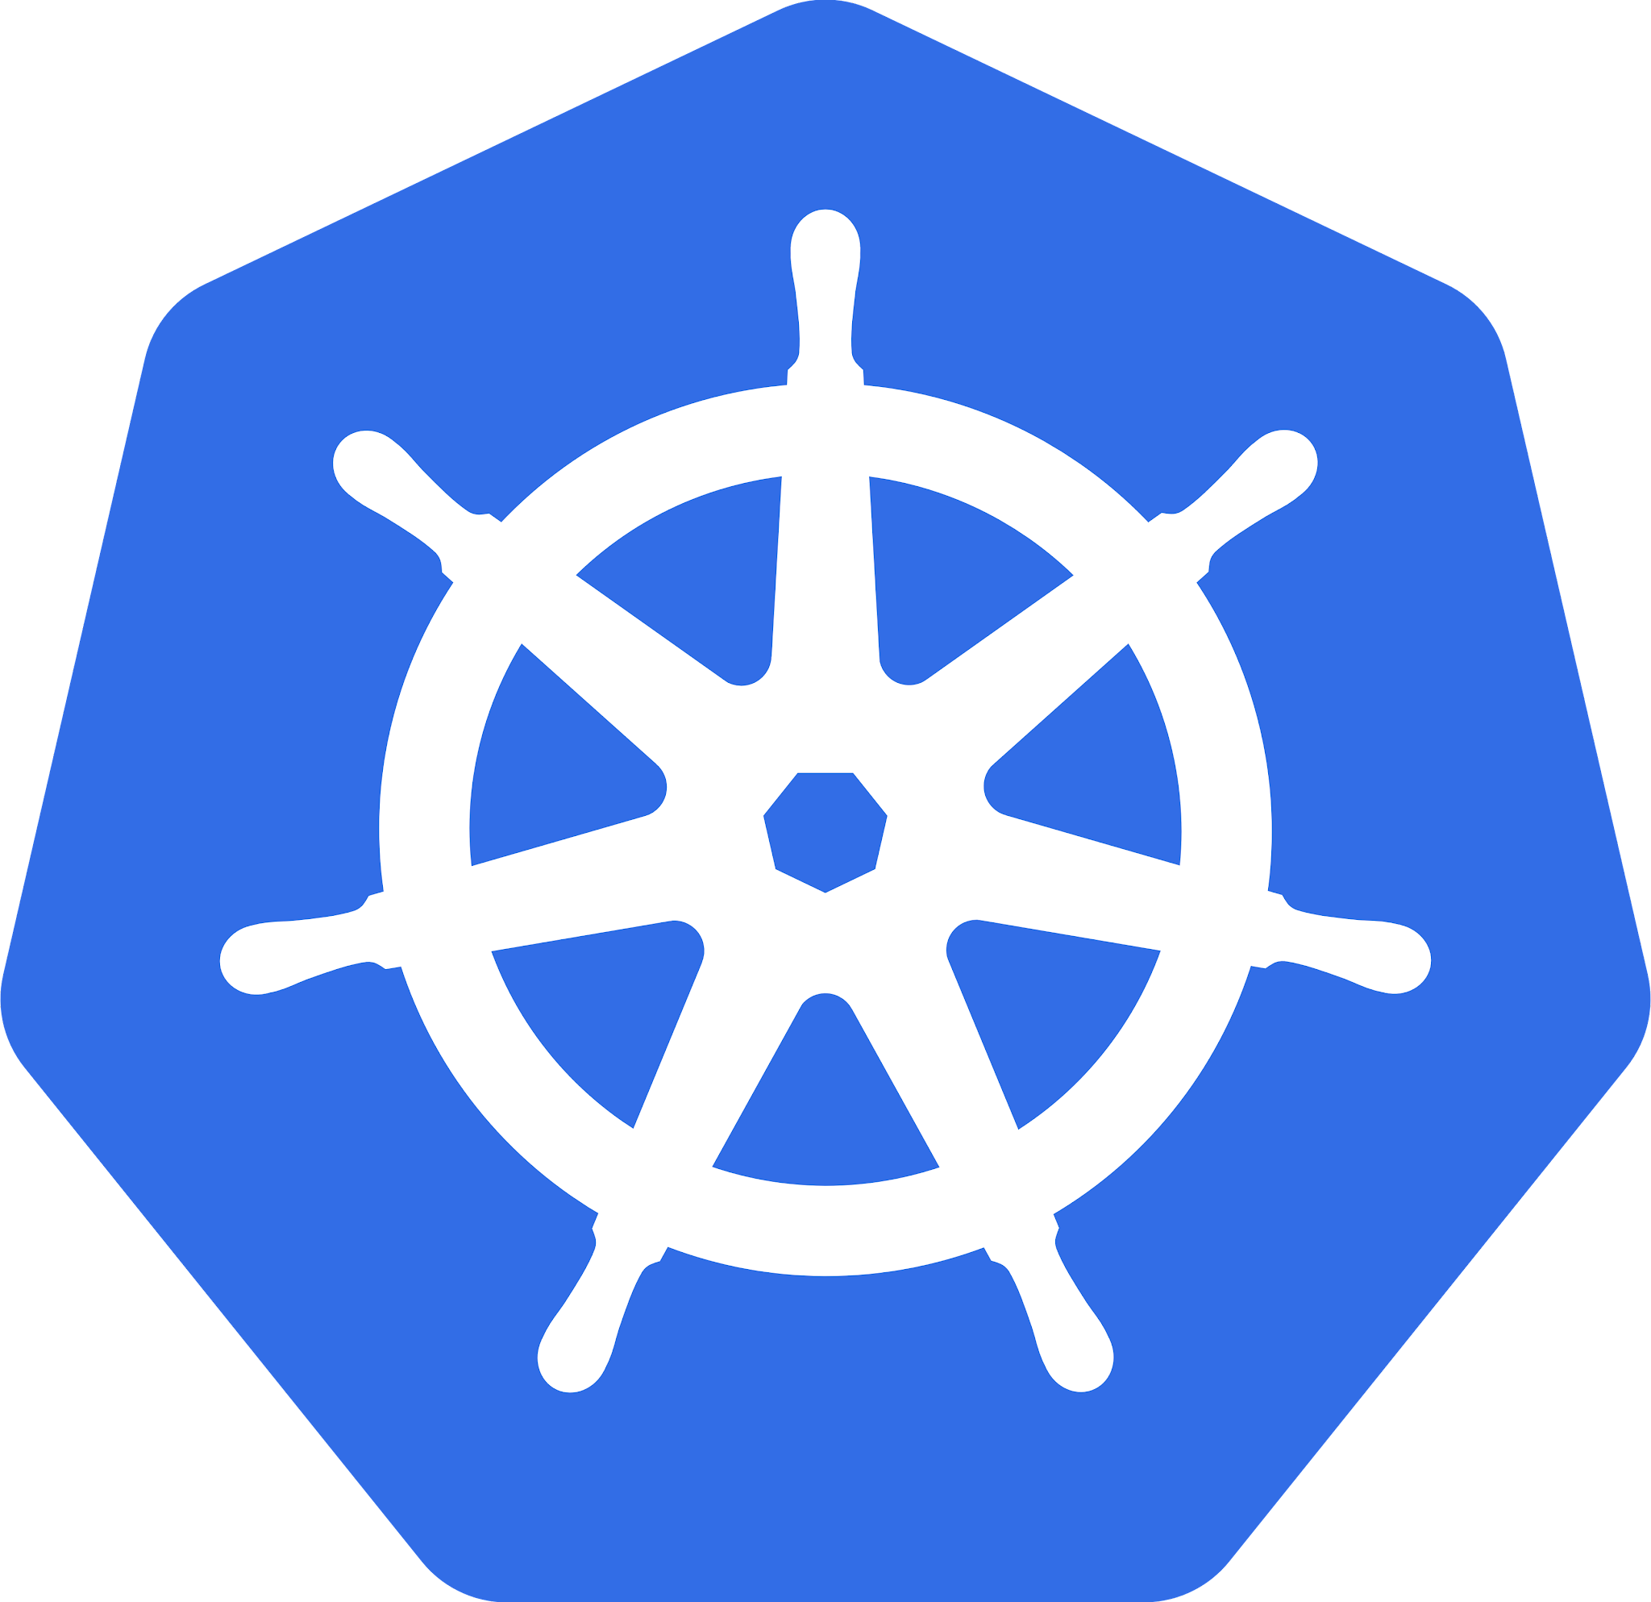
Unravelling Kubernetes Services.
With Ghanatava Vashu Thakaran

Slide 2
Content
What is kubernetes?
Kubernetes architecture overview.
The problem with pods.
Kubernetes services.
Endpoint objects and Endpoint Slices
Types of Services
Service registration
Service Discovery

Slide 3
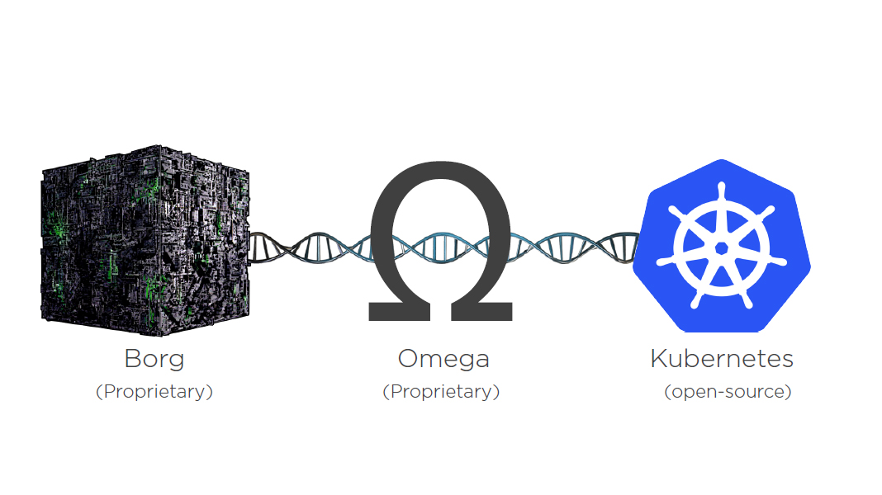
What is Kubernetes?
Kubernetes also known as K8s, is an open-source system for automating deployment, scaling, and management of containerized applications.
Kubernetes was born at google for managing containers. Kubernetes evolved from Borg and Omega which existed before.

Slide 4
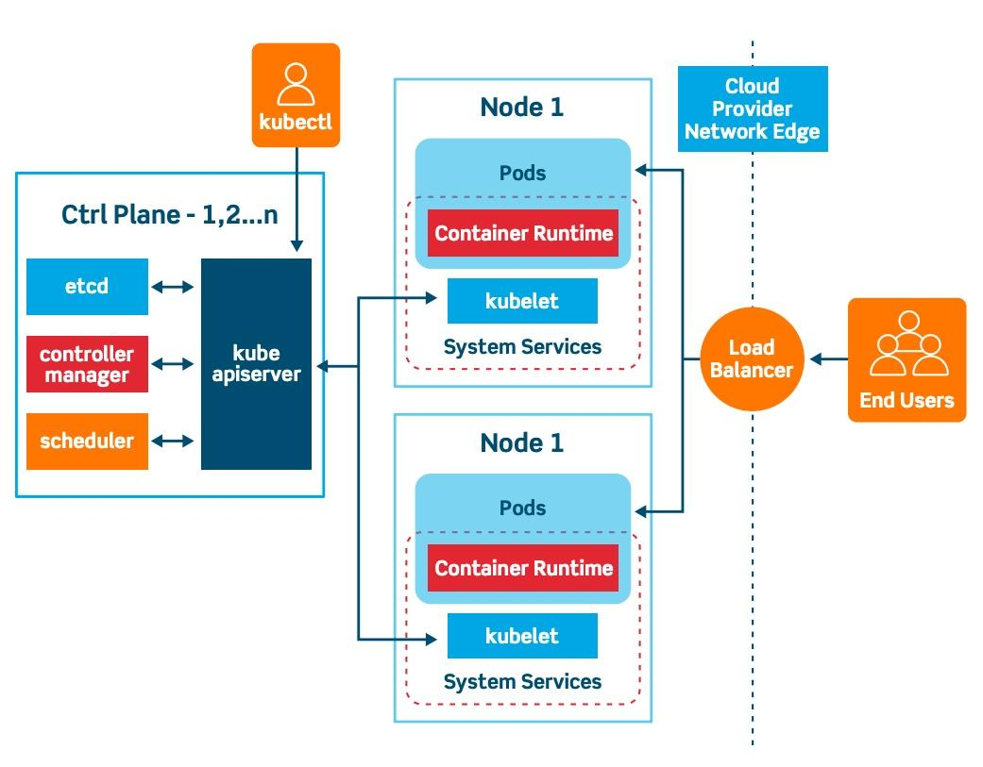

Slide 5
The problem with Pods
Pods are ephemeral. They are created, get deleted, get crashed , get replaced and more.
Pods are unreliable as every new pod will have a new endpoint(ip and port)
We need something stable to ensure smooth communication without keep updating pod ips everytime a pod is replaced.

Slide 6
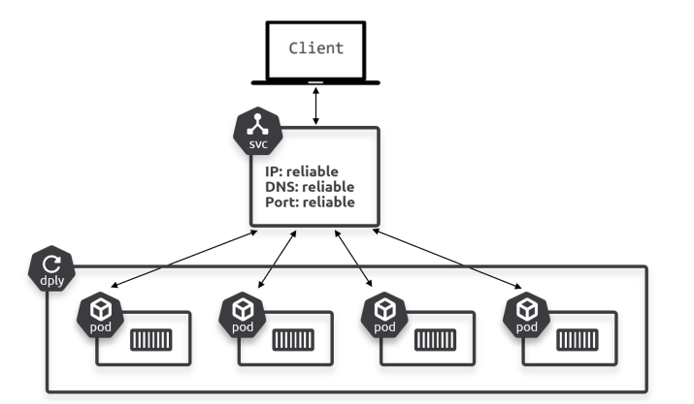
Services
Service is a k8s object which provides a stable and reliable networking for pods.
Service observes the changes and updates its list of healthy Pods it sends traffic to. But it never changes its stable IP, DNS, and port.

Slide 7
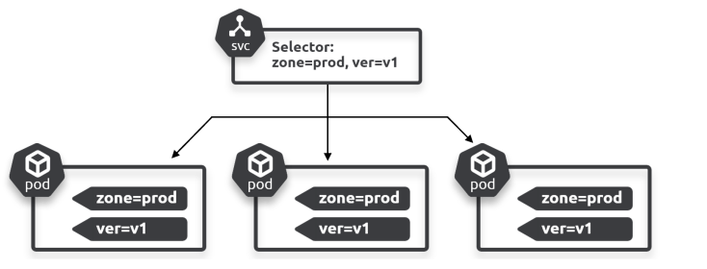
Services
Services are loosely coupled to pods using selector and labels.

Slide 8
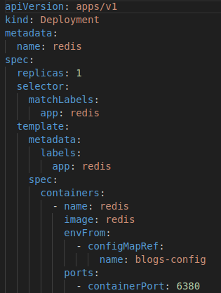
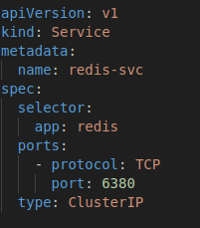
Services
This service selects all pods labelled app: redis
kubectl get svc
Or
kubectl get services

Slide 9
Endpoints objects and Endpoint slices
Services dynamically update the list of healthy matching Pods through a combination of label selection and a construct called an Endpoints object.
Every Service gets its own Endpoints object with the same name as the Service. This holds a list of all the Pods the Service matches and is dynamically updated.
You can see the endpoints with normal kubectl command.
$ kubectl get endpoints

Slide 10
Endpoint objects and Endpoint slices
The problem with Endpoint objects is, every time you add or remove a Pod from behind the Service, the entire Endpoints object gets updated, sent across the network, and consumed by every node.
K8s introduced Endpoint slices to slice up the large monolithic Endpoint objects into smaller consumable slices
By default Endpoint slices contain a hundred endpoints each.
$ kubectl get endpointslices

Slide 11
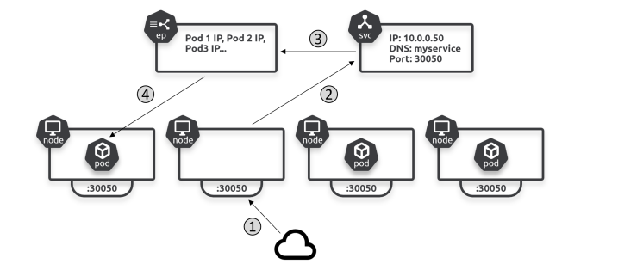
Endpoint objects and Endpoint Slices

Slide 12
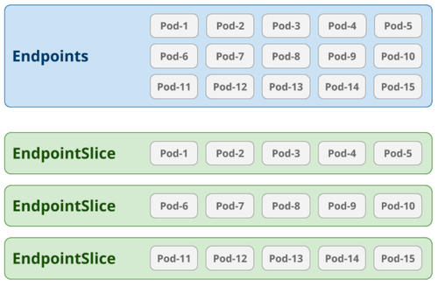
Endpoint objects and Endpoint slices

Slide 13
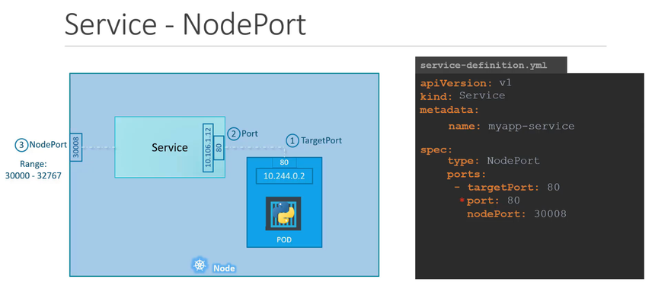
Types of Services

Slide 14
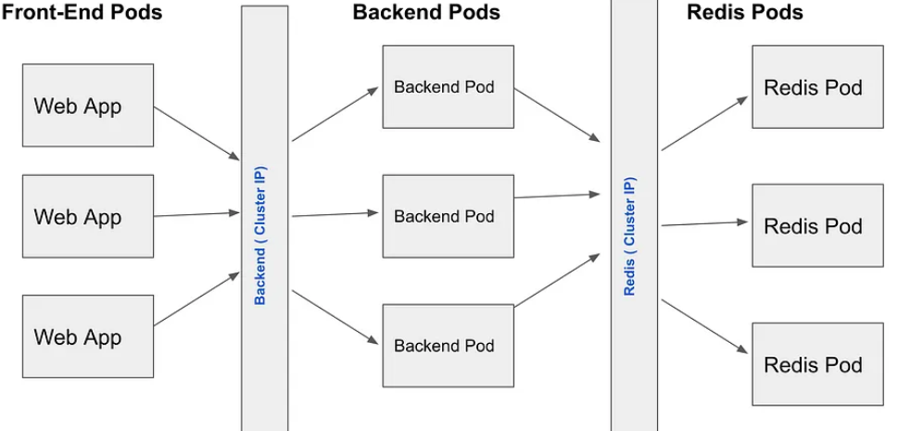
Types of Services

Slide 15
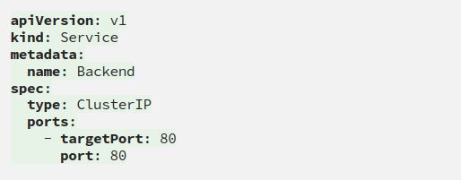
Types of Services

Slide 16
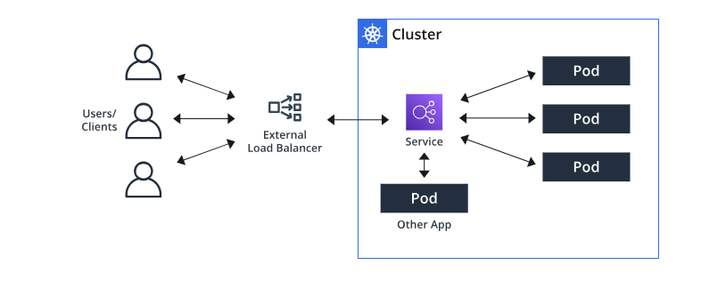
Types of Services

Slide 17
Service Registration
Kubernetes uses its internal DNS as a service registry.
All Kubernetes Services are automatically registered with DNS.
For this to work, Kubernetes provides a well-known internal DNS service that we usually call the “cluster DNS”.
It’s implemented in the kube-system Namespace as a set of Pods managed by a Deployment called coredns and fronted by a Service called kube-dns.
$ kubectl get pods -n kube-system -l k8s-app=kube-dns
$ kubectl get svc -n kube-system -l k8s-app=kube-dns

Slide 18
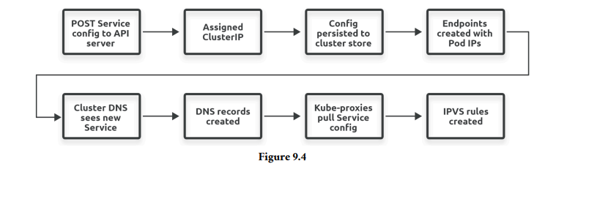
Service Registration

Slide 19
Service Registration
The process of service registration looks like this (exact flow might slightly differ):
1. You post a new Service manifest to the API server
2. The request is authenticated, authorized, and subjected to admission policies
3. The Service is allocated a stable virtual IP address called a ClusterIP
4. An Endpoints object (or EndpointSlice) is created to hold a list of healthy Pods matching the Service’s label selector
5. The Pod network is configured to handle traffic sent to the ClusterIP
6. The Service’s name and IP are registered with the cluster DNS

Slide 20
Service Registration
The kube-proxy agent on every node is watching the API server for new Endpoints/EndpointSlice objects. When it sees one, it creates local networking rules on all worker nodes to redirect ClusterIP traffic to Pod IPs. In modern Linux-based Kubernetes clusters, the technology used to create these rules is the Linux IP Virtual Server (IPVS). Older versions used iptables.

Slide 21
Service Discovery
For service discovery to work, apps need to know both of the following.
The name of the Service fronting the apps they want to connect to
How to convert the name to an IP address
Application developers are responsible for point 1. They need to code apps with the names of Services fronting the other apps they want to consume.
Kubernetes takes care of point 2, converting the name to an IP.

Slide 22
Service Discovery
Kubernetes automatically configures every container so it can find and use the cluster DNS to convert Service names to IPs. It does this by populating every container’s /etc/resolv.conf file with the IP address of the cluster DNS Service as well as any search domains that should be appended to unqualified names.
An “unqualified name” is a short name such as ent. Appending a search domain converts it to a fully qualified domain name (FQDN) such as ent.default.svc.cluster.local.

Slide 23
Service Discovery
With what you’ve learned so far, let’s talk through the process of the Pods in the one app sending requests to the other app. The process is as follows.
Know the name of the remote app (Service name)
Name resolution (service discovery)
Network routing

Slide 24
Service Discovery
Some network magic, ClusterIPs are on a “special” network called the service network, and there are no routes to it! This means containers send all ClusterIP traffic to their default gateway.
The container’s default gateway sends the traffic to the node it’s running on. The node doesn’t have a route to the service network either, so it sends it to its own default gateway. Doing this causes the traffic to be processed by the node’s kernel, which is where the magic happens…

Slide 25
Service Discovery
Every Kubernetes node runs a system service called kube-proxy that implements a controller watching the API server for new Services and Endpoints objects. When it sees them, it creates local IPVS rules telling the node to intercept traffic destined for the Service’s ClusterIP and forward it to individual Pod IPs.
Kubernetes originally used iptables to do this trapping and load-balancing. However, it was replaced by IPVS in Kubernetes 1.11. The is because IPVS is a high-performance kernel-based L4 load-balancer that scales better than iptables and implements better load-balancing.

Slide 26
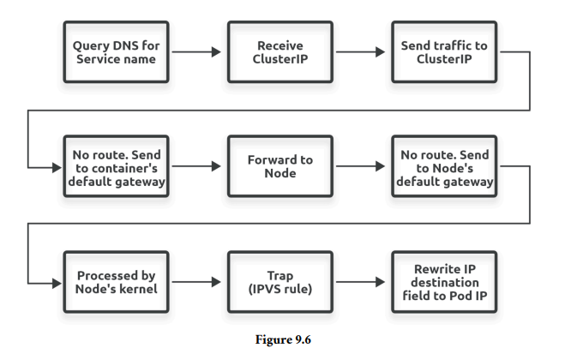
Service Discovery

Slide 27

Thank You

Slide 28

A little bit about myself
Name: Ghanatava Vashu Thakaran
Member @FOSSCUK
Learning DevOps
Areas of interest
  K8s
  Networks
  CoreDNS
Twitter: @GThakaran
Linkedin: @ghanatava
Github: @ghanatava
Hashnode: @ghanatava.hashnode.dev

