Slide 1


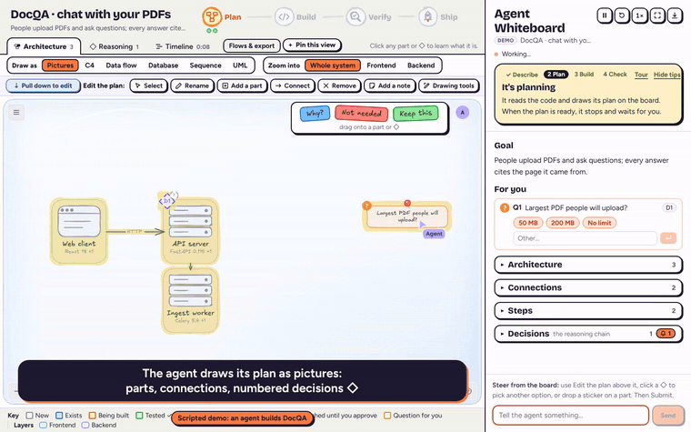
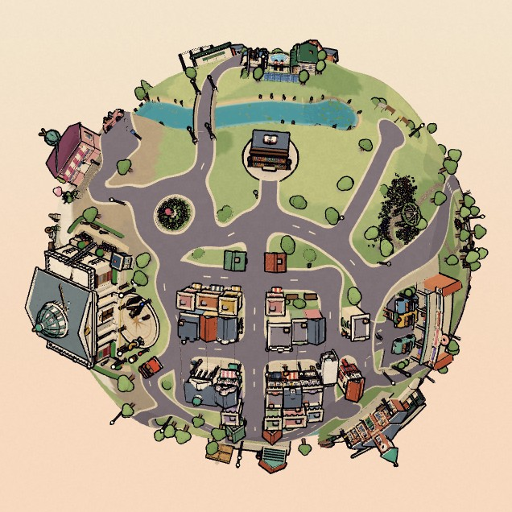




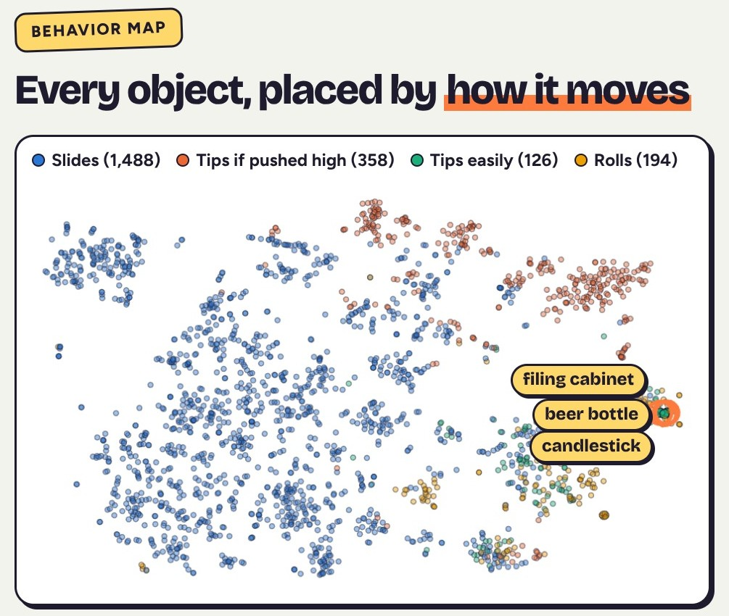
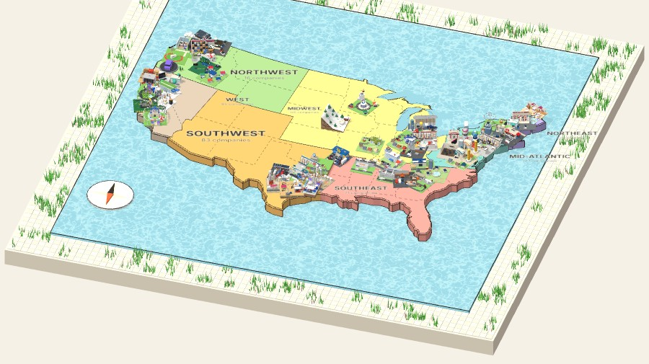

I lead physics-based AI at MIT Lincoln Laboratory, and I build playful software on the side.
Notes:
Day job: I was the first AI hire in my group at MIT Lincoln Laboratory and grew CADME, which turns engineering drawings into physics-verified CAD, into a government program of record. Before that I built an enterprise AI product at JPMorgan Chase. On the side: Agent Whiteboard has a coding agent draw its plan and decisions so you can steer it; Behavior Search finds 3D objects by how they move in simulation; QR Compass and The Vanishing Gallery are 3D web worlds I built.

