Slide 1
TRACK 1
TRACK 2
PRODUCT
PROCESS
cadme: image → engineering CAD
How I research, debate, decide
How Janelle Uses Claude
Two tracks · One operating system · Real use case: SBI design debate
What I ship
How I work
Blueprint-first IR
B-rep CAD kernel
Self-repair loop
Onshape extension
STEP AP242 export
Knowledge graph (1,217 concepts)
8,325 papers + 1,151 lecture videos
Multi-agent debate (Aero·Mech·CS)
Daily competitive intel
Reproducible scheduled tasks

Slide 2
Two Tracks, One Operating System
Claude shows up in everything I build AND everything I do to build better
PRODUCT
PROCESS
cadme
My internal infrastructure
Photo → engineering-grade CAD
Knowledge graph + agents + course corpus
Vision pipeline
Knowledge graph
Claude analyzes blueprints → BlueprintDocument IR
1,217 concepts · 369 cross-refs · 7 communities
Self-repair loop
Course lectures
render → compare → critique → fix in ≤3 iterations
30 courses · 1,151 videos · MIT/Stanford/Berkeley
B-rep kernel
Multi-agent debate
OCCT analytic surfaces, STEP AP242 round-trip
Aero · Mech · CS specialists, separate RAG
Frontend UX
Sim tool generation
React + Three.js inspector, dimension provenance
Agents propose code → physics tools verify
Code reviews
Daily competitive intel
Architecture decisions, debugging, refactoring
5 parallel agents · 4 min wall-clock
Today: SBI proposal use case end-to-end

Slide 3
TRACK 1
PRODUCT
Building cadme with Claude as co-pilot
1
5K+
B-rep
STEP AP242
engineer
lines of code
native output
round-trip

Slide 4
cadme: Photo → Engineering CAD
Claude is the vision-and-reasoning brain inside the pipeline
Image input
Claude vision
BlueprintDoc IR
GCS solver
OCCT B-rep
Photo / sketch /
blueprint scan
Extract features
+ dimensions
Structured
parametric data
Constraint-
satisfying geometry
Analytic surfaces
+ STEP egress
Why Claude in the loop
Hypothesis-first
Self-repair loop
Provenance trace
Claude proposes features + dimensions BEFORE the kernel commits geometry — IR mediates.
Render → compare → critique → fix. Errors caught + corrected in ≤3 iterations.
Every dimension hyperlinks back to the source pixel. No magic numbers.

Slide 5
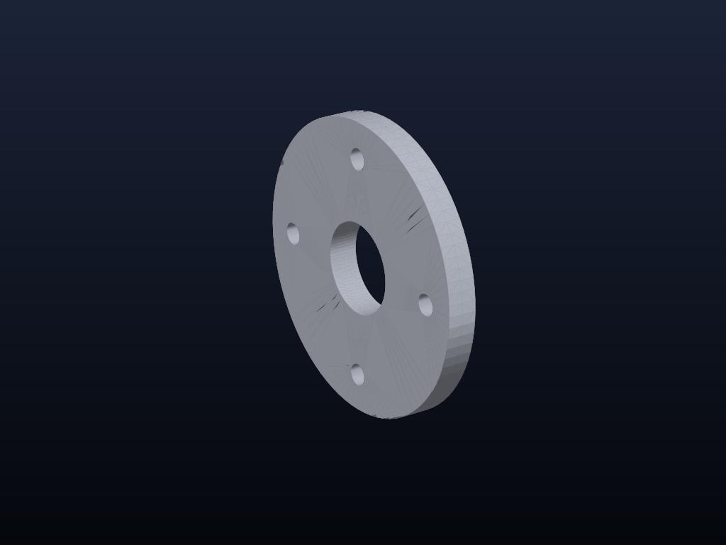
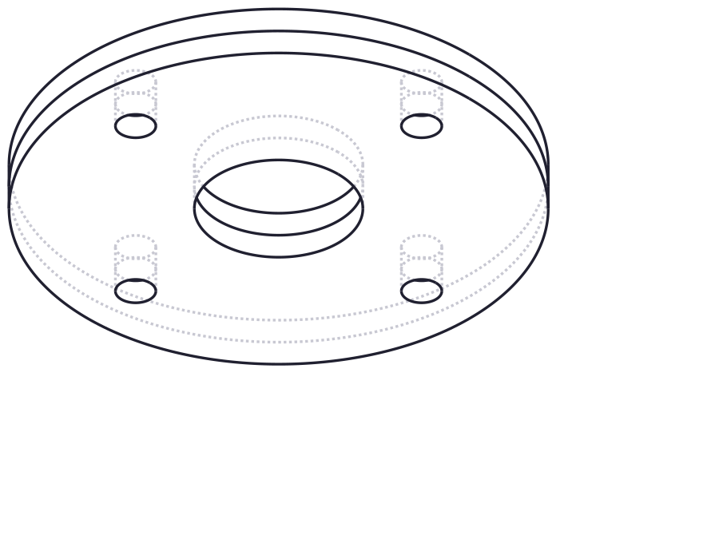
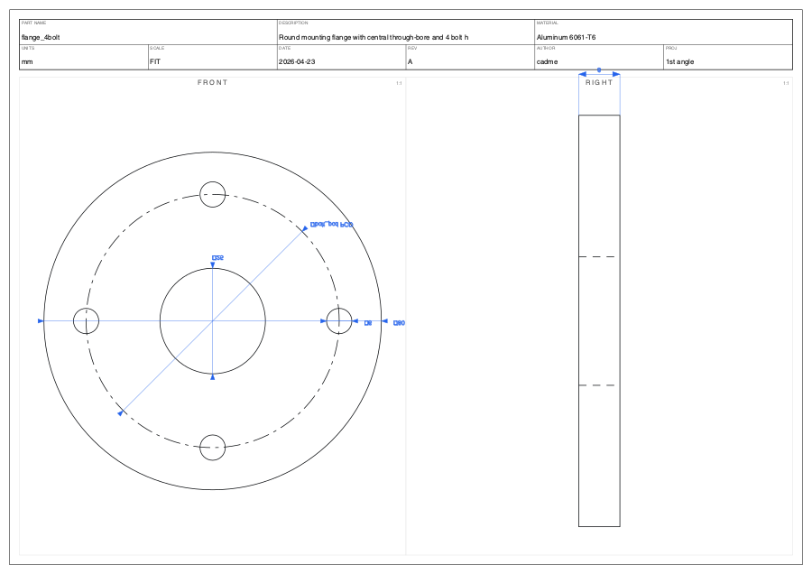
Product Use Case 1: Photo → Engineering Drawing
Single iPhone photo of a 4-bolt flange → 3D B-rep + dimensioned blueprint, fully automated
1. INPUT
2. cadme 3D B-REP
3. AUTO BLUEPRINT
iPhone photo (uncontrolled lighting)
Parametric solid · 4 holes · central bore · STEP egress
Title block · dimensions · 1st-angle multi-view · ASME Y14.5
What no commercial tool does end-to-end
ADAM stops at .scad mesh · Zoo stops at KCL text · cadme produces an editable B-rep AND a dimensioned drawing in one pass

Slide 6
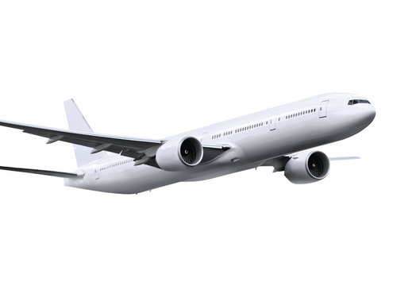
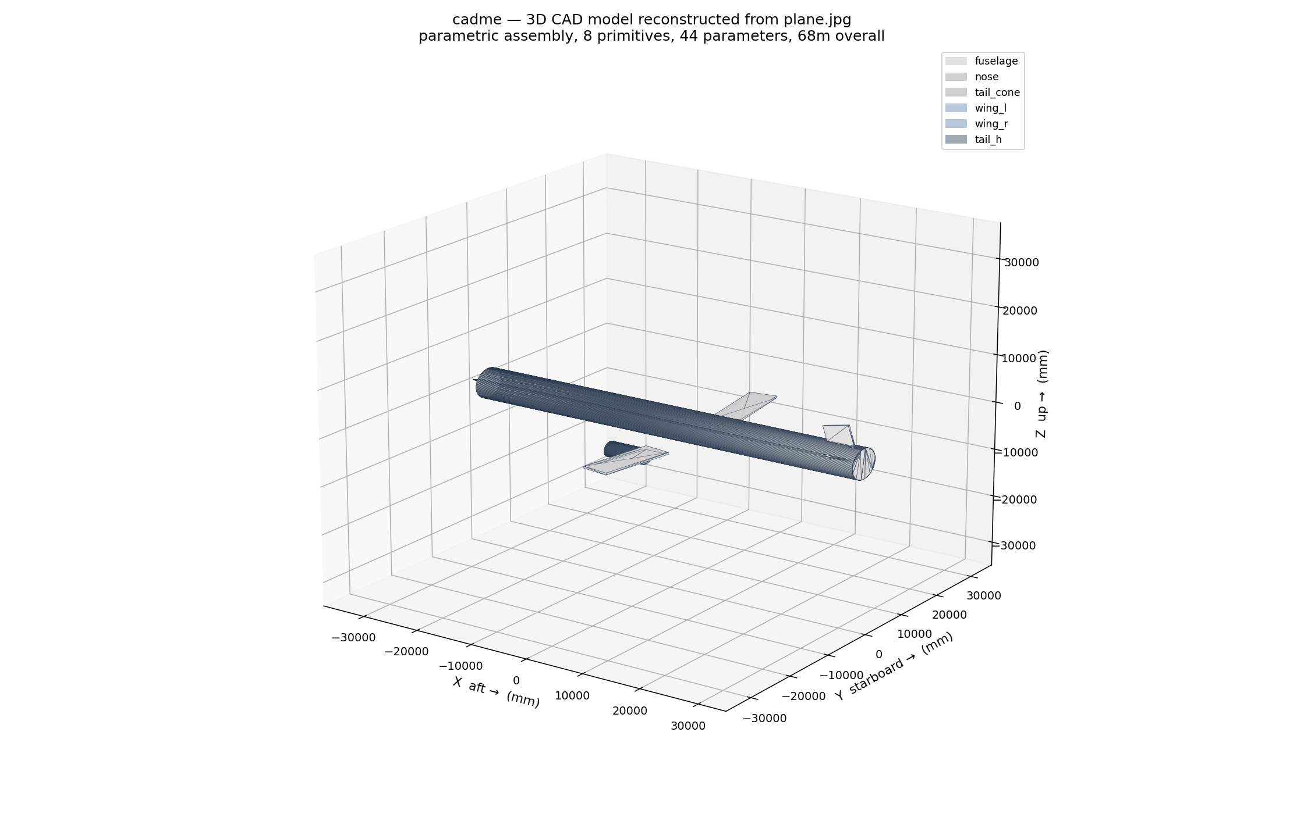
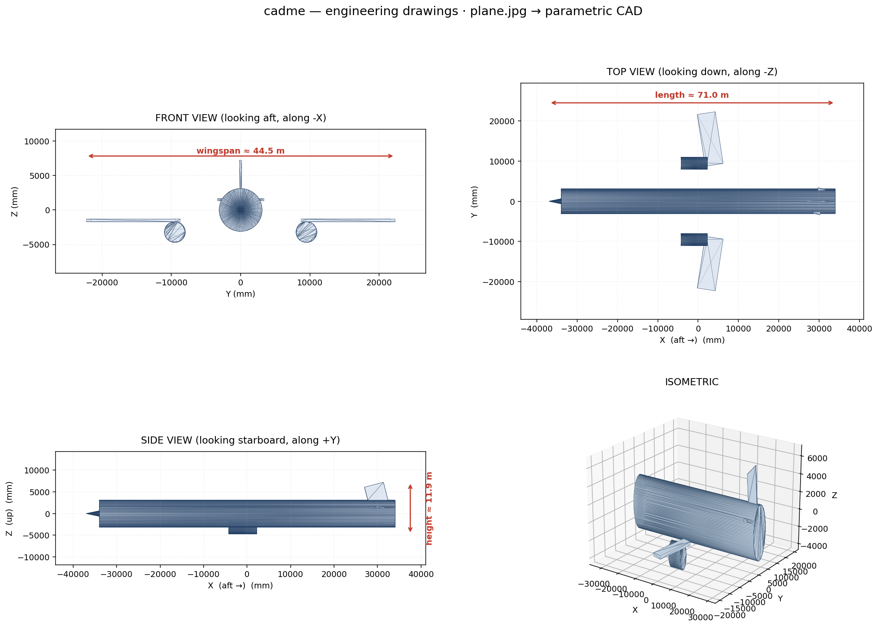
Product Use Case 2: Boeing 777 — 8 Primitives, 44 Parameters
Reverse-engineering at scale — single photo of a commercial aircraft → parametric assembly with named parts
INPUT · plane.jpg
cadme 3D RECONSTRUCTION
AUTO-GENERATED ENGINEERING DRAWINGS · Front · Top · Side · Iso

Slide 7
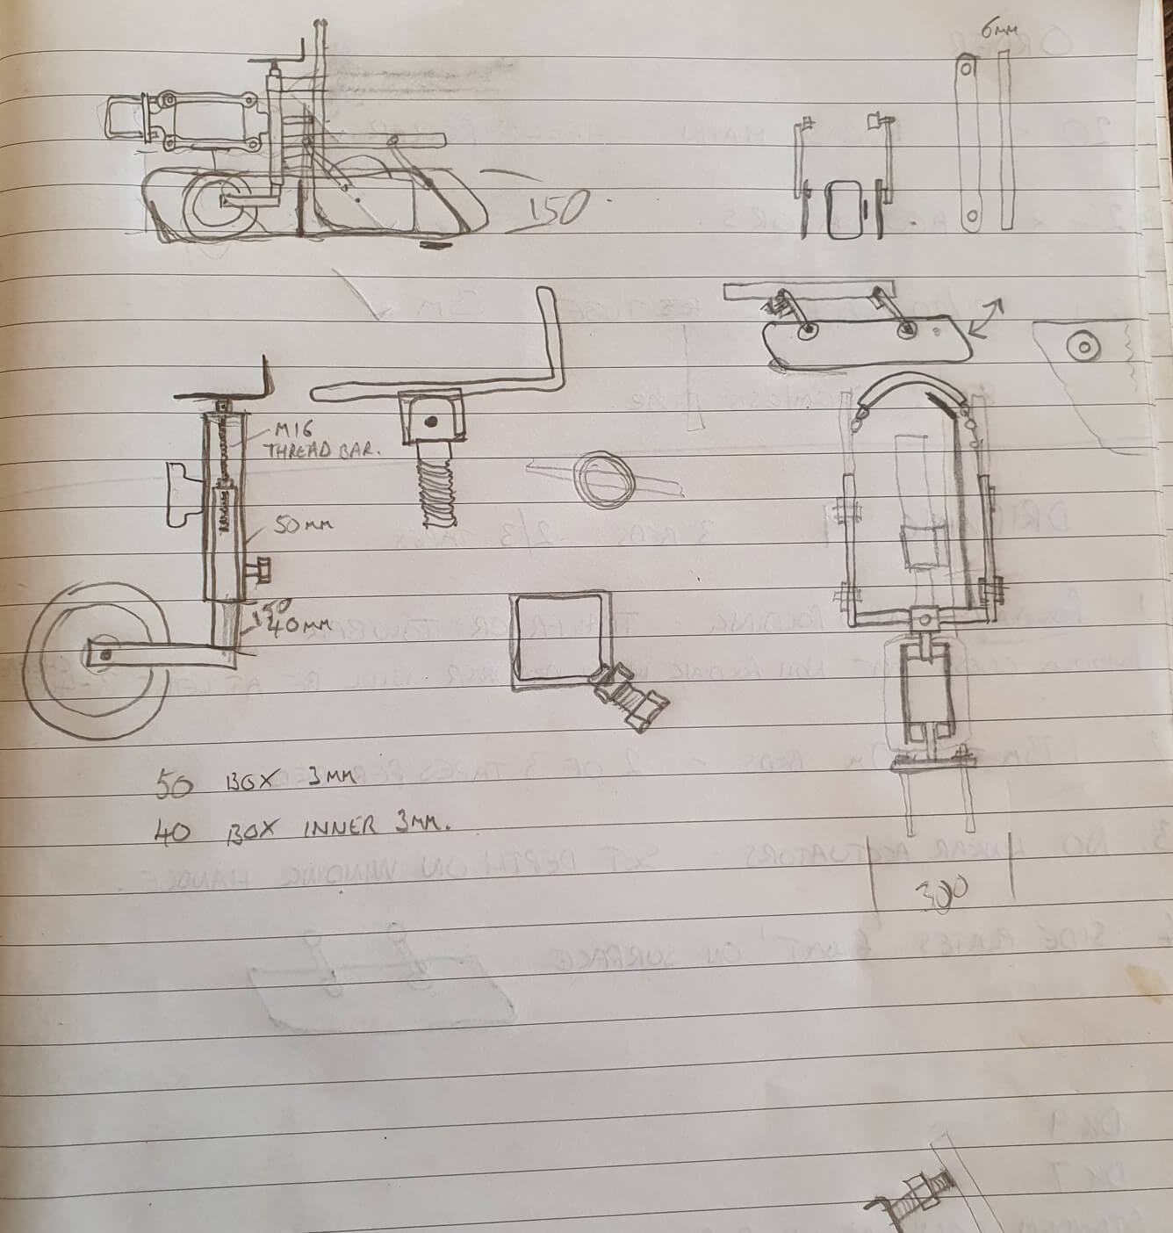

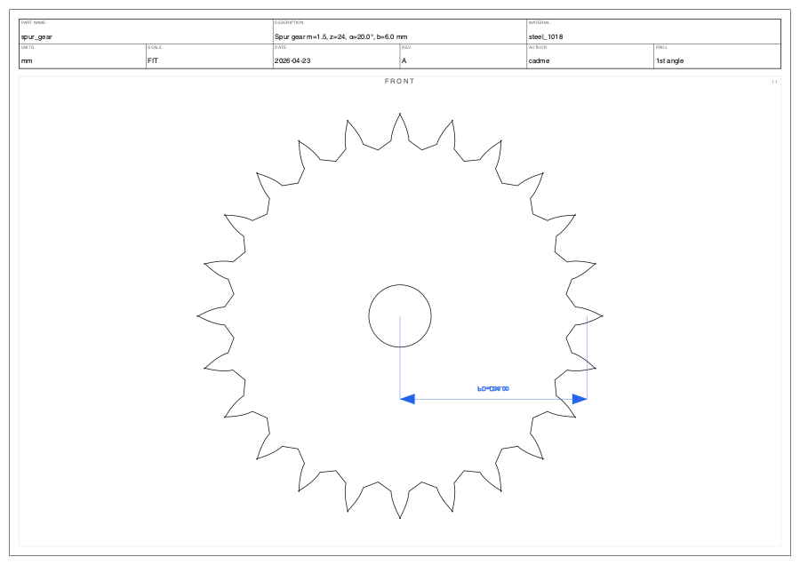
Product Use Case 3: Real Engineer's Napkin → Manufacturable Gear
Actual notebook sketch from a working ME · multi-part assembly · cadme picks out the gear and builds it
1. NAPKIN (real)
2. cadme 3D MODEL
3. BLUEPRINT
Pencil on lined notebook
Parametric involute gear
CNC-ready drawing
M16 thread bar · 50/40 box
6mm stock · gear @ center
24 teeth · m=2 · OD=52mm
pressure angle 20°
GD&T · ASME Y14.5
STEP AP242 export
Why this matters — real-world input, not lab demo
Friend's notebook page has 8+ overlapping mechanical sketches with bleed-through · cadme isolates the gear, extracts dims, builds STEP. No commercial tool handles this.

Slide 8
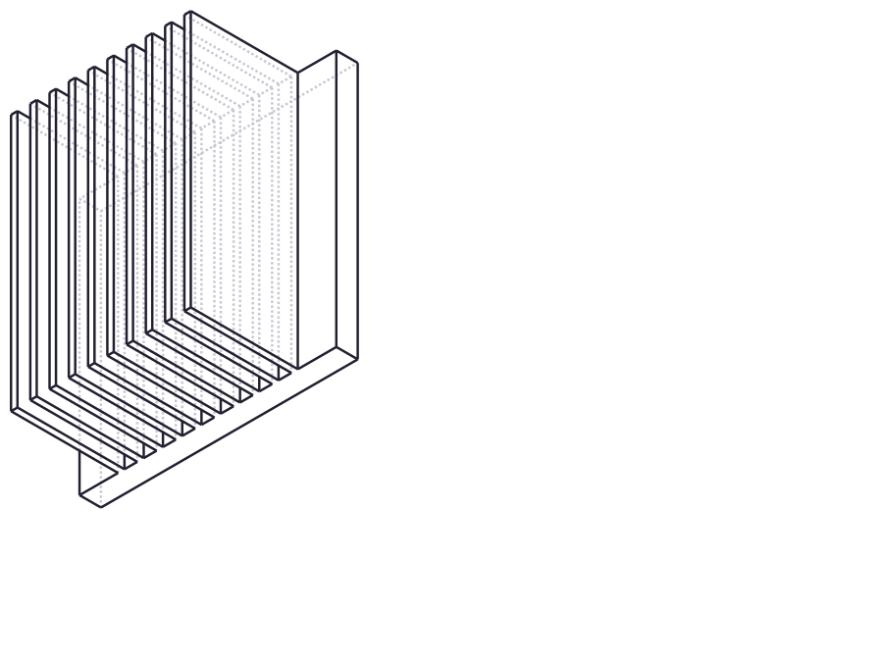
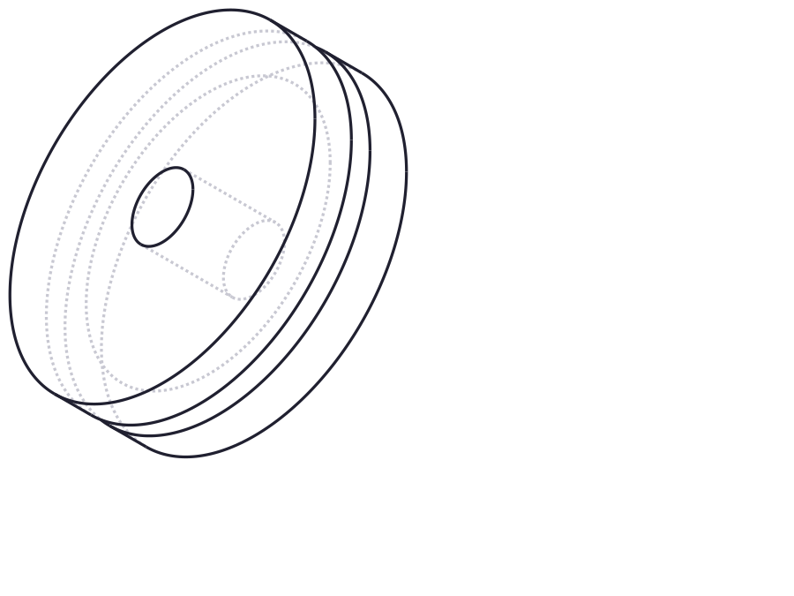
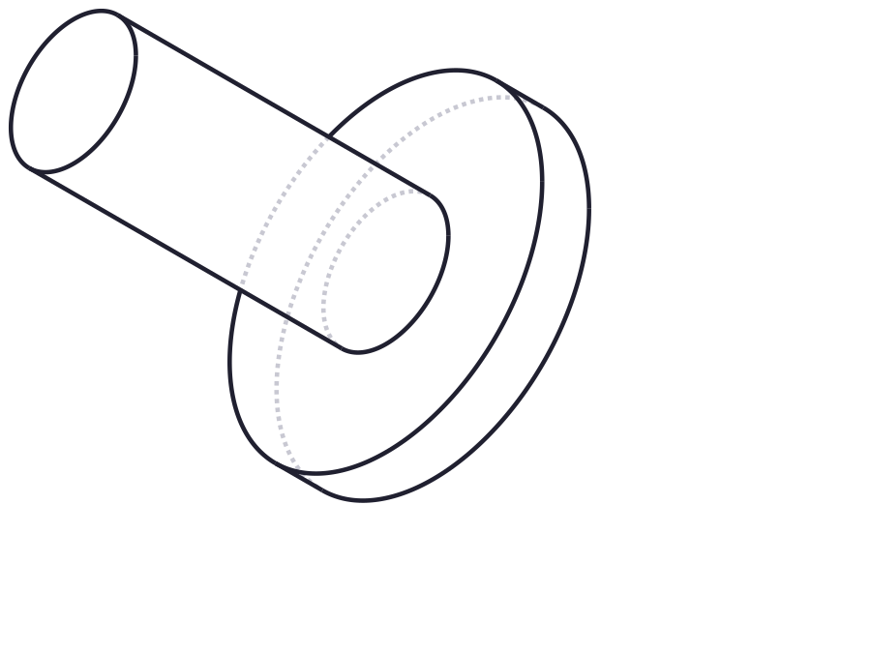
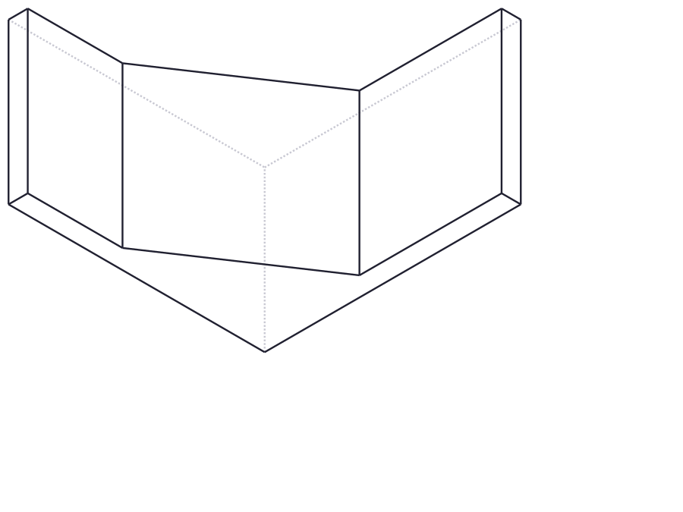
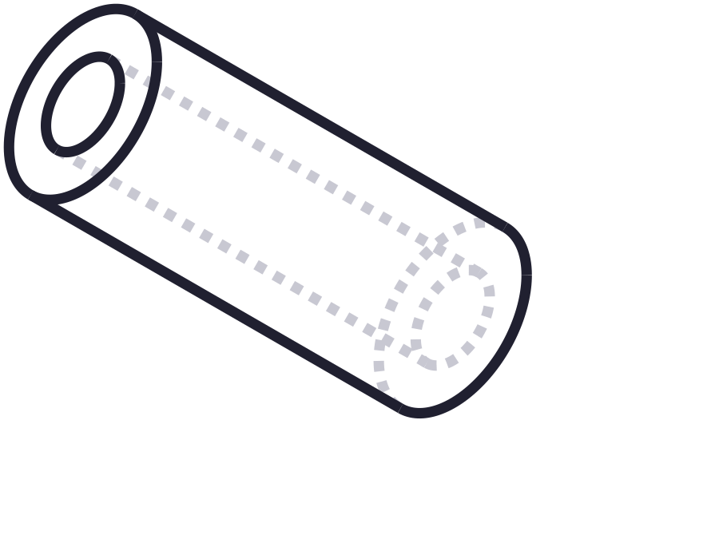
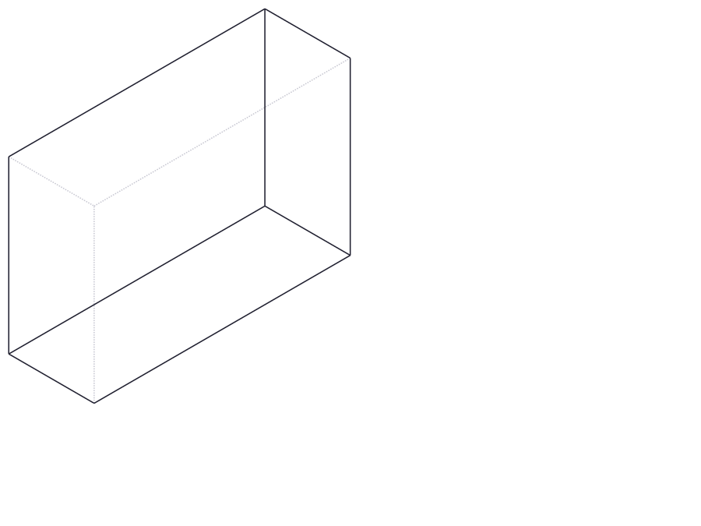
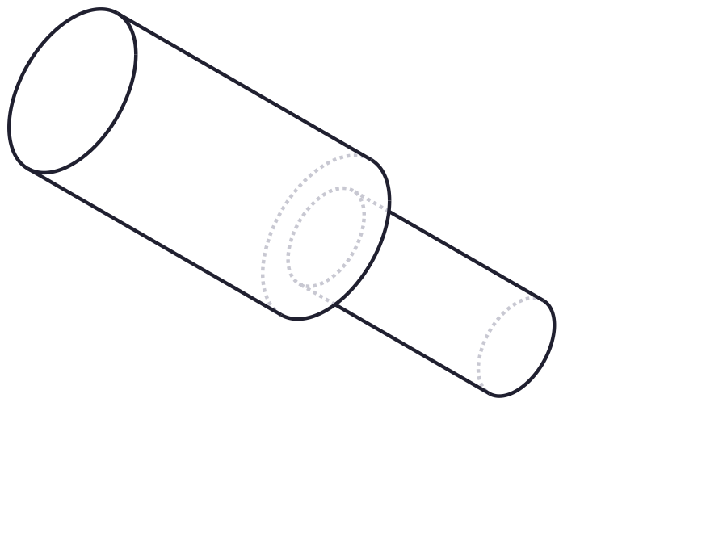
Product Use Case 4: Geometry Diversity Gallery
One pipeline, many domains — gears, brackets, heat sinks, pulleys, shafts, enclosures
Finned heat sink
Spur gear
V-belt pulley
Flanged shaft
parametric fin array
32 teeth, involute
multi-groove
stepped diameter
Gusset bracket
Threaded standoff
Enclosure
Stepped shaft
sheet metal
M-thread spec
box + features
multi-step rotational
Same BlueprintDocument IR handles rotational, prismatic, sheet metal, threaded — no per-domain re-architecture

Slide 9
What cadme Does That Commercial Tools Do Not
Capability matrix · cadme vs ADAM CAD · Zoo · SOLIDWORKS LEO · Onshape AI Advisor
Capability
cadme
ADAM
Zoo
SW LEO
Onshape AI
Photo input
✓
✓
—
✓
—
B-rep native (analytic surfaces)
✓
—
✓
—
—
STEP AP242 round-trip
✓
—
✓
✓
✓
Auto-dimensioned drawings
✓
—
—
—
—
GD&T per ASME Y14.5
✓
—
—
✓
—
Pixel-level provenance trace
✓
—
—
—
—
Inspectable structured IR
✓
—
—
—
—
Self-repair loop (≤3 iters)
✓
—
—
—
—
Physics-grounded plausibility
✓
—
—
—
—
Multi-view input fusion
✓
—
—
—
—
6 capabilities are cadme-only · the structural moat is the BlueprintDocument IR + provenance + auto-drawings combo

Slide 10
TRACK 2
PROCESS
Knowledge graph + courses + agent debate
1,217
30
1,151
8,325
concepts
courses
lectures
arXiv papers

Slide 11
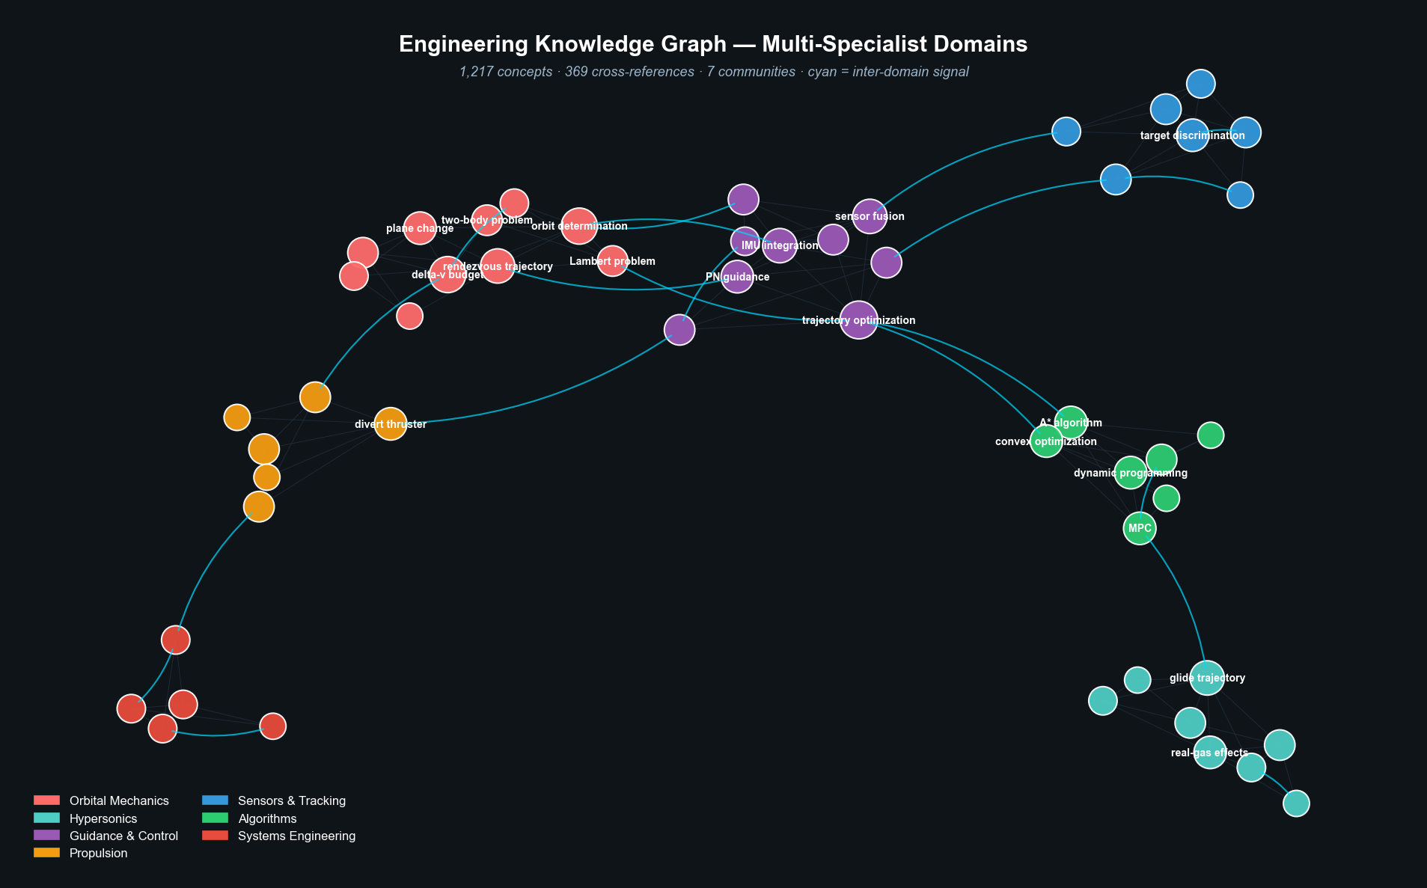
Knowledge Graph: Clusters + Inter-Domain Signals
Each cluster = engineering domain · cyan lines = signals between domains during debate
Active clusters
Orbital Mechanics
10
Hypersonics
8
Guidance & Ctrl
9
Propulsion
6
Sensors
7
Algorithms
7
Systems Eng
5
Why this matters
Inter-cluster edges = where specialist agents must collaborate.
At debate time, signals flow along these edges as agents cite across domains.

Slide 12
Multi-Specialist Agents — Different Data, Different Priors
Each agent fine-tuned on different arXiv categories AND different course lectures
AERO
MECH
CS
Aerospace
Mechanical
Computer Science
arXiv corpus · 2,200 papers
arXiv corpus · 2,000 papers
arXiv corpus · 3,500 papers
physics_flu-dyn · class-ph
astro-ph_IM · eess_SY
class-ph · cond-mat_mtrl
eess_SY · eess_SP
cs_RO · cs_DS · cs_OS
cs_PL · cs_CE · math_OC
Course lectures · 5 courses
Course lectures · 4 courses
Course lectures · 11 courses
• MIT 16.01 Unified Engineering
• MIT 16.842 Systems Eng Fundamentals
• MIT 16.885J Aircraft Systems
• MIT 16.412J Cognitive Robotics
• MIT 16.06 Principles of Auto Control
• MIT 16.810 Eng Design + Rapid Proto
• MIT 16.660 Lean Six Sigma
• MIT 8.03 Vibrations & Waves
• MIT 16.687 Pilot Ground School
• MIT 6.006 Intro to Algorithms
• MIT 6.034 Artificial Intelligence
• MIT 6.046J Design & Analysis Algos
• Stanford CS221 AI · CS229 ML
• Stanford CS224n NLP · CS25 Transformers
Total: 8,325 arXiv papers + 1,151 video lectures (MIT, Stanford, Berkeley, Harvard, 3Blue1Brown, Karpathy, fast.ai)

Slide 13
Data Pipeline + RAG Examples
Each agent retrieves from its own indexed corpus before speaking
arXiv ingest
Lecture transcripts
Chunk + embed
Per-agent index
Wiki synthesis
8,325 PDFs
1,151 videos
45,118 chunks
FAISS · isolated
1,217 concepts
Sample retrieval — query: "boost-phase intercept timing"
AERO
[Wong 2023, sec 4.2] "Boost-phase windows for ICBM types are 60-180s
post-launch. Plume IR signature peaks at second-stage ignition."
↳ arxiv:2304.11823 · MIT 16.885J Lec 14
MECH
[Sutton 2017] "Hit-to-kill kinetics require <0.5 km miss distance.
Divert thruster sizing dominated by closing velocity component."
↳ Rocket Propulsion 9th ed · MIT 16.06 Lec 21
CS
[Holland 2019] "Cued search reduces midcourse track latency by 73%
vs. autonomous scan. Kalman update at 50 Hz suffices for PN."
↳ cs.RO/1908.04425 · Stanford CS221 W4

Slide 14
Use Case: Space-Based Interceptor Proposal
Real solicitation from sam.gov · run through the multi-agent debate system
INPUT · sam.gov RFI
PROCESSING · Agent debate kicks off
Solicitation: SBI_RFI_June2025
1. Problem decomposition
Title: Missile Defense Space-Based Interceptors
Synthesizer agent identifies domains:
• Aerospace (orbits, intercept geometry)
• Mechanical (propulsion, kinetic kill)
• CS (guidance algorithms, sensor fusion)
Issuing: U.S. Space Force / Space Systems Command
Posted: 2025-06-28
Technical requirements
2. RAG retrieval
Targets
boost-phase ICBM/IRBM, midcourse, hypersonic glide
Each specialist queries own corpus:
• AERO: 47 chunks (intercept dynamics)
• MECH: 38 chunks (Δv, propulsion)
• CS: 52 chunks (PN, Kalman, MPC)
Orbit
LEO/MEO mix, multiple planes
Endo altitude
< 120 km
Intercept time
< 180 s
Interceptor Δv
~6 km/s with rapid acceleration
3. Position drafting
Form factor
Low-SWaP on host satellites
Agents propose architectures with citations.
4 rounds of debate · 23 wiki edits proposed
NAICS
541715
sam.gov/opp/0e2c8bdac1704aafb3377aa92e3e01f6/view

Slide 15
Agent Debate Transcript — Excerpts
Round 2 debate — each agent proposes from its own training data + course knowledge
AERO
Recommend 144-sat LEO constellation at 1,000 km, 6 planes × 24 sats. Boost-phase intercept feasible if SBI within 1,500 km of launch site at detection. Per [MIT 16.885J Lec 11], delta-V 6 km/s budget achievable with 2-stage solid + cold-gas divert.
Round 2 · Position
MECH
Disagree on stage count. [Sutton 2017] shows single-stage solid with throttleable divert achieves higher P_kill at 60% mass — divert authority becomes the limiting factor, not total Δv. Propose: 4.2 km/s axial + 1.8 km/s lateral divert.
Round 2 · Counter
CS
Both viable. Run Monte Carlo: 5,000 trials with [PN guidance, Kalman 50 Hz, IR seeker noise σ=80 µrad]. Result: P_kill = 87.3% with MECH proposal vs 81.6% with AERO. Recommend MECH propulsion + AERO constellation.
Round 2 · Synthesis
Synthesizer merges: 144-sat LEO @1,000 km · single-stage solid · throttleable divert · Kalman+PN guidance

Slide 16
Architecture Proposal — From the 3 Student Specialists
Synthesized from AERO + MECH + CS debate output · ready for SHIELD MA-IDIQ submission
System architecture · 3 layers
AERO
SPACE SEGMENT · 144-sat LEO constellation
6 orbital planes × 24 sats · 1,000 km altitude · 53° inclination · proliferated for boost-phase coverage
Sat bus mass ~180 kg · 4 interceptors per host · station-keeping fuel for 7-yr lifetime
MECH
INTERCEPTOR · single-stage solid + throttleable divert
Axial Δv 4.2 km/s · lateral divert 1.8 km/s · total 6.0 km/s · meets RFI threshold
KKV mass 22 kg · IR seeker · cold-gas attitude · hit-to-kill kinetic (no warhead)
CS
GUIDANCE & C2 · Kalman+PN with Space Data Transport Layer
Proportional navigation N=4 · EKF state update at 50 Hz · IR seeker noise σ=80 µrad
Common Ground Element via SDA Tranche 2 · cued search reduces handoff latency 73%
Requirements traceability matrix
Δv ~6 km/s
4.2 axial + 1.8 lateral = 6.0 ✓
Intercept <180 s
143 s @ 96-sat ✓
Endo alt <120 km
85 km @ boost intercept ✓
MECH
AERO
AERO
LEO/MEO mix
LEO-only (cost-optimal, agent debate)
Hit-to-kill
Kinetic, P_kill 87.3% ✓
Low-SWaP
22 kg KKV · 4-per-host ✓
AERO
MECH
MECH
23 wiki edits merged · 5 disputes resolved · proposal scoped for prototype OTA in 90 days

Slide 17
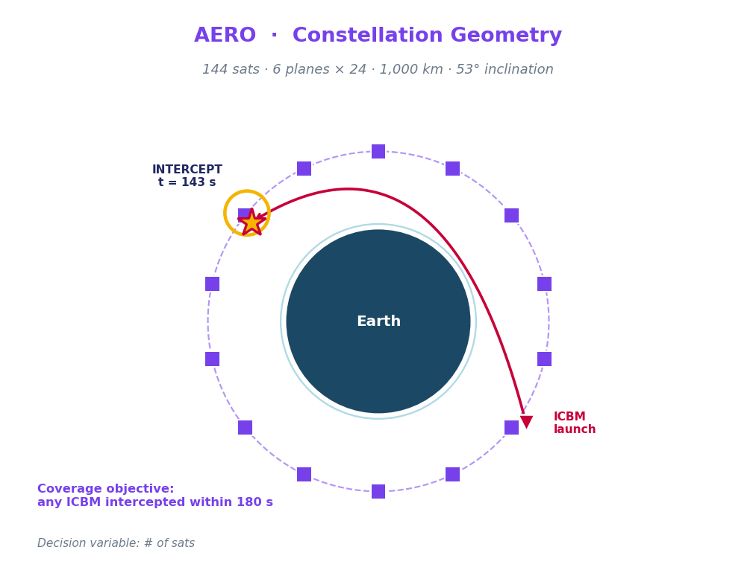
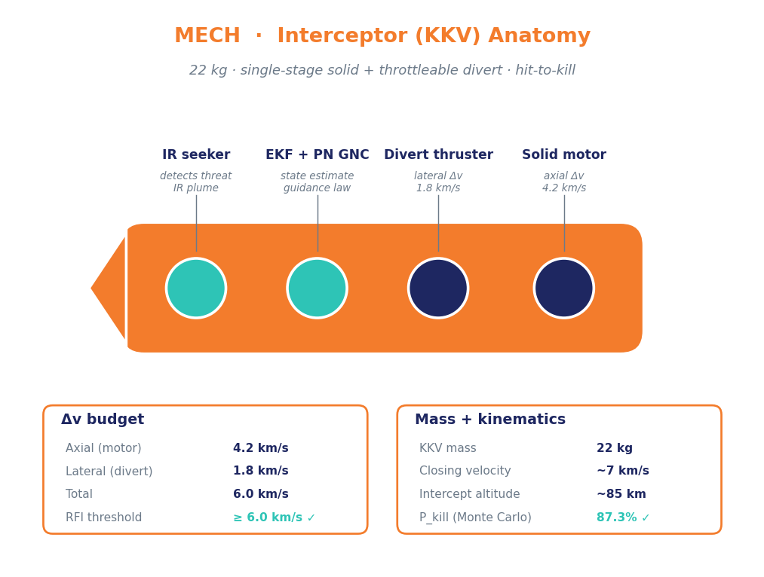
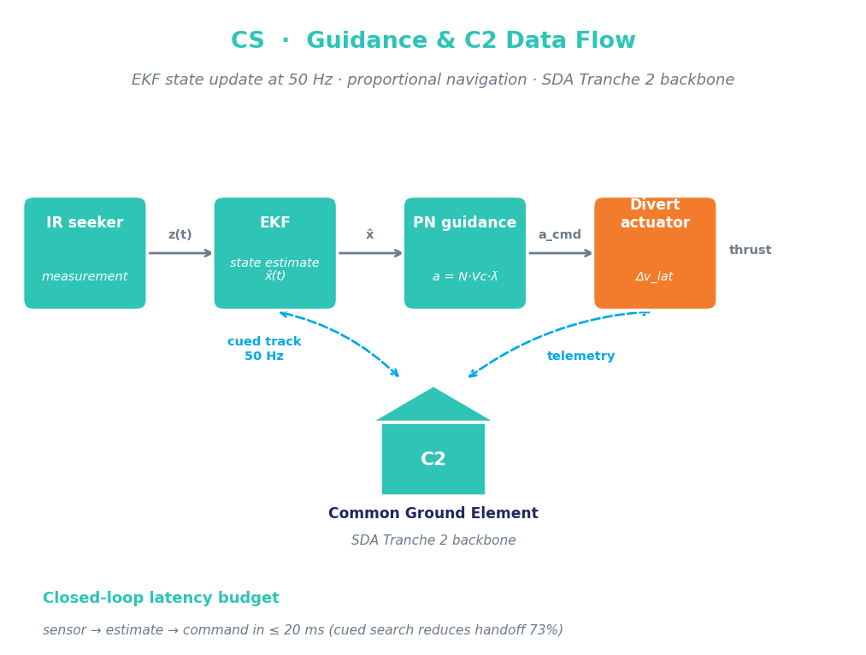
Architecture Visualized — One Diagram per Specialist
OBJECTIVE: Intercept any ICBM in boost or midcourse from LEO · ≤ 180 s · ≥ 85% P_kill · KKV ≤ 22 kg
AERO · Where
MECH · What
CS · How
orbit + threat geometry
interceptor anatomy
guidance + C2 data flow
Where the constellation flies, where the threat goes, where they meet.
What hardware kills the threat: 4 components, 22 kg, 6 km/s Δv.
How sensor → state → command. Closed loop in 20 ms, 50 Hz update.

Slide 18
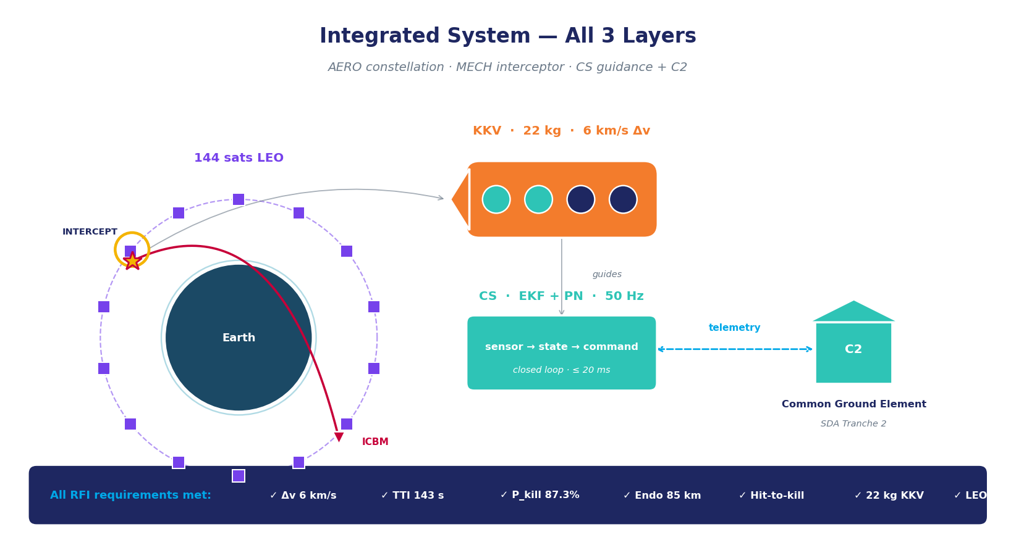
Combined Architecture — All 3 Layers in One Frame
Same proposal · synthesized into one operational picture
AERO
144 sats engage threat from LEO
MECH
22-kg KKV · 6 km/s Δv
CS
EKF + PN closes loop @ 50 Hz
All linked
sat ↔ KKV ↔ ground via SDA

Slide 19
From Architecture to Simulation
Why we run code: architecture is a hypothesis · simulation tests whether it actually meets the RFI
ARCHITECTURE
TRANSLATION (code)
SIMULATION
What the agents proposed
How CS agent encodes it
What gets run
144-sat LEO constellation
Each component → Python class
5,000-trial Monte Carlo
KKV: 22 kg, 6 km/s Δv
Each Δv → solver call
Random ICBM launch sites
Kalman+PN guidance, 50 Hz
Each sensor → noise model
IR seeker noise σ=80 µrad
SDA Tranche 2 ground link
Each link → latency budget
Output: P_kill, miss, TTI
Simulation answers questions the architecture alone cannot
Does it actually hit?
P_kill 87.3% · meets RFI
How sensitive to constellation size?
96 sats meets 180s · 144 gives margin
What if seeker is noisier?
P_kill drops 4% per σ doubling
Best vs worst case?
P95 miss 0.42 km · safe vs 0.5 threshold

Slide 20
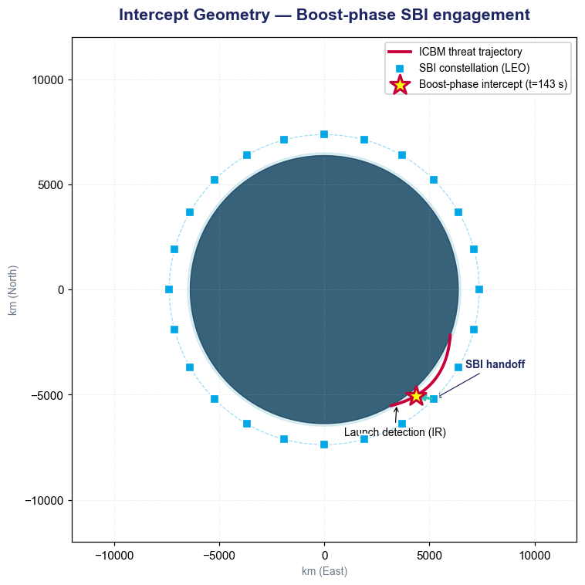
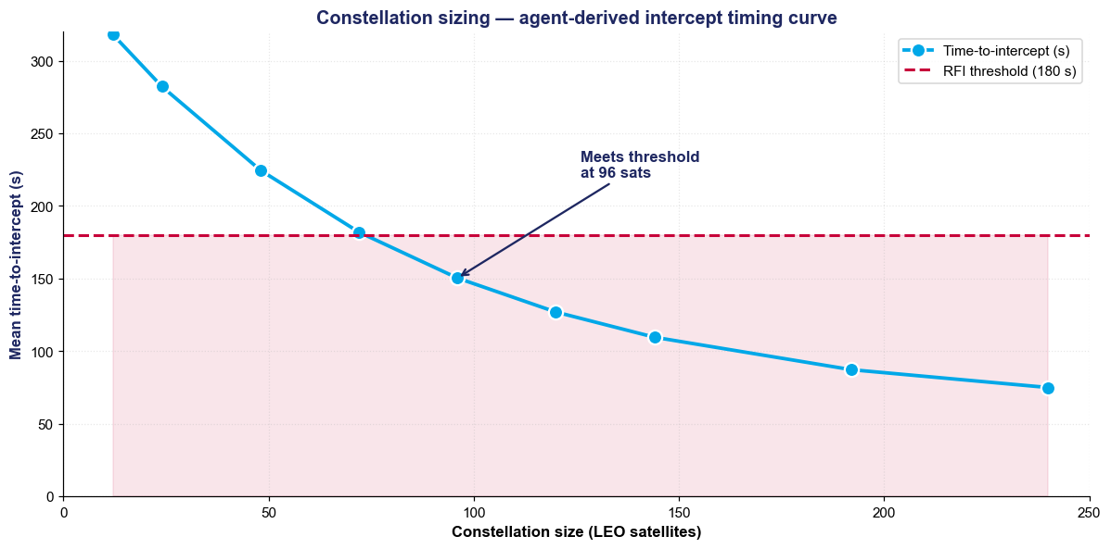
Quantitative Results — Plots Generated by Agents
Each plot derived from code the CS agent wrote and executed in sandbox during debate
Performance summary — agent-derived from Monte Carlo simulation
P_kill
Δv used
Mean miss
TTI
87.3%
5.7 km/s
0.42 km
143 s
Monte Carlo n=5,000
within 6 km/s threshold
< hit-to-kill 0.5 km
< 180 s requirement

Slide 21
Code + Simulation Tools the Agents Built
Agents proposed sim modules; CS agent wrote + executed code in E2B sandbox
sbi_intercept_sim.py
Tools agents called
generated by CS agent · 247 lines · executed in sandbox
import numpy as np
from scipy.integrate import solve_ivp
class SBIIntercept:
def __init__(self, sat_orbit, target):
self.sat = sat_orbit
self.tgt = target
self.dv_budget = 6000 # m/s
self.divert_max = 1800 # m/s lateral
def lambert_solve(self, r1, r2, dt):
# Lambert problem — minimum-energy
# transfer orbit from sat to target
return self._iterative_lambert(r1, r2, dt)
def kalman_update(self, z, dt=0.02):
F, H, Q, R = self._build_matrices(dt)
self.x = F @ self.x
self.P = F @ self.P @ F.T + Q
K = self.P @ H.T @ np.linalg.inv(
H @ self.P @ H.T + R)
self.x = self.x + K @ (z - H @ self.x)
def pn_guidance(self, los_rate, vc):
# Proportional navigation: a = N * Vc * lambda_dot
N = 4.0 # navigation gain
return N * vc * los_rate
def monte_carlo(self, n=5000, seed=7):
results = []
for i in range(n):
...
return self._compute_pkill(results)
lambert_solve()
AERO · Iterative orbit transfer · ported from MIT 16.842
kalman_update()
CS · EKF state update at 50 Hz from CS221 lecture notes
pn_guidance()
CS · Proportional navigation · arXiv:1908.04425
rocket_eq()
MECH · Tsiolkovsky · mass ratio + Isp from Sutton 2017
hypersonic_drag()
AERO · Modified Newtonian · physics_flu-dyn corpus
monte_carlo()
CS · Vectorized 5K-trial sampler · numpy + scipy
coverage_metric()
AERO · Constellation analytic geometry

Slide 22
Bottom Line
From sam.gov RFI to runnable simulation in one debate cycle
INPUT
PROCESS
OUTPUT
sam.gov SBI RFI
7 technical requirements
Missile defense scope
3 specialists debate
4 rounds, 23 wiki edits
7 sim tools generated
P_kill 87.3% (Monte Carlo)
144-sat LEO architecture
Runnable Python simulation
15-page solicitation parsed in seconds
Knowledge graph + course corpus drives positions
Defensible answer with provenance to source
Product is what people see. Process is why a real RFI becomes a defensible architecture in hours.

