Slide 1

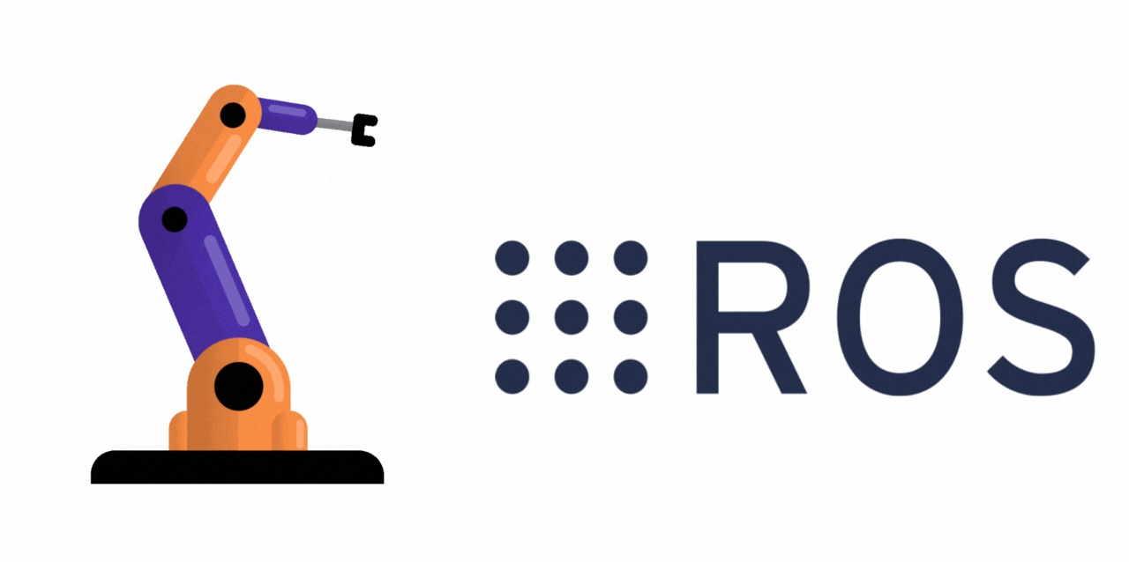

QNX ROS2 IMU Demo Overview
There are 3 main layers on the raspberry pi - the QNX layer, the ROS2 layer, and the python scripts with the IMU code
QNX is the operating system which provides real-time capability on the raspberry pi
Linux is not a real time system. This means that QNX guarantees that critical tasks like sensor polling or control loops happen in precise time limits. It does this through:
      A microkernel architecture: only the essential kernel runs in privileged mode, everything else like drivers/filesystems/networking run as separate user space processes
      Priority based schedule means that higher priority tasks always run first which avoids latency spikes
      Deterministic message passing which means that inter process communication is predictable and bounded in time.
Layers

Slide 2
QNX ROS2 IMU Demo Overview
ROS2 humble is our middleware layer that provides modular messaging and communication capabilities between processes (these are known as nodes). If you see the acronym DDS (data distribution service), this refers to the standard protocol used for all messaging which operates in a publish/subscribe fashion.
Layers

Slide 3
QNX ROS2 IMU Demo Overview
Our demo (imu_pub.py and imu_sub.py) contains the application nodes using rclpy (the python library for ros2) and sensor_msgs
Layers

