Slide 1
GIT

Slide 2
Version Control System

Slide 3
Version Control System
Version control is a system that records changes to a file or set of files over time so that you can recall specific versions later.

Slide 4
Why use Version Control System?
Reverting back code
Review the history of some code
To prove that a particular change broke or fixed a piece of code
Code review: To see how much work is being done, and where, when and by whom
To experiment with a new feature without interfering with working code
Lost code from machine due to System failure, Natural calamities etc.

Slide 5
Types of Version Control System

Slide 6

Local Version Control Systems
Records all changes to a file in a database.
No collaboration, team members can work on the same file at the same time.

Slide 7
Centralized Version Control Systems
All the file versions are kept in a single server.
The clients can then connect to the server and checkout files.
Examples of CVCS are CVS, Subversion, and Perforce etc.

Slide 8
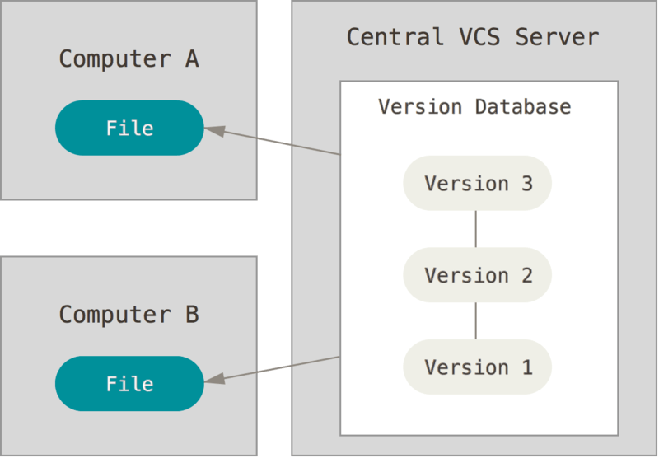
Centralized Version Control Systems

Slide 9
Centralized Version Control Systems
Drawbacks:
Single point of Failure, If a server goes down for an hour, then during that hour nobody can collaborate at all or save versioned changes to anything they’re working on

Slide 10
Distributed Version Control Systems
Server as well as the client keep a copy of the file versions.
If any server dies, any of the client repositories can be copied back up to the server to restore data.
Examples: Git, Mercurial, Bazaar or Darcs

Slide 11
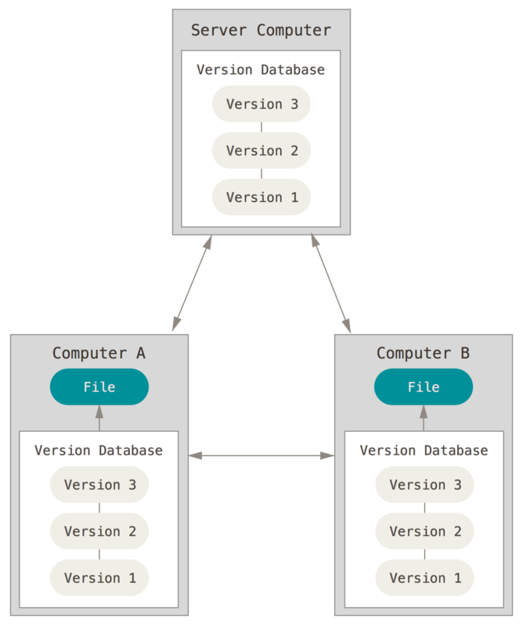
Distributed Version Control Systems

Slide 12
GIT HISTORY

Slide 13
GIT HISTORY
BitKeeper, a propreity software, was made free to use license for open source projects.
In 2002, Linus Torvalds, the creator of Linux kernel, moved the project to BitKeeper.
To maintain the spirit of free software in everything they did, Andrew Tridgel creator of Samba (allows for interoperability between Linux servers and Windows-based clients) reverse engineered BitKeeper client.
This violated the non-compete clause of BitKeeper's license agreement.
BitKeeper decided to revoke their free license

Slide 14
GIT HISTORY
Annoyed by this, Linus Torvalds decided to create GIT
After 11 years, in 2016, BitKeeper was made open source.
Read more here: http://www.infoworld.com/article/2670360/operating-systems/linus-torvalds--bitkeeper-blunder.html

Slide 15
GIT HISTORY
The word GIT is a British slang for a stupid or unpleasant person
Quote from Linus Torvalds:
"I'm an egotistical bastard, and I name all my projects after myself. First Linux, now git."

Slide 16
Git Architecture

Slide 17
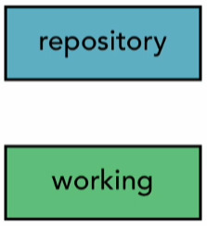
Two-tree architecture
Lot of other version control systems use Two-tree architecture.
We call them trees because they represent a file structure.

Slide 18
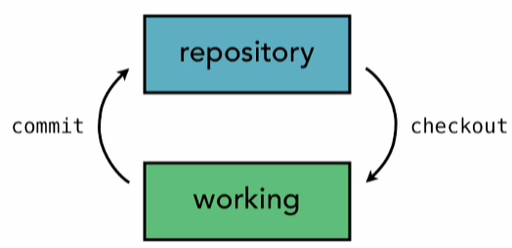
Two-tree architecture
Get latest files from server / repository (checkout)
Changes to files are saved in the hard-disk (local copy)
It is then sent to the server (commit)

Slide 19
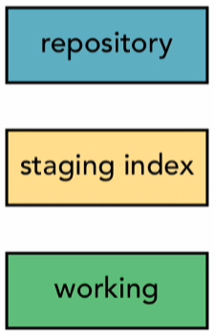
Three-tree architecture
Git however uses a three-tree architecture.
Uses an extra tree called staging index.
Allows Partial commit.

Slide 20
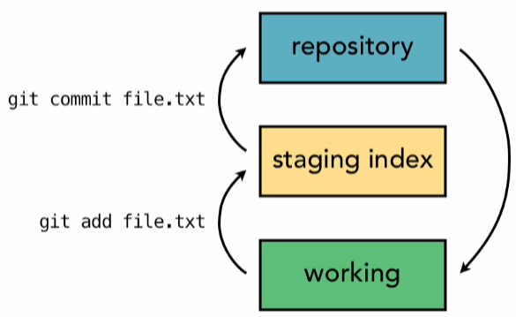
Three-tree architecture
Latest files are taken from repository (checkout)
Changes made are saved in hard-disk (local copy)
Set of changes are staged (staging)
Staged changes are uploaded to server (committing)

Slide 21
Three-tree architecture
Latest files are taken from repository (checkout)
Changes made are saved in hard-disk (local copy)
Set of changes are staged (staging)
Staged changes are uploaded to server (committing)

Slide 22
Git Workflow

Slide 23
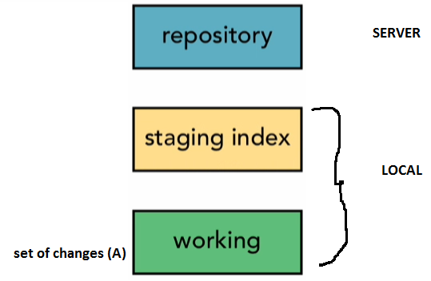
Git Workflow
Changes made are first saved on the hard disk. We call it the local copy

Slide 24
Git Workflow
Set of changes that need to be committed are staged

Slide 25
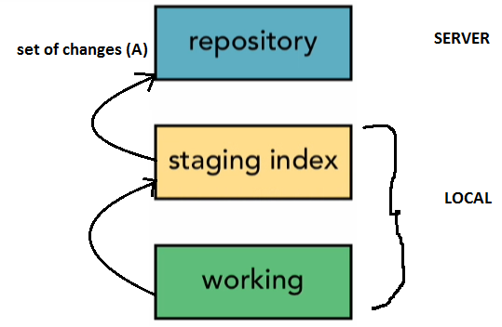
Git Workflow
Staged changes are committed to the repository

Slide 26
Git Workflow
Git generates a checksum for each commit
Checksum is a string of hexadecimal numbers
Same data will always have the same checksum
Thus ensures data integrity
Git uses SHA-1 hash algorithm to create checksums, its 40 characters long.
5ab70de3d8081bf2fd0ce2a2c0d057ba2497034b

Slide 27
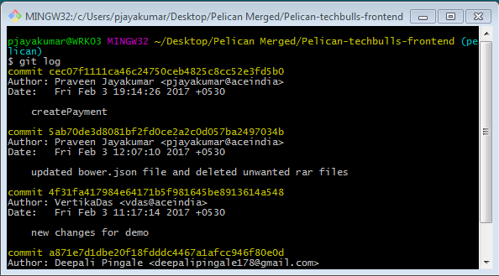

Slide 28
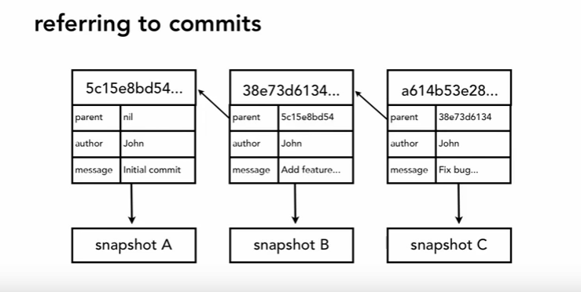
Git Workflow
For each commit Git adds its meta-data which includes parent, author, message etc.
Each parent points to last commit, thus helps to maintain commit sequence.

Slide 29
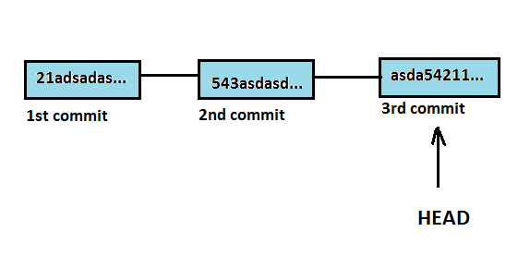
Git Workflow
HEAD is a ref (reference) to the currently checked out commit.
By default HEAD will point to the latest commit
As we make new commits the pointer is moves to point to the latest commit.
Head allows for commit navigation.
Stackoverflow answer describes it better http://stackoverflow.com/a/42185781/5936814

Slide 30
Working with Git

Slide 31
Working with Git

