Slide 1
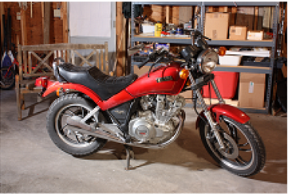
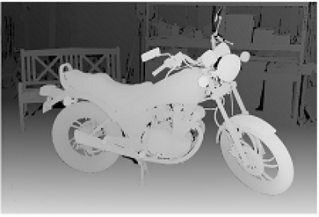
What is Depth of an Image?
RGB image
Depth image
Combination of 2D image with depth information gives us 3D image / RGBD image

Slide 2
Why Do We Need Depth?
Surveillance
Drones
Robotics
Automotive
Augmented Reality
Medical imaging
3D reconstruction
3D scanning / 3D printing
3D display
3D video compression

Slide 3
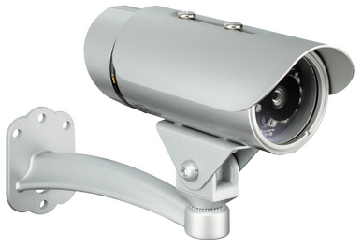
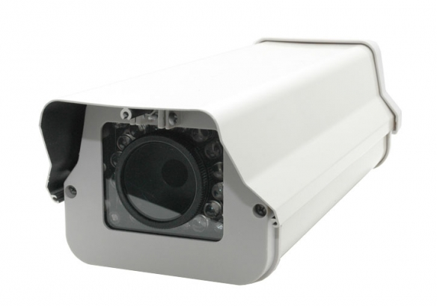
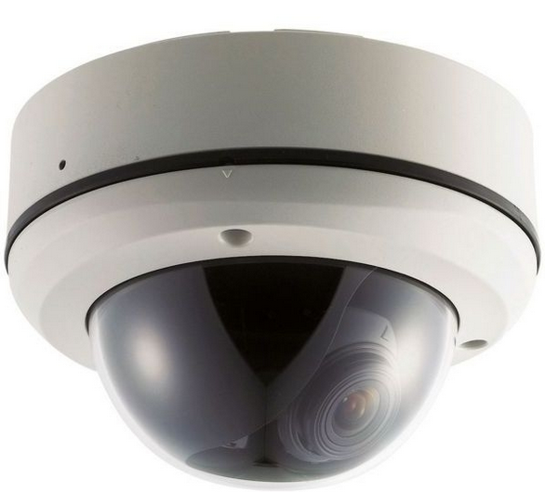
Why Do We Need Depth?
Surveillance
China has more than 200 million surveillance cameras (1 per 7 citizens)
USA has more than 40 million surveillance cameras (1 per 8 citizens)
UK has more than 6 million surveillance cameras (1 per 11 citizens)
Surveillance cameras are becoming smarter
Computer vision tasks on 3D images perform better

Slide 4
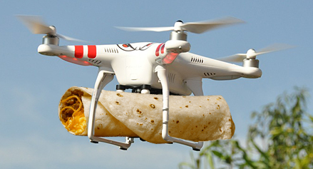
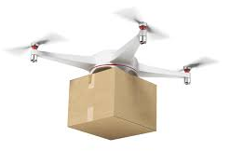
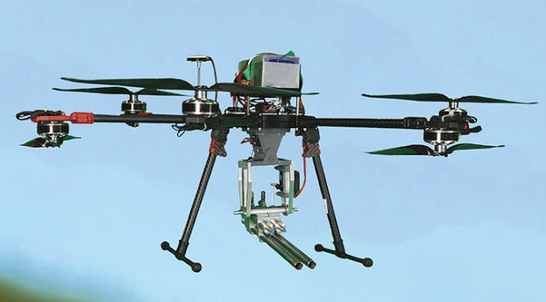
Why Do We Need Depth?
Drones
Autonomous flights
Autonomous landings
Obstacle avoidance
Civil applications
Military applications
www.geospatialworld.net
thehustle.co
droneanalyst.com

Slide 5
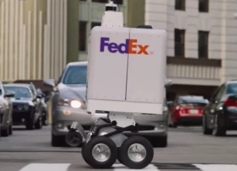
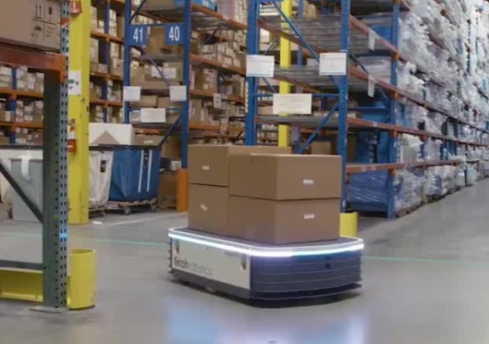
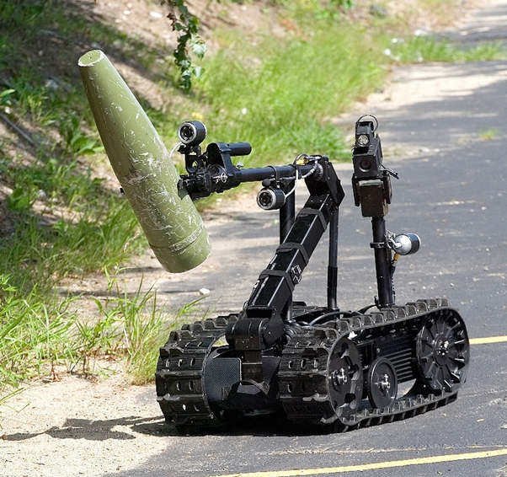
Why Do We Need Depth?
Robotics
Autonomous navigation
Obstacle avoidance
Object grasping
Civil applications
Military applications
venturebeat.com
zdnet.com
bostonmagazine.com

Slide 6
How To Extract Depth?
Object
Object
Object
Object
Left
image plane
Right
image plane
Image plane
Left
image plane
Right
image plane
Image plane
Structured light projector
Structured light projector
IR Laser
emitter and sensor
Left camera
Right camera
Camera
Left camera
Right camera
Camera
Passive Stereo
Structured Light
Active Stereo
Time of Flight
Higher power consumption
Expensive

Slide 7
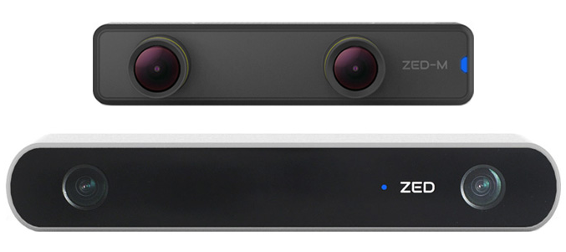
Passive Stereo
Interpupillary Distance 62mm ±10mm
Zed Mini baseline : 63 mm
Zed Mini range : 0.15m – 12m
Object
+ Low power
+ Low cost
+ Good accuracy
+ Good range
Higher range requires big form factor
Accuracy decreases for short range
+ Can be combined with other techniques
1080p, 30 fps
Left
image plane
Right
image plane
Left camera
Right camera
Passive Stereo
Target : 4K, 60 fps
4K, 30 fps
1080p, 60 fps
Zed baseline : 120 mm
Zed range : 0.5m – 20m
1080p, 30 fps

Slide 8
Disparity
We perceive depth of a 3D point based on its disparity in our left and right retinal images
Disparity is the difference in the location of the same 3D point in left and right images
Rectified images fulfil the epipolar constraint
Point 2
B : Baseline
F : Focal Length
x1L : Location of P1 on the left image plane
x1R : Location of P1 on the right image plane
x2L : Location of P2 on the left image plane
x2R : Location of P2 on the right image plane
xL1 – xR1 : Disparity of P1
xL2 – xR2 : Disparity of P2
Point 1
Left
image plane
Right
image plane
x2L
x2R
x1L
x1R
Focal length
Baseline
Left camera
Right camera
Binocular Vision

Slide 9
Triangulation
Triangulation is the method of determining the depth from disparity
Depth is inversely proportional to disparity
Point 2
B : Baseline
F : Focal Length
x1L : Location of P1 on the left image plane
x1R : Location of P1 on the right image plane
x2L : Location of P2 on the left image plane
x2R : Location of P2 on the right image plane
xL1 – xR1 : Disparity of P1
xL2 – xR2 : Disparity of P2
$Depth\left(Point1\right)=\frac{BF}{xL1−xR1}$
Point 1
$Depth\left(Point2\right)=\frac{BF}{xL2−xR2}$
Left
image plane
Right
image plane
x2L
x2R
x1L
x1R
Focal length
Disparity (P1) > Disparity (P2)
(xL1 – xR1) > (xL2 – xR2)
Baseline
Left camera
Right camera
Binocular Vision

Slide 10
Depth from Disparity
Similar Triangles
P(x,z)
-f
zb + z( zb - bf
$z$
L(xL,f)
R(xR,f)
$f$
z
b
Left camera
Right camera

Slide 11
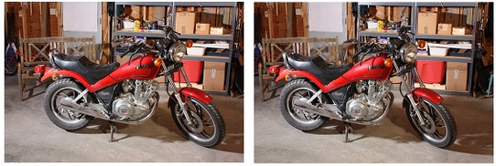
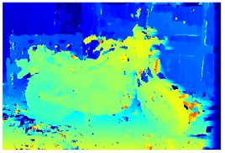
Disparity Estimation
Local Methods
Block Matching
Optical Flow
Feature Matching
Semi Global Method
Global Methods
Dynamic Programming
Graph Cuts
Belief Propagation
Left Image
Right Image
Depth Image

Slide 12
Block Matching
Left Image
Right Image

Slide 13
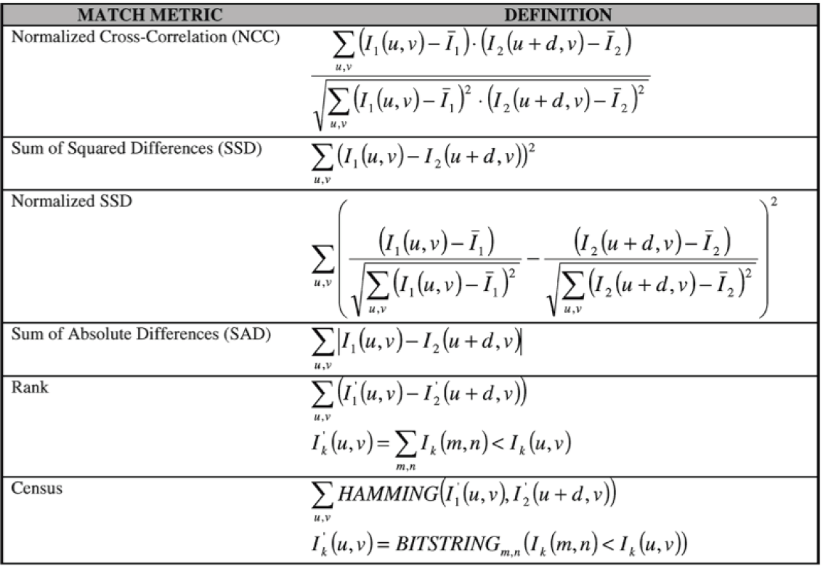
Block Matching Costs
Brown, M. Z., Burschka, D., and Hager, G. D. 2003. Advances in Computational Stereo. IEEE Trans. Pattern Anal. Mach. Intell. 25, 8 (Aug. 2003), 993-1008.

Slide 14
Rank Transform
Counts the number of pixels in the NxM filtering window that have lower intensity than the center pixel
Output is a single value ranging from 0 to NxM-1
3x3 rank transform example
40
37
35
39
38
33
Output of rank transform: 5
40
36
30

Slide 15
Census Transform
Identifies the pixels in the NxM filtering window that have higher intensity than the center pixel
Output is a NxM-1 bit string
3x3 census transform example
40
37
35
1
0
0
Output of census transform:
10010100
39
38
33
1
0
40
36
30
1
0
0

Slide 16
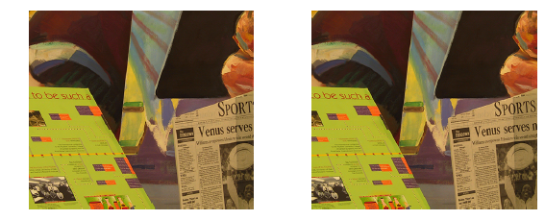
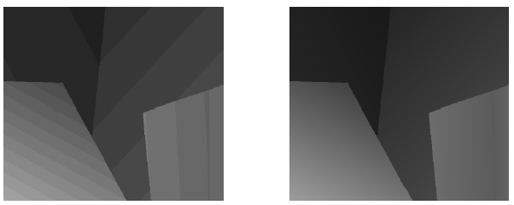
Sub Pixel Accurate Depth Estimation

Slide 17
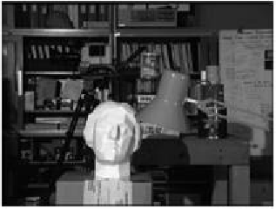
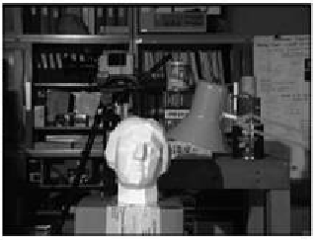
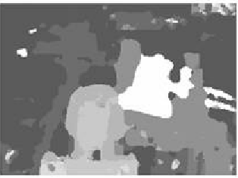
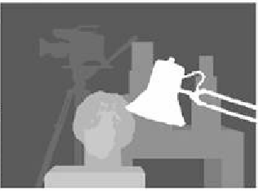
Depth Post Processing
Cross Check
Irregularities
Lack of textures
Light reflections
Noise
Occlusions
Area covered behind foreground object
Not seen in both views
Left Image
Right Image
Median
Filter
Depth Image
Ground Truth

Slide 18
2D Median Filter
Commonly used to filter out impulsive noise from images
Can smooth out the depth map by replacing the outliers
Irregularities in block matching will result with non-valid depth values
3x3 median filter example
40
37
35
40
37
35
Sorted values:
30, 33, 35, 36, 37, 39, 40, 40, 58
39
58
33
39
37
33
40
36
30
40
36
30

Slide 19
Papers Implementing Median Filter
Mutual information based semi-global stereo matching on the gpu
Stereo Processing by Semiglobal Matching and Mutual Information
Real-time semi-global matching disparity estimation on the gpu
Real-time semi-global matching on the cpu
Real-time stereo vision system using semi-global matching disparity estimation: architecture and fpga-implementation
Efficient stereo matching based on a new confidence metric
Matching Cost Computation Algorithm and High Speed FPGA Architecture for High Quality Real-time Semi Global Matching Stereo Vision for Road Scenes

