Slide 1


SMART INDIA HACKATHON 2026
Problem Statement ID – 26164
Problem Statement Title - Enterprise Cryptographic Discovery & Analysis Tool (ECDAT)
Theme - Blockchain & Cybersecurity
PS Category - Software
Team ID -
Team Name - Blindspot

Slide 2
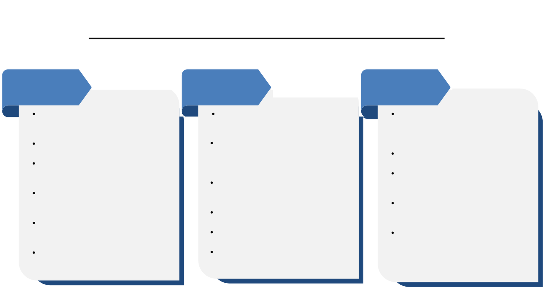
Proposed Solution
Detailed Explanation of the Proposed Solution
How it addresses the problem
Innovation and uniqueness of the solution
Multi-surface scanners: source code, dependencies, binaries, containers
Normalizes all findings into standard CycloneDX CBOM format
Risk engine applies Mosca's inequality (X + Y > Z)
Recommends Pure PQC / Hybrid / Monitor based on tier
Interactive GUI with drill-down and CBOM export
Catalogues artefacts, internal and external facing
Covers algorithms, keys, certs, protocols, libraries, hardware
Flags harvest now decrypt later exposure
Classifies by type, lifetime, criticality
Implements Mosca's algorithm directly
Recommends fixes by risk, latency, cost
Splits risk logic: encryption vs signature exposure differs
Trust anchor escalation for root CA/code/firmware signing keys
Risk-tiered strategy: not one size fits all PQC or hybrid
Standards first CycloneDX output for real interoperability
Full traceability: GUI shows exactly why each tier was assigned

Slide 3
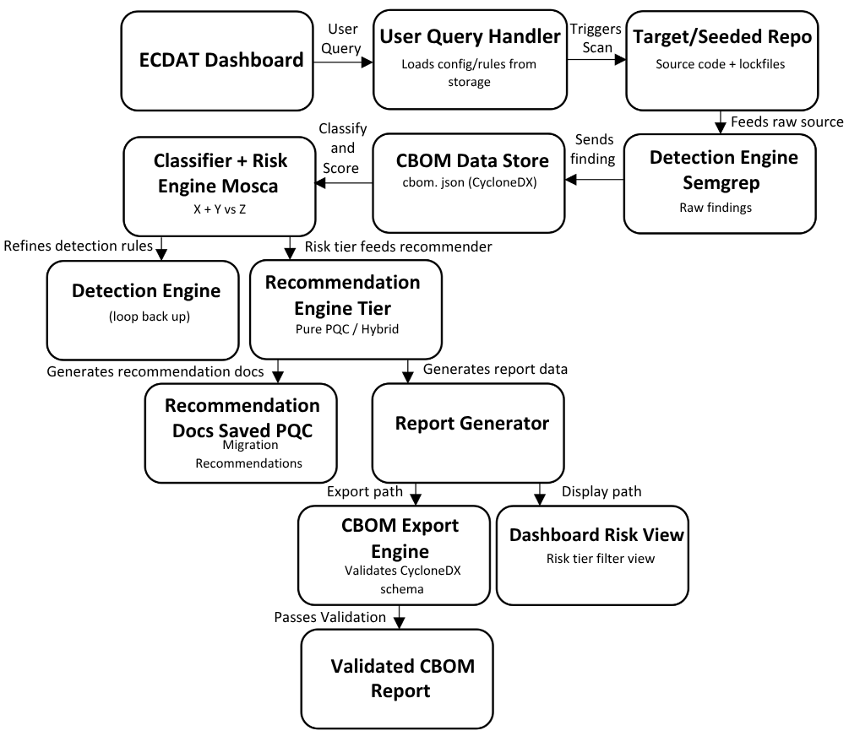
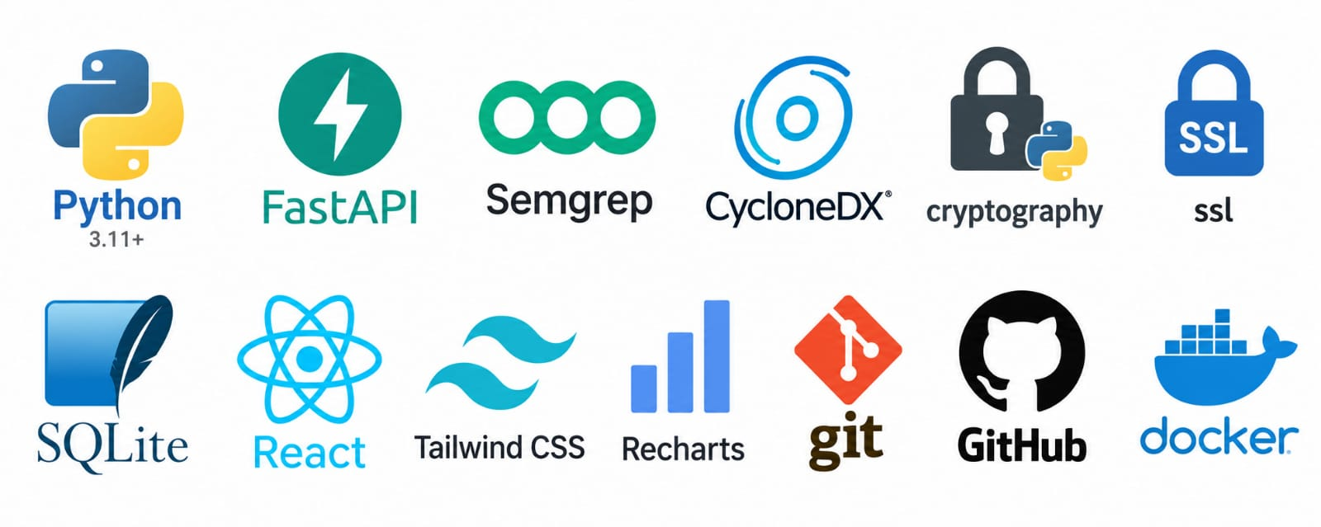

TECHNICAL APPROACH
ARCHITECTURE
Pipeline: scan → CBOM → classify → risk → recommend → GUI
Parallel scanners feed one CycloneDX CBOM store
Risk engine uses Mosca's algorithm, split by type
Signatures escalate only if long-lived trust anchors
Recommends Pure PQC, Hybrid, or Monitor by tier
COMPONENTS:
Scan Orchestrator: dispatches source, dependency, binary scans
CBOM Store: standardized crypto artefact inventory
Classification Engine: tags type, lifetime, criticality
Risk Assessment Engine: scores via Mosca's algorithm
Recommendation Engine: suggests fixes by cost and risk
GUI Dashboard: visualizes results, exports CycloneDX report
X + Y > Z

Slide 4
FEASIBILITY AND VIABILITY
Analysis of the feasibility of the idea
A working demo (source-code scanner + Mosca risk engine + basic GUI) is buildable in the given time using existing open-source tools and libraries.
Full coverage of binaries and live infra scanning is harder, but can be shown as a later phase without weakening the core demo.
The core idea builds on real, published standards (CycloneDX, NIST PQC algorithms), so the approach isn't speculative - it's implementable.
Potential Challenges
Scanners may miss crypto usage that's hidden, obfuscated, or loaded only at runtime.
Estimating migration time (Y) and quantum-arrival time (Z) for Mosca's formula is uncertain and hard to justify precisely.
Security teams may not trust an automated risk score unless they can see exactly why an artefact was flagged.
Strategies to overcome
Start with a few well-tested languages/libraries and clearly label detection limits instead of overpromising coverage.
Use published estimates (NIST, Global Risk Institute) for Y and Z, and let users override defaults for their own context.
Make every risk score explainable in the GUI by showing the underlying values (X, Y, Z or trust-anchor flag) behind each decision.

Slide 5
IMPACT AND BENEFITS
FOR INSTANCE: USER STORY
Scenario
A bank's security team, facing an upcoming regulatory deadline for quantum safe migration, uses ECDAT to scan its transaction processing systems and third-party libraries.
Impact
Reduced Compliance Risk: ECDAT flags RSA-2048 encryption protecting 15-year transaction records as Critical using Mosca's algorithm, catching "harvest-now-decrypt-later" exposure before an audit does.
Faster Migration Planning: Instead of manually reviewing every system, the team gets a prioritized, risk-tiered list; cutting planning time significantly.
Benefits
Smarter Resource Allocation: Risk-tiered recommendations mean budget goes to Pure PQC for critical systems, Hybrid for actively used ones, and low-risk items are deferred; no wasted migration effort.
Audit-Ready Documentation: The exported CycloneDX CBOM report gives compliance teams ready evidence for regulators, cutting manual reporting work.
Impacts:-
Reduced Compliance Risk
Faster, Focused Migration Planning
Lower Exposure to Data Breaches
Benefits:-
Centralized Crypto Visibility
Smarter Resource Allocation
Audit-Ready Documentation
Quantum-Safe Readiness

Slide 6
RESEARCH AND REFERENCES
PQC Reference Values (FIPS 203 ML-KEM) : NIST's finalized post-quantum key-exchange sizes.
Dataset: https://csrc.nist.gov/pubs/fips/203/final
1. OpenSSL : Real-world target repo to scan; crypto-dense source proves your tool works beyond synthetic code.
GitHub: https://github.com/openssl/openssl
2. CBOMkit : IBM's reference CBOM generator; scans a repo and produces a structured cryptographic inventory.
GitHub: https://github.com/cbomkit/cbomkit
Datasets:
https://docs.google.com/document/d/1LWQdOPm-QrkMEDLvYn0jdJmn5vnncAHIJqNTjcBCf0I/edit?usp=sharing
Research Papers:
https://docs.google.com/document/d/1kG2FP-WwYUFhnxrSE1AOAjxuoIcYW4o40v7XeEUv1Og/edit?usp=sharing
The Discovery & CBOM Foundation:
Paper Name: Hidden Ciphers and Where to Find Them:
Static Discovery and Assessment of Cryptographic Assets in Software (arXiv, 2026) https://arxiv.org/html/2608.04857v1?hl=en-US
The Risk Assessment Engine:
Paper Name: Towards a Unified Quantum Risk Assessment (QARS) (MDPI Electronics, 2025) https://www.mdpi.com/2079-9292/14/17/3338?hl=en-US

