Slide 1
SIH26104 · SMART INDIA HACKATHON
VoiceGuard
A multi-signal voice-integrity layer for high-risk phone calls —
and an honest measurement of where synthetic-speech detection actually stands.
Ghanshyam Kumavat · Team · Your Institution Name
[DRAFT — update team names before presenting]

Slide 2
THE PROBLEM
Voice cloning turned a
phone call into an attack surface
A FEW SECONDS
of a target's speech is enough for modern TTS / voice-conversion to produce a convincing clone.
Financial institutions and call centres still treat a caller's voice as a soft proof of identity — for confirming a transfer, changing a beneficiary, or resetting a credential.
Current text-to-speech and voice-conversion systems need only a short clip of a target's speech to produce a clone convincing over a telephone channel.
NO VISUAL CHECK
A phone call has no face to verify — voice is the only signal, and it's exactly the one being attacked.
This is the brief behind SIH26104: a real-time voice-integrity layer for exactly this call.
VoiceGuard · SIH26104
2

Slide 3
WHAT PUBLISHED RESULTS CLAIM
< 1% EER
Independent evaluations report up to an order-of-magnitude degradation on real-world audio.
published, in-domain accuracy
35.8%
We reproduced this ourselves — on a model we did not even train.
Equal Error Rate on In-the-Wild audio — the same countermeasure, evaluated honestly on speech it never saw in training.
VoiceGuard · SIH26104
3

Slide 4
“
No single detector generalizes
to a voice it has never heard.
So we stopped searching for a better classifier — and built a system
that doesn't need any one signal to be perfect.
— THE DESIGN THESIS BEHIND VOICEGUARD

Slide 5
BEFORE WE TRUSTED A SINGLE NUMBER
We found our own benchmark
was lying to us
50%
= CHANCE
an uninformative signal
Bona fide and spoofed clips in the standard ASVspoof 2019 corpus differ systematically in leading/trailing silence — an artifact of how the dataset was assembled, unrelated to synthesis.
A model can partly solve the labelling task without ever listening to the voice itself.
The fix: trim and loudness-normalise identically for both classes, fingerprint every setting, and gate every future model against this exact test.
13–15%
WHAT WE SCORED
using only the silent parts of the clip
After the fix: 41–59% — models are keying on speech, not the artifact.
VoiceGuard · SIH26104
5

Slide 6
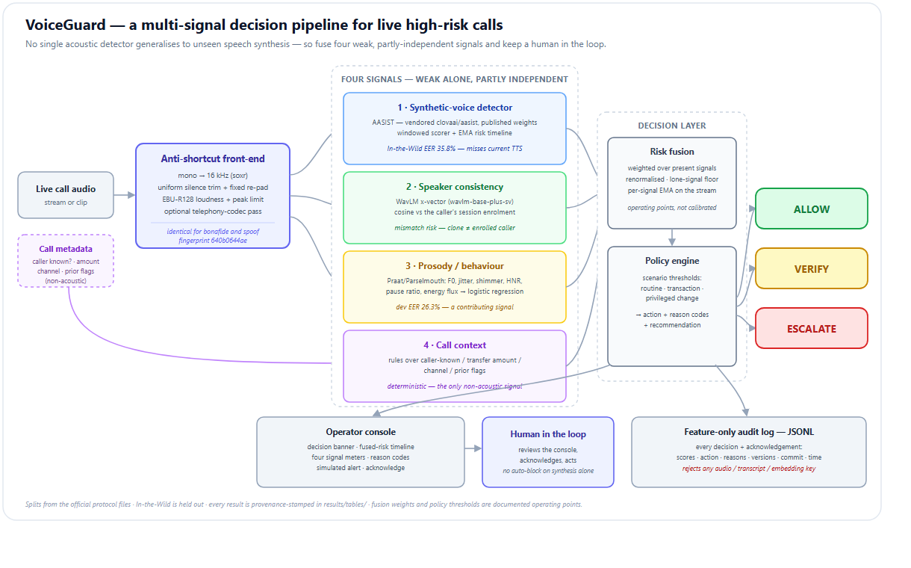
HOW VOICEGUARD DECIDES
One pipeline, four signals, one auditable decision
VoiceGuard · SIH26104
6

Slide 7
WEAK ALONE, PARTLY INDEPENDENT TOGETHER
Four signals
1
Synthetic voice
2
Speaker consistency
AASIST acoustic model — 35.8% EER alone, misses modern TTS entirely.
WavLM voiceprint vs. the enrolled caller — catches clones the acoustics miss.
3
Prosody & behaviour
4
Call context
Praat features: rhythm, pitch, pauses — weak by design, independent evidence.
Caller ID, transfer amount — the one signal that isn't acoustic at all.
VoiceGuard · SIH26104
7

Slide 8
MEASURED, NOT CLAIMED
Detection performance through our front-end
READING THIS
Lower is better.
35.8% In-the-Wild is a real improvement over our own 58.2% baseline — and still not a deployable number.
Dev EER looks worse than published (9.6% vs. ~1%) because our front-end removes the shortcut those figures partly relied on — the honest score is the higher one.
VoiceGuard · SIH26104
8

Slide 9
A REAL, REPRODUCIBLE SESSION
Where fusion earns its place
ACOUSTIC MODEL ALONE
VOICEGUARD, FUSED
ESCALATE
29 / 100
68 / 100
Well below the system's own 65/100 synthetic-voice threshold.
Speaker mismatch — similarity 0.33 vs. enrolled voice
Taken in isolation, this call goes through.
Caller number not recognised
₹75,000 transfer requested
One signal the acoustics miss is caught by another — that's the whole design.
VoiceGuard · SIH26104
9

Slide 10
INDICCALL-EVAL PILOT
Four languages, one surprise
n = 40 clips / language · MMS-TTS · threshold 0.65
Trained only on English — yet it flags Indian-language clones more often than English ones.
Non-English synthesis sits further from the “natural English” distribution the model learned — not evidence of real multilingual robustness. A recall number, not yet an EER.
VoiceGuard · SIH26104
10

Slide 11
NOT A MOCKUP — A RUNNING FASTAPI + WEBSOCKET SERVICE
What the operator sees
CALL IN PROGRESS — TRANSACTION
Decision banner, fused-risk timeline, and four live signal meters — the same numbers as the worked example.
Every action change writes a feature-only audit event: scores, reasons, model version, git commit. No audio. No transcript.
ESCALATE
Pause approval — verify the caller through the registered number.
Synthetic voice
29
Speaker mismatch
100
Prosody / behaviour
20
Call context
65
REST + WebSocket API · operator console · acknowledge-to-clear alert flow
Feature-only audit trail: ALLOW → ESCALATE → ACKNOWLEDGED
VoiceGuard · SIH26104
11

Slide 12
LIMITS, STATED PLAINLY
What we're honest about
1
Not our trained model — published AASIST weights, re-evaluated honestly through our front-end.
2
Fusion weights and policy thresholds are documented operating points, not calibrated on held-out data.
3
The acoustic model's 4-second window is slower than a sub-2-second first-read target.
4
The IndicCall-Eval pilot is synthetic-only, 40 clips per language — no bona fide multilingual slice yet.
We'd rather show the gaps than hide them.
VoiceGuard · SIH26104
12

Slide 13
WHAT'S NEXT
Roadmap
1
2
3
4
5
Trained model
Calibration
Latency
Real alerts
Multilingual data
Kaggle T4 fine-tune — target < 15% ITW EER
Replace tuned points with held-out probability calibration
VAD gate + lightweight first-pass, sub-2s read
SMS / email / webhook — plus gRPC + SDK
Consented bona fide recordings per language
VoiceGuard · SIH26104
13

Slide 14
Fuse the signals.
Keep a human in the loop.
Thank you — questions welcome
github.com/ghanshyam1011/voice-clone-detector

