Slide 1

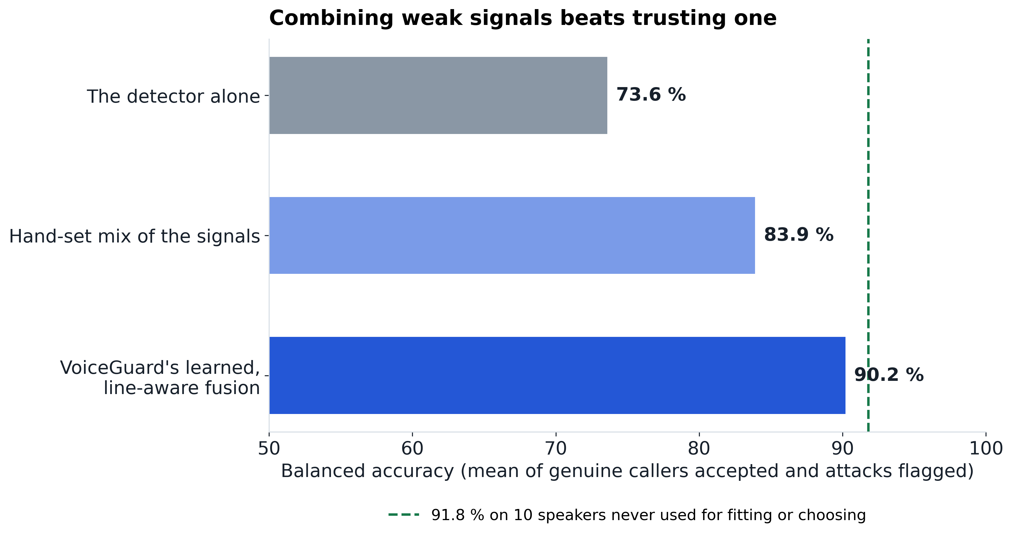
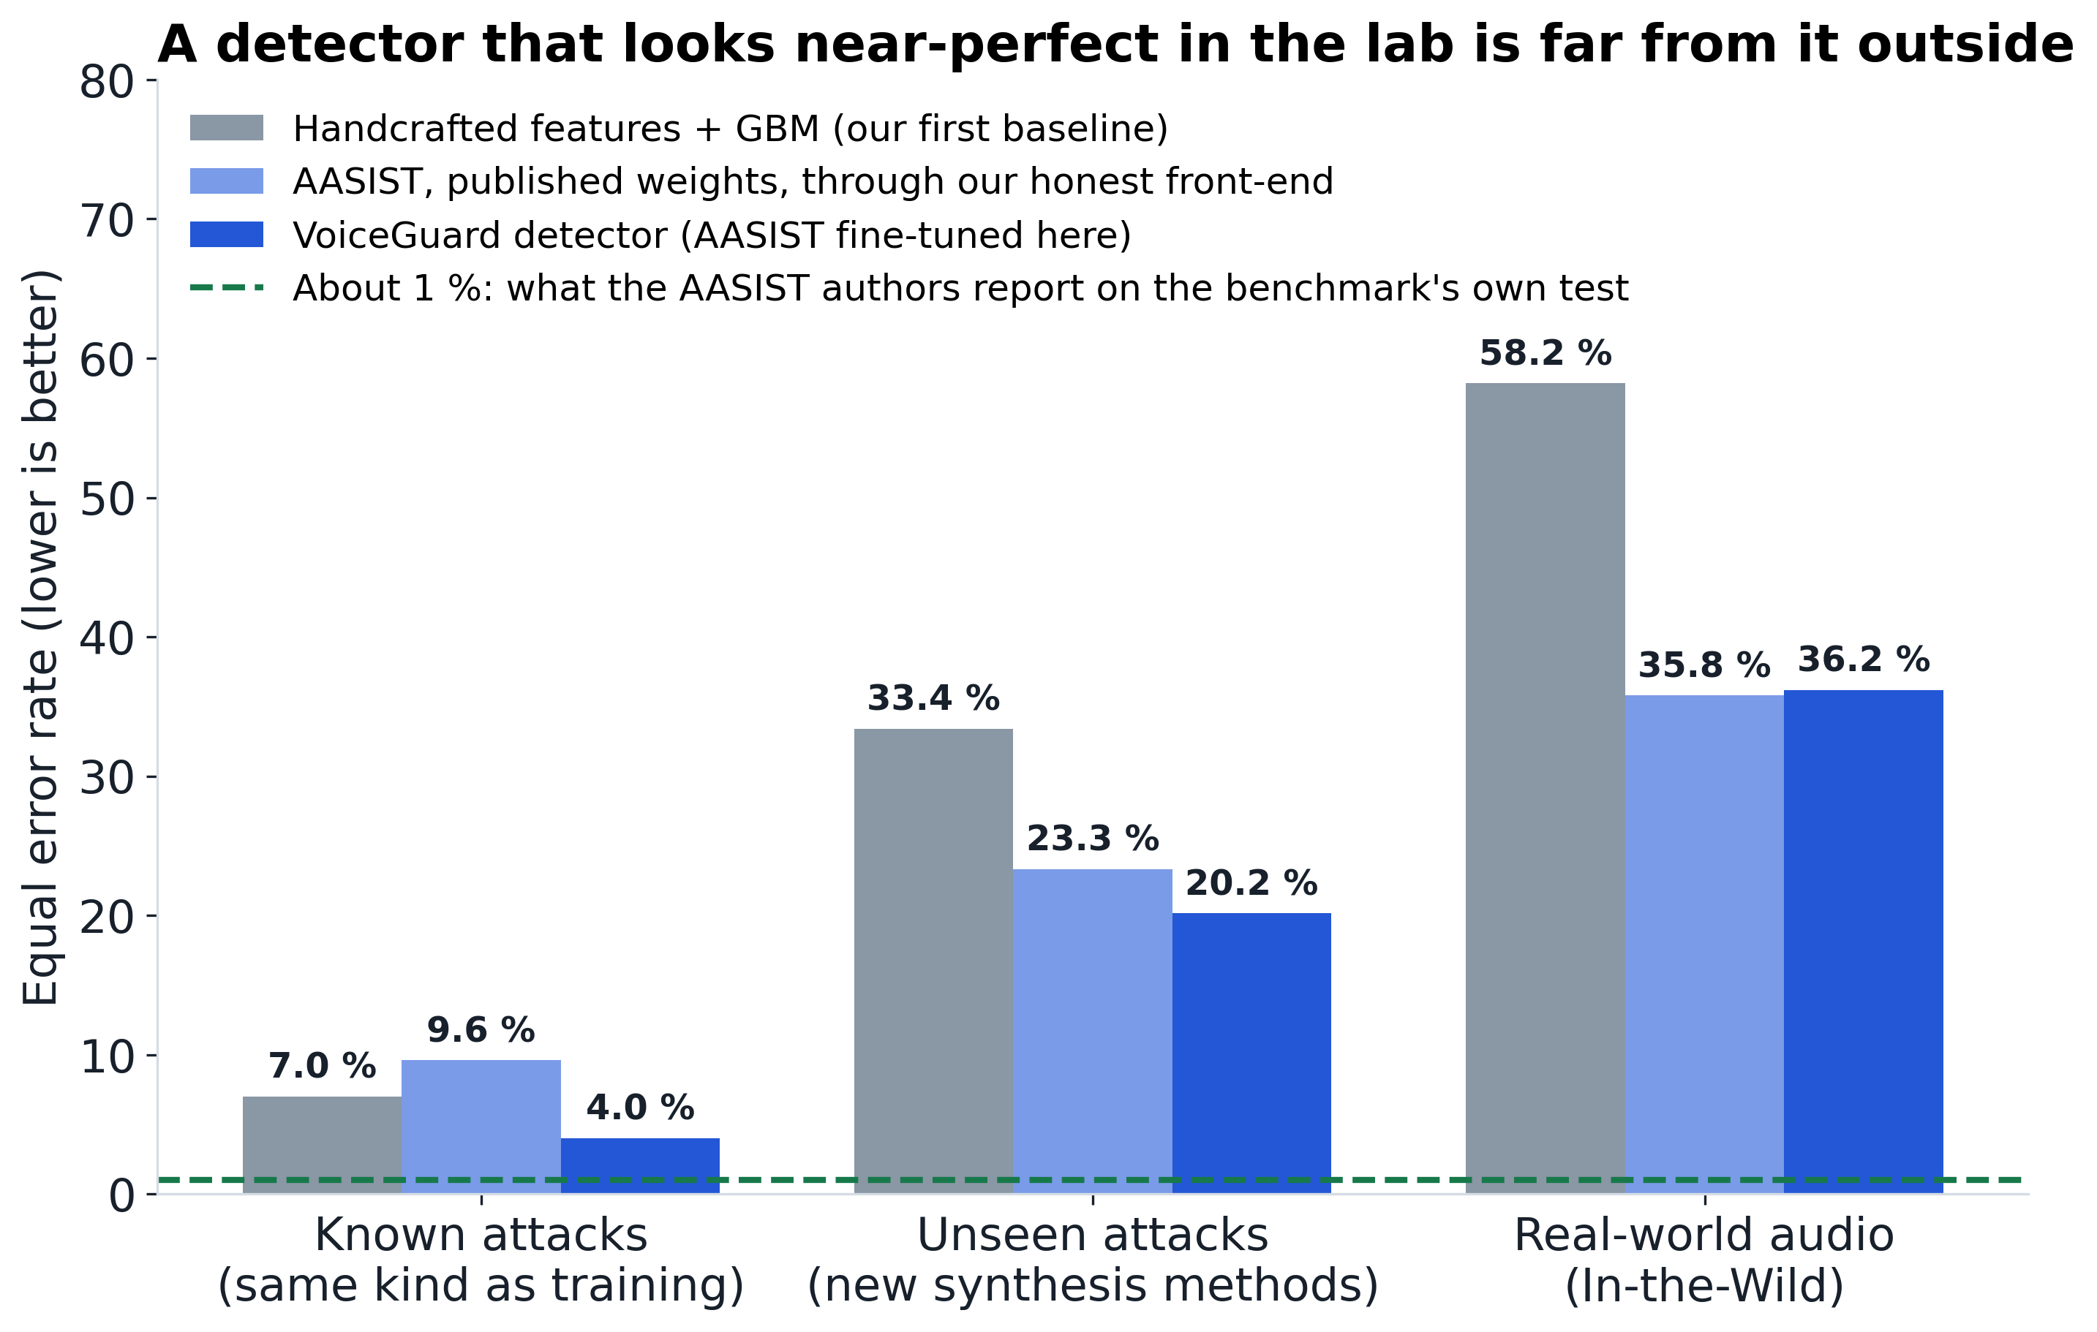
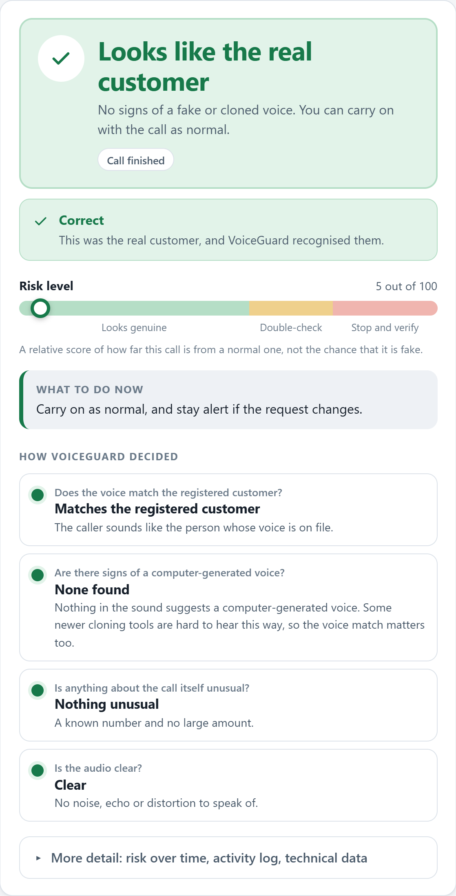
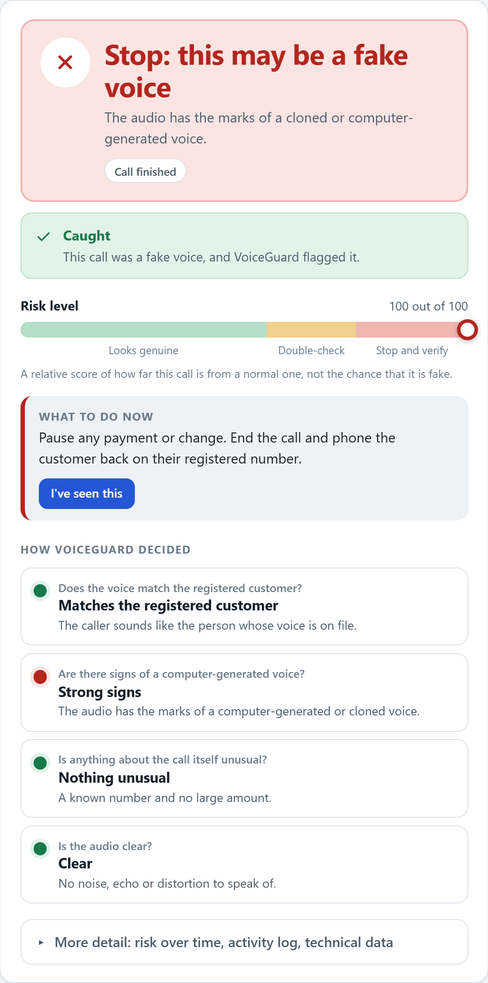
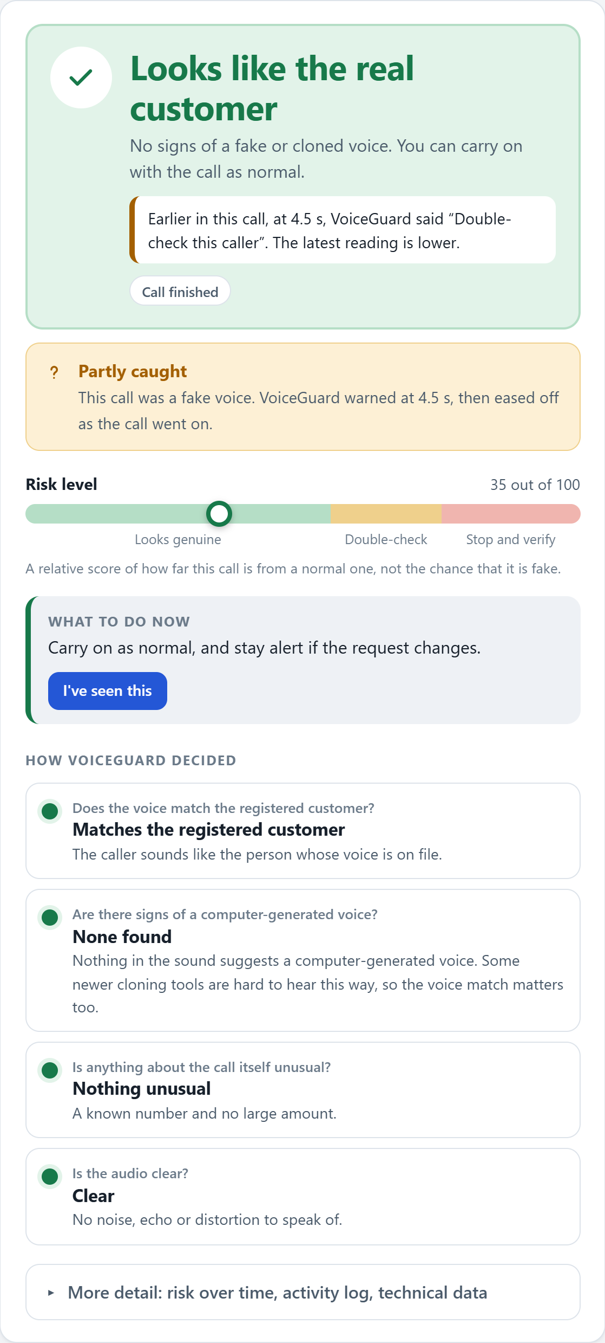
VoiceGuard
Real-time detection of AI voice-cloning fraud on phone calls
SUBJECT: SCALABLE ML AND BDA | FACULTY: PROF. SHWETA JAISWAR | AY 2025–26
STUDENT: GHANSHYAM KUMAVAT (23102A0043) | VIDYALANKAR INSTITUTE OF TECHNOLOGY, DEPARTMENT OF COMPUTER ENGINEERING
1 PROBLEM STATEMENT
METHODOLOGY / WORKFLOW DIAGRAM
RESULTS AT A GLANCE
A voice no longer proves who is speaking.
Four partly independent kinds of evidence, combined every half second
90.2%
86.6%
35.8%
A few seconds of speech are enough for free AI tools to copy someone's voice. Fraudsters use cloned voices to phone banks and call centres, pretend to be a customer, and push through payments or account changes — and the agent has seconds to decide.
Live call
1
2
balanced accuracy, unseen speakers
balanced accuracy, unseen situations
In-the-Wild EER (was 58.2%)
Phone, VoIP
or microphone
Input gate
Fair front-end
Repairs bad audio; says
WAITING when unsure
Identical for real and fake,
so recording can't give it away
71–75%
268
19
2 OBJECTIVES
3
4
5
6
modern clones caught, clean line
automated tests, all passing
real-world-like situations tested
Detect cloned and computer-generated voices on live calls, in real time.
Combine four partly independent kinds of evidence instead of trusting one detector.
Say plainly how sure the system is, and keep a person in charge of the decision.
Measure honestly, including the failures, and keep callers' audio private by design.
Voice detector
Voice match
Recording style
Call details
AASIST, tuned for
noise, rooms, phone lines
WavLM print vs.
the customer's voice on file
Noise, echo, clipping —
sets how far to trust #3
Known number? Amount?
Not from the audio
FUSION & ROBUSTNESS BENCHMARK
7
8
ALLOW
carry on
Trust-weighted fusion
Policy
VERIFY
double-check
3 WHY ONE DETECTOR IS NOT ENOUGH
Clone, voice and call alarms
kept separate, then combined
Routine, payment or
sensitive call: how much is enough
ESCALATE
stop and verify
On its own benchmark the best published detector reports about 1% error. On real-world audio it errs on 36% — and a current text-to-speech voice was flagged only 8% of the time.
Recording style can only change how far the detector is trusted — never raise an alarm on its own. This fixed a real false alarm on a genuine WhatsApp voice note.
TECHNOLOGIES AND TOOLS USED
MODELS
AASIST anti-spoofing network · WavLM voice embeddings · Silero VAD · RawBoost
CODE
Python 3.11 · PyTorch · scikit-learn · NumPy / pandas / librosa
SERVING
FastAPI · WebSocket · gRPC + Protocol Buffers
DATA
ASVspoof 2019 · In-the-Wild · LibriSpeech · kNN-VC / SpeechT5 / MMS clones
QUALITY
pytest — 268 tests · ruff · Git / GitHub
RESULTS: THE CONSOLE IN ACTION
Speaker-disjoint evaluation: the countermeasure alone 73.6% → hand-set fusion 83.9% → VoiceGuard's learned, channel-aware fusion 90.2% balanced accuracy.
Screens from the live console, playing three built-in demo calls. The scorecard tells you whether VoiceGuard was right, including when it missed.
CONCLUSION
4 DECISION THRESHOLDS
A real customer
A cloned voice
The honest hard case
ALLOW
Risk 0–39 / 100 · carry on
An end-to-end pipeline: anti-shortcut evaluation → four-signal fusion → policy decision → audited console.
Measured honestly: real-world EER improves 58.2% → 35.8%; fused balanced accuracy reaches 90.2% on unseen speakers.
Combining partly independent signals, not any single detector, is what makes the decision trustworthy.
VERIFY
Risk 40–69 / 100 · double-check the caller
ESCALATE
Risk 70–100 / 100 · stop and verify
LIMITATIONS & NEXT STEPS
5 DATASET & EVALUATION SCOPE
On real-world audio the detector alone is weak (35.8% EER); it supports the decision, it does not make it alone.
Tested on simulated rooms, lines and codecs, not recorded real calls; Indian-language results are a small synthetic pilot.
Alerts are simulated; authentication / TLS hardening is not yet built.
Next: train on modern cloning tools, collect consented real calls and Indian-language speech, real alert delivery, edge inference.
ASVspoof 2019 LA: train on known attacks, dev (A01–A06) and eval (A07–A19, unknown methods).
In-the-Wild: found audio, never trained on, never used to pick a threshold.
19 real-world-like situations: rooms, phone codecs, clipping, packet loss, hum, music, background voices.
Modern-clone harness: kNN-VC voice conversion and SpeechT5 synthesis of enrolled speakers never seen in training.
IndicCall-Eval pilot: MMS-TTS synthetic attacks in 5 Indian languages (synthetic side only, so far).
6 HOW THE OPERATOR DECIDES
REFERENCES
Live console: one plain-language verdict — Looks like the real customer / Double-check / Stop — the four contributing checks, and a scorecard saying whether VoiceGuard was right, including when it missed.
Audit trail: every decision logged with scores, reason codes and model version — never audio, a transcript or a voiceprint.
One engine, three transports: REST, WebSocket and gRPC, verified to produce identical decisions on the same clip.
[1] J. Jung et al., “AASIST: Audio Anti-Spoofing Using Integrated Spectro-Temporal Graph Attention Networks,” ICASSP 2022.
[2] X. Wang et al., “ASVspoof 2019: A Large-Scale Public Database of Synthesized, Converted and Replayed Speech,” 2020.
[3] N. Müller et al., “Does Audio Deepfake Detection Generalize?,” Interspeech 2022 (In-the-Wild).
[4] S. Chen et al., “WavLM: Large-Scale Self-Supervised Pre-Training for Full Stack Speech Processing,” 2022.
[5] H. Tak et al., “RawBoost: A Raw Data Boosting and Augmentation Method for Speech Anti-Spoofing,” ICASSP 2022.
[6] G. Kumavat, “VoiceGuard — source code, results and model card,” GitHub repository, 2026.
Green answer, low risk. Scorecard: Correct.
Red Stop, with what to do: pause the payment, call the customer back.
A free open-source clone: warned early, then eased off. We show misses too.
https://github.com/ghanshyam1011/voice-clone-detector
PROJECT SUPERVISOR / FACULTY SIGNATURE
EXTERNAL EXAMINER SIGNATURE
_______________________________________________
_______________________________________________

