Slide 1
Student Record Management System
1
Student Name: Ashika Mandal
Course: B.Tech (4th Year)
Enterprise-style Java Spring Boot REST Application

Slide 2
Project Overview
The Student Record Management System is a Spring Boot based REST API application.
It allows efficient management of student information using CRUD operations following layered architecture.
2

Slide 3
Problem Statement
Manual student record management is time-consuming and error-prone.
This project provides a digital, secure, and scalable solution.
There is a high risk of data loss due to improper storage or human mistakes.
3

Slide 4
Technology Stack
Java 17
Spring Boot
Spring Data JPA (Hibernate)
H2 / MySQL
REST APIs
HTML, CSS, JavaScript
4

Slide 5
System Architecture
Controller Layer – Handles HTTP requests
Service Layer – Business logic
Repository Layer – Database operations
Database – Stores student records
5

Slide 6
Application Flow
6
User sends request via UI / Postman
→ Controller receives request
→ Service processes logic
→ Repository interacts with DB
→ Response returned to user

Slide 7
REST API Endpoints
7
POST /students – Add student
GET /students – View all students
GET /students/{id} – View student by ID
PUT /students/{id} – Update student
DELETE /students/{id} – Delete student

Slide 8
Core Features
Add Student
View Student Records
Update Student Details
Delete Student
Global Exception Handling
8

Slide 9
Exception Handling
9
Centralized GlobalExceptionHandler
Handles:
• Invalid requests
• Resource not found
• Method not allowed
• Runtime exceptions

Slide 10
Database & Persistence
10
H2 Database used for development
MySQL supported for production
Hibernate ORM handles mapping

Slide 11
Conclusion
13
This project demonstrates enterprise-level application design using Java and Spring Boot.
It follows industry best practices such as layered architecture, RESTful APIs, and proper exception handling.
The application implements complete CRUD operations with real database integration (MySQL).
It ensures data consistency, validation, and maintainability, making it scalable for future enhancements.
The project provides hands-on experience with frontend–backend integration.

Slide 12
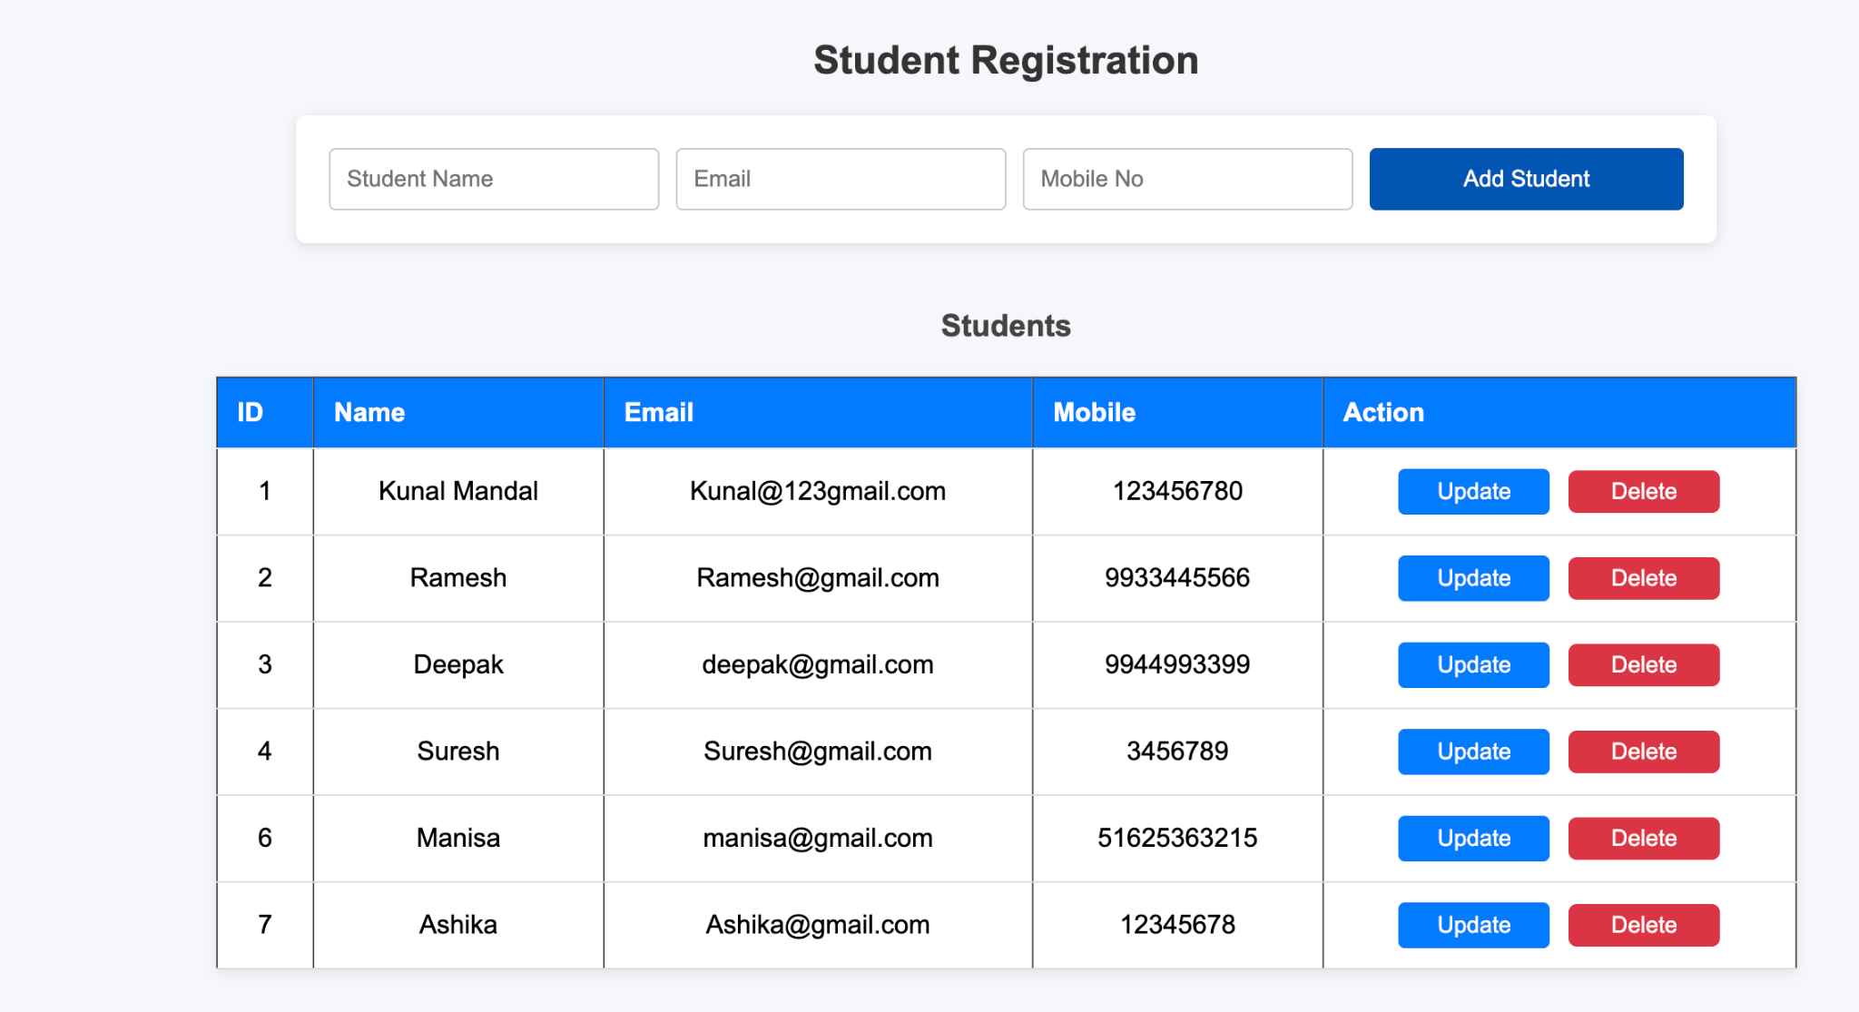
📝 Student Registration Form & Data
14

Slide 13
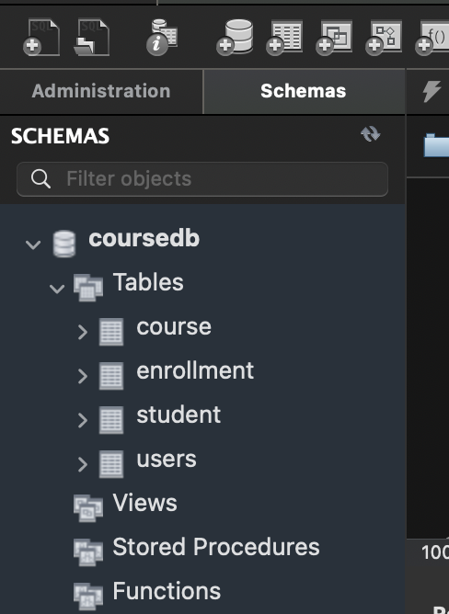
🗄️ MySQL Database Structure
15

Slide 14
🔄 Application Flow
🖥️ Frontend (HTML / CSS / JS)
⬇️ REST API Calls
⚙️ Spring Boot REST API
⬇️ JPA / Hibernate
🗄️ MySQL Database

Slide 15
🌐 REST API Flow
📥 GET → Fetch student records
➕ POST → Add new student
✏️ PUT → Update student details
❌ DELETE → Remove student record
All APIs are exposed using Spring Boot REST Controllers

Slide 16
Thank You for Your Time and Consideration 🙏
I welcome your feedback, questions, and suggestions
Ashika Mandal
B.Tech, 4th Year Student

