Slide 1
Programming Exercise Results

Slide 2
Step 2
Enter the mean bipolar voltage and total activation time in the table below.
Global mean of all recorded bi-bipolar voltages | Atrial total activation time

Slide 3
Step 3: Conduction velocity and bipolar voltage map
Make snapshots of voltage map and calculated conduction velocity map and put them in the corresponding boxes.
Bi-polar voltage map
Conduction velocity map

Slide 4
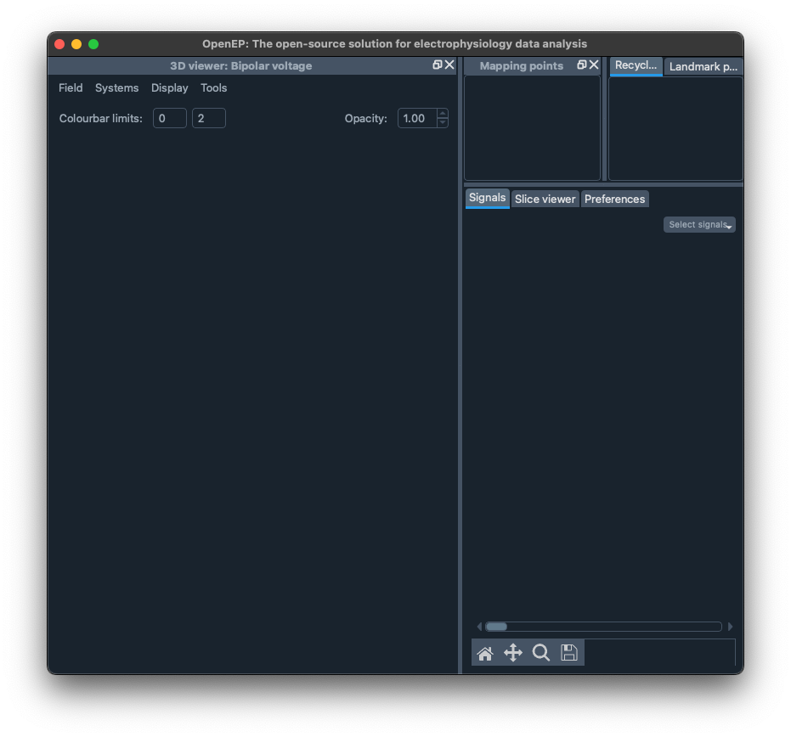
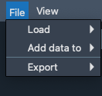
Step 4
Create a similar graphical user interface in Python using PyQt library.
Add a drop down menu with two options (conduction velocity and voltage)
By clicking on each option, the corresponding map must be visualized in the window
Conduction velocity
Voltage

