Slide 2
Calculating the HR Factor using Gaussian 09 Output
Steps:
Calculate the optimized geometry of the ground and excited state
Calculate the normal vibrational modes by diagonalizing the mass weighted Hessian
Project the difference of the excited and ground state geometries onto the normal coordinates
Calculate the Huang-Rhys factor.

Slide 3


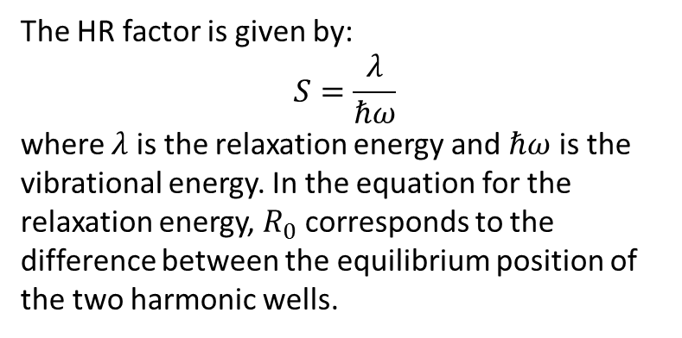

Calculating the HR Factor using Gaussian 09 Output
The HR factor is given by:
$$S=\frac{λ}{ℏω}$$
where $λ$ is the relaxation energy and $ℏω$ is the vibrational energy. In the equation for the relaxation energy, $R_{0}$ corresponds to the difference between the equilibrium position of the two harmonic wells.
$$λ=\frac{1}{2}mω^{2}R_{0}^{2}$$
$$ℏω$$
$$R_{0}$$
First we have to setup and run Gaussian 09 geometry optimizations. The program g09_lambda.exe can create the Gaussian 09 input files for ground, excited, cation and anion calculations using the –m option and supplying the xyz coordinates (see the documentation and example for help). The Gaussian program will generate chk files that need to be converted to fch files using the formchk utility before the HR factor can be calculated using the g09_lambda.exe program.

Slide 4
Calculating the HR Factor using Gaussian 09 Output
Example usage to create G09 input files:
./g09_lambda.exe –m –i input.inp
The –m option tells the program to make the Gaussian 09 input files and the -i option tells the program to look in the file input.inp for information about the desired calculation.
Sample input file for setting up Gaussian 09 calculations:
# h2.inp input file for making G09 input
# Lines starting with # are ignored
# the format is: keyword value
# the program reads the keyword, and then assigns # the value to the appropriate variable
# method for ground/cation/anion calcs
method ‘B3LYP/cc-pVTZ’
# method for excited calc
emethod ‘TD=(nstates=1,root=1) B3LYP/cc-pVTZ’
# name of input files generated
task h2
# xyz file containing coordinates to be optimized
xyz_file h2.xyz
Sample xyz file:
H 0.0 0.0 0.0
H 0.0 0.0 0.7
The format is:
atom_type x y z

Slide 5
Calculating the HR Factor using Gaussian 09 Output
Example usage to run g09_lambda.exe to calculate the HR factors.
./g09_lambda.exe –i h2.inp –o h2.out
The –o option specifies the output file.
Sample input file:
# input.inp input file
# the names of the formatted checkpoint files
ground_fch ‘h2_g.fch’
excited_fch ‘h2_e.fch’
anion_fch ‘h2_a.fch’
cation_fch ‘h2_c.fch’
# information for calculating the
# effective HR factors
lower_bound 0.d0
upper_bound 5.d4

Slide 6
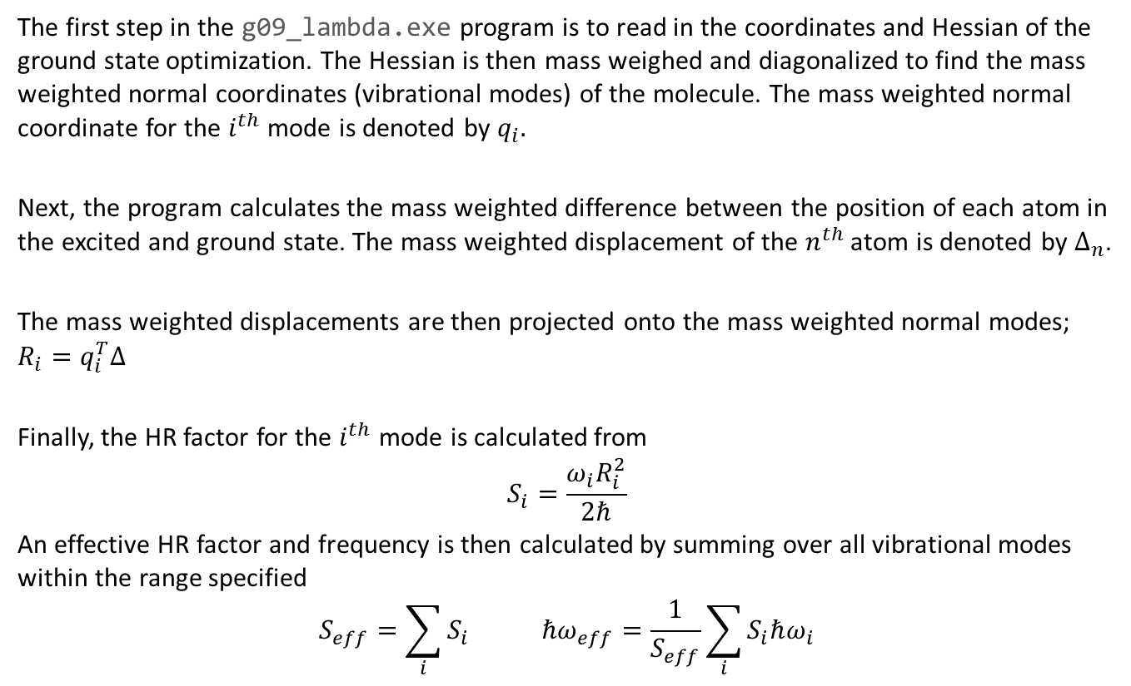
Calculating the HR Factor using Gaussian 09 Output
The first step in the g09_lambda.exe program is to read in the coordinates and Hessian of the ground state optimization. The Hessian is then mass weighed and diagonalized to find the mass weighted normal coordinates (vibrational modes) of the molecule. The mass weighted normal coordinate for the $i^{th}$ mode is denoted by $q_{i}.$
Next, the program calculates the mass weighted difference between the position of each atom in the excited and ground state. The mass weighted displacement of the $n^{th}$ atom is denoted by $Δ_{n}$.
The mass weighted displacements are then projected onto the mass weighted normal modes; $R_{i}=q_{i}^{T}Δ$
Finally, the HR factor for the $i^{th}$ mode is calculated from
$$S_{i}=\frac{ω_{i}R_{i}^{2}}{2ℏ}$$
An effective HR factor and frequency is then calculated by summing over all vibrational modes within the range specified
$$S_{eff}=\sum_{i}{S_{i}} ℏω_{eff}=\frac{1}{S_{eff}}\sum_{i}{S_{i}ℏω_{i}}$$

Slide 7
Calculating the HR Factor using Gaussian 09 Output
The output for our example is:
The output (continued):
h2.out
UB3LYP
CC-pVTZ
************************************************************
Mode Frequency (cm-1) lambda
************************************************************
1 -0.0000213381 -0.0000000000
2 0.0000001868 0.0000000000
3 0.0000191587 -0.0000000000
4 15.0909164122 0.0000000000
5 15.0909174546 0.0000000000
6 4419.5054209318 -46.7234503820
************************************************************
Effective HR range (cm-1): 0.0 50000.0
Effective HR Factor: 2183.08
Effective HR Frequency: 4419.51
************************************************************
Mode Frequency (cm-1) lambda-
************************************************************
1 -0.0000213381 -0.0000000000
2 0.0000001868 0.0000000000
3 0.0000191587 -0.0000000000
4 15.0909164122 0.0000000000
5 15.0909174546 0.0000000000
6 4419.5054209318 -2.9071401138
************************************************************
Effective HR- range (cm-1): 0.0 50000.0
Effective HR- Factor: 8.45
Effective HR- Frequency: 4419.51
************************************************************
Mode Frequency (cm-1) lambda+
************************************************************
1 -0.0000213381 -0.0000000000
2 0.0000001868 0.0000000000
3 0.0000191587 -0.0000000000
4 15.0909164122 0.0000000000
5 15.0909174546 0.0000000000
6 4419.5054209318 -2.1342424985
************************************************************
Effective HR+ range (cm-1): 0.0 50000.0
Effective HR+ Factor: 4.55
Effective HR+ Frequency: 4419.51
Remember, you can use the –h or –-help
Options at any time if you need a reminder how to use the program:
./g09_lambda.exe -h

