Slide 1
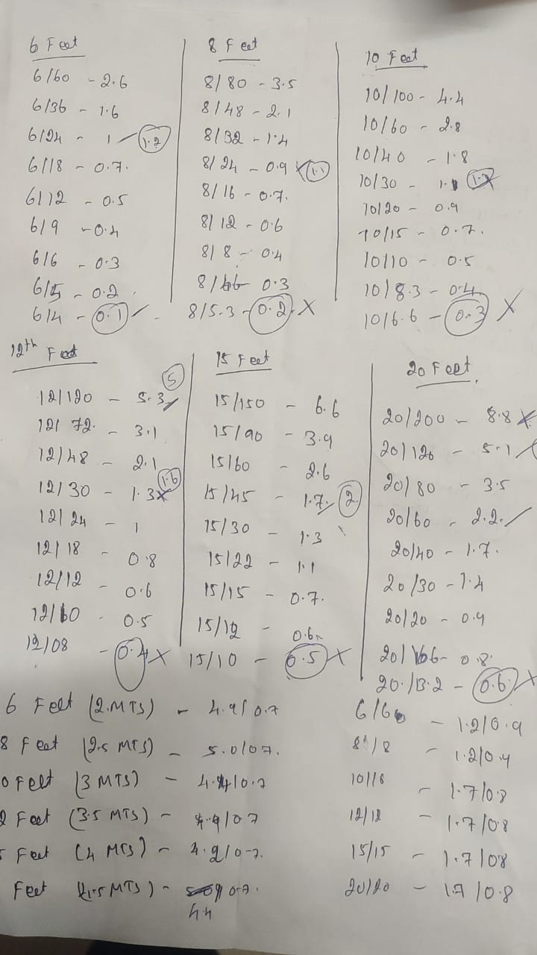

Slide 2
1
1.6/2.6
1.2/2.6
7/26
5/26
4/26
3/26
2/26
1/26
1
8/13
6/13
7/26
5/26
2/13
3/26
1/13
1/26

Slide 3
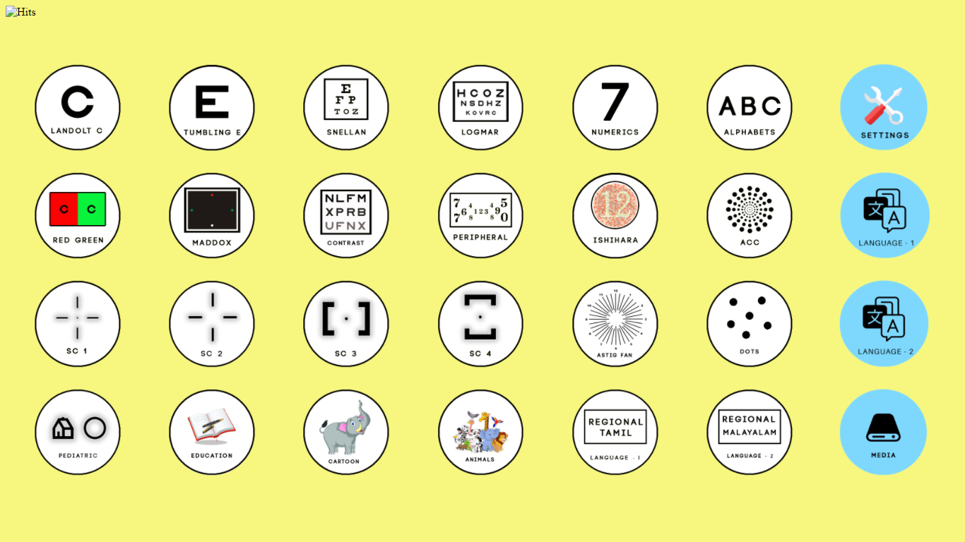

Slide 4
PHOTO
PHOTO
PHOTO

Slide 5
PHOTO
PHOTO
PHOTO
PHOTO
PHOTO
PHOTO
PHOTO
PHOTO
PHOTO
PHOTO
PHOTO
PHOTO

