Slide 1
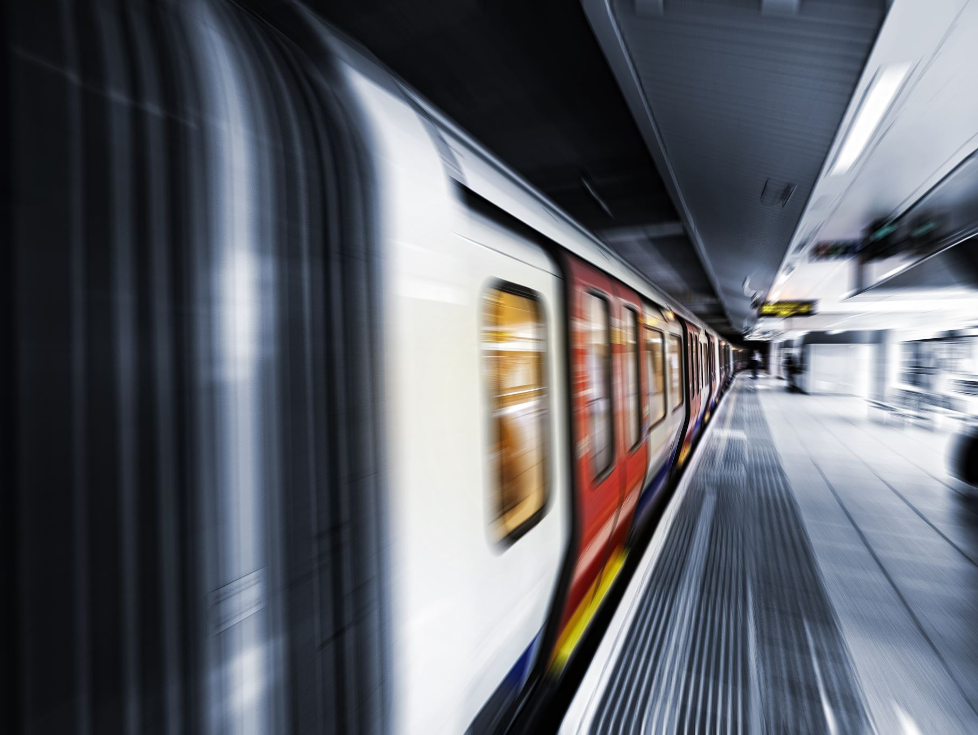
Optimizing Metro Train Maintenance With Predictive Analytics
Using Sparse Autoencoder for Sensor Fault Detection
Tushar Gharpure • Domain Applications • x23289902.student.ncirl.ie

Slide 2
Background & Scope
- Metro trains rely on Air Production Units (APUs) for braking and suspension.
- Failures in APUs can cause service delays and safety risks.
- Traditional maintenance is reactive or schedule-based.
- Predictive maintenance helps detect faults early.
- Sparse Autoencoders learn normal patterns and detect deviations.

Slide 3
Goal & Dataset
- Goal: Detect anomalies in APU sensor data & group fault types.
- Dataset: MetroPT (17+ analog and digital sensor features).
- Data Preprocessing: Normalization and windowing (30 time steps).
- No labeled faults; unsupervised anomaly detection used.

Slide 4
Model Implementation
- Sparse Autoencoder with TimeDistributed Dense layers.
- Input: 3D → samples × 30 timesteps × features.
- L1 regularization enforces sparsity.
- Loss: Mean Squared Error (MSE).
- Anomalies flagged if error > 95th percentile.
- PCA + KMeans used to cluster anomaly types.

Slide 5
Model Implementation – Detailed Measures
1. 3D Input Format: (samples × 30 timesteps × features) enables learning sensor trends over time.
2. TimeDistributed Layers: Applies dense layers to each timestep independently, preserving sequence structure.
3. L1 Regularization: Encourages sparsity in encoding, making the model focus on key signals.
4. MSE Loss: Measures reconstruction accuracy; higher values mean unusual behavior.
5. Adaptive Threshold: Set at 95th percentile of errors to detect outliers dynamically.
6. PCA + KMeans: Groups detected anomalies into clusters representing different fault types.

Slide 6

Business Value & Wrap-up
- Detects early failures before breakdowns.
- Identifies which sensor is causing the issue.
- Reduces downtime, boosts operational efficiency.
- Easy to deploy in real-time systems.
- Future: API deployment, dashboards, live alerting.

Slide 7

Thank You
Questions?

