Slide 1
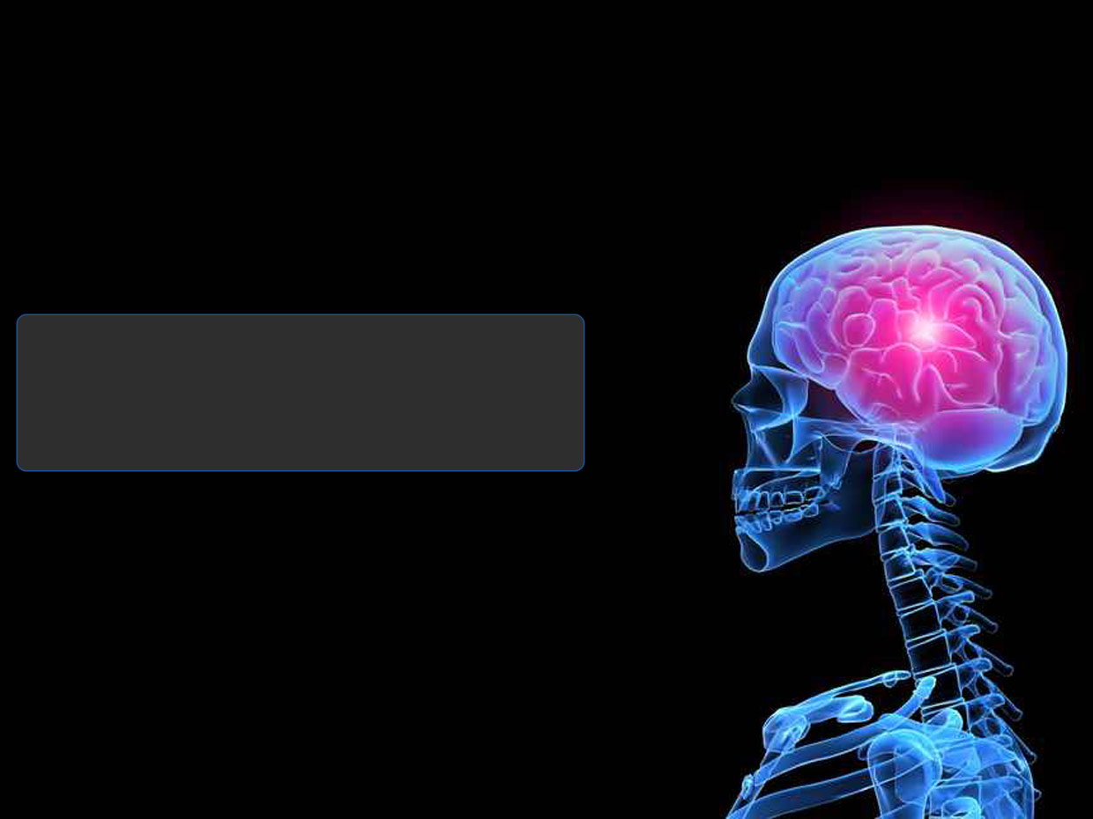
Abhijit Nikhade (fr4466)
Harshini Gangapuram (fr8393)
BRAIN TUMOR DETECTION USING COLOR BASED K MEANS CLUSTERING SEGMENTATION
Presented to:
Dr. Richard Genik.

Slide 2
Epidemiology : Brain Tumor
According to latest update on Brain Tumor Statistics by Central Brain Tumor Registry of United States(CBTRUS) (November 2014)
Brain tumors are the:
One of the leading causes of cancer-related deaths in children under age 20.
Second leading cause of cancer-related deaths in males ages 20-39.
Fifth leading cause of cancer-related deaths in females ages 20-39.

Slide 3
Epidemiology : Brain Tumor Statistics
Nearly 70,000 new cases of primary brain tumors will be diagnosed this year.
More than 4,600 children between the ages 0-9 will be diagnosed with a brain tumor this year.
Brain and CNS tumors are the most common cancers among children ages 0-19.
There are nearly 700,000 people in the US living with the brain tumor.
This year, nearly 14,000 people will lose their battle with the brain tumor.
There are more than 120 types of brain tumors.

Slide 4
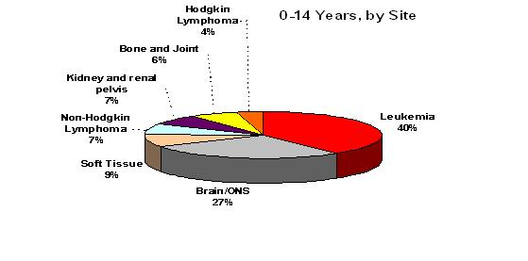
Epidemiology
Source: Surveillance, Epidemiology, and End Results Program, 1975-2003, Div. of Cancer Control and Pop. Sciences, NCI, 2006
27%

Slide 5
Significance of the Project
Based on DIP.
Segmentation is an important process in most of the medical image analysis.
K-means Clustering and Histogram Clustering.

Slide 6
Objective of Project
We are using a color based segmentation method that uses the K means clustering technique to track tumor objects in magnetic resonance (MR) brain images.
The key concept in this color based segmentation algorithm with k-means is to convert a given gray level MR image in to a color space image and then separate the position of tumor objects from other items of an MR image by using K means clustering and histogram clustering.
Experiment demonstrates that the method can successfully achieve segmentation for MR brain images to help pathologists distinguish exactly lesion size and region.

Slide 7
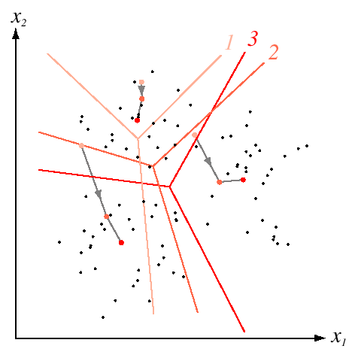
K-means Clustering Concept
It is pixel based clustering method.
It is simple and computational complexity is relatively low compared to other clustering techniques.
Most acceptable method in biomedical image segmentation.

Slide 8
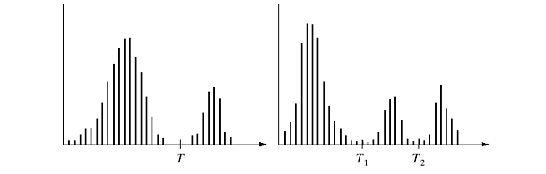
Histogram Statistics
(a) Single Thresholding
(b) Multiple Thresholding

Slide 9

New Approach-Flowchart
Original Image(Gray)
L* Luminosity layer
a*/b* Chromaticity layer
Pseudo color translation
Color plane(R)
Color plane(G)
Color plane(B)
Color space translation
Color plane(L*)
Color plane(a*)
Color plane(b*)
K-means cluster
Cluster selection
Histogram based cluster
Segmented Image

Slide 10
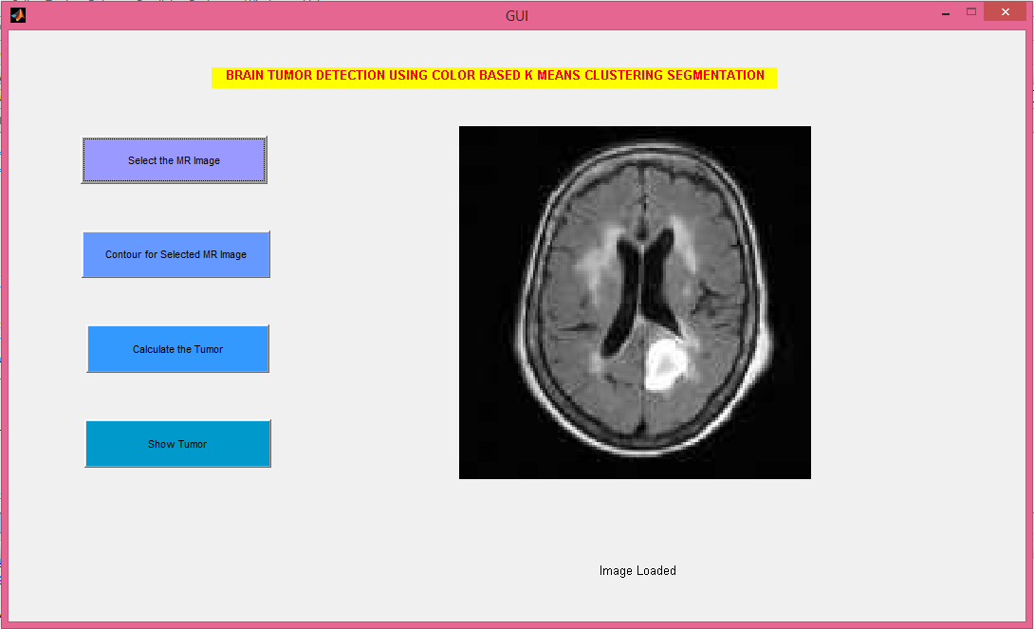
GUI

Slide 11
GUI Instructions
Open the 2010 or a newer version of MATLAB
Make sure that the current directory contains the file GUI.m, main.m and evolution_LGD.m, otherwise change the current directory or add files to the path
Type ‘GUI’ into the command window, the GUI should open
On clicking the pushbutton ‘Select the MR image’, browser should open to select the given MR Image.
On clicking the pushbutton ‘Contour for Selected MR Image’, the threshold values for the image will set..
On clicking the pushbutton ‘Calculate the Tumor’, the K-means clustering algorithm will run to calculate the given tumor and it will store the value of tumor in variable ‘phi’.
On clicking the pushbutton ‘Show Tumor’, the new image showing tumor section will display in axis plane.

Slide 12
Applications
Medical Applications
Locate tumors and other pathologies
  Measure tissue volumes
  Computer guided surgery
  Diagnosis
  Treatment planning
  study of anatomical structure
2. Locate objects in satellite images (roads, forests, etc.)
3. Face Recognition
4. Finger print Recognition , etc.

Slide 13
References
The Cancer Imagine Archieve (TCIA) www.cancerimagingarchieve.net
National Biomedical Imaging Archieve www.ncia.nci.nih.gov
Ming-Ni Wu1, Chia-Chen Lin2, Chin-Chen Chang3 - Brain Tumor Detection Using Color-Based K-Means Clustering Segmentation
https://www.acco.org/Information/AboutChildhoodCancer/ChildhoodCancerStatistics.aspx
http://www.abta.org/about-us/news/brain-tumor-statistics/
Http://www.cbtrus.org

Slide 14
Thank You!

