Slide 1

EAI-Product Team

Slide 2
Introduction.
Deliveries.
Road Map/POC.
Delivery Management.
Roles and Responsibilities

Slide 3

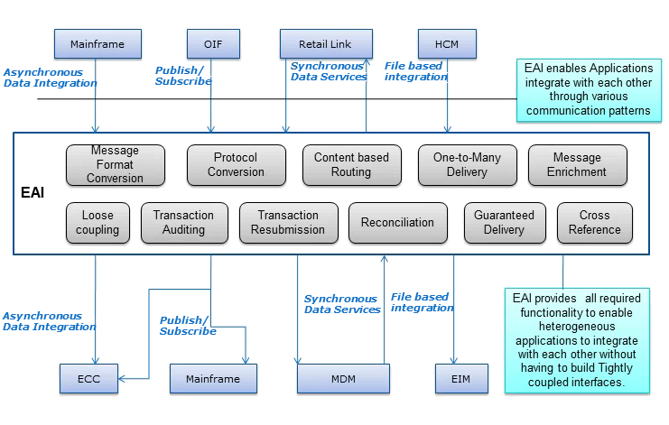
EAI Introduction

Slide 4
Introduction
First generation EAI needs were addressed with individual, tightly coupled components which were precise to a certain interface or a specific business need
Since every interface has its own implementation, the utilization of MQ,MB components was huge which indeed was increasing the development, maintenance and infrastructure consumption and efforts
To overcome these factors, the next generation EAI solution was designed to be loosely coupled, highly scalable and configurable ,which can address all the existing ,on going and forth coming business requirements

Slide 5
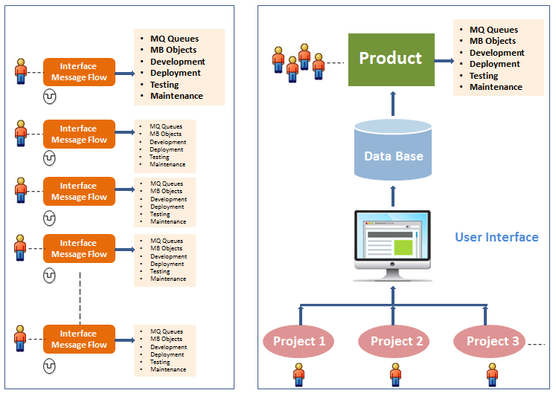
Resource Management/Collaboration

Slide 6
Delivery-User Interface
As a part of Application we have provided a rich GUI built using Microsoft Technologies, Angular JS & Bootstrap.
UI eases the work or the user to provide configuration for other systems in the application. It enables the user to review the transaction logs of various systems activities

Slide 7





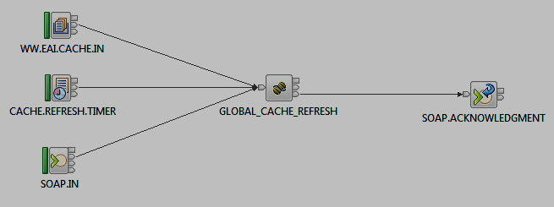



  Cache Refresh Scenario
Properties
File
Database
z Cache
Database View and Key Details
Database View and Key Details
Database View and Key Details
Database View and Key Details
Query Results
Query Results
Query Results
Query Results
On demand refresh through MQ
Trigger Message
System
Hourly refresh through Timer
Hourly refresh through Timer
Refresh Success Ack
Scenario Details Object
Scenario Details Object
Scenario Details Object
Trigger
Scenario Details Object
Trigger
On demand refresh through WebService
Service request
Service Client
ESB110001

Slide 8


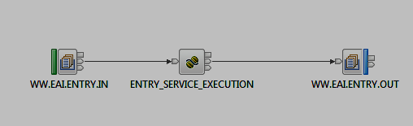
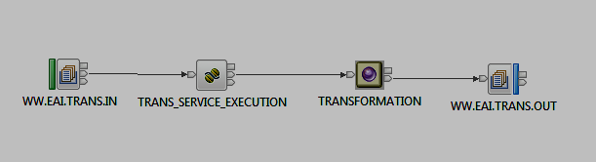
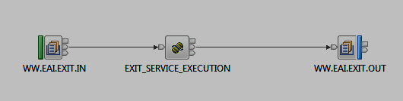
  Scenario Execution
EAI Header
Services
EAI Header
I0718 Message
EAI Header
zCache
EAI Framework
I0700 Message
I0698 Message
Entry Flow
MQRFH Header
MQRFH Header
Destination List
Message
MQRFH Header
EAI Header
EAI Header
EAI Header
Trans Flow
I0718 Message
I0700 Message
I0698 Message
I0698 Message
I0718 Message
Source
System
I0700 Message
Target System
EAI Header
Destination List
EAI Header
EAI Header
Exit Flow
I0698 Message
I0700 Message
I0718 Message
I0718 Message
I0698 Message
I0700 Message
Destination List
ESB110001

Slide 9


Delivery Management
REQUIREMENTS
BUILD
Backlog
Scrum
Planning
Development
Continuous Integration
Stake Holder
Backlog
Review
Sprint
Planning
Implementation
Design
Testing /Sign Off
Planning
Priorities
Build
Deploy
Product Team
Change Initiation (Product Enhancement)
Failure
Success
RELEASE

Slide 10





Team Hierarchy
Product Owner
Product Architect
SCRUM TEAM
Scrum Master
Technical Lead 1
Technical Lead 2
Technical Lead 3
Technical Lead n
Team 1
Team 2
Team 3
Team n

Slide 11


Together We Succeed

