Slide 1

Stronghold High Level
GIP-Tech-Services-EAI

Slide 2
Agenda
ESB Patterns
IIB
WMQ Cluster
3-Flow
MFT

Slide 3
ESB Patterns

Slide 4
ESB Patterns
Publish-Subscribe messaging
Request – Reply (MQ)
Request – Response (SOAP/REST)
Asynchronous one way (MQ)
Asynchronous one way with acknowledgment (MQ)
Asynchronous one way with acknowledgment (SOAP/REST)
Batch (File based communication)

Slide 5
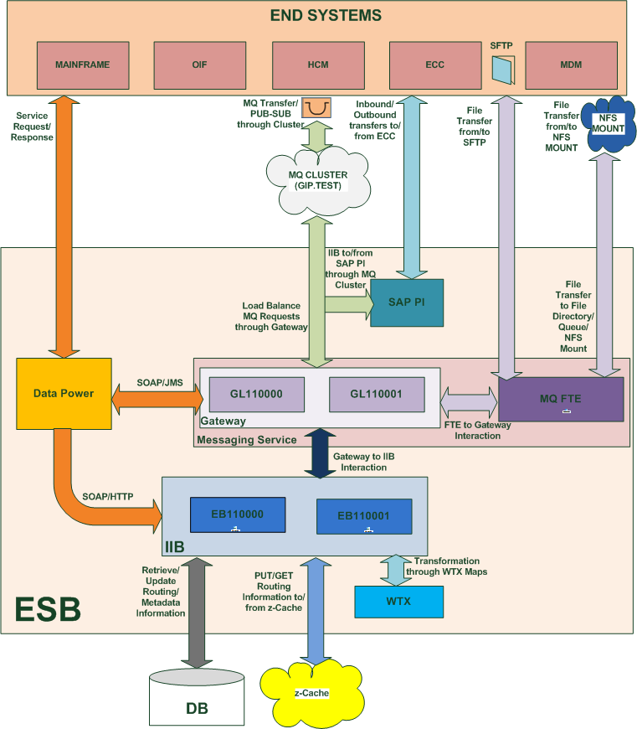


ESB Patterns
Service Request
Data
Service Request
Publish Data
Message
Pub-Sub Pattern
Data
Service Over HTTP Pattern
Data
Message Queue Pattern
FTE MQ Pattern
Data
NFS FTE Pattern
Service Over JMS Pattern
SFTP FTE Pattern
Service Request
Reply Message
Local Agent
Local Agent
Bridge Agent
BridgeAgent
Local Agent
Local Agent
Data
Data
Data
Data
Data
Data
Data
Service Response
Data

Slide 6
IIB

Slide 7
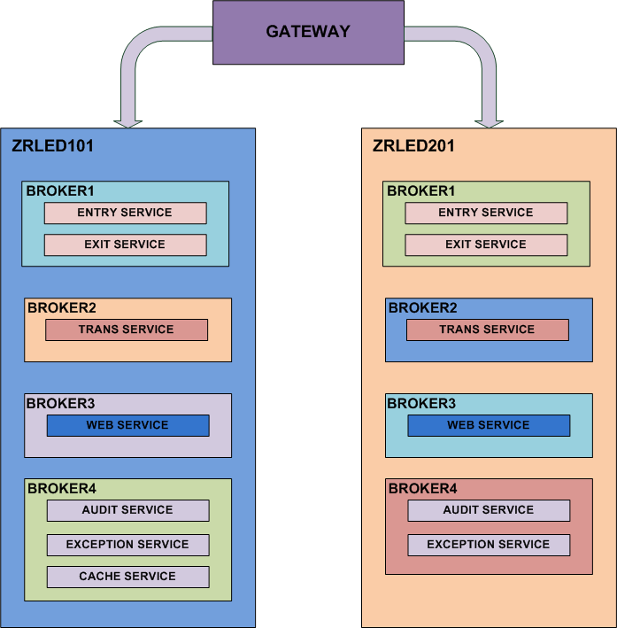
IIB
Notes:
This slide describes concept of a Processing Hop, that is one of the EAI 2.0 Architectural component.

Slide 8
WMQ Cluster

Slide 9
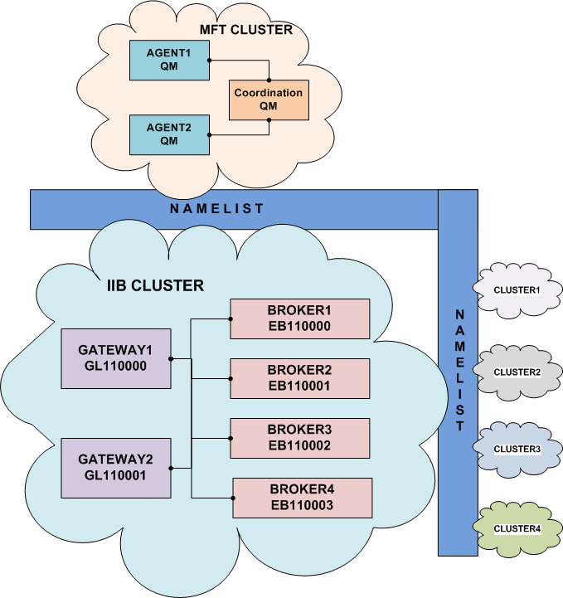
WMQ Cluster
Notes:
This slide describes concept of a Processing Hop, that is one of the EAI 2.0 Architectural component.

Slide 10
3 Flow

Slide 11
3-Flow
EAI 2.0 architecture would employ 3 standard processing Hops for majority of business interfaces
Entry
Hop
Transformation
Hop
Exit
Hop
Message
Message
Message
From
Src
System
Trnsfm
Hop
MQ
MQ
Exit
Hop
MQ
MQ
To Target
System
Entry hop will identify processing route and services for the interface from Routing cache that is loaded from configuration database.
Transformation hop will perform enrichment and source-to-target message mapping using WTX.
Exit hop will perform encoding/encryption if required on target message before routing it to the target system.
Notes:
This slide describes concept of a Processing Hop, that is one of the EAI 2.0 Architectural component.

Slide 12
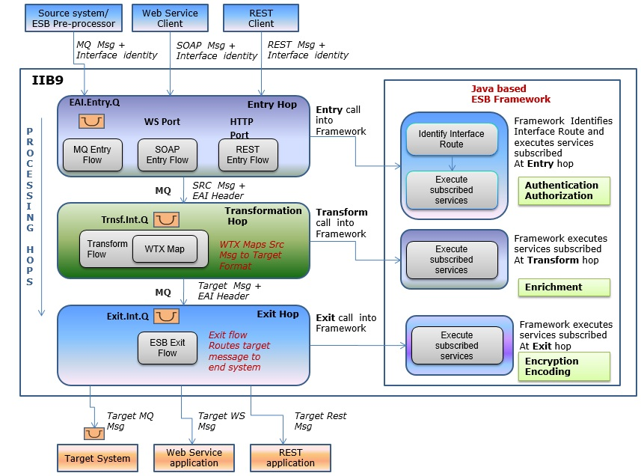
3-Flow

Slide 13
MFT

Slide 14
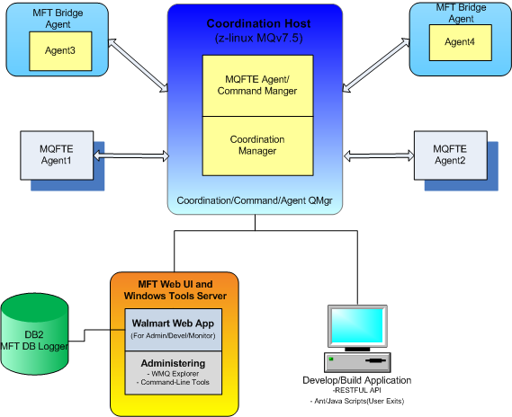
MFT

Slide 15

Q & A
Together We Succeed

