Slide 1
Physics 4250: Computational Physics Final Project
Efficient Path Optimization with Quadtree Partitioning
Gene Harvey, Courtney Bonner, Adnan Hafeez

Slide 2
Overview
Algorithm that finds the shortest path between two points
Quadtree
A*
C Code and Python
MATLAB

Slide 3

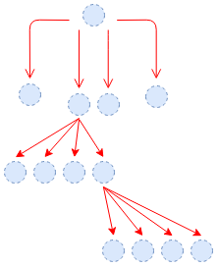
Data Structure
Quadtree: To localize and isolate obstacles from a map and turn continuous empty space into a grid that can be treated as a graph
Whole Image
Quadrants
Whole Image

Slide 4
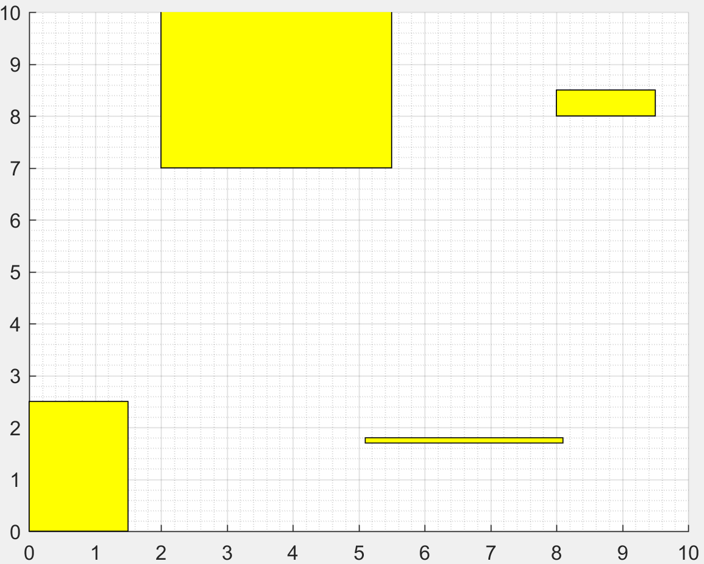
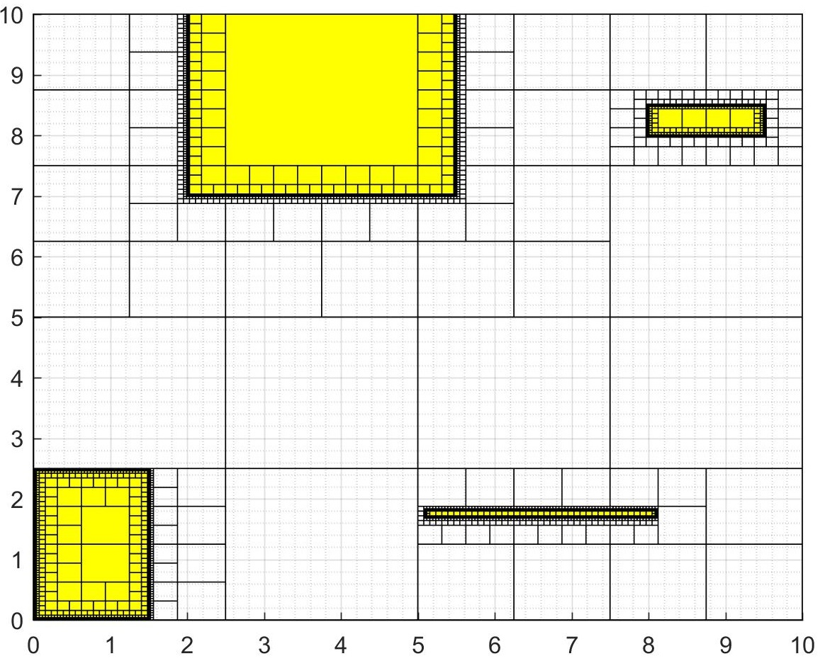
Original Image
Partitioned with Quadtree

Slide 5
Method for data structures
Once the tree is constructed the program removes all the lowest level children
A node is constructed(Square boxes)
This makes a graph out of non-discrete map making pathfinding easier
Advantages of Quadtree
The tree contains all the information we need to find the shortest path
Easy to construct
The information of all the nodes is output to the Python code

Slide 6

Quadtree challanges
Had to make a tradeoff between memory efficiency and temporal efficiency. We chose CPU efficiency.
For our purposes 16GB was sufficient
Modifications required to conserve memory
Would greatly effect temporal efficiency
Memory usage
$\text{𝒪}\left(4^{n^{2}}\right)$
(This is bad)

Slide 7
Control variables used to offset memory issue
actual_to_max_children_ratio
(0.75) A guess for what percentage of the maximum number of nodes will actually be created. The maximum number of nodes is 4^{n} where n is the chosen threshold
max_num_adjacent
(30) A guess for the maximum number of adjacent nodes any given node will have
Program exits and notifies the user if either of these values are set too low
If too high => causes memory over flow => causing program to most likely crash

Slide 8
Path Optimization
Goal: Take the Quadtree image outputted by the C program and find the shortest path between any and all points

Slide 9
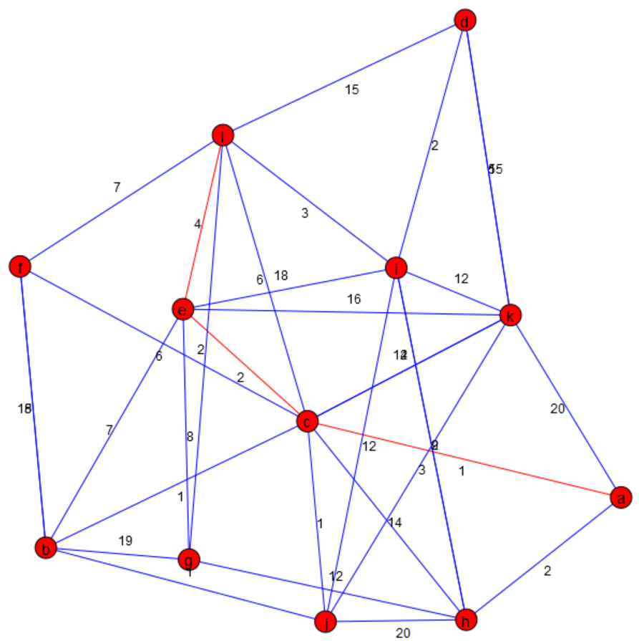
One method
Dijkstra’s Algorithm
Used for graphs with weighted edges
Deterministic
We use a variation of Dijkstra’s algorithm called A*
Works in same way, but adds a heuristic
Otherwise algorithms are identical

Slide 10
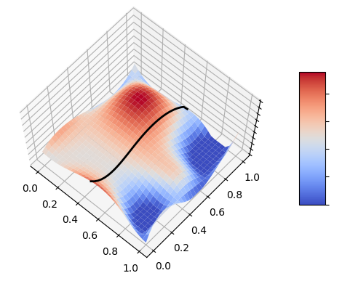
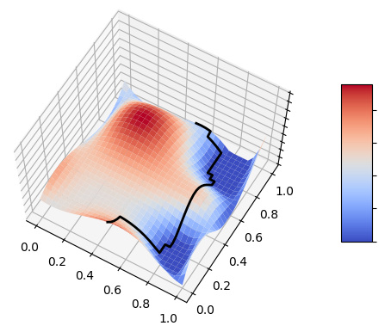
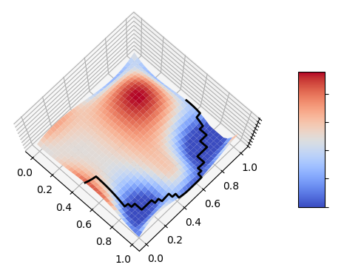
A better method
Heuristic adds externally defined cost to movement
Basically, it’s a potential
Results in a constraint to search space
Our case: Euclidean distance
Downside: May give poor results
A*: Large scalar parameter
A*: ∝ scalar parameter
Dijkstra solution

Slide 11
Dynamic Programming
Previous paths can be used to find newer paths
Reducing computation time
Using a memory-based data structure
The next time a same sub problem occurs, instead of re-computing its solutions, one simply looks up the previously computed solution

Slide 12
Challenges
Lackluster computation speed
Multithreading
20 minutes vs 39 days
(Days are generally longer than minutes)

Slide 13
Improvements
All paths are currently found recursively, which is usually not as fast as an iterative algorithm
If time permitted, rewrite algorithm iteratively to see how much of a speedup we could get.

Slide 14
Thank You Any questions?

