Slide 1

A Federated Learning Approach for Layer 2 Network Intrusion Detection with Explainable AI Across Distributed Network Segments
Hosein Ghasemizade
Dr. Azita Shirazipour
Central Tehran Branch

Slide 2
TABLE OF CONTENT
Research Overview
Literature and Research Background
Methodology
Data Analysis
Conclusions and suggestions

Slide 3
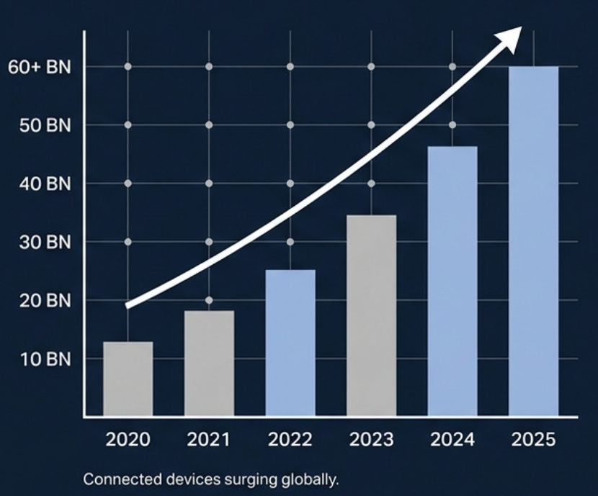
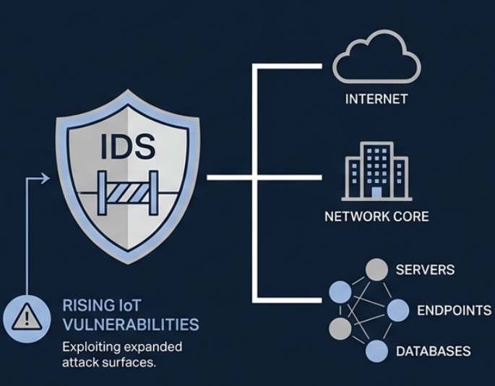
THE THREAT LANDSCAPE
Introduction | Research Overview
Exponential growth of edge devices
TRADITIONAL IDS AS THE PERIMETER GATEKEEPER
1
2
3
4
5

Slide 4
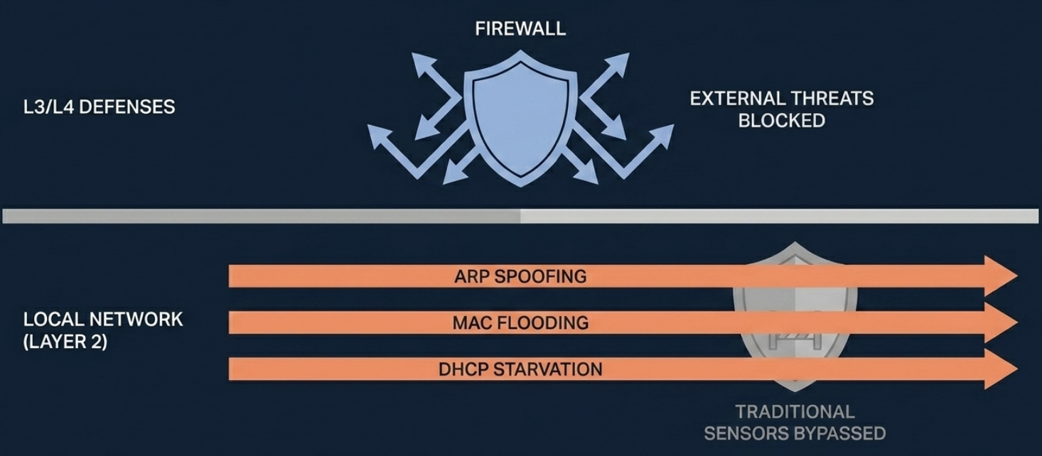
THE LAYER 2 BLIND SPOT
Problem Statement | Research Overview
1
2
3
4
5

Slide 5
INDENTIFYING THE RESEARCH GAP
Research Gap | Research Overview
DEEP LEARNING IDS
LAYER 2 SECURITY
While FL and XAI have been applied to intrusion detection systems, their combined use for Layer 2 attack detection remains relatively underexplored.
1
2
3
4
5
FEDERATED PRIVACY

Slide 6
RESEARCH OBJECTIVES
Research Objectives | Research Overview
1
3
Maximize Detection Accuracy
Detect localized Layer 2 attacks with high precision.
Preserve Data Privacy
Keep raw data on local nodes at all times.
1
2
3
4
5
2
4
Ensure Explainability
Provide transparent, human readable reasoning for alerts.
Lightweight Deployment
Operate efficiently on edge hardware with limited resources.

Slide 7
CORE RESEARCH QUESTIONS
Research Questions| Research Overview
Can a federated Layer-2 IDS achieve comparable detection performance to a centralized IDS?
Q1
How does Non-IID data distribution across network segments affect federated IDS performance?
Q2
1
2
3
4
5
Does FedProx improve robustness and detection performance compared with FedAvg under heterogeneous network conditions?
Q3
Which Layer-2 traffic features contribute most significantly to attack detection decisions according to SHAP analysis?
Q4
Can the proposed federated IDS be deployed efficiently on resource-constrained devices such as Raspberry Pi?
Q5

Slide 8
RESEARCH HYPOTHESES
Research Hypotheses| Research Overview
CNN + Bi-LSTM Architecture
Will maximize the accuracy of stealthy attack detection
H1
FedProx over FedAvg
Will stabilize traning and perform better on
Non-IID distributed data.
1
2
3
4
5
H2
SHAP Integration
Will successfully demystify the AI black box
And increase decision transparency.
H3

Slide 9
IDS Based on Location
Literature Work| Literature and Research Background
HIDS (Host-IDS)
Install on a system/host
Review logs, processes, and internal activities
Detailed visibility but limited to the same device
Not suitable for analyzing the entire network
NIDS(Network-IDS)
Network-level exposure
Analysis of traffic and packets between nodes
A comprehensive view of the entire network behavior
Suitable for network attacks
1
2
3
4
5

Slide 10
LITERATURE TABLE
Literature Table| Literature and Research Background
Study | L2 Detection | Deep Learning | Federated Privacy | Explainable AI
Papers 1-2 | ✅ | ✅ | ❌ | ❌
Papers 3-4 | ✅ | ✅ | ❌ | ✅
Papers 5-6 | ❌ | ❌ | ✅ | ❌
Proposed Framework | ✅ | ✅ | ✅ | ✅
1
2
3
4
5
Review of seven foundational papers indicates that existing IDS research has not sufficiently explored the combination of Layer 2 attack detection, Federated Learning, explainability, Non-IID evaluation, and lightweight deployment within a single framework.

Slide 11
PROPOSED SYSTEM ARCHITECTURE
Proposed system Architecture | Methodology
Federated Nodes
Local Feature Extraction
Encrypted Weights
(No Raw Data)
Federated Nodes
Local Feature Extraction
Aggregation Server FedProx Integration
Explainable AI (XAI) Module
Analyst Dashboard
1
2
3
4
5
Encrypted Weights
(No Raw Data)
Federated Nodes
Local Feature Extraction
Encrypted Weights
(No Raw Data)

Slide 12
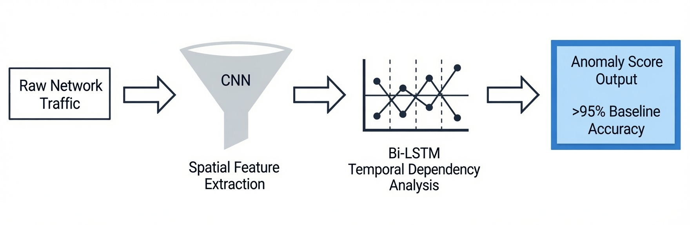
THE DEEP LEARNING ENGINE
Deep Learning | Methodology
1
2
3
4
5

Slide 13

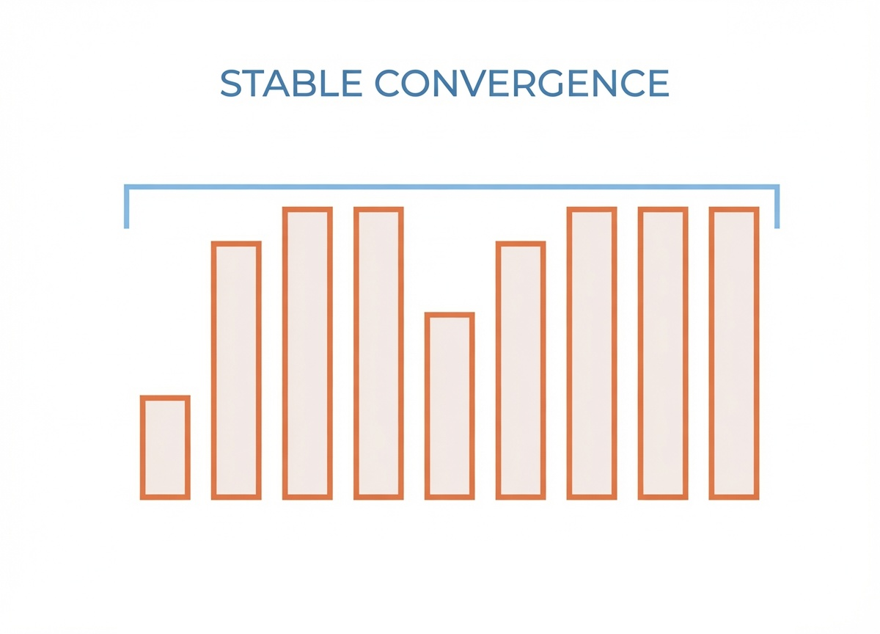
FEDERATED LEARNING FRAMEWORK HANDLEING REAL-WORLD NON-IID DATA
Federated Learning Framework | Methodology
FEDAVG ALGORITHM
FEDPROX ALGORITHM
1
2
3
4
5
Struggles with uneven data distribution across network segments.
Introduces a proximal term to balance unequal local training.

Slide 14
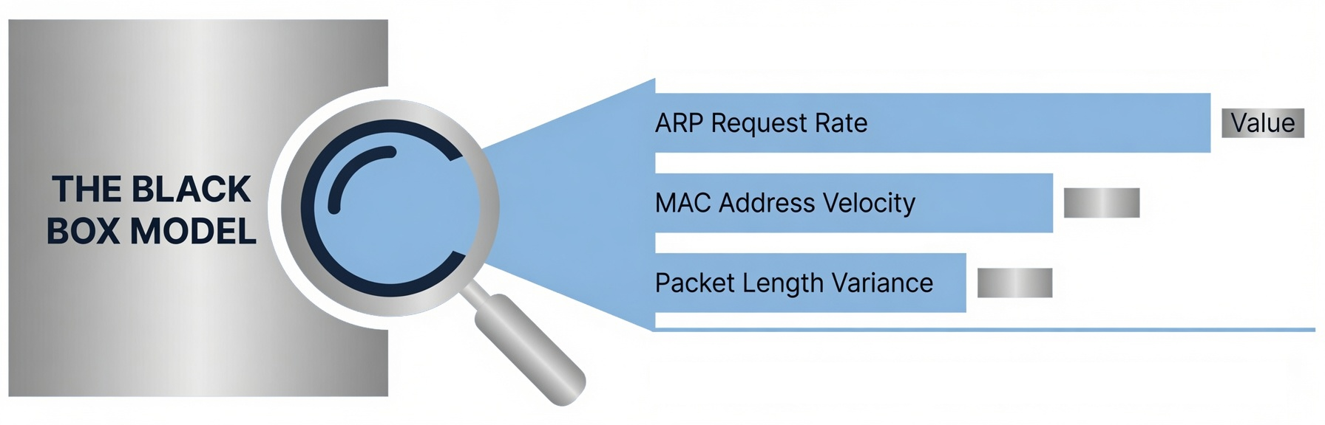
EXPLAINABLE AI (THE SHAP LENS)
Explainable AI | Methodology
FEATURE IMPORTANCE ANALYSIS
1
2
3
4
5
TRANSPARENT ANALYST INSIGHTS

Slide 15

METHODOLOGY (DATASETS)
Datasets | Methodology
Training & Simulation
Real-World Validation
Benchmarking
CL2-IDS
BCAST IDS
1
2
3
4
5
CICIDS-2023
Simulates Layer 2 behaviors across multiple federated nodes.
Introduces environmental noise to validate robustness.
Provides performance baselines against conventional legacy systems.

Slide 16
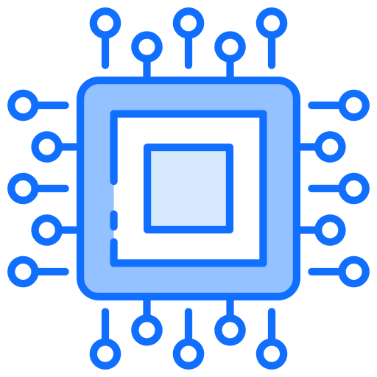




EVALUATION METRICS & HARDWARE VIABILITY
Evaluation Metrics | Data Analysis
$$Precision= \frac{TP}{TP+FP}$$
$$Accuracy= \frac{TP+TN}{TP+TN+FP+FN}$$
$$F1−Score= \frac{2∗Precision∗Recall}{Precision+Recall}$$
$$Recall= \frac{TP}{TP+FN}$$
1
2
3
4
5
0.992
0.988
Hardware Utilization CPU & Memory Overhead Monitoring
ROC-AUC Curve
PR-AUC Curve

Slide 17
EXPECTED RESULTS & FEASIBILITY
Expected Results | Data Analysis
Centralized DL Baseline
100% Data Privacy Retained
Performance Gap
Federated DL Projection
Robust in Non-IID Environments
3
4
5
1
2
Edge Hardware Ready

Slide 18
PRIMARY RESEARCH INNOVATIONS
Research Innovations| Data Analysis
1
Designing a federated learning-based layer 2 intrusion detection framework for distributed environments with the aim of preserving privacy and not transmitting raw data.
2
Investigating the effect of heterogeneous data (IID / Non-IID) on system performance and simulating real-world conditions of organizational networks.
1
2
3
4
5

Slide 19
PRIMARY RESEARCH INNOVATIONS
Research Innovations| Data Analysis
3
Analysis of the performance of the FedProx algorithm in improving stability and accuracy compared to FedAvg in Non-IID conditions.
4
Using SHAP for model explainability and identifying features effective in detecting attacks.
1
2
3
4
5

Slide 20
Conclusion & Future Work
Conclusion & Future Work| Conclusions
Conclusion
Successfully neutralizes Layer2 blind spots
Preserves total data privacy without sacrificing performance.
Eliminates the AI black box via SHAP.
Future Work
Transitioning from simulated environments to real-time deployment.
Evolving toward fully autonomous Edge AI security frameworks.
1
2
3
4
5

Slide 21
THANK YOU FOR ATTENTION.

