Slide 1

A Federated Learning Approach for Layer 2 Network Intrusion Detection with Explainable AI Across Distributed Network Segments
Hosein Ghasemizade
Dr. Azita Shirazipour
Central Tehran Branch

Slide 2
TABLE OF CONTENT
Research Overview
Literature and Research Background
Methodology
Data Analysis
Conclusions and suggestions
Questions & Discussion

Slide 3
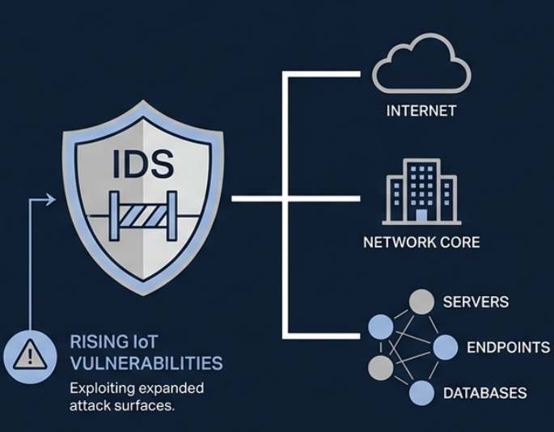
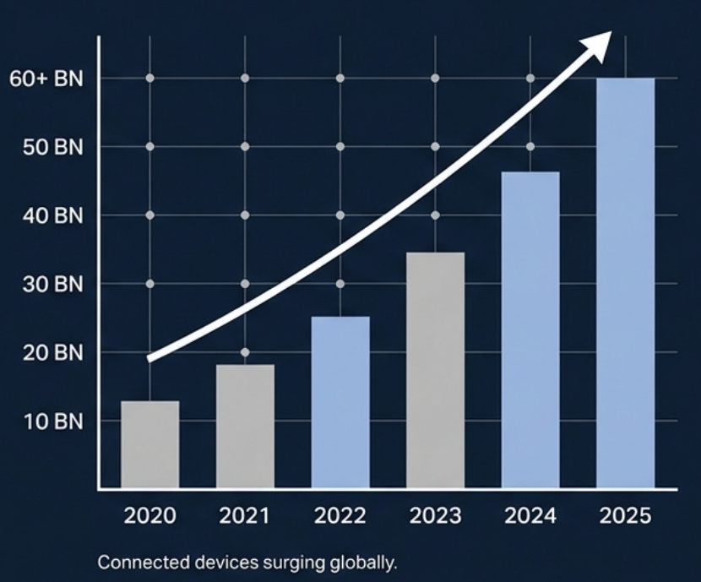
THE THREAT LANDSCAPE
Introduction | Research Overview
Exponential growth of edge devices
TRADITIONAL IDS AS THE PERIMETER GATEKEEPER

Slide 4
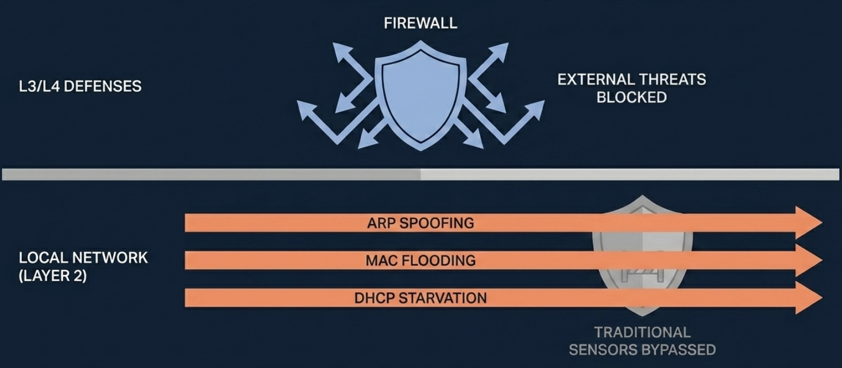
THE LAYER 2 BLIND SPOT
Problem Statement | Research Overview

Slide 5
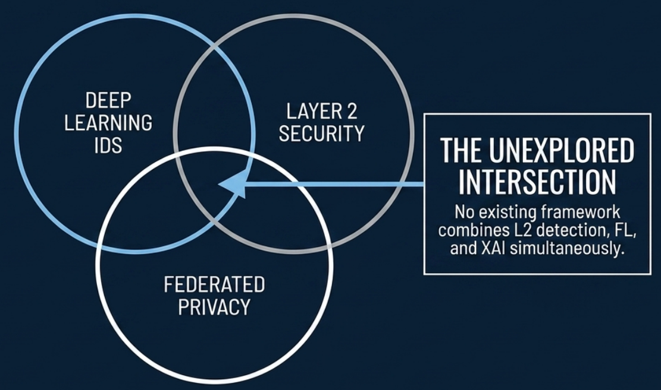
INDENTIFYING THE RESEARCH GAP
Research Gap | Research Overview

Slide 6
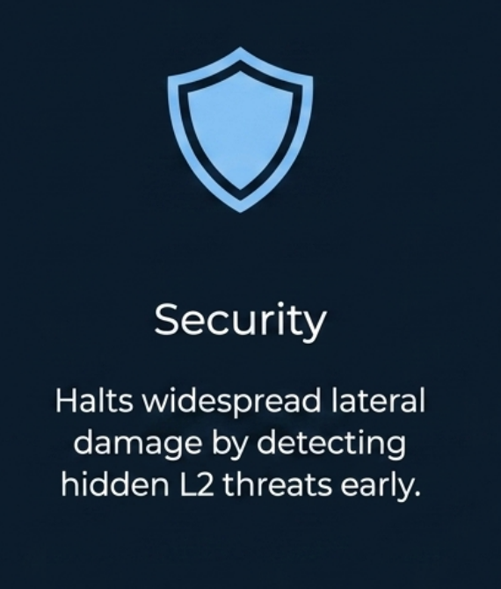
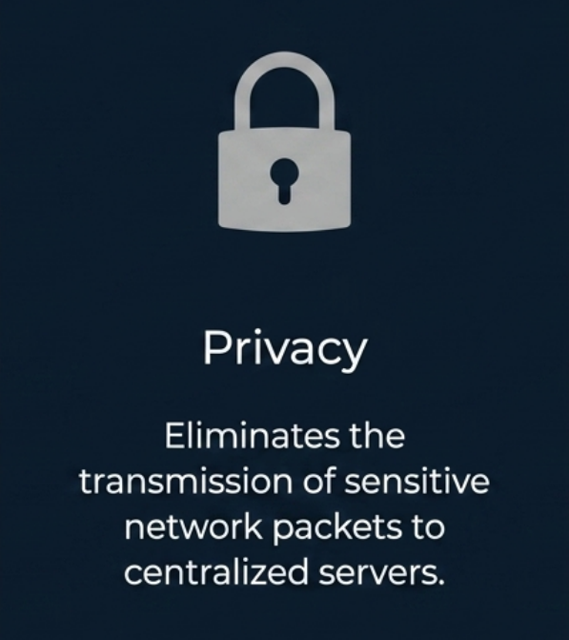

SIGNIFICANCE OF THE STUDY
Significance of Study | Research Overview

Slide 7
RESEARCH OBJECTIVES
Research Objectives | Research Overview
1
3
Maximize Detection Accuracy
Detect localized Layer 2 attacks with high precision.
Preserve Data Privacy
Keep raw data on local nodes at all times.
2
4
Ensure Explainability
Provide transparent, human readable reasoning for alerts.
Lightweight Deployment
Operate efficiently on edge hardware with limited resources.

Slide 8
CORE RESEARCH QUESTIONS
Research Questions| Research Overview
Can a federated Layer-2 IDS achieve comparable detection performance to a centralized IDS?
Q1
How does Non-IID data distribution across network segments affect federated IDS performance?
Q2
Does FedProx improve robustness and detection performance compared with FedAvg under heterogeneous network conditions?
Q3
Which Layer-2 traffic features contribute most significantly to attack detection decisions according to SHAP analysis?
Q4
Can the proposed federated IDS be deployed efficiently on resource-constrained devices such as Raspberry Pi?
Q5

Slide 9
RESEARCH HYPOTHESES
Research Hypotheses| Research Overview
CNN + Bi-LSTM Architecture
Will maximize the accuracy of stealthy attack detection
H1
FedProx over FedAvg
Will stabilize traning and perform better on
Non-IID distributed data.
H2
SHAP Integration
Will successfully demystify the AI black box
And increase decision transparency.
H3

Slide 10
LITERATURE MATRIX
Literature Matrix| Literature and Research Background
Study | L2 Detection | Deep Learning | Federated Privacy | Explainable AI
Papers 1-2 | ✅ | ✅ | ❌ | ❌
Papers 3-4 | ✅ | ✅ | ❌ | ✅
Papers 5-7 | ❌ | ❌ | ✅ | ❌
Proposed Framework | ✅ | ✅ | ✅ | ✅
Review of 7 foundational papers confirms the absence of a comprehensive IDS solution.

Slide 11
PROPOSED SYSTEM ARCHITECTURE
Proposed system Architecture | Methodology
Federated Nodes
Local Feature Extraction
Encrypted Weights
(No Raw Data)
Aggregation Server FedProx Integration
Federated Nodes
Local Feature Extraction
Explainable AI (XAI) Module
Analyst Dashboard
Encrypted Weights
(No Raw Data)
Federated Nodes
Local Feature Extraction
Encrypted Weights
(No Raw Data)

Slide 12
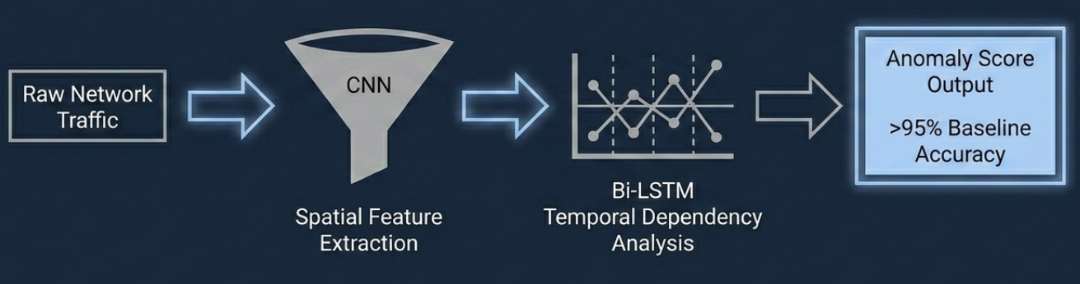
THE DEEP LEARNING ENGINE
Deep Learning | Methodology

Slide 13
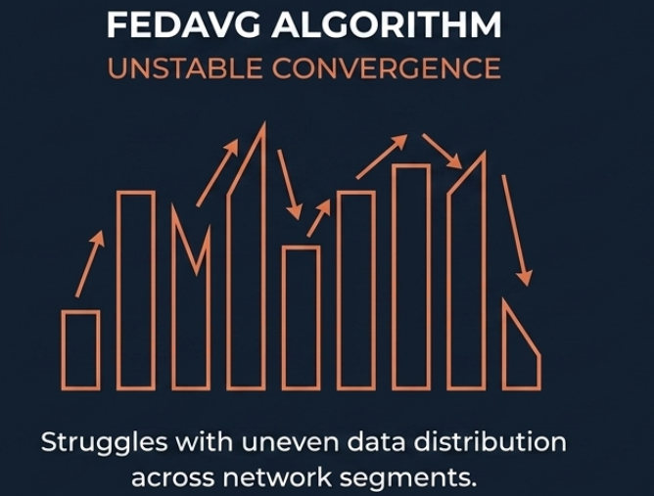
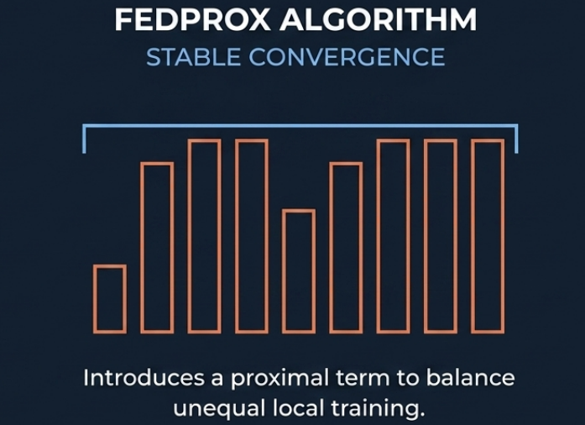
FEDERATED LEARNING FRAMEWORK HANDLEING REAL-WORLD NON-IID DATA
Federated Learning Framework | Methodology

Slide 14
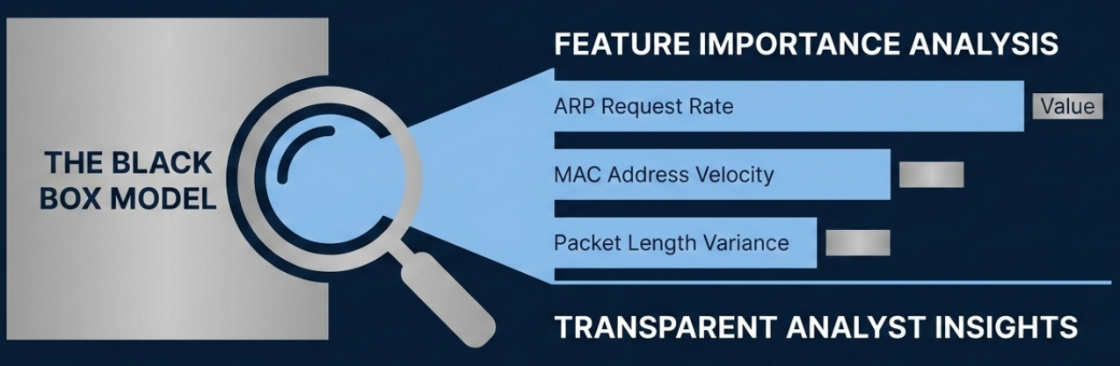
EXPLAINABLE AI (THE SHAP LENS)
Explainable AI | Methodology

Slide 15

METHODOLOGY (DATASETS)
Datasets | Methodology
Training & Simulation
Real-World Validation
Benchmarking
CL2-IDS
BCAST IDS
CICIDS-2023
Simulates Layer 2 behaviors across multiple federated nodes.
Introduces environmental noise to validate robustness.
Provides performance baselines against conventional legacy systems.

Slide 16
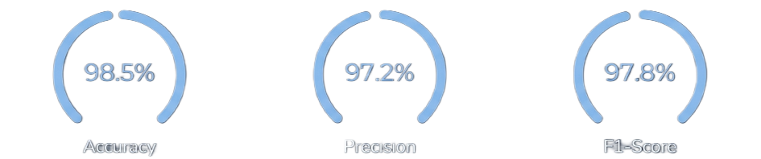

EVALUATION METRICS & HARDWARE VIABILITY
Evaluation Metrics | Data Analysis
0.992
0.988
Hardware Utilization CPU & Memory Overhead Monitoring
ROC-AUC Curve
PR-AUC Curve

Slide 17
EXPECTED RESULTS & FEASIBILITY
Expected Results | Data Analysis
Centralized DL Baseline
100% Data Privacy Retained
Performance Gap
Federated DL Projection
Robust in Non-IID Environments
Edge Hardware Ready

Slide 18
PRIMARY RESEARCH INNOVATIONS
1
Unprecedented Integration
framework to unite Federated Learning and L2 attack detection.
2
Operational Transparency
Application of XAI to transform network anomalies into actionable intelligence.
3
Standardized Evaluation
A holistic framework measuring both algorithmic accuracy and hardware overhead.

Slide 19
Conclusion & Future Work
Conclusion
Successfully neutralizes Layer2 blind spots
Preserves total data privacy without sacrificing performance.
Eliminates the AI black box via SHAP.
Future Work
Transitioning from simulated environments to real-time deployment.
Evolving toward fully autonomous Edge AI security frameworks.

