Slide 1
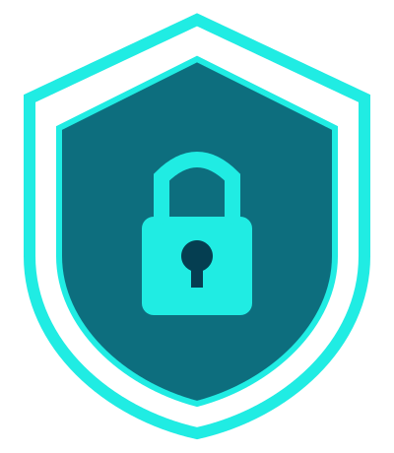
CHAPTER 1
Cybersecurity
Fundamentals
Essential Principles, Practices & Technologies
to Protect Systems, Networks & Data
Learn from Practitioners
Notes:
The fundamentals of cybersecurity are the essential principles, practices, and technologies used to protect systems, networks, and data from various cyber threats and attacks. These fundamentals form the foundation of any secure IT environment.
In this chapter the basic fundamentals principles are covered which is the foundation in a Cybersecurity world.

Slide 2

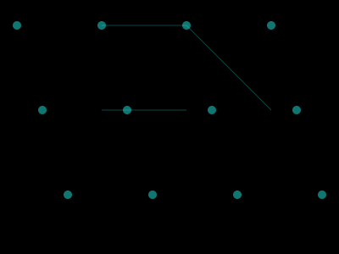
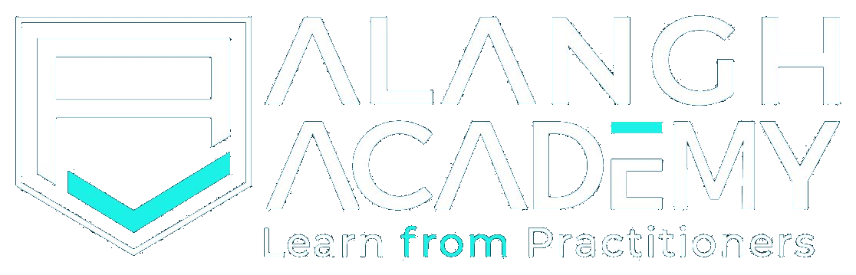
Introduction to Cybersecurity
Overview
Notes:
Cybersecurity is the practice of protecting computer networks, devices, and information from damage, loss or unauthorized access. It is important to note that cybersecurity protects digital information from cyberthreats. The protection of information means the preservation of confidentiality, integrity, and availability of information in the cyberspace.
Cybersecurity professionals act to protect servers, endpoints, databases, and networks by finding security gaps and misconfigurations that create vulnerabilities.

Slide 3
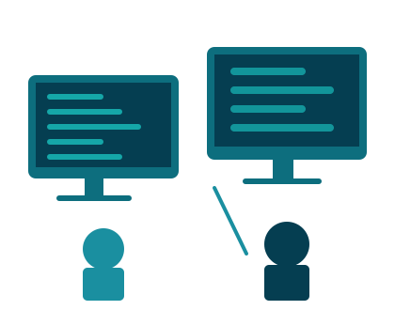
Learning Objectives
After completing this lesson, you will be able to achieve these objectives:
Overview of cybersecurity and its threat landscape covering CIA (Confidentiality, Integrity & Availability) and the threats globally
Various Cybersecurity protection layers and the best Cybersecurity practices to be implemented
Cybersecurity and co-relation with industry standards, compliance and regulatory laws and the various Cybersecurity domains
Evolution of cybersecurity, role and Future of AI in Cybersecurity and current Cybersecurity market
Notes:
Learning Objectives:
After completing this lesson, you will be able to achieve the understanding of the below topics:
Overview of cybersecurity and its threat landscape covering CIA (Confidentiality, Integrity & Availability) and the threats globally
Various Cybersecurity protection layers and the best Cybersecurity practices to be implemented
Cybersecurity and co-relation with industry standards, compliance and regulatory laws and the various Cybersecurity domains
Evolution of cybersecurity, role and Future of AI in Cybersecurity and current Cybersecurity market

Slide 4


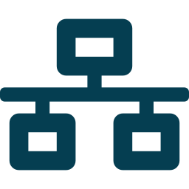



What Is Cybersecurity?
Categories of Cybersecurity
Critical Infrastructure
Application Security
Network Security
Internet of Things (IoT) Security
People and Processes
Cloud Security
Notes:
Cybersecurity can be divided into five categories: critical infrastructure security, application security, network security, cloud security, and the Internet of Things (IoT) security.
Note that other organizations may categorize the types of cybersecurity differently or label them differently. In addition to these five categories there are the people and processes that use technology to defend computer systems, networks, and the information therein.
These different categories reflect the extent that computer technologies have transformed the world.
From online management of gas pipelines or electrical grids to applications that allow users to buy and sell goods online to collaborating with work colleagues irrespective of geography to renting data storage in the cloud to tracking printer toner and maintenance, all of these technologies have transformed how people live and how they do business.

Slide 5



Why Is Cybersecurity Important?
Improved Efficiencies
Digital
Transformation
Digital Libraries
The digital transformation has realized enormous efficiencies, expanded conveniences, and exponentially increased productivity. Without securing computer networks and the links that connect them, all of these advances are at risk.
Notes:
The digital transformation has realized enormous efficiencies, expanded unheard of conveniences, supplied omnipresent access to information, and exponentially increased productivity, which has grown wealth and improved the quality of life. For example, people living in remote areas of the world can access medical experts using computer technologies. Personal medical information can be collected locally and transferred to medical experts to assist in diagnosis and remedies. Without securing computer networks and the links that connect them, all of these advances are at risk.

Slide 6


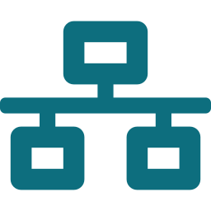
Information Security and Information Systems Security
Information security (InfoSec) is the practice of protecting information.
Processes
Threats
Systems
Digital
Physical
Information stored electronically — computers, networks, servers, cloud systems, databases
Information in physical form — files on a desk, in cabinets, printed documents, hardware
Notes:
Information security, also known as InfoSec, is the practice of protecting information. InfoSec includes the tools and processes used for preventing, detecting, and remediating attacks and threats to sensitive information, both digital and physical. InfoSec also includes documenting the processes, threats, and systems that affect the security of information. The nature of the information is inclusive and broad. It includes information stored electronically on a computer, or information laying on someone’s desk, or stored in a file cabinet. Information that might require protection could also include everything from mission-critical data, to HR policies to legal contracts.

Slide 7
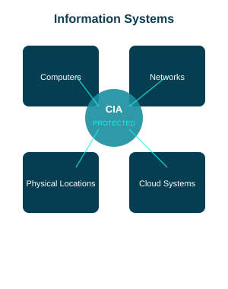




Information Systems Security
Information systems security is a part of InfoSec. It is defined as the protection of information systems against:
Unauthorized Access
Modification
Destruction
Denial of Access
Notes:
Information systems security is a part of InfoSec. It is defined as the protection of information systems against unauthorized access, modification, destruction, or the denial of access to authorized users. Information systems include the devices, computer networks, and physical locations that store or transmit sensitive information. The form of the information can be digital or physical.

Slide 8
IT Security — Information Classification
IT security scrutinizes all information to categorize and prioritize its sensitivity.
TOP SECRET
SECRET
← Increasing controls and safeguards required
CONFIDENTIAL
PROTECTED
UNPROTECTED
Notes:
IT security scrutinizes all information within an organization in order to categorize and prioritize its sensitivity. Some information is labelled as unprotected, meaning that no controls are necessary, while some information is labelled as protected, meaning that some level of protection and control is required. Depending on the protected information’s criticality, it could be labelled confidential, secret, or top secret. Each successive protected level requires more rigorous control and safeguards.

Slide 9
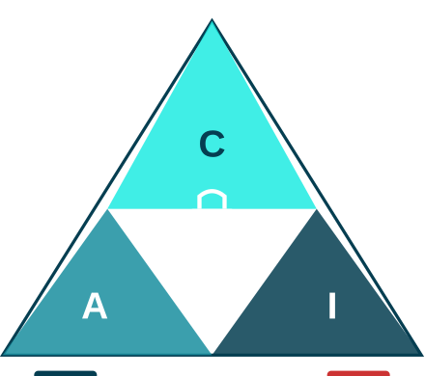


What are the Principles of Information Security?
01
02
Confidentiality
Data is kept
confidential
and private.
Integrity
Data is authentic,
accurate, reliable,
and free from
tampering.
03
Availability
Data is available
to those who
need it.
Notes:
There is a triad of principles that constitutes the objectives of information security. These principles are confidentiality, integrity, and availability which form the letters C-I-A.
Private information must remain confidential. Accountability of who is trying to access the information and whether or not they are authorized to access it and also have assurance that the information is authentic, in other words has integrity. The information must be protected from an unauthorized change, and if it is altered then it needs to be alerted.
Last, authorized parties must have access to the information. Technologies, policies, and processes must be in place to ensure reliable availability. Together, these three principles constitute the CIA triad.
Conversely, Infosec works to prevent the disclosure and alteration of information. In addition, it strives to ensure that authorized parties are not denied information.
These characteristics, known as the DAD triad (Disclosure, Alteration, and Denial/Destruction), are the opposite of the CIA triad.

Slide 10
The DAD Triad — Opposite of CIA
InfoSec works to PREVENT these three security failures:
D
Disclosure
A
Alteration
D
Denial / Destruction
Exposes confidential data to unauthorized parties. An effective security solution will help neutralize disclosure threats.
The alteration of data, or the inability to test for alteration, makes data untrustworthy. Any change must be authorized, tracked, and verifiable.
Prevents legitimate and authorized agents from accessing data. A network firewall can help neutralize denial threats.
Notes:
Disclosure exposes confidential data to unauthorized parties.
The alteration of data, or the inability to test for alteration, makes the data untrustworthy. Data should remain in its original, accurate, and trustworthy state, and any change must be authorized, tracked, and verifiable.
Denial of information prevents legitimate and authorized agents from accessing data. An effective security solution, such as a network firewall, will help neutralize the DAD triad.

Slide 11



First Line of Defense — People & Education
Human error is the leading cause of network and computer breaches.
It starts with People
& Education
Phishing Awareness
Numerous studies have identified human error as the leading cause of network breaches.
Educating people at work and at home to:
• Think before clicking
• Identify phishing attacks
• Recognize social engineering
• Follow security best practices
Identity Protection
Password Security
Notes:
Considering the importance of protecting the cyber infrastructure, which is vital to the continued prosperity and quality of life to much of the world, certain precautions can be taken.
It starts with people and education. Numerous studies have identified human error as the leading cause of network and computer breaches. This situation can be addressed by educating people at work and at home to think before clicking and to help them identify phishing attacks and other common attack methods by bad actors.

Slide 12
Threat Landscape
of Cybersecurity
What are the threats? Who are the bad actors?
Notes:
What is a threat landscape? A threat landscape is the collection of threats in a given context or domain and includes information about the perpetrators of the threats: the bad actors. In the context of cybersecurity, the threat landscape includes all known and possible threats to computer networks. The introduction of new technologies and methods ensures a dynamic landscape where evolving new threats arise on an ongoing basis.
This Threat Landscape module provide an essential understanding of the following fundamentals:
Identify the different types of bad actors and hackers by their motivations and tactics.
Different types of bad actors are more likely to attack certain verticals or types of businesses.

Slide 13
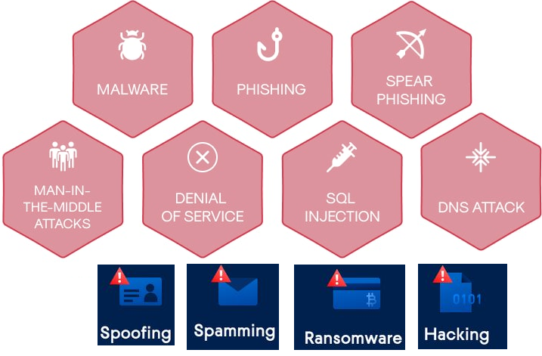
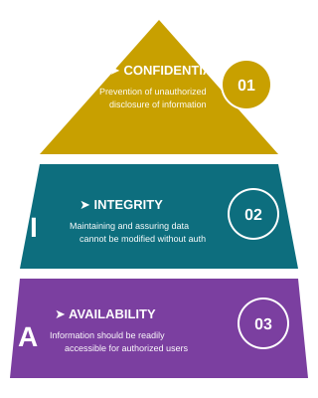
Threat Landscape of Cyber Security covering CIA
PHISHING
Spamming
Notes:
The key risks and trends of current cyber threat landscape through Confidentiality, Integrity, and Availability triad are below:
Confidentiality:
AI-enabled social engineering & deepfakes Attackers use generative AI to craft hyper-realistic phishing, voice scams, and impersonation attacks that can bypass traditional detection
Nation-state espionage State-sponsored groups (e.g., Iran’s IRGC) conduct targeted spear-phishing campaigns to harvest credentials and sensitive information
Supply-chain compromises Breaches in trusted vendors (e.g., Microsoft Exchange, Change Healthcare) enable attackers to indirectly access confidential data
Integrity:
Supply-chain tampering Attackers plant malicious code in updates/libraries, undermining system trust (e.g., Salt Typhoon on telco infrastructure).
Blended cyber-physical threats Compromising devices like RFID, smart buildings, or even pagers/walkie-talkies to manipulate physical outcomes.
Prompt-injection in AI systems Malicious inputs can alter model outputs or memory, damaging data and decision integrity in LLMs
Availability:
Ransomware & double extortion More aggressive tactics lock data and threaten publication unless ransom is paid.
AI-automated large-scale attacks AI tools enable rapid, distributed attacks like DDoS and polymorphic malware that morph continually.
Critical infrastructure targeting Increasing cyber-warfare threats on sectors like energy, telecom, aviation, and water

Slide 14
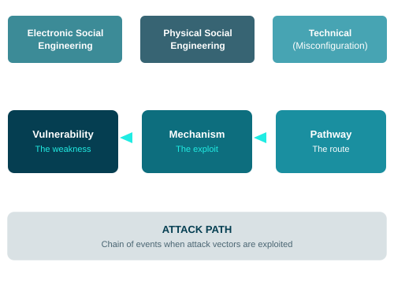
Cybersecurity Threats & Attack Vectors
A cybersecurity threat is an action exploiting a vulnerability that results in harm to a system.
Notes:
What is a cybersecurity threat? A cybersecurity threat is an action exploiting a vulnerability that results in harm to a network or computer system.
Bad actors are the instigators of cybersecurity threats. They exploit different attack vectors to achieve their goals. Broadly speaking, an attack vector is a method used by a bad actor to illegally access or inhibit a network, system, or facility. There are three components that comprise an attack vector: (1) the vulnerability, (2) the mechanism or object that exploits the vulnerability, and (3) the pathway to the vulnerability.
Here are a couple of examples. XYZ receives an email from a colleague asking him to review an attached document. He saves the document to his hard drive and opens it. Unbeknownst to XYZ, the sender was not really his colleague and the document installed malware onto his computer. In this example, the vulnerability is the user, the mechanism is the malware and the socially engineered message that convinced him to download the document, and the pathway is the email.

Slide 15
Attack Path — Real-World Example
An attack path is the chain of events that occurs when attack vectors are exploited.
1
2
3
4
5
Social Engineering
Physical Access
Malware Deployment
Reconnaissance
Data Exfiltration
→
→
→
→
Bad actor poses as technician, convinces authorized person to open restricted server room door
Actor gains entry to the server room via tailgating — bypassing physical access controls
USB device discretely connected to server, installing malware — silent persistence established
Malware begins scanning internal systems, harvesting credentials and mapping the network
Sensitive data extracted — the final stage of the attack path is complete
Notes:
In another example, an authorized person is entering a server room, which is a restricted zone. He notices a technician laden with boxes and computer equipment loitering outside. She explains that she needs to upgrade some equipment but forgot her access pass. Although, the authorized person doesn’t recognize her, she sounds convincing and he wants to be helpful, so he opens the door and she passes through. While in the server room she discretely connects a USB device to one of the servers that installs malware. In this example, the vulnerability was the authorized person and an unprotected server. The mechanism was the malware and the situation used to convince the man to allow her access to the server room. The pathway was the door into the server room and the USB device that released the malware.
From these examples, attack vectors can be divided into electronic social engineering, physical social engineering, and technical, which includes vulnerabilities such as computer misconfiguration. The bad actor first needed to access the facility before the user acquired access to the server room, and the server infection was merely the first stage in a chain of events that may include reconnaissance and the exfiltration of data. The preparation of an attack campaign is sometimes referred to as an attack path. An attack path is the chain of events that occurs when attack vectors are exploited.

Slide 16

Cybersecurity Threat Category 1: Social Engineering
Social Engineering
The act of using psychological manipulation to trick people into taking some action contrary to their best interests — such as disclosing confidential information.
Key ingredients of a successful social engineering attack:
• Gaining the trust of the victim
• Compelling them to act (urgency/fear)
Common forms: Phishing, Vishing, Smishing, Pretexting, Baiting, Tailgating
Notes:
Cybersecurity threats can be divided into four categories: social engineering, malicious software (known as malware), unauthorized access to physical places or computer systems, and system design failure.
Social engineering is the act of using psychological manipulation to trick people into taking some action that is contrary to their best interests, such as disclosing confidential information. The ingredients of a successful social engineering attack usually involve gaining the trust of the victim and then compelling them to act.

Slide 17

Cybersecurity Threat Category 2: Malware
Malware
Software designed to disrupt, damage, or gain unauthorized access to a computer system.
Types of Malware:
• Viruses — attach to legitimate files
• Worms — self-replicating, spread across networks
• Trojans — disguised as legitimate software
• Ransomware — encrypts data for ransom
• Spyware — silently monitors and collects data
• Rootkits — hides deep in system
Notes:
Malware is software that is designed to disrupt, damage, or gain unauthorized access to a computer system.

Slide 18

Cybersecurity Threat Category 3: Unauthorized Access
Unauthorized Access
Physical: A bad actor following an authorized person through a door after they have swiped their badge — known as tailgating.
Digital: A bad actor looking over someone's shoulder as they type their credentials (shoulder surfing).
Prevention: Multi-factor authentication, access controls, security cameras, mantraps, biometrics.
Notes:
Unauthorized physical access could be a bad actor following an authorized person through a door after they have swiped their badge. This is known as tailgating. Unauthorized digital access could be a bad actor looking over someone’s shoulder as they type their credentials.

Slide 19

Cybersecurity Threat Category 4: System Design Failure
System Design Failure
A security flaw in a computer system or application that a bad actor exploits to gain access.
Examples:
• Unpatched software vulnerabilities
• Misconfigured servers or firewalls
• Weak default credentials
• SQL injection vulnerabilities
• Buffer overflow exploits
• Zero-day vulnerabilities
Notes:
System design failure is a security flaw in a computer system or application that the bad actor exploits to gain access to a computer system. There are many examples of cyberattacks that fall into one or more of these categories.

Slide 20
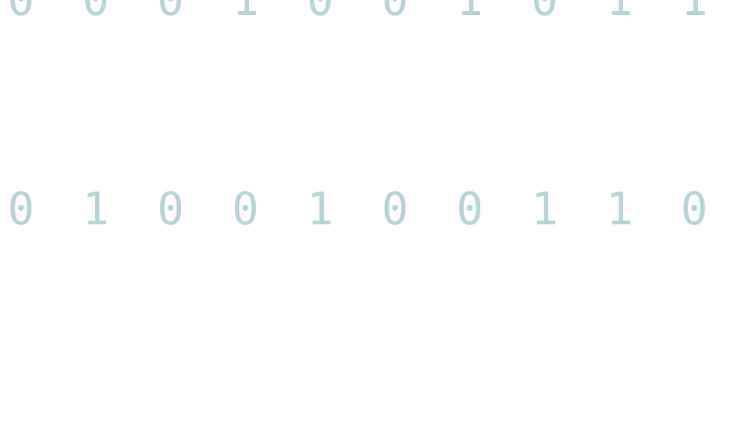


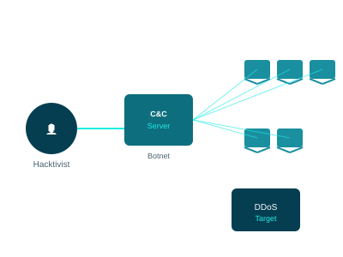


Identify the different types of bad actors and hackers by their motivations and tactics.
Categories of Hackers
The Hacktivist — Botnet / DDoS
White Hat
Black Hat
Ethical
Malicious
Grey Hat
Blue Hat
Not malicious,
not ethical
Ethical,
hired third party
Threat Actors
Notes:
What is a bad actor? Bad actors, also known as threat actors, are persons who try to steal, sabotage, or stop user from using computer systems or accessing information that the user is authorized to use and that is stored on or in transit between computing devices.

Slide 21
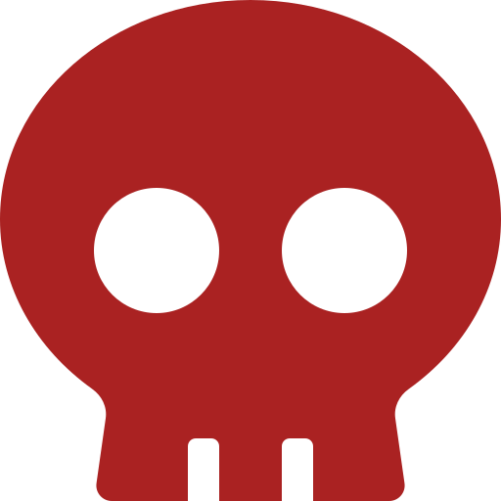
Bad Actors — Who Are They?
Bad actors (threat actors) are persons who try to steal, sabotage, or stop users from using computer systems or accessing authorized information.
They could be:
• Someone in a local coffee shop setting up a fake Wi-Fi access point
• A disgruntled employee leveraging access to corporate data
• A full-time scammer in a call center in another country
• A teenager using freely available ransomware tools
Cybersecurity is no longer just an IT problem — it is an operational and national security issue.
Notes:
While there are various types of bad actors who have different motivations that help explain their activities. A bad actor could be anyone, located anywhere. It could be someone in a local coffee shop who is setting up a fake Wi-Fi access point to steal data, a disgruntled employee who is leveraging their employee status to gain deeper access to corporate data, someone in another country whose full-time job is to scam people from a call center, or it could be a teenager in the neighborhood who is curious about the freely available programs on the internet that makes distributing malware and ransomware as easy as a few clicks of the mouse.
The most recent notable ransomware example occurred in July 2025, involving a critical zero‑day vulnerability in Microsoft SharePoint servers, exploited to deploy Warlock ransomware—targeting hundreds of unpatched systems, including government and enterprise networks. More than 400 servers were compromised across sectors such as government, education, healthcare, transportation, finance, and technology. The attack Encrypted critical server files and the Warlock ransomware deployed machine‑key persistence, which allowed continued access even after patching of the systems.
As such, Cybersecurity is no longer just an IT problem but an operational and national security issue impacting multiple systems.

Slide 22

Bad Actor Types — The Five Categories
Bad actors can be grouped into types based on their character, motivations, and attack methods.
Explorer
Hacktivist
Cyberterrorist
Cybercriminal
Cyberwarrior
Note: Bad actors are NOT a homogeneous group — each type has distinct motivations and tactics.
Notes:
There can be a myriad of motivations for their criminal behavior, and these different motivations not only influence their attack methods but provide insight into their character and beliefs. Bad actors can be grouped into types based on their character, motivations, and the common attack methods that they use. It’s important to note that bad actors are NOT a homogeneous group.
The types of bad actors are explorer, hacktivist, cyberterrorist, cybercriminal, and cyberwarrior.

Slide 23

Bad Actor Type 1: The Explorer
The least nefarious of all bad actor types.
Motivation: Notoriety and curiosity about weaknesses in computer networks.
Behavior: Does not intend to inflict serious damage — might change a webpage or advertise their cleverness.
Common technique — Phishing:
Tricks people into giving up personal information via:
• Phishing (broad email campaign)
• Spear Phishing (targeted at specific person)
• Smishing (SMS/text)
• Vishing (voice/phone call)
Notes:
The explorer is perhaps the least nefarious of all the bad actor types.
Notoriety is the biggest motivator within this group. The explorer is curious about the kinds of weaknesses that exist on computer networks and strives to find and exploit them. They do not intend to inflict serious damage, but they might change a page on a website to embarrass someone or do something to advertise to the world how clever they are.
One method used by explorers and other bad actor types is called phishing. Essentially, they trick people into giving up personal information. An example of phishing is an email from a seemingly legitimate source to a broad group of people. The ingredients of a successful phishing attack are, one, to gain the trust of the recipient or at least to appear innocuous, and two, to manufacture an emergency to force the recipient to act. There are variants of phishing that can be deployed as well. Spear phishing also uses email, but the email is directed at a specific person or group. The explorer also might choose to call or text the user, better known as smishing and vishing. While not using email, the same ingredients are required for the scheme to be successful. Phishing and its variants, however, are not exclusive to the explorer, and other bad actor types might use them for their own purposes.
Phishing Example:
A phishing email might state that some business demands the recipient’s immediate attention and a link to the organization’s site is provided for their convenience. The link, however, does not direct their browser to the legitimate site but rather takes them to a look-a-like rogue site. The rogue site provides the login page and the victim dutifully types their username and password. When the victim clicks submit the rogue site returns a message that their password was incorrect. A link is provided to the legitimate login page, the victim tries again, and this time logs in successfully. Because people often type their passwords quickly and sometimes make mistakes, the victim may not be alerted to the fact that something fishy has transpired. But meanwhile, the bad actor has the victim’s username and password and can now log in as them.

Slide 24
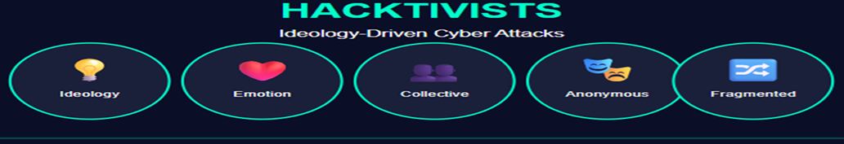

Bad Actor Type 2: The Hacktivist
Unlike the self-interested Explorer, hacktivists are fervent believers in an external cause.
Motivation: Ideology — animated by an emotive force against corporations, political or social organizations.
Method: Build botnets in secret → C&C server → DDoS attacks against targeted organizations.
Hacktivists lack computer resources for large attacks, so they must gain control of thousands of other people's computers to mount effective DDoS attacks.
Notes:
Unlike the self-interested explorer, hacktivists are fervent believers in an external cause. They are motivated by ideology or are animated by an emotive force. The hacktivists’ idealism drives them to act collectively in common cause against an enemy.
While hacktivists may collectively crusade against a specific corporation, or go after political or social organizations that they feel did something bad, their extremism demands anonymity and online groups, by nature, are fragmented.
A common strategy of hacktivists is to build a botnet in secret. To make a botnet, the hacktivist sets up a command-and-control (C&C) server that is accessible on the internet. This is a central coordination point for all the botnet nodes. Next, they craft malware that, once installed on some unsuspecting computers, waits patiently for instructions from the C&C server. The C&C server instructs thousands of botnet nodes to send messages to the targeted server, which becomes overwhelmed by requests and stops responding. This is called a distributed denial-of-service (DDoS) attack. Hacktivists lack the computer resources to make a successful DDoS attack, so they must gain control of thousands of other people's computers.

Slide 25
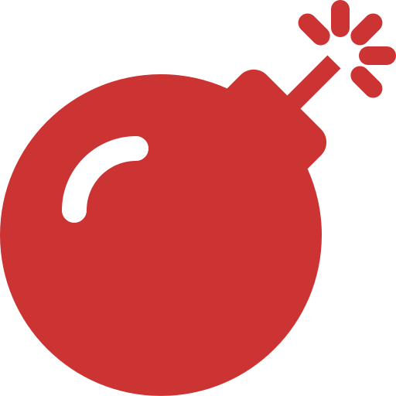
Bad Actor Type 3: The Cyberterrorist
More in common with the hacktivist — motivation is driven by ideology, but violence is directed more broadly against a society.
Target: Online infrastructure — nuclear power plants, natural gas pipelines, electrical power grids (Operational Technology).
Method: DDoS attacks and spear phishing campaigns targeting high-privilege users.
Operates more like a cohesive virtual army with structure and direction.
Notes:
The cyberterrorist has more in common with the hacktivist than the explorer. Their motivation is also driven by ideology, but their violence is directed more broadly against a society. While hacktivists are content with punishing their enemies, cyber terrorists strive to intimidate and destabilize a society by destroying or disrupting computer or communication networks. They like to target online infrastructure, such as nuclear power plants, natural gas pipelines, and electrical power grids. This type of online infrastructure is called operational technology.

Slide 26

Bad Actor Type 4: The Cybercriminal
Motivation: Money — plain and simple.
Methods: Phishing, identity/credit card theft, ransomware.
CASE STUDY — NASCAR Ransomware Attack (2025):
• Threat Actor: Medusa (RaaS group)
• Timeline: March 31–April 3, 2025
• Attack Vector: Phishing / compromised credentials
• Payload: Medusa Ransomware
• Impact: Employee SSNs exposed, systems disrupted
• Ransom Demand: $4 million
• Lesson: MFA + EDR + regular backups + IR testing
Notes:
Like hacktivists, and unless they are sponsored by a nation state, they lack the resources to inflict catastrophic destruction and must beg, borrow, and steal technology to mount effective attacks. Unlike hacktivists, cyberterrorists operate more like a cohesive virtual army. They have structure and direction. They can deploy tactics such as DDoS to attack targets, but a favorite method is spear phishing. Once they have identified a person with extensive network privileges, they target them with a carefully planned social engineering campaign.
The motivation of a cybercriminal is more self-centered: They want money plain and simple. They achieve this goal by a combination of phishing, theft of identities or credit cards, which they use or sell on the black market, or ransomware. Ransomware is a type of malware that blocks access to computer information or systems until a ransom is paid. Sometimes there can be multiple motivations for a group, or two or more bad actor types. An explicit example is of the recent 2025 cyberattack against National Association for Stock Car Auto Racing (NASCAR), a behemoth in American motorsports.
Case study of the Ransomware Attack on NASCAR (2025):
Domain: Sports & Entertainment
Type of Attack: Ransomware
Geo: United States
The National Association for Stock Car Auto Racing (NASCAR), LLC is an American auto racing sanctioning and operating company that is best known for stock car racing. It is considered to be one of the top ranked motorsports organizations in the world and is one of the largest spectator sports leagues in America. NASCAR maintains digital infrastructure for ticketing, media streaming, fan data, and business operations.
Incident Overview
Timeline of Attack: Between March 31 and April 3, 2025
Threat Actor: Medusa (RaaS - Ransomware-as-a-Service group). Medusa is an active threat actor with numerous high-profile victims, including Toyota Financial Services (TFS), which was struck in November 2023, Minneapolis Public Schools (MPS), targeted in February 2023, and Philippine Health Insurance Corporation (PhilHealth), which suffered an incident in September 2023.
Attack Vector: Suspected entry vectors include:
Phishing emails or compromised employee credentials
Unpatched systems in IT infrastructure
Payload: Medusa Ransomware
Impact:
Operational Downtime: Core business systems were disrupted, but racing events and fan services were not impacted, according to public statements.
Data Breach: Highly sensitive information such as employee SSNs and internal documents were confirmed to be exposed.
Reputation Risk: NASCAR faced criticism over potential lapses in cybersecurity; trust impact among partners and staff.
Legal/Compliance: Penalties under U.S. data protection laws if negligent handling is proven.
Ransom : $4 million in ransom
Root Cause Analysis: Though not publicly disclosed suspected root cause includes Phishing emails or compromised employee credentials and unpatched systems within NASCAR IT infrastructure
Lesson Learned: Implement a robust technical control like MFA, network segmentation, endpoint detection & response (EDR) solutions. Ensure regular backup and restoration controls, regular security audits of third-party vendors and cloud systems, incident response and testing and also conduct regular security awareness training.

Slide 27

Bad Actor Type 5: The Cyberwarrior
The most dangerous bad actor — has resources of a nation-state at their disposal.
Motivation: National interests of their home country.
Missions: Espionage, extortion, embarrassment, disruption of critical infrastructure.
Weapon of Choice: Zero-day exploits — vulnerabilities unknown to the vendor, where the vendor has zero days to fix the problem.
Cyberwarriors conduct intensive research on operating systems and applications to find weaknesses kept secret until they can be deployed.
Notes:
Cyberwarriors are the least self-interested, but are nonetheless the most dangerous because they have the resources of a nation-state at their disposal. Cyberwarriors are motivated by the national interests of their home country. Whether cyberwarriors are good, bad or neutral depends on which nation-state they fight for. Their methods are vast and sometimes secret, and their missions include espionage, extortion, and embarrassment on the one hand, to using targeted cyberweapons to disrupt, damage, or destroy critical infrastructure on the other.

Slide 28
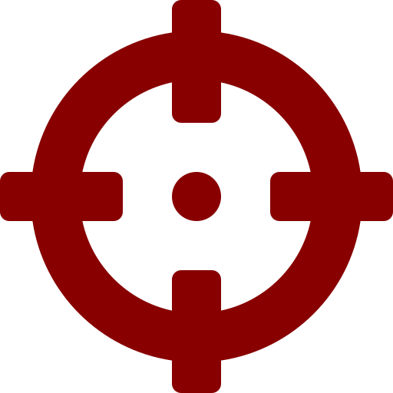
Zero-Day Exploits — The Cyberwarrior's Weapon
Zero-day exploits are vulnerabilities in common operating systems and applications that:
• Are unknown to the software vendor
• Give the vendor zero days to fix the problem
• Must remain secret until they can be deployed
• Are often state-level intelligence assets
Once a zero-day exploit is publicly known, the vendor immediately issues a patch — so cyberwarriors protect their secrets carefully.
Most Recent Example (July 2025): Warlock ransomware exploited a zero-day in Microsoft SharePoint — over 400 servers compromised across government, healthcare, and enterprise sectors.
Notes:
They like to leverage unpatched vulnerabilities in common operating systems and applications. These are known as zero-day exploits-presumably because when the exploit is launched, the vendor has zero days to fix the problem. Cyberwarriors do intensive research on these common operating systems and applications, finding weaknesses, bugs, and other behaviors that they can use to attack the enemy’s computer systems. The weaknesses must remain a secret until they can be used because once they are known the vendor will issue a patch immediately.

Slide 29

Hacker Categories — The Hat System
Just as there are different types of bad actors, there are different categories of hackers, identified by symbolic hat colors:
White Hat — Ethical hacker; with proper authorization, probes the network to identify vulnerabilities.
Black Hat — Attacks a network for profit or to cause harm.
Grey Hat — Attacks a network contradicting lawful and ethical behavior, but without malicious intent. Most closely aligns with the Explorer.
Blue Hat — Outside security consulting firms employed for penetration testing prior to system launch.
Notes:
Just as there are different types of bad actors, there are different categories of hackers, each identified by a symbolic color. The main categories are: white hat, black hat, grey hat, and blue hat.
A white hat is an ethical hacker who, with proper authorization, probes the network to identify vulnerabilities.
In contrast, a black hat is a hacker who attacks a network for profit or to cause harm.
A grey hat is a hacker who attacks a network, contradicting lawful and ethical behavior, but who does not have the same malicious intent as a black hat hacker. This category most closely aligns with the explorer bad actor.
A blue hat hacker is a variant of a white hat. This category of hacker refers to outside computer security consulting firms that are employed for penetration testing of a system prior to its launch and with the intent to detect and close vulnerabilities.

Slide 30
Understanding Cyberattacks
Using Attack Frameworks
Cyber Kill Chain · MITRE ATT&CK
Notes:
To better understand and defend against cyberattacks, it is helpful to examine the various frameworks that have been developed to classify and analyze them. These frameworks provide a structure for identifying the different stages of attack, discerning the different tactics used during those stages, analyzing their impact, and developing strategies for prevention and response.
Attack frameworks were developed in response to cyberattacks that were more sophisticated and protracted than in the past. These types of attacks, which can involve extended periods of surveillance and planning before methodically attacking a targeted computer network, are often referred to as advanced persistent threats (APTs). While attack frameworks embody extensive knowledge about attackers’ tactics and techniques, they are more than a knowledge base.
Lockheed Martin’s Cyber Kill Chain and MITRE ATT&CK are only two of several cyberattack frameworks in the industry. These are likely to be used at least in one of these frameworks during a career in cybersecurity.

Slide 31
Understanding Cyberattacks Using Attack Frameworks
Cyber Kill Chain — Lockheed Martin (2011)
Weaponization
Exploitation
Command and
control
1.
2.
3.
4.
5.
6.
7.
Reconnaissance
Delivery
Installation
Exfiltration
Notes:
Cyber Kill Chain
One of the most widely used frameworks for analyzing cyberattacks is the Cyber Kill Chain, developed by Lockheed Martin in 2011. The Cyber Kill Chain is a seven-step model that describes the stages of a cyberattack, from the initial reconnaissance and weaponization of the attack method to the final exploitation and exfiltration of data.

Slide 32
MITRE ATT&CK
Adversarial Tactics, Techniques & Common Knowledge · Published by MITRE Corporation - 2013
2013 EST.
What is MITRE ATT&CK?
A constantly evolving resource providing common language and approach for understanding and mitigating cyberattacks. Classifies and describes cyberattacks and intrusions using a comprehensive matrix system.
Matrix Structure
1
Initial Access
2
Execution
3
Defense Evasion
Entry point
Running code
Avoiding detection
Key Benefits
✓
Common Language
✓
Threat Prioritization
Unified framework for discussing cyber threats
Map critical threats by techniques and categories
✓
Comprehensive TTPs
✓
Effective Mitigation
Detailed attacker tactics, techniques & procedures
Design and implement better
countermeasures
Notes:
In 2013, the MITRE (name intentionally chosen to be non-descriptive) Corporation published the adversarial tactics, techniques, and common knowledge or MITRE ATT&CK guideline. The guideline classified and described cyberattacks and intrusions. So, like the Cyber Kill Chain, it will help to understand the attacker’s methodology, but MITRE is more than that. It is a constantly evolving resource that provides a common language and approach for understanding and mitigating cyberattacks. The matrix is organized into a series of "techniques" that describe specific tactics and methods used by attackers to compromise systems and steal or manipulate information. These techniques are grouped into categories based on the type of attack or activity being performed, such as "Initial Access", "Execution", and "Defense Evasion”.
One of the key benefits of the MITRE ATT&CK matrix is that it provides a common language and framework for discussing and analyzing cyber threats. This allows organizations to communicate and coordinate their efforts to prevent and respond to attacks more effectively. The matrix also helps organizations to identify and prioritize the most critical threats and vulnerabilities by mapping them to the appropriate techniques and categories.
The matrix is also a valuable resource for security professionals because it provides a comprehensive overview of the tactics, techniques, and procedures (TTPs) used by attackers. This allows security teams to better understand the methods and motivations of attackers, and to design and implement countermeasures to prevent or mitigate attacks more effectively.

Slide 33
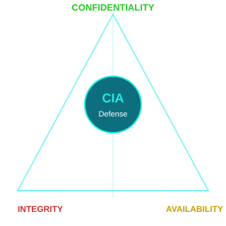
Defense & Mitigation Strategies
Protection Measures
● Multi-Factor Authentication (MFA)
● Data Encryption
● AI-Powered Anomaly Detection
● Threat Intelligence Sharing
Protection Measures — Availability
● Robust Backup & Recovery Systems
● Ransomware & Extortion Planning
● DDoS Protection
Protection Measures — Integrity
● Segmented Networks
● Stringent Vendor Audits
● AI-Powered Response Tools
● Software Bill-of-Materials (SBOM)
● Code-Signing Checks
● Monitor Cyber-Physical Systems
● Apply Firmware Attestation
Implementation Strategy:
Deploy & Monitor
Audit & Verify
Maintain & Protect
Notes:
For Confidentiality:
Deploy multi-factor authentication, data encryption, and AI-powered anomaly detection.
Conduct threat intelligence sharing (e.g., ISACs (Information Sharing and Analysis Center), CISA (Cybersecurity and Infrastructure Security Agency) updates).
For Integrity:
Perform stringent vendor audits, software bill-of-materials, and code-signing checks.
Monitor cyber-physical systems for tampering; apply firmware attestation.
For Availability:
Maintain robust backup and recovery systems; plan for ransomware and extortion scenarios.
Use DDoS protection, segmented networks, and AI-powered response tools.

Slide 34


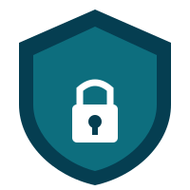


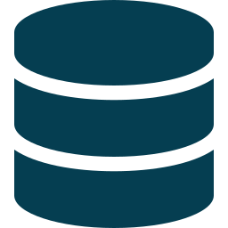


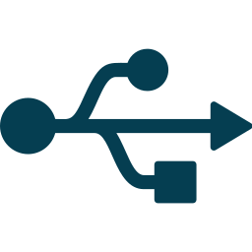




CYBERSECURITY BEST PRACTICES
Cybersecurity best practices include robust access controls, regular software updates, strong password policies, multi-factor authentication, data encryption, and comprehensive incident response plans.
Use strong passwords
Encrypt files
Enable 2-factor authentication
Avoid using public networks
Backup data regularly
Be wary of phishing (email)
Adopt zero-trust security
Disable remote connectivity
Centralize security management
Vulnerability scanning & patching
Conduct regular cybersecurity audits
Invest in security upgrades
Be wary of phishing
Keep software up to date
Educate and Train employees
Notes:
Cybersecurity best practices include robust access controls, regular software updates, strong password policies, multi-factor authentication, data encryption, and comprehensive incident response plans. These practices, when implemented effectively, significantly reduce the risk of cyberattacks and data breaches.
Use strong passwords
Enable 2-factor authentication
Backup data regularly
Adopt zero-trust security principles
Centralize security management
Conduct regular cybersecurity audits
Develop an incident response plan
Encrypt files
Avoid using public networks
Be wary of phishing
Disable remote connectivity
Employ continuous vulnerability scanning and patching
Invest in security upgrades
Keep software up to date
Educate and Train employees

Slide 35
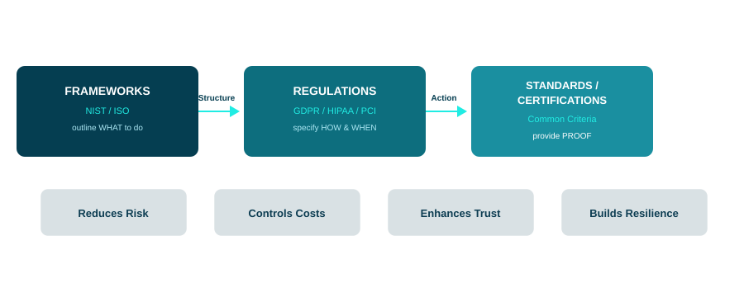
Cyber Security and Co-relation with Industry Standards,
Compliance and Regulatory Laws
Notes:
Cybersecurity aligns with the major industry standards, compliance regimes, and regulatory laws by bringing structure, accountability, and enforcing best practices to security programs. Cybersecurity frameworks set the blueprint, regulations enforce action, and certifications verify adherence. Effective alignment reduces risk, controls costs, enhances trust, and builds resilient operations.
How They Correlate & Align:
Structure → Implementation → Proof: Frameworks like NIST (National Institute of Standards and Technology) / ISO (International Organization for Standardization) outline what to do, regulations like GDPR (General Data Protection Regulation) / HIPAA (Health Insurance Portability and Accountability Act) / PCI DSS (Payment Card Industry Data Security Standard) specify how and when, standards like Common Criteria provide proof through evaluation.

Slide 36
International Standards & Frameworks
ISO/IEC 27001 (ISMS)
Formal framework for establishing, operating, monitoring, reviewing, and improving the Information Security Management System (ISMS).
NIST Cybersecurity Framework (CSF)
Voluntary, risk-based controls across five core functions: Identify, Protect, Detect, Respond, Recover.
IEC 62443
Industrial automation and control systems (OT) — mandates secure architecture, component management, and supply-chain auditing.
Common Criteria (ISO/IEC 15408)
International standard for evaluating the security of IT products — structured, repeatable process to assess and certify security requirements.
Cyber Essentials (UK)
UK government-backed scheme with 5 baseline controls: firewalls, patching, access, malware, and configuration. Basic and Plus certification levels.
Notes:
International Standards & Frameworks:
ISO/IEC 27001 (ISMS)
Jointly published by International Organization for Standardization (ISO) and the International Electrotechnical Commission (IEC), provides a formal framework for establishing, operating, monitoring, reviewing, and improving the Information Security Management System (ISMS).
NIST Cybersecurity Framework (CSF)
A guideline created by the U.S. National Institute of Standards and Technology (NIST) to help organizations understand, manage, and reduce cybersecurity risks. Offers voluntary, risk-based controls across five core functions (Identify, Protect, Detect, Respond, Recover).
IEC 62443
Developed by the International Electrotechnical Commission (IEC). Focused on industrial automation and control systems and operational technology it mandates secure architecture, component management, and supply-chain auditing .
Common Criteria (ISO/IEC 15408)
ISO/IEC 15408, commonly called the Common Criteria (CC), is an international standard for evaluating the security of IT products and systems. A global standard to test and prove that a cybersecurity product is secure and trustworthy by providing a structured and repeatable process to assess, test, and certify that a product (like software, hardware, or a security device) meets specific security requirements.
Cyber Essentials (UK)
Cyber Essentials is a UK government-backed cybersecurity scheme designed to help organizations protect themselves against common cyber threats. A baseline standard that comprises of five technical controls (firewalls, patching, access, malware, config) with a Basic self assessment and a Plus certification levels through an independent technical audit to verify security controls.

Slide 37
Regulatory Requirements & Laws
These mandate specific security controls, reporting standards, and governance requirements:
GDPR (EU)
HIPAA (US)
Privacy-by-design, breach reporting within 72 hours, DPIAs, data subject rights. Fines up to €20M / 4% turnover.
Administrative, physical, and technical safeguards for PHI; breach notifications and risk assessments are foundational.
PCI-DSS
SOX (US)
Protection of cardholder data using strict encryption, network, and access controls; applies to all payment processors.
Internal controls and secure financial recordkeeping; impacts IT processes, audit trails, and access monitoring.
FISMA (US Federal)
DORA (EU)
Federal agencies follow NIST SP 800-53 controls, continuous monitoring, and risk-based governance.
Financial institutions — robust ICT risk management, third-party oversight, and operational resilience.
NIS2 Directive (EU)
EU CRA
Cybersecurity mandates for critical infrastructure and digital service providers — maturity and incident transparency.
Cyber Resilience Act — cybersecurity obligations on manufacturers of connected products, vulnerability management.
Notes:
Regulatory Requirements & Laws:
These often mandate specific security controls, reporting standards, and governance requirements:
GDPR (EU)
Enforces privacy-by-design, breach reporting within 72 hours, DPIAs, and data subject rights. Fines up to €20 M / 4% turnover
HIPAA (US)
Requires administrative, physical, and technical safeguards for PHI; breach notifications and risk assessments are foundational
PCI-DSS
Governs protection of cardholder data using strict encryption, network, and access controls; applies to all payment processors
SOX (Sarbanes-Oxley, US)
Mandates internal controls and secure financial recordkeeping; impacts IT processes, audit trails, and access monitoring
FISMA (US Federal)
Requires federal agencies and their contractors to follow NIST SP 800-53 controls, continuous monitoring, and risk-based governance .
DORA (EU Financial Resilience Act)
Applies to financial institutions, demanding robust ICT risk management, third-party oversight, and operational resilience
NIS2 Directive (EU)
Tightens cybersecurity mandates for critical infrastructure and digital service providers, emphasizing maturity and incident transparency
Cyber Resilience Act (EU CRA)
Enforces cybersecurity obligations on manufacturers of connected products, including vulnerability management and secure development lifecycles

Slide 38
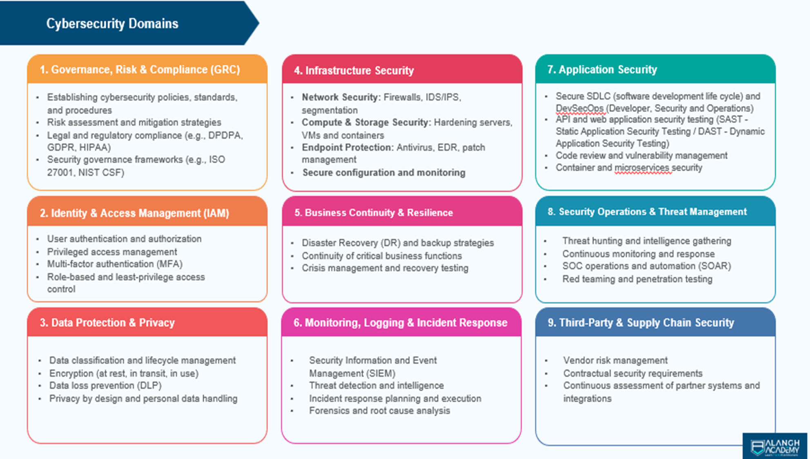
Notes:
Cybersecurity is typically organized into several domains with each domain representing specific area of security & protection, control, and governance. Let us see the major cybersecurity domains which are commonly recognized across different frameworks like NIST, ISO 27001, CIS and CSA.
Governance, Risk & Compliance (GRC): This domain is a coordinated framework that integrates an organization's governance, risk management, and compliance covering the below points:
Establishing cybersecurity policies, standards, and procedures
Risk assessment and mitigation strategies
Legal and regulatory compliance (e.g., DPDPA, GDPR, HIPAA)
Security governance frameworks (e.g., ISO 27001, NIST CSF)
Identity & Access Management (IAM): This is a cybersecurity framework of policies, processes, and technologies that ensures the right people, machines, and software components have the right access to digital resources at the right times and covers the below scope:
User authentication and authorization
Privileged access management
Multi-factor authentication (MFA)
Role-based and least-privilege access control
Data Protection & Privacy: This domain specifically focusses to protect data from unauthorized access, corruption, loss, theft, or destruction and ensure sensitive personal information is handled ethically, legally, and in line with individuals' rights and consent. These includes the below sub domains:
Data classification and lifecycle management
Encryption (at rest, in transit, in use)
Data loss prevention (DLP)
Privacy by design and personal data handling
Infrastructure Security: In Cybersecurity this domain scopes to protect an organization's physical and digital assets, including hardware, software, networks, and data centers, from both cyber and physical threats and covers the below sub domains:
Network Security: Firewalls, IDS/IPS, segmentation
Compute & Storage Security: Hardening servers, VMs, and containers
Endpoint Protection: Antivirus, EDR, patch management
Secure configuration and monitoring
Business Continuity & Resilience: This domain focuses on ensuring that an organization can continue its critical operations and recover quickly in the event of a cyber incident, disaster, or system failure and constitutes the below domains:
Disaster Recovery (DR) and backup strategies
Continuity of critical business functions
Crisis management and recovery testing
Monitoring, Logging & Incident Response: This domain focuses on detecting, analyzing, and responding to security incidents to minimize their impact on an organization and involves the below sub domains:
Security Information and Event Management (SIEM)
Threat detection and intelligence
Incident response planning and execution
Forensics and root cause analysis
Application Security: As the name suggests this domain primarily focusses in protecting software applications from threats and vulnerabilities throughout the entire lifecycle, from development to deployment and involves the below domains:
Secure SDLC (software development life cycle) and DevSecOps (Developer, Security, and Operations)
API and web application security testing (SAST - Static Application Security Testing / DAST - Dynamic Application Security Testing)
Code review and vulnerability management
Container and microservices security
Security Operations & Threat Management: This domain focuses on detecting, analyzing, responding to, and mitigating cyber threats in real time through continuous monitoring and proactive defense mechanisms and consists of the below domains:
Threat hunting and intelligence gathering
Continuous monitoring and response
SOC operations and automation (SOAR)
Red teaming and penetration testing
Third-Party & Supply Chain Security: This domain primarily focuses on protecting an organization from risks introduced by external vendors, partners, and service providers that connect to or process the organization’s data, systems, or infrastructure and comprises of the below sub domains:
Vendor risk management
Contractual security requirements
Continuous assessment of partner systems and integrations

Slide 39
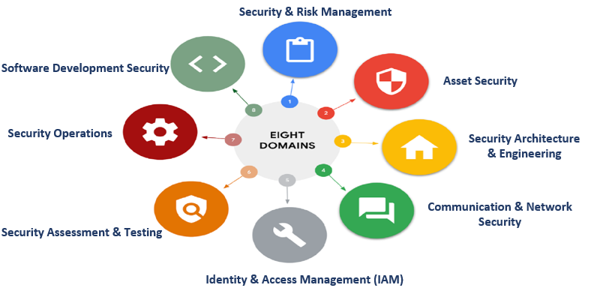
CISSP - Cybersecurity Domains
Notes:
The CISSP (Certified Information System Security Professional) Common Body of Knowledge (CBK) - governed by (ISC)² - remains a foundational framework in Cybersecurity. These 8 domains are widely recognized across the industry and Serve as the foundation for global cybersecurity governance:
Security & Risk Management This domain focuses on information security governance, risk management, compliance, and the core principles of confidentiality, integrity, and availability (CIA).
Asset Security This domain covers the protection of organizational assets, including data classification, data lifecycle management, and proper handling of information.
Security Architecture & Engineering This domain deals with the design and implementation of secure systems and architectures, including cryptography, security models, and vulnerability mitigation.
Communication & Network Security This domain focuses on securing communication channels and networks, including network architecture, protocols, and security controls.
Identity & Access Management (IAM) This domain is concerned with managing user identities, access rights, and authentication and authorization mechanisms.
Security Assessment & Testing This domain covers the processes for evaluating the effectiveness of security controls through continuous monitoring, audits, and risk-based assessments.
Security Operations This domain focuses on the day-to-day management of security operations, including incident response, disaster recovery, and threat monitoring.
Software Development Security This domain addresses the security considerations throughout the software development lifecycle, including secure coding practices, vulnerability management, and secure development environments.

Slide 40





EVOLUTION OF
CYBERSECURITY
Early Years
1960s – 1980s
• Mainframes and basic security models • First computer viruses • Rise of antivirus software
Internet Boom
1990s
• Widespread web access • Cybercrime and phishing • Firewalls and IDS
Web & Email Expansion
2000s
• Rise of malware and spam • VPNs and endpoint protection • Security companies grow
Cloud & Mobile Era
2010s
• Advanced threats (APTs, ransomware) • Cloud challenges • BYOD
Modern Cybersecurity
2020s– Present
• Zero trust architecture • AI, SOAR, and XDR • Supply chain risk
Notes:
Below are the summary of the evolvement of Cybersecurity:
Early Years (1960s–1980s): Birth of Security Concepts started with the introduction of mainframes like basic security models (e.g., user access controls). During the 1970’s the first concepts of computer viruses (theory) Creeper virus in 1971 the first example of malware originated. During the 1980’s the rise of personal computers started and the first antivirus programs and the term “hacker” gain prominence.
Internet booming period (1990s): Network Threats started to emerge and widespread internet access began combined with introduction of spam emails, phishing scams, and website defacements. This gave the rise to introduction of various security solutions like Firewalls, antivirus software, and intrusion detection systems (IDS).
Web & Email services Expansion (2000s): Sophistication of Threats started with Malware Evolution and Email & Browser Exploits giving rise to organizations starting to adopt perimeter-based security, VPNs, and endpoint protection and the presence of companies like Symantec, McAfee, Kaspersky in the market.
Cloud & Mobile Era (2010s): During this period came the rise of Advanced Threats and technology like Advanced Persistent Threats (APTs), Ransomware, Cloud infrastructure, BYOD concept (Bring Your Own Device) introducing introduce mobile and IoT threats, and Security-as-a-Service (SECaaS) outsourcing of cybersecurity functions (MDR, SIEM, etc.)
Current Cybersecurity (2020s–Present): AI, Zero Trust & Threat Intelligence came into picture introducing Zero Trust Architecture (ZTA), AI (Artificial Intelligence) & ML (Machine Learning) in Cybersecurity, Extended Detection and Response (XDR) and Security Orchestration (SOAR) gain traction. Tools and services like Cloud-native Security - Cloud Security Posture Management (CSPM), Cloud-Native Application Protection Platform (CNAPP), serverless security tools, Ransomware-as-a-Service (RaaS) and the final Post-Quantum Security for encryption-safe algorithms in a post-quantum world.
Cybersecurity and it’s Future:
AI vs. AI: Cyber defense and cyberattacks will both use AI, leading to intelligent offensive and defensive tools.
Quantum-Resistant Encryption: Traditional encryption may be obsolete post-quantum computing.
Autonomous SOCs: AI-driven, self-healing security operations center’s fully integrated with SIEM solution.
Cybersecurity Mesh: A distributed approach to securing digital assets across various environments.
Increased Regulation: Cybersecurity compliance becoming mandatory for all industries.

Slide 41
The Role and Future of AI in Cybersecurity
AI mimics human decision-making and adapts dynamically to evolving cyber threats.
AI vs. AI
Autonomous Cyber Defense
Adversarial AI evades detection; Defensive AI evolves to recognize AI-generated threats using neural networks.
Self-learning AI systems identify, isolate, and respond to threats. Autonomous SOCs running 24/7.
Cognitive Security
AI-Powered Risk Management
Integrating AI with cognitive computing — interpret unstructured data (social media, threat reports) to predict attacks.
Continuous risk assessments based on user, asset, and organizational data — enhances GRC capabilities.
Proactive Threat Hunting
Integration with Zero Trust
Predictive cybersecurity via AI — forecast likely attack vectors before exploitation, proactive hardening.
Dynamic access control supported by AI for real-time identity verification and policy enforcement.
Notes:
The Role and Future of AI in Cybersecurity
Artificial Intelligence in cybersecurity refers to the use of machine learning (ML), natural language processing (NLP), and other AI techniques for detecting any threats automatically, analyzing large volumes of data, responding to incidents in real-time and predicting vulnerabilities before exploitation. AI basically mimics human decision-making processes and adapts dynamically to the ever evolving cyber threats. Below are the summary of the future of AI in cybersecurity:
AI vs. AI (Offensive AI vs Defensive AI):
Adversarial AI will be used by threat actors to evade detection, mimic legitimate traffic, or generate polymorphic malware and
Defensive AI will evolve to recognize these AI-generated threats in real-time using deeper neural networks and threat modeling.
Autonomous Cyber Defense:
Without any human intervention Self-learning AI systems will identify, isolate, and respond to threats giving rise to Autonomous Security Operations Centers (SOC) running 24/7 with minimal human oversight.
Cognitive Security:
Integrating AI with cognitive and perceptive computing will allow systems to interpret unstructured data (like social media or threat reports) to predict emerging attacks.
AI-Powered Driven Management:
Continuous risk assessments (RA) based on user, asset, and organizational data using AI models enhancing the GRC (Governance, Risk, Compliance) capabilities.
Proactive Threat Hunting:
Predictive cybersecurity driven through AI and forecasting likely attack vectors before exploitation ensuring the proactive hardening of systems with the required security controls.
Integration with Zero Trust Models:
Dynamic access control supported by AI for real-time identity verification, and policy enforcement in zero-trust architectures.

Slide 42




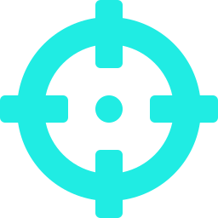

Global Cybersecurity Market Overview
IMARC Group:
1.
USD 299.6 billion in 2024 → USD 644.4 billion by 2033, CAGR 8.9%
Fortune Business Insights:
2.
USD 225.72 billion in 2025 → USD 443.1 billion by 2032, CAGR 14.3%
Persistence Market Research:
3.
USD 225.7 billion in 2025 → USD 443.1 billion by 2032, CAGR 10.2%
Grand View Research:
4.
USD 245.62 billion in 2024 → USD 500.70 billion by 2030, CAGR 12.9%
Precedence Research:
5.
USD 301.91 billion in 2025 → USD 878.48 billion by 2034, CAGR 12.6%
Gartner (End-User Spending):
6.
USD 183.9 billion in 2024 → USD 212 billion in 2025, +15.1% YoY
Notes:
Global Cybersecurity Market Overview:
IMARC (International Market Analysis Research and Consulting) Group reports the global cybersecurity market size reached USD 299.6 billion in 2024, projected to rise to USD 644.4 billion by 2033, with a CAGR (Compound annual growth rate) of 8.9% across 2025-2033.
Fortune Business Insights values the global market at USD 172.24 billion (2023), growing to USD 562.72 billion by 2032, at a projected CAGR of 14.3% .
Persistence Market Research estimates USD 225.7 billion in 2025, growing to USD 443.1 billion by 2032, with a CAGR of 10.2% .
Grand View Research positions the 2024 market at USD 245.62 billion, forecasting USD 500.70 billion by 2030, at a 12.9% CAGR .
Precedence Research estimates USD 301.91 billion in 2025, rising to USD 878.48 billion by 2034, at a 12.6% CAGR
Gartner projects global end-user spending on information security will reach USD 183.9 billion in 2024, rising to USD 212 billion in 2025, representing 15.1% year-over-year growth. Over the extended period 2023-2028, Gartner estimates spending will grow from USD 162 billion to approximately USD 292-294 billion, indicating a CAGR of around 11.7-12.5%

Slide 43
Global Cybersecurity Workforce Gap
Demand for cybersecurity professionals far outpaces supply — the shortage is growing:
5.5M
Active global cybersecurity workforce (ISC² 2024)
A very modest 0.1% increase from prior year
4.8M
Global workforce gap — up 19% year-on-year (2024)
Total demand: ~10.2 million professionals globally
7.1M
BCG/GCF estimate: total cybersecurity professionals worldwide
~2.8M positions unfilled; Asia-Pacific accounts for 56% of shortage
4M+
WEF reported shortfall as of mid-2024
Projects shortage to reach 85 million by 2030 → $8.5 trillion unrealized revenue/year
Notes:
ISC² 2024 Cybersecurity Workforce Study:
Active global cybersecurity workforce: approximately 5.5 million professionals, a very modest 0.1% increase from the prior year.
Global workforce gap: Around 4.8 million, up 19% year-on-year in 2024.
Total demand to meet requirements: about 10.2 million professionals globally .
Workforce growth is reducing to a slower pace and as such there is a growth in demand for far outpaces supply despite organizations increasing requirements in cybersecurity.
Boston Consulting Group (BCG) & Global Cybersecurity Forum (2024):
There is an estimated growth of approx. 7.1 million cybersecurity professionals worldwide and the demand continues to exceed supply which leaves approximately 2.8 million positions unfilled, especially acute in Asia-Pacific which accounts for 56% of the shortage.
World Economic Forum (WEF):
WEF reported a shortfall of 4 million cybersecurity professionals globally as of mid‑2024. This projects growth in shortage to as much as 85 million by 2030, with an estimated USD 8.5 trillion in unrealized revenue per year due to unfilled roles.
It is estimated that 64% of the organizations face increased risk due to cybersecurity skills gaps out of which less than 15% is expected to have a substantial improvements by 2026.
Regional Distribution & Focus Areas
Asia-Pacific region experiences the largest shortages (accounts for approx. 56% of global gap).
North America and Europe also report significant unmet demand where the availability of required cybersecurity professionals does not satisfy the requirements.
Scheduling gaps are especially acute in sectors like financial services, healthcare, industrials, and government .

Slide 44

Cybersecurity
Fundamentals
Chapter 1 Complete
Thank you for attending!
Notes:
In this chapter we have learned the basic fundamentals of Cybersecurity and it’s underlying domains, the various threat factors, challenges, the best practices that an organization needs to follow to be secure and also be compliant with the industry standards and regulatory requirements, evolution of Cybersecurity and most importantly the importance of Cybersecurity and it’s growth in the global market.

