Slide 1

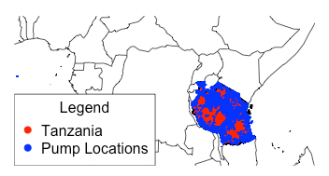
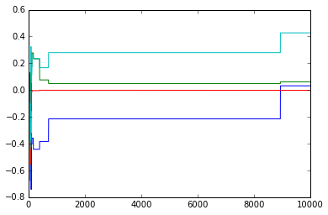
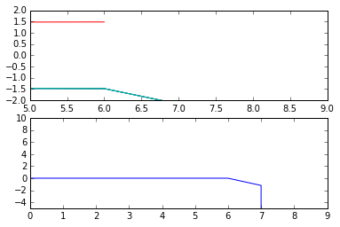
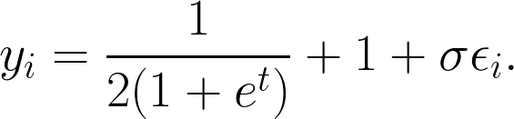


Predicting Water Pump Failure and Optimising Maintenance Schedules in Tanzania
Samuel Kim
samuelkim@college.harvard.edu
AM207 MCM and Stoch. Opt.
Gareth Haslam
haslam.gareth@gmail.com
Spring 2015
Introduction
I am an abstract. I am succinct and carefully written.
blah blah blah
Data
Figure 1. A map indicating the locations of water pumps in Tanzania.
Data for this project was provided as part of a challenge set by DrivenData.org - a platform developed by former Harvard SEAS students. The data was collected from Taarifa, an open source platform for reporting infrastructure issues and the Tanzanian Ministry of Water. The dataset contains information on various parameters such as pump construction year, installer, water type, location and other relevant details.
Access to clean water is a fundamental need for people all over the world. Around 11% of the world’s population currently lack such access due to either lack of natural resources or lack of infrastructure [1]. In Tanzania, despite the availability of water, only 33.5% have access to a piped source [2]. Many others depend on pumps for their supply. When these pumps fail, that can create serious problems for the people who depend on them. We aim to use Bayesian Methods and Simulated Annealing to predict which pumps are likely to be need in repair and optimise the route the engineering crew can take.
Conclusions
 | date_recorded | funder | gps_height | installer | longitude | latitude | basin
id
69572 | 2011-03-14 | Roman | 1390 | Roman | 34.938093 | -9.856322 | Lake Nyasa
8776 | 2013-03-06 | Grumeti | 1399 | GRUMETI | 34.698766 | -2.147466 | Lake Victoria
34310 | 2013-02-25 | Lottery Club | 686 | World vision | 37.460664 | -3.821329 | Pangani
67743 | 2013-01-28 | Unicef | 263 | UNICEF | 38.486161 | -11.155298 | Ruvuma / Southern Coast
19728 | 2011-07-13 | Action In A | 0 | Artisan | 31.130847 | -1.825359 | Lake Victoria
blah blah blah
Approach
Results
Each water pump has a label indicating its current functional status: functional, non-functional, or functional needs repair. We use a variation of logistic regression known as ordered logistic regression (ologit) that assigns each data point with one of these labels. We then select a number of parameters which we have a prior belief to have a strong influence on functionality, choose priors on their distributions and construct a Metropolis-Hastings Sampler to select the optimum value for each parameter. New predictions of functionality can then be made from this model.
blah blah blah
(a)
(b)
Citations and Links
Figure 2. (a) Sampler values for model coefficients. (b) Geweke test for convergence.
[1] UN Water. 2013. World Water Day Day 2013 - Facts and Figures. www.unwater.org . Accessed 29/4/2015
[2] Morisset J., 2012. Tanzania: Water is life, but access remains a problem. blogs.worldbank.org 10/09/12. Accessed 29/4/2015.
here is some of my code.
School of Engineering and Applied Sciences • Institute for Applied Computational Science

