Slide 1

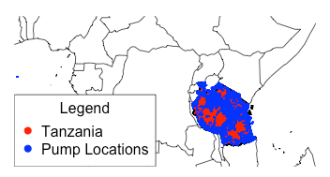
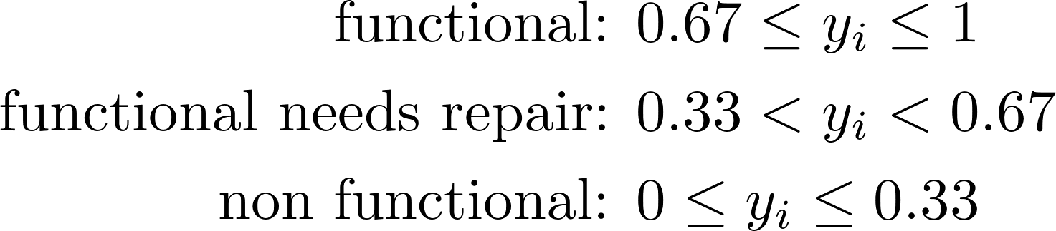
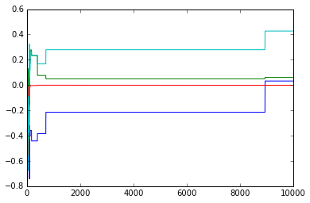
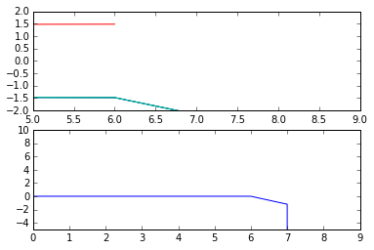
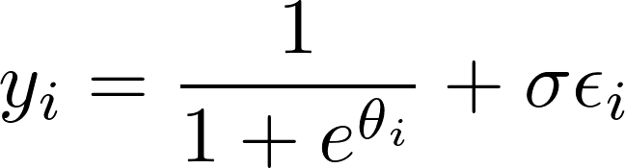


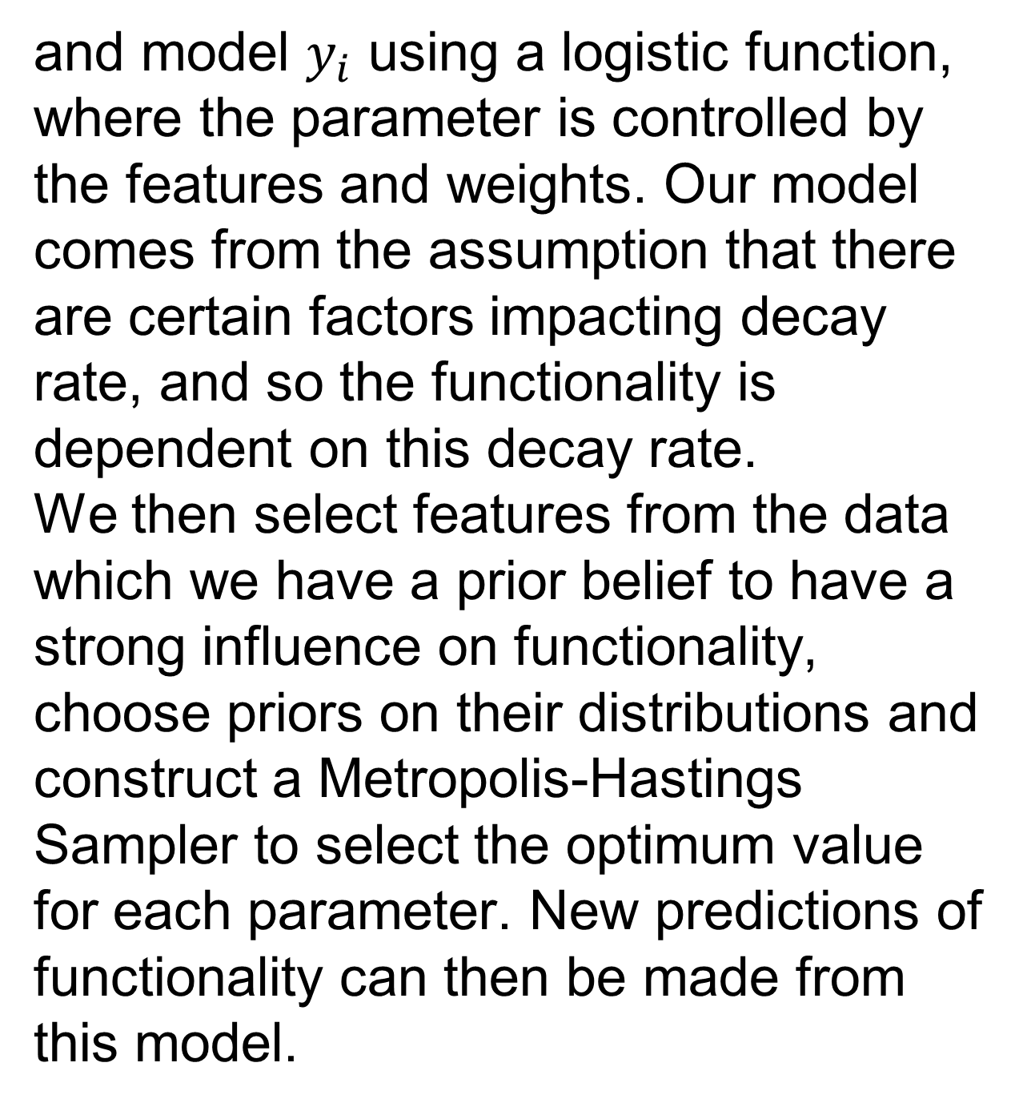
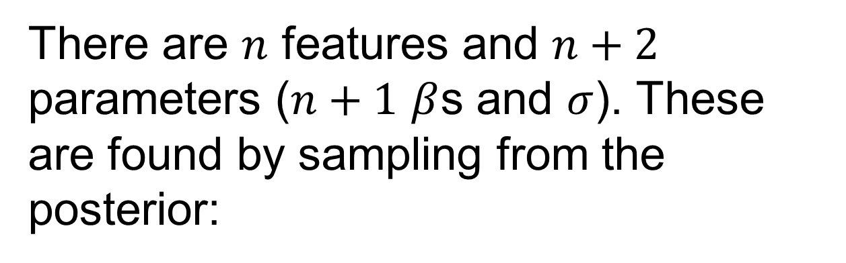
Predicting Water Pump Failure and Optimizing Maintenance Schedules in Tanzania
Samuel Kim
samuelkim@college.harvard.edu
AM207 MCM and Stoch. Opt.
Gareth Haslam
haslam.gareth@gmail.com
Spring 2015
Introduction
Predicting failure of water wells is an important issues for millions of people in developing countries who rely on these wells for their clean drinking water. Using the dataset collected on Tanzanian water wells, collected by Taarifa, we aim to use Bayesian inference methods to investigate how to better predict failure. Our second goal is to use information about the location of the wells to optimize their maintenance schedules by finding the shortest path between non-functioning or damaged wells. We will approach this second task using stochastic optimization methods
blah blah blah
Methods
Results
Figure 1. A map indicating the locations of water pumps in Tanzania.
To make the categorical labels compatible with Bayesian methods, we assign a range for each label (the exact limits can be adjusted):
The MH sampler algorithm successfully converges for the parameters. However, so far, results are limited. Accuracy of predictions using cross-validation are only slightly higher than randomly guessing. This implies that our model is not accurate, and that the features we chose are very weakly correlated, if at all, to the functionality of the well.
Access to clean water is a fundamental need for people all over the world. Around 11% of the world’s population currently lack such access due to either lack of natural resources or lack of infrastructure [1]. In Tanzania, despite the availability of water, only 33.5% have access to a piped source [2]. Many others depend on pumps for their supply. When these pumps fail, that can create serious problems for the people who depend on them. We aim to use Bayesian Methods and Simulated Annealing to predict which pumps are likely to be need in repair and optimize the route the engineering crew can take.
and model $y_{i}$ using a logistic function, where the parameter is controlled by the features and weights. Our model comes from the assumption that there are certain factors impacting decay rate, and so the functionality is dependent on this decay rate.
We then select features from the data which we have a prior belief to have a strong influence on functionality, choose priors on their distributions and construct a Metropolis-Hastings Sampler to select the optimum value for each parameter. New predictions of functionality can then be made from this model.
(a)
(b)
Data
Figure 2. (a) Sampler values for model coefficients. (b) Geweke test for convergence.
Data is provided by DrivenData.org, a platform to equip nonprofits with the power of data analysis. The data was collected by Taarifa, an open source platform for reporting infrastructure issues, and the Tanzanian Ministry of Water. The dataset contains information on 59,400 wells with 39 parameters such as pump construction year, installer, type of pump, water quality, location, population around the well, cost of water, quantity and other details. These include a mix of categorical and numerical data, and there are also many missing values. The training set of data also includes labels indicating each well’s current status: functional, non-functional, or functional needs repair.
Conclusions
We have demonstrated a Bayesian model for the functionality of water wells and found the parameters using a training data set. However, predictions are not yet accurate, suggesting that there is a lot of work to be done in fine-tuning the model as well as extracting more meaningful features from the data set.
There are $n$ features and $n+2$ parameters ($n+1$ $β$s and $σ$). These are found by sampling from the posterior:
Citations and Links
Additionally, because the data has a lot of missing values, we decided to impute data using the average from other data points (or mode for categorical data).
[1] UN Water. 2013. World Water Day Day 2013 - Facts and Figures. www.unwater.org . Accessed 29/4/2015
[2] Morisset J., 2012. Tanzania: Water is life, but access remains a problem. blogs.worldbank.org 10/09/12. Accessed 29/4/2015.
id | date_recorded | funder | gps_height | installer | longitude | latitude | basin
69572 | 2011-03-14 | Roman | 1390 | Roman | 34.938093 | -9.856322 | Lake Nyasa
8776 | 2013-03-06 | Grumeti | 1399 | GRUMETI | 34.698766 | -2.147466 | Lake Victoria
34310 | 2013-02-25 | Lottery Club | 686 | World vision | 37.460664 | -3.821329 | Pangani
67743 | 2013-01-28 | Unicef | 263 | UNICEF | 38.486161 | -11.155298 | Ruvuma / Southern Coast
19728 | 2011-07-13 | Action In A | 0 | Artisan | 31.130847 | -1.825359 | Lake Victoria
School of Engineering and Applied Sciences • Institute for Applied Computational Science

