Slide 1

Predicting Water Pump Failure and Planning Maintenance in Tanzania
Samuel Kim and Gareth Haslam
AM 207 Final Project
Notes:
Hello! My name is Samuel Kim and I am a senior at the College. My partner, Gareth Haslam, is an extension school student. Our project is on predicting water pump failure in Tanzania, and planning maintenance routes for the non-functioning water pumps.

Slide 2
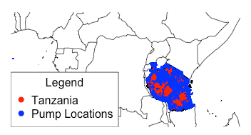
Problem Description
Classify wells as
functional
non-functional,
needing repair
id | date_recorded | funder | gps_height | … | longitude | latitude | basin
69572 | 2011-03-14 | Roman | 1390 | … | 34.938093 | -9.856322 | Lake Nyasa
8776 | 2013-03-06 | Grumeti | 1399 | … | 34.698766 | -2.147466 | Lake Victoria
34310 | 2013-02-25 | Lottery Club | 686 | ... | 37.460664 | -3.821329 | Pangani
Notes:
The first part of our project is to classify the water wells in Tanzania as one of three categories: “functional”, “needs repair”, and “non functional.” We are given labeled data from DrivenData, consisting of data on over 59,000 wells with 39 parameters, including GPS coordinates, installer, cost of water, and other details.

Slide 3
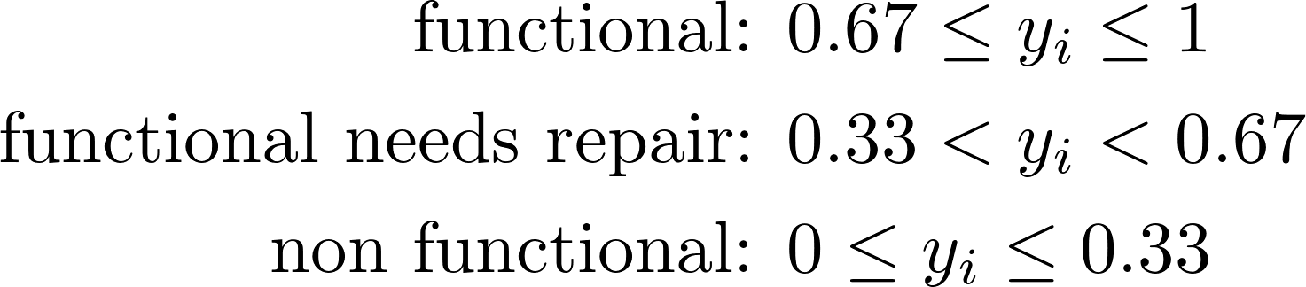
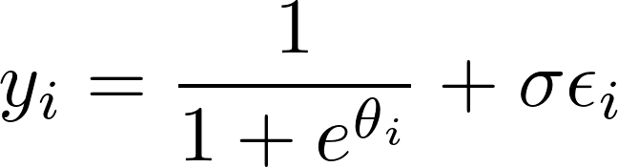
Approach: Bayesian Inference
Notes:
We decided to approach this problem using Bayesian inference in which we build a model for the functionality of the well based on its features, and then use stochastic sampling from the posterior probability distribution to calculate the parameters of our model. In this case, we convert the labels to number ranges, model this using a logistic function, which is controlled by a linear combination of the features where the weights are the parameters that we need to calculate.

Slide 4
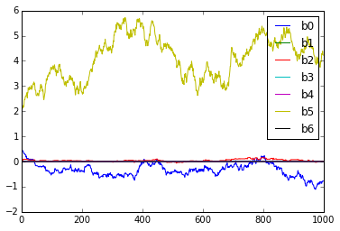
Prediction Results
Method | Prediction Accuracy | Time
Bayesian Inference | 60% | Long
Notes:
In the end, after experimenting with feature selection and algorithm parameters, we were able to reach a 60% cross-validation prediction accuracy. Unfortunately, our sampling methods to optimize the model parameters takes a very long time and limit how much we can optimize feature selection.
We can also compare our approach to other machine learning methods. K Nearest Neighbors reaches 69% prediction accuracy with no training time, and Random Forest can reach 80% prediction accuracy with a reasonable training time.

Slide 5
Prediction Results
Method | Prediction Accuracy | Time
Bayesian Inference | 60% | Long
K Nearest Neighbors | 69% | Short
Random Forest | 80% | Medium
Notes:
In the end, after experimenting with feature selection and algorithm parameters, we were able to reach a 60% cross-validation prediction accuracy. Unfortunately, our sampling methods to optimize the model parameters takes a very long time and limit how much we can optimize feature selection.
We can also compare our approach to other machine learning methods. K Nearest Neighbors reaches 69% prediction accuracy with no training time, and Random Forest can reach 80% prediction accuracy with a reasonable training time.

