Slide 1

Predicting Water Pump Failure and Planning Maintenance in Tanzania
Samuel Kim and Gareth Haslam
AM 207 Final Project
Notes:
Hello! My name is Samuel Kim and I am a senior at the College. My partner, Gareth Haslam, is an extension school student. Our project is on predicting water pump failure in Tanzania, and planning maintenance routes for the non-functioning water pumps.

Slide 2
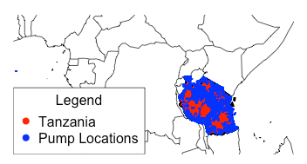
Problem Description
Classify wells as
functional
non-functional,
needing repair
id | date_recorded | funder | gps_height | … | longitude | latitude | basin
69572 | 2011-03-14 | Roman | 1390 | … | 34.938093 | -9.856322 | Lake Nyasa
8776 | 2013-03-06 | Grumeti | 1399 | … | 34.698766 | -2.147466 | Lake Victoria
34310 | 2013-02-25 | Lottery Club | 686 | ... | 37.460664 | -3.821329 | Pangani
Notes:
The first part of our project is to classify the water wells in Tanzania as one of three categories: “functional”, “needs repair”, and “non functional.” We are given labeled data from DrivenData, consisting of data on over 59,000 wells with 39 parameters, including GPS coordinates, installer, cost of water, and other details.

Slide 3
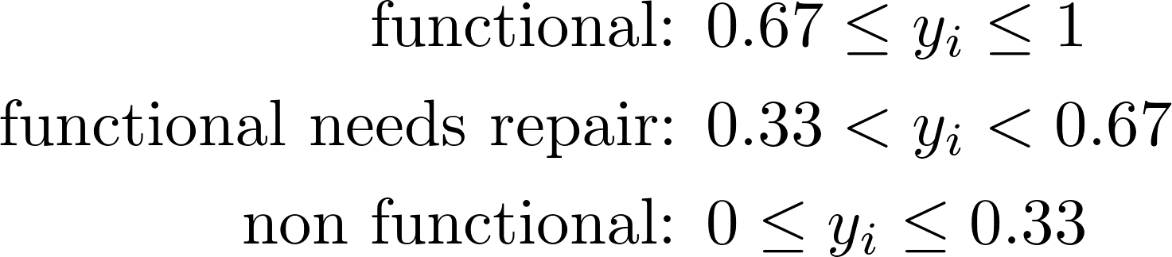
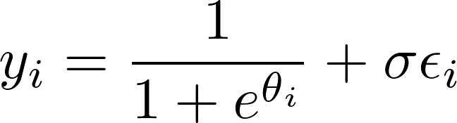
Approach: Bayesian Inference
Notes:
We decided to approach this problem using Bayesian inference in which we build a model for the functionality of the well based on its features, and then use stochastic sampling from the posterior probability distribution to calculate the parameters of our model. In this case, we convert the labels to number ranges, model this using a logistic function, which is controlled by a linear combination of the features where the weights are the parameters that we need to calculate.

Slide 4
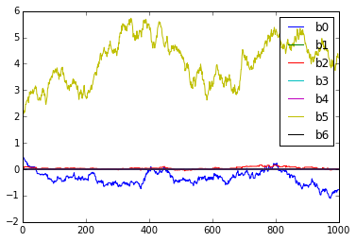
Prediction Results
Method | Prediction Accuracy | Time
Bayesian Inference | 60% | Long
Notes:
In the end, after experimenting with feature selection and algorithm parameters, we were able to reach a 60% cross-validation prediction accuracy. Unfortunately, our sampling methods to optimize the model parameters takes a very long time and limit how much we can optimize feature selection.
We can also compare our approach to other machine learning methods. K Nearest Neighbors reaches 69% prediction accuracy with no training time, and Random Forest can reach 80% prediction accuracy with a reasonable training time.

Slide 5
Prediction Results
Method | Prediction Accuracy | Time
Bayesian Inference | 60% | Long
K Nearest Neighbors | 69% | Short
Random Forest | 80% | Medium
Notes:
In the end, after experimenting with feature selection and algorithm parameters, we were able to reach a 60% cross-validation prediction accuracy. Unfortunately, our sampling methods to optimize the model parameters takes a very long time and limit how much we can optimize feature selection.
We can also compare our approach to other machine learning methods. K Nearest Neighbors reaches 69% prediction accuracy with no training time, and Random Forest can reach 80% prediction accuracy with a reasonable training time.

Slide 6
Optimising the maintenance of faulty water pumps
Notes:
Having identified methods for predicting which water pumps are likely to be in need of repair, we can then develop tools to assist maintenance crews in planning out how they will visit the faulty pumps as efficiently as possible, using stochastic optimisation.

Slide 7
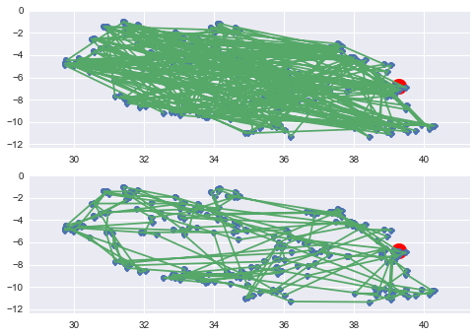
Visiting the faulty pumps
Notes:
We use simulated annealing to solve a simple version of the travelling salesman problem. The points in blue represent a subset of the pumps that are predicted to be faulty. The maintenance crew has to visit each pump in turn, starting out from the depot in Dar Es Salaam (marked in red). The top figure shows an initial random route selection, and the bottom figure shows the optimised route after simulated annealing.

Slide 8
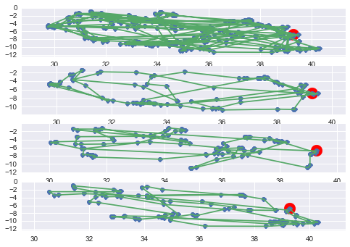
Multiple Maintenance Crews
Notes:
The total distance shown in the first optimised route at the top, is about 41,000 km which is obviously much greater than a single crew can travel in a reasonable time. Splitting the problem up into one to be solved by multiple maintenance crews leaving from the same depot leads to an overall decrease in total distance covered to 34,500 km. An interesting extension would be select the optimal location of multiple depots.

Slide 9
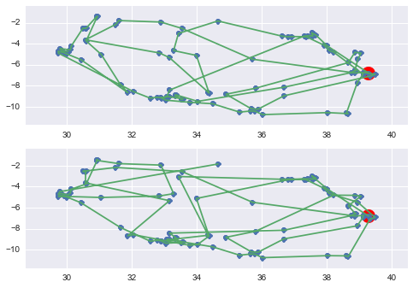
Prioritising Remote Pumps
Simple distance optimisation
Prioritised remote pumps
Notes:
Finally, we adjust our cost function to include a factor that gives greater weight to steps that will take our maintenance crew to more remote pumps as opposed to finding the simple shortest distance. This is based on the assumption that faulty pumps which are more remote (as measured by calculating the k-dimensional tree average distance of the 5 nearest neighbours) will have fewer alternatives close by so the crew should try to get there earlier. We can see that by prioritising remote pumps leads to some jarring jumps between locations and doubling back compared to the simple distance route. The overall distance covered is much higher.

Slide 10
Conclusions
Notes:
We have shown that Bayesian modelling can produce pre- dictions for the operating status of water pumps that are significantly better than the naive baseline prediction. The approach assumes an a priori model of how the pump functions based on parameters that we believe to be sig- nificant and then updates the relative strength of each of these parameters probabilistically to converge towards to optimal values. However, we have also shown that other Machine Learning Methods can produce superior predic- tions based on simpler assumptions. Having developed methods for identifying faulty pumps we have demon- strated the use of simulated annealing to optimise the route that a maintenance crew can take and added con- straints such as a fixed depot, and multiple crews. Inter- esting avenues for future work have also been suggested.

