Slide 1

Predicting Water Pump Failure and Planning Maintenance in Tanzania
Samuel Kim and Gareth Haslam
AM 207 Final Project
Notes:
Hello! My name is Samuel Kim and I am a senior at the College. My partner, Gareth Haslam, is an extension school student. Our project is on predicting water pump failure in Tanzania, and planning maintenance routes for the non-functioning water pumps.

Slide 2
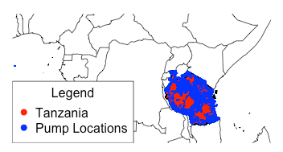
Problem Description
Classify wells as
Functional
needs repair
non-functional
Notes:
The first part of our project is to classify the water wells in Tanzania as one of three categories: “functional”, “needs repair”, and “non functional.” We are given labeled data from DrivenData, consisting of data on over 59,000 wells with 39 parameters, including GPS coordinates, installer, cost of water, and other details.

Slide 3
Problem Description
Classify wells as
Functional
needs repair
non-functional
Notes:
The first part of our project is to classify the water wells in Tanzania as one of three categories: “functional”, “needs repair”, and “non functional.” We are given labeled data from DrivenData, consisting of data on over 59,000 wells with 39 parameters, including GPS coordinates, installer, cost of water, and other details.

Slide 4
Problem Description
Classify wells as
Functional
needs repair
non-functional
Notes:
The first part of our project is to classify the water wells in Tanzania as one of three categories: “functional”, “needs repair”, and “non functional.” We are given labeled data from DrivenData, consisting of data on over 59,000 wells with 39 parameters, including GPS coordinates, installer, cost of water, and other details.

Slide 5
Problem Description
Classify wells as
Functional
needs repair
non-functional
Notes:
The first part of our project is to classify the water wells in Tanzania as one of three categories: “functional”, “needs repair”, and “non functional.” We are given labeled data from DrivenData, consisting of data on over 59,000 wells with 39 parameters, including GPS coordinates, installer, cost of water, and other details.

Slide 6
Problem Description
Classify wells as
Functional
needs repair
non-functional
id | date_recorded | funder | gps_height | … | longitude | latitude | basin
69572 | 2011-03-14 | Roman | 1390 | … | 34.938093 | -9.856322 | Lake Nyasa
8776 | 2013-03-06 | Grumeti | 1399 | … | 34.698766 | -2.147466 | Lake Victoria
34310 | 2013-02-25 | Lottery Club | 686 | ... | 37.460664 | -3.821329 | Pangani
Notes:
The first part of our project is to classify the water wells in Tanzania as one of three categories: “functional”, “needs repair”, and “non functional.” We are given labeled data from DrivenData, consisting of data on over 59,000 wells with 39 parameters, including GPS coordinates, installer, cost of water, and other details.

Slide 7
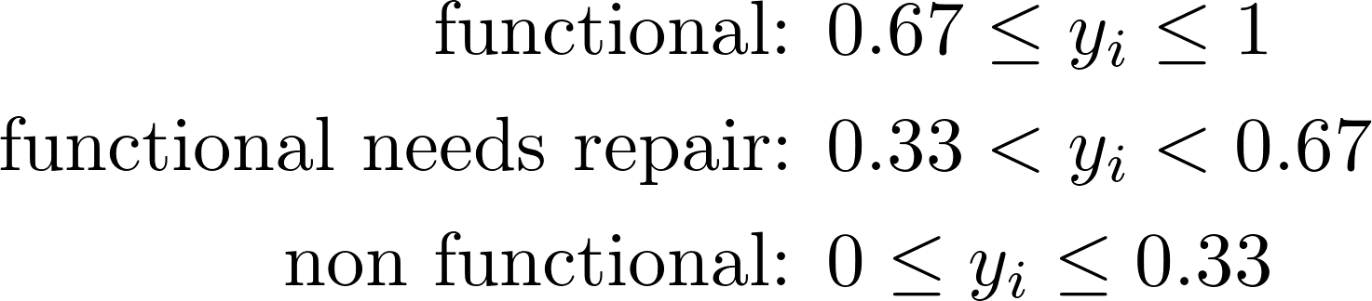
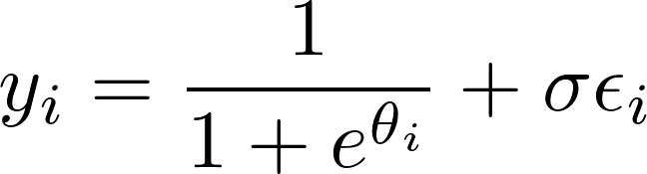
Approach: Bayesian Inference
Notes:
We decided to approach this problem using Bayesian inference in which we build a model for the functionality of the well based on its features, and then use stochastic sampling to calculate the parameters of our model. Our model is a logistic function, which is controlled by a linear combination of the features where the weights are the parameters that we need to calculate.

Slide 8
Approach: Bayesian Inference
Notes:
We decided to approach this problem using Bayesian inference in which we build a model for the functionality of the well based on its features, and then use stochastic sampling to calculate the parameters of our model. Our model is a logistic function, which is controlled by a linear combination of the features where the weights are the parameters that we need to calculate.

Slide 9
Approach: Bayesian Inference
Notes:
We decided to approach this problem using Bayesian inference in which we build a model for the functionality of the well based on its features, and then use stochastic sampling to calculate the parameters of our model. Our model is a logistic function, which is controlled by a linear combination of the features where the weights are the parameters that we need to calculate.

Slide 10
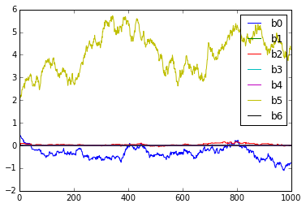
Prediction Results
Method | Prediction Accuracy | Time
Bayesian Inference | 60% | Long
Notes:
In the end, after experimenting with feature selection and algorithm parameters, we were able to reach a 60% cross-validation prediction accuracy. Unfortunately, our sampling methods to optimize the model parameters takes a very long time and limit how much we can optimize feature selection.
We can also compare our approach to other machine learning methods. K Nearest Neighbors reaches 69% prediction accuracy with no training time, and Random Forest can reach 80% prediction accuracy with a reasonable training time.

Slide 11
Prediction Results
Method | Prediction Accuracy | Time
Bayesian Inference | 60% | Long
K Nearest Neighbors | 69% | Short
Random Forest | 80% | Medium
Notes:
In the end, after experimenting with feature selection and algorithm parameters, we were able to reach a 60% cross-validation prediction accuracy. Unfortunately, our sampling methods to optimize the model parameters takes a very long time and limit how much we can optimize feature selection.
We can also compare our approach to other machine learning methods. K Nearest Neighbors reaches 69% prediction accuracy with no training time, and Random Forest can reach 80% prediction accuracy with a reasonable training time.

Slide 12
Optimising the maintenance of faulty water pumps
Notes:
Having identified methods for predicting which water pumps are likely to be in need of repair, we can then plan out how maintenance crews will visit the faulty pumps as efficiently as possible, using stochastic optimisation.

Slide 13
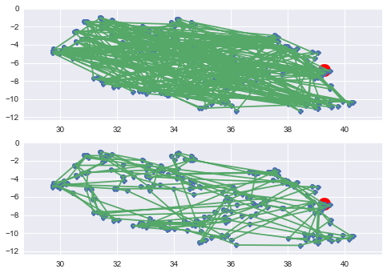
Visiting the faulty pumps
Notes:
We use simulated annealing to solve a simple version of the travelling salesman problem. The points in blue represent faulty pumps. The maintenance crew has to visit all the pumps, starting out from the depot marked in red. This shows an initial random route selection, and this shows the optimised route after simulated annealing.

Slide 14
Visiting the faulty pumps
Notes:
We use simulated annealing to solve a simple version of the travelling salesman problem. The points in blue represent faulty pumps. The maintenance crew has to visit all the pumps, starting out from the depot marked in red. This shows an initial random route selection, and this shows the optimised route after simulated annealing.

Slide 15
Visiting the faulty pumps
Notes:
We use simulated annealing to solve a simple version of the travelling salesman problem. The points in blue represent faulty pumps. The maintenance crew has to visit all the pumps, starting out from the depot marked in red. This shows an initial random route selection, and this shows the optimised route after simulated annealing.

Slide 16
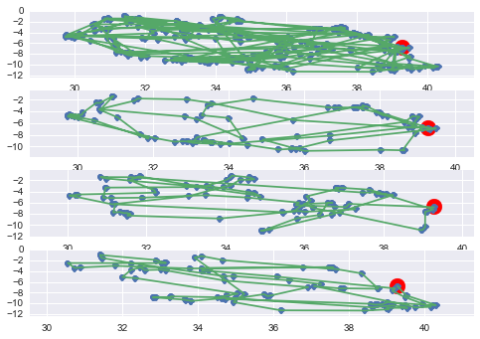
Multiple Maintenance Crews
Notes:
The total distance shown in the first optimised route at the top, is about 41,000 km which is obviously much greater than a single crew can travel in a reasonable time. Allowing for multiple maintenance crews leaving from the same depot leads to an 16% decrease in total distance covered.

Slide 17
Multiple Maintenance Crews
Notes:
The total distance shown in the first optimised route at the top, is about 41,000 km which is obviously much greater than a single crew can travel in a reasonable time. Allowing for multiple maintenance crews leaving from the same depot leads to an 16% decrease in total distance covered.

Slide 18
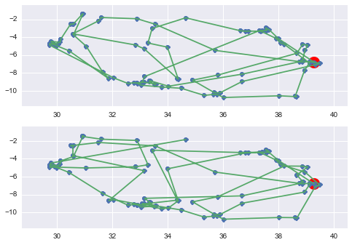
Prioritising Remote Pumps
Simple distance optimisation
Prioritised remote pumps
Notes:
Finally, we adjust our function to give greater weight to more remote pumps as opposed to finding the simple shortest distance. This is based on the assumption that faulty pumps which are more remote will have fewer alternatives close by so the crew should try to get there earlier. We can see that by prioritising remote pumps leads to some jumps and doubling back compared to the simple distance route. The overall distance covered is much higher.
In summary, we used Bayesian Inference modeling to predict the functionality of water wells in Tanzania, and then used simulated annealing to plan out optimal routes to repair the non functioning water wells.

Slide 19
Conclusions
Predicted faulty
water pumps
Planned out routes for maintenance
crews
Notes:
We have shown that Bayesian modeling can produce predictions for the operating status of water pumps that are significantly better than the naive baseline prediction. The approach assumes an a priori model of how the pump functions based on parameters that we believe to be significant and then updates the relative strength of each of these parameters probabilistically to converge towards to optimal values. However, we have also shown that other Machine Learning Methods can produce superior predictions based on simpler assumptions. Having developed methods for identifying faulty pumps we have demonstrated the use of simulated annealing to optimize the route that a maintenance crew can take and added constraints such as a fixed depot, and multiple crews. Interesting avenues for future work have also been suggested.

