Slide 1

Welcome
Analysis and Application of Queuing Theory in Supermarkets

Slide 2
Introduction to Queuing Theory
Mathematical study of waiting lines (queues)
Applied in:
Supermarkets, banks, hospitals, transport systems
Helps:
Minimize waiting time
Improve customer service
Reduce idle time and operational costs

Slide 3
Study Objective & Context
Goal: Analyze supermarket checkout process using queuing models
Focus:
Evaluate current multi-line setup
Propose more efficient alternative (M/M/S)
Expected Benefit: Enhanced service & reduced cost

Slide 4

Real-World Observation
Studied checkout process at "XYZ Supermarket"
Setup: 3 cashiers, each with a separate queue
Issues noted:
Line imbalance
Inefficiency during peak hours
Data sources:
Direct observation, interviews, surveys

Slide 5



M/M/1 (Current system):
3 independent queues (1 per cashier)
Poisson arrivals, exponential service times
M/M/s (Proposed system):
Single line, multiple servers
Customers served by first available cashier
M/M/S
M/M/1
Queuing Models Used

Slide 6

M/M/1 – Key Formulas
λ = Arrival rate | μ = Service rate
Utilization: ρ = λ / μ
Average in system: Ls = λ / (μ − λ)
Average in queue: Lq = (λ²) / (μ(μ − λ))
Wait in queue: Wq = ρ / (μ − λ)
Time in system: Ws = 1 / (μ − λ)
Probability of 0 customers: P₀ = 1 − ρ
Probability of n customers: 𝑃ₙ = 𝑃₀ ∗ 𝜌ⁿ

Slide 7
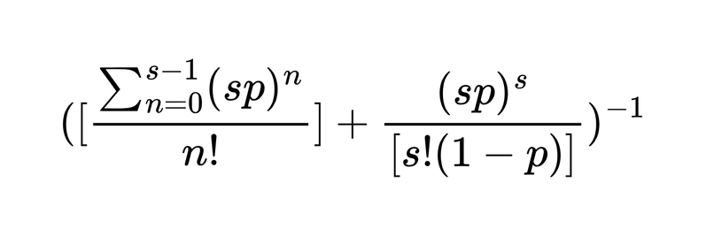
M/M/S – Key Formulas
ρ = λ / (sμ)
P₀ =
Lq = Ps × (ρ / (1 − ρ)²)
Ws = Wq + (1/μ)
Wait in queue: Wq = Ps / [sμ(1 − ρ)²]
Total in system: Ls = Lq + λ / μ

Slide 8
Model Assumptions
Customer arrivals follow Poisson process
Service time = exponential distribution
No queue limit (infinite capacity)
First-Come, First-Served (FCFS)
No customer prioritization
Employees (servers) work at full capacity
No impact of queue length on speed
Arrival rate slightly higher than service rate

Slide 9
M/M/1
M/M/S
Avg. waiting time: 4.33 min
Total cost: ₹1578.8
Avg. waiting time: 9 min
Total cost: ₹2475
Results
M/M/s reduced both waiting time & cost
More efficient under all observed time slots
Comparative Results

Slide 10
Recommendations & Future Work
Simulation: Use software tools to test complex or emergency scenarios
Behavioral Study: Account for customers switching lines or leaving
Self-Checkouts: Assess effect on queue lengths and staff workload

Slide 11
Mohamed Osama | 20220477
Rawan Ehab | 20220133
Ghassan ELGendy | 20220239
Ibrahim Medhat | 20221003
Abdelrahman Ashry | 20220189
Name
ID
References
Jhala, Nityangini & Bhathawala, Pravin
"Analysis and Application of Queuing Theory in Supermarkets"
International Journal of Innovative Research in Science, Engineering and Technology, Vol. 6, No. 9, 2017

