Slide 1

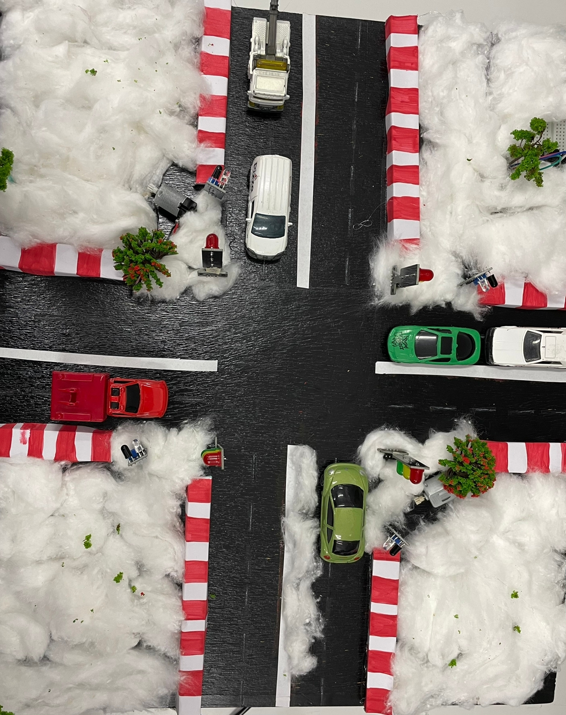
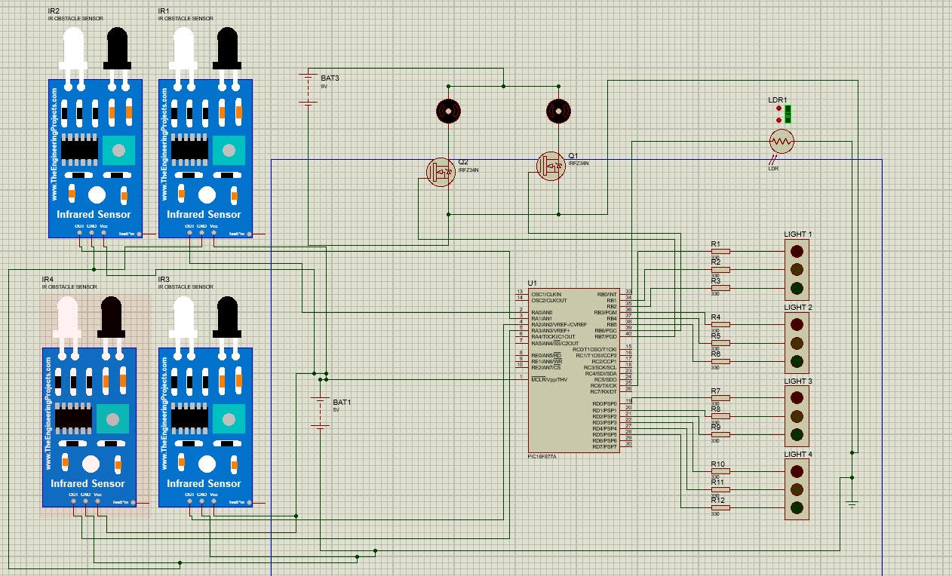
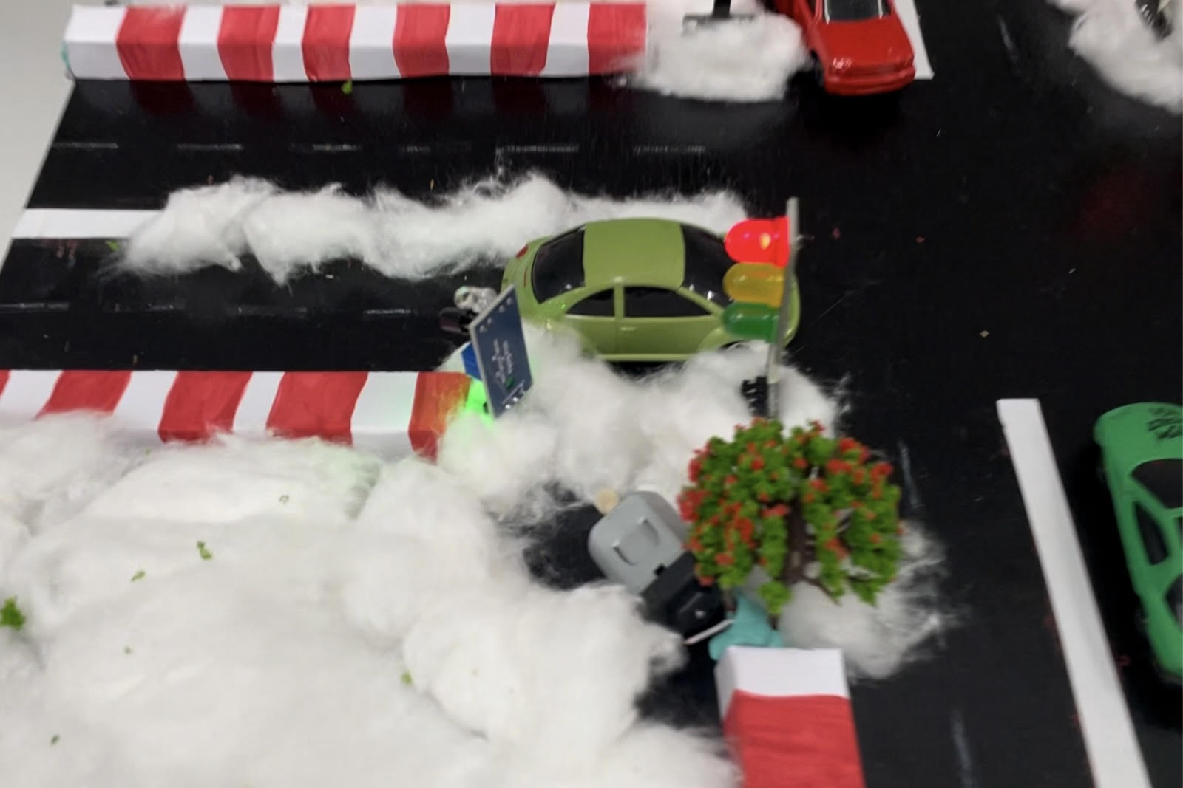
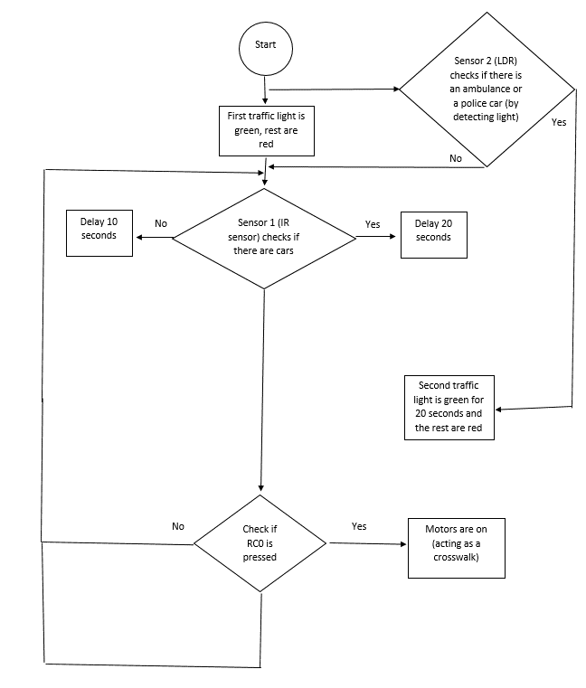
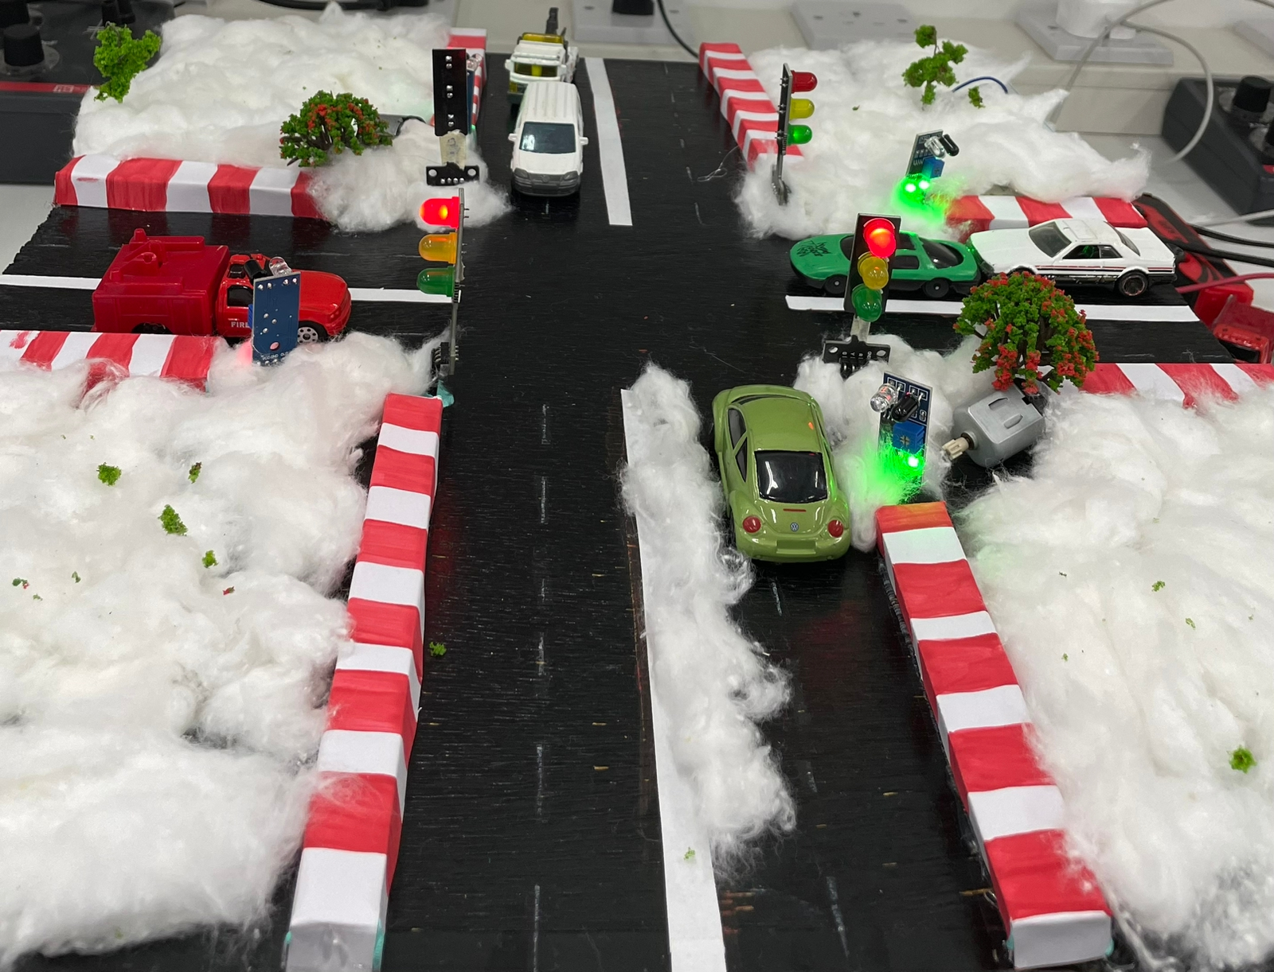
Smart Traffic Lights
G. Haddadin, I. Al-Samardali, and Z. Haddadin
Supervisor: Dr. Belal Sababha
Embedded Systems Final Design Project, Fall 2023
King Abdullah II School of Engineering
Princess Sumaya University for Technology
Introduction
This project aims to reduce traffic congestion, improve the road experience, and save a lot of time wasted on the road. This will also increase the efficiency of the public transport system which will further contribute to resolving the issue. Also, this solution will affect the medical and public safety sectors by prioritizing the lanes of ambulances and police vehicles.
Results
Normal traffic lights with fixed time intervals disregard the traffic situation at each intersection. The proposed system provides dynamic time intervals for traffic lights according to the number of vehicles present and the urgency of each lane. More cars will lead to a longer green light time, and in the case of an emergency, the lane will be prioritized over the others.
Figure 3: Top View.
The motor will turn on and starts to rotate once the button has been clicked and the fourth traffic light closes so the crosswalk for pedestrians starts operating.
Figure 4: The Motor Rotating.
The LDR interrupt will work as a flashing light sensor. When an emergency flashing light is detected, the assigned traffic light for the ambulance, police, or fire department opens immediately.
Figure 5: The Final Prototype in Operation.
Design
The infrared and light sensors are mounted on the sidewalk to detect the vehicle on the road. These sensors will sense the presence of a car or a flashing light passing by. The unit generates an output signal for red, green, and yellow signals and monitors their timings taking into consideration the number of vehicles on each road. A schematic diagram was designed using Proteus software as shown below.
Figure 1: Schematic Diagram.
Figure 2: Flowchart.
Conclusion
To conclude, the main purpose of our project is to help avoid congestion and traffic on the road by using IR sensors that detect objects to help speed up the process. A push button was used to help people cross the road safely and efficiently. Also, once there is an emergency, the ambulance or police car will be able to move faster as all other traffic lights on the road will be red except the one that detected the emergency lights, this will enable it to reach its destination on time without any delays. Such a system can be applied in cities like Amman to solve the problem of increased traffic that we have been facing recently due to our growing population.

