Slide 1
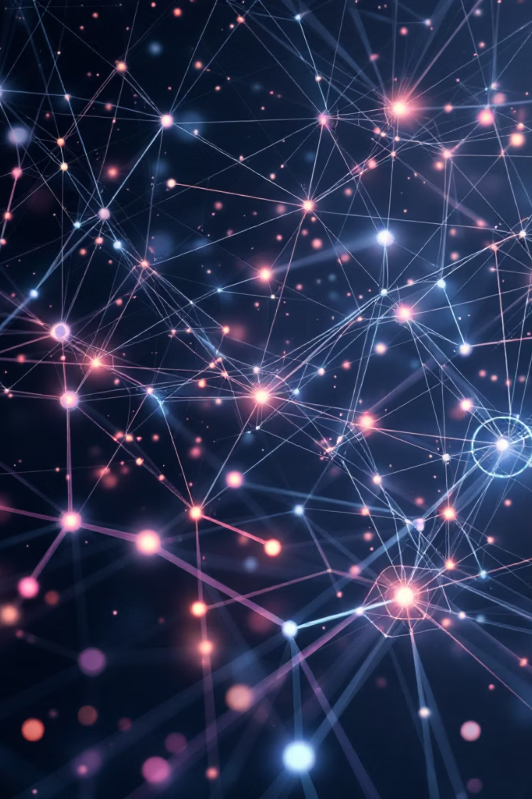
One-Step Diffusion Models: Compressing Slow Generation into a Single Forward Pass
A technical survey of recent advances in compressing diffusion model generation into single-step inference

Slide 2

The Problem: Why Diffusion Models Are Too Slow for Real-Time Use
Standard diffusion models, exemplified by DDPM (Ho et al., NeurIPS 2020), generate images through iterative denoising of random noise over 50 to 1000 sequential steps. Each step requires a full neural network forward pass, accumulating significant computational overhead. On a consumer-grade T4 GPU, generating a single image with standard SDXL architecture takes approximately 8–12 seconds, making real-time applications—interactive creative tools, on-device generation, video synthesis, and responsive AI systems—effectively impossible.
The fundamental goal of one-step diffusion research is to collapse the entire denoising chain into a single forward pass: input random noise, output clean image, eliminate iteration entirely. This represents a paradigm shift from sequential processing to direct mapping, fundamentally changing how we think about generative modeling.
Timeline of the Field
2020: DDPM
1
Ho et al. established the 1000-step baseline with Denoising Diffusion Probabilistic Models
2
2021: DDIM
Song et al. introduced deterministic sampling, reducing to 50 steps
March 2023: Consistency Models
3
Song et al. presented first 1-step distillation at ICML 2023 (arXiv 2303.01469)
4
September 2023: InstaFlow
Liu et al. demonstrated rectified flow 1-step approach (ICLR 2024, arXiv 2309.06380)
October 2023: LCM
5
Luo et al. introduced latent consistency distillation framework (arXiv 2310.04378)
6
November 2023: SDXL-Turbo/ADD
Sauer et al. pioneered adversarial distillation (arXiv 2311.17042)
2024: DMD2
7
Yin et al. achieved FID 1.28 with distribution matching at NeurIPS 2024 (arXiv 2405.14867)

Slide 3



How Researchers Solved One-Step Generation: Three Distinct Paradigms
The field converged on three fundamentally different approaches to compress multi-step diffusion into single-step inference. Each paradigm represents a distinct philosophy about how to transfer knowledge from a slow teacher model to a fast student.
Paradigm 1: Consistency Distillation
Paradigm 2: Adversarial Diffusion Distillation (ADD)
Paradigm 3: Distribution Matching Distillation (DMD)
Key idea: Force the model to map any noisy intermediate on the probability flow ODE trajectory directly to the clean image x₀. A self-consistency loss trains this without adversarial training.
Key idea: Combine score distillation from a large teacher model with a GAN discriminator that enforces photorealism at every step. Classifier-free guidance is baked into the distillation—inference uses guidance_scale=0.
Key idea: Instead of matching trajectories, train the student to minimize KL divergence to the teacher's full output distribution. DMD2 adds a GAN loss and backward simulation to improve quality further.
Papers: Consistency Models (Song et al., ICML 2023, arXiv 2303.01469); Latent Consistency Models (LCM, Luo et al., arXiv 2310.04378)
Papers: SDXL-Turbo (Sauer et al., arXiv 2311.17042); SDXL-Lightning (Lin et al., arXiv 2402.13929)
Papers: DMD (Yin et al., CVPR 2024, arXiv 2311.18828); DMD2 (Yin et al., NeurIPS 2024 Oral, arXiv 2405.14867)
GitHub: github.com/openai/consistency_models and github.com/luosiallen/latent-consistency-model
GitHub: huggingface.co/stabilityai/sdxl-turbo and huggingface.co/ByteDance/SDXL-Lightning
GitHub: github.com/tianweiy/DMD2
Result: FID 1.28 on ImageNet-64×64, 500x speedup over the teacher model.
Result: FID 3.55 on CIFAR-10 in one step. LCM works as a LoRA plug-in on any Stable Diffusion checkpoint.
Result: First method to unlock true single-step synthesis with a foundation model. Preferred over LCM-XL in human evaluations.

Slide 4
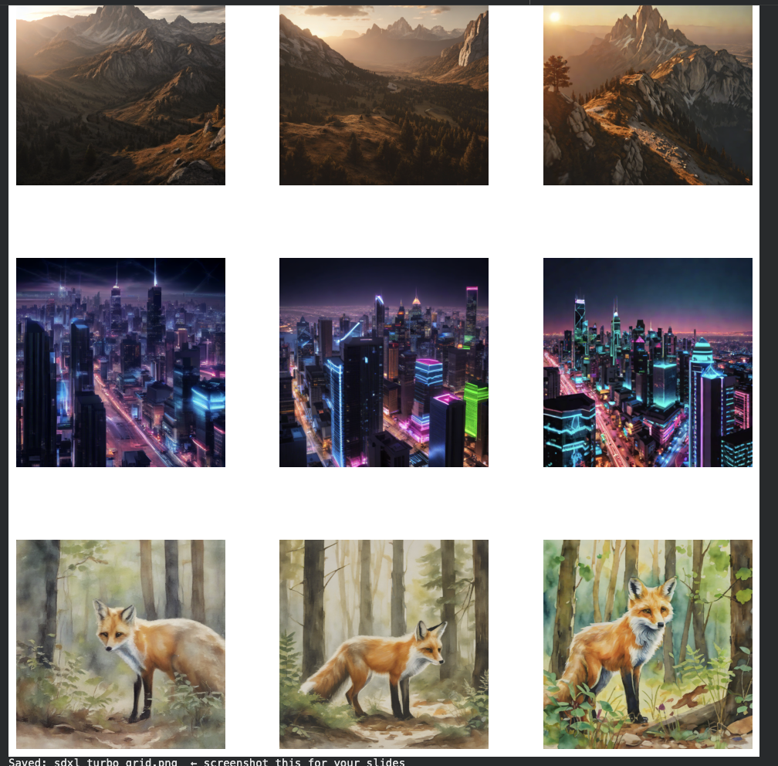

Running SDXL-Turbo: Official Code, Google Colab T4 GPU
We used the official code from the SDXL-Turbo model card on HuggingFace (huggingface.co/stabilityai/sdxl-turbo). No custom training—just inference on the pre-trained model.
from diffusers import AutoPipelineForText2Image import torch pipe = AutoPipelineForText2Image.from_pretrained( "stabilityai/sdxl-turbo", torch_dtype=torch.float16, variant="fp16" ).to("cuda") image = pipe( prompt="a mountain at golden hour, cinematic, 8k", num_inference_steps=1, # one step — the whole point guidance_scale=0.0, # required: guidance baked into distillation ).images[0]
Key Implementation Notes
num_inference_steps=1 is what makes this one-step generation.
guidance_scale=0.0 is not optional—Adversarial Diffusion Distillation bakes classifier-free guidance into the training process, so adding it again at inference would break the model (Sauer et al. [4], Section 3).
We also ran LCM from github.com/luosiallen/latent-consistency-model for comparison.
Measured Results on Colab T4 GPU
0.79s
1.03s
SDXL-Turbo 1-step
LCM 1-step
Fastest single-step generation
Consistency distillation baseline
1.43s
10s
LCM 4-step
Standard SDXL 25-step
Improved quality with more steps
Baseline reference
13x
Speedup Demonstrated
One-step methods vs. baseline
Quality observation from our 3×3 grid (3 prompts × 3 step counts): Even at 1 step, all three prompts—photorealistic landscape, futuristic city, watercolor painting—produced coherent, prompt-faithful images. Quality improved visibly at 2 and 4 steps, with 4-step output approaching photorealism.

Slide 5




Method Comparison, Open Gaps, and Full References
Comprehensive Method Comparison
SDXL-Turbo
LCM
We ran this: ADD distillation, 1–4 steps, 512px output, 0.79s per image on T4, best 1-step quality in human evaluations vs. LCM-XL. arXiv 2311.17042.
We ran for comparison: Consistency distillation, 1–4 steps, 768px output, 1.03s at 1-step, pluggable as LoRA on any SD checkpoint. arXiv 2310.04378.
InstaFlow
DMD2
Rectified flow + reflow pipeline, FID 23.3 on COCO at 1-step, 0.09s per image, first SD-level one-step model. arXiv 2309.06380.
Distribution matching + GAN, FID 1.28 on ImageNet-64, NeurIPS 2024 Oral, 500x speedup over teacher. arXiv 2405.14867.
Open Research Gaps
1-step text-image alignment
Still weaker than multi-step on complex compositional prompts requiring fine-grained reasoning
Mode coverage
One-step models under-represent rare or tail samples in the distribution, limiting diversity
Video generation
Extending ADD and LCM temporally is an early-stage open problem with limited published results
Controllability
Integrating ControlNet natively at 1-step remains unsolved—current approaches require multi-step scheduling
Evaluation metrics
FID alone is insufficient—prompt-faithful perceptual metrics combining quality and alignment are needed
Key insight for practitioners: All three paradigms share one core idea—derive a fast student model from a slow teacher. The difference between them is entirely in the loss function used to do the matching: self-consistency loss, adversarial loss, or KL divergence.
References
[1] Song et al. "Consistency Models." ICML 2023. arxiv.org/abs/2303.01469. github.com/openai/consistency_models
[2] Luo et al. "Latent Consistency Models." arXiv:2310.04378. github.com/luosiallen/latent-consistency-model
[3] Liu et al. "InstaFlow: One Step is Enough." ICLR 2024. arxiv.org/abs/2309.06380. github.com/gnobitab/InstaFlow
[4] Sauer et al. "Adversarial Diffusion Distillation." arXiv:2311.17042. huggingface.co/stabilityai/sdxl-turbo
[4b] Lin et al. "SDXL-Lightning." arXiv:2402.13929. huggingface.co/ByteDance/SDXL-Lightning
[5] Yin et al. "One-step Diffusion with Distribution Matching Distillation." CVPR 2024. arxiv.org/abs/2311.18828
[6] Yin et al. "Improved Distribution Matching Distillation." NeurIPS 2024 Oral. arxiv.org/abs/2405.14867. github.com/tianweiy/DMD2

