Slide 1
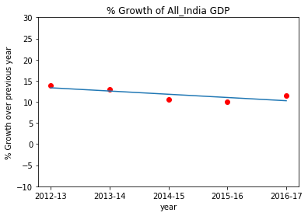
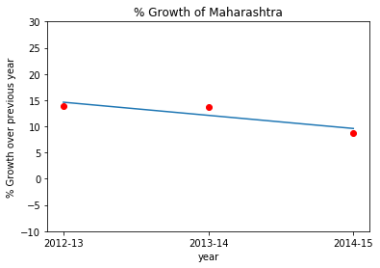
Part-I: GDP Analysis of the Indian States

Slide 2
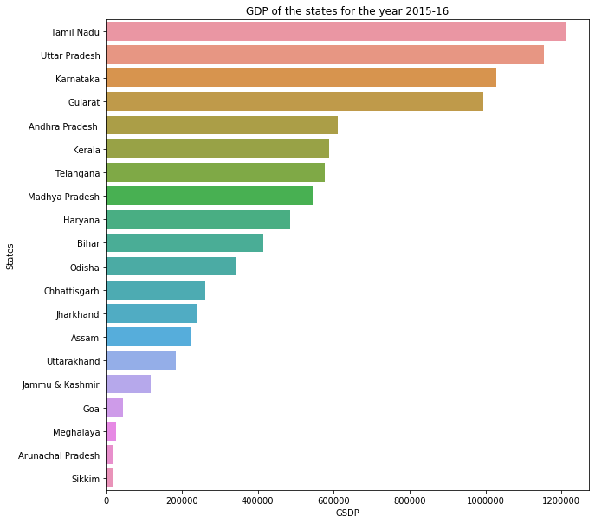
GDP of the states for the year 2015-16:
Used Bar Plot for the data Analysis purpose as it is easier to understand , read and Compare the GDP of the states with one another
As per the bar chart the top 5 States based on total GDP are :Tamil Nadu, Uttar Pradesh, Karnataka, Gujarat, Andhra Pradesh
And bottom 5 states based on GDP are :Sikkim, Arunachal Pradesh, Meghalaya, Goa, J&K

Slide 3
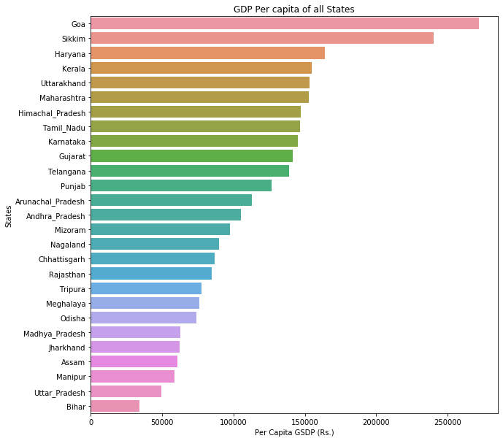
GDP per capita for all the states
top 5 and the bottom 5 states based on the GDP per capita are
Top 5 : Goa, Sikkim,Haryana, Kerala, Uttarakhand
Bottom 5 : Bihar, Uttar-Pradesh, Manipur, Assam, Jharkhand
GDP High : Goa: 271793.0
GDP Low: Bihar : 33954.0
Ratio :

