Slide 1
Engineering the Java Web Application
SE 432
Software Engineering for Web Applications

Slide 2
Introduction
What we have studied so far is the following:
A request is made to a JSP or a Servlet, and then that JSP or Servlet handles all responsibilities for the request, including
processing the request,
validating data,
handling the business logic,
and generating a response
This is known as Model 1 Architecture

Slide 3
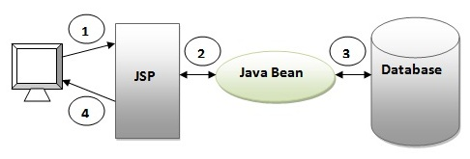
Model 1 Architecture
Commonly used in smaller, simple task applications due to its ease of development

Slide 4
Model 1 Architecture
Client directly calls a JSP page
The JSP page accesses the JavaBeans (the application model)
The next view to display is determined either by hyperlinks selected in the source document or by request parameters
Control is decentralized, because the current page being displayed determines the next page to display
In addition, each JSP page or servlet processes its own inputs (parameters from GET or POST)
Provide a more lightweight design for small, static applications
Suitable for applications that have very simple page flow

Slide 5
Model 1 Architecture
Easy and quick to develop web applications, however it has the following disadvantages:
Navigation control is decentralized since every page contains the logic to determine the next page
If a JSP page name is changed that is referred to by other pages, we need to change it in all the pages
that leads to the maintenance problem
Time consuming: you need to spend more time to develop custom tags in JSP (to avoid using the scriptlet tag)
Hard to extend: it is better for small applications but not for large applications

Slide 6
Navigation Control
In this simple example, we can see that since there is no central point for receiving the requests and that the same page is being called by different pages, this makes it difficult to manage and maintain this especially for larger applications → thus, we need a central point of entry for the application → Controllor
R3
P2
P3
R1
R2
P1
P5
P6
P4

Slide 7
JSP in Model 1
Typical picture: use JSP to make it easier to develop and maintain the HTML content
For simple dynamic code, use scripting elements
For slightly more complex applications, use custom classes called from scripting elements
For moderately complex applications, use beans and custom tags

Slide 8
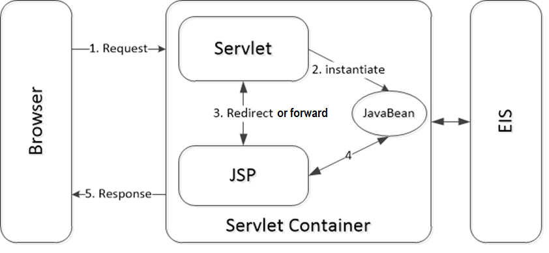
Model 2 Architecture
Model 2 solves the problems in Model 1

Slide 9
Model-2 Architecture
Introduces a controller servlet between the browser and the JSP pages being delivered
The controller centralizes the logic for dispatching requests to the next view based on the request URL, input parameters, and application state
The controller also handles view selection, which decouples JSP pages and servlets from one another
Easier to maintain and extend, because views do not refer to each other directly
Controller servlet provides a single point of control for security and logging, and often encapsulates incoming data into a form usable by the back-end MVC model
For these reasons, the Model 2 architecture is recommended for most interactive applications

Slide 10
Model-View-Controller (MVC)
MVC is an architectural pattern
Consists of three modules
Model (bean): represents the state (data) and business logic of the application
View (JSP): responsible to display data (presentation)
Controller (servlet): acts as an interface between view and model (intercepts all requests)

Slide 11
MVC
The model, as usual, does all the computational work, and no I/O
The model can consist of multiple classes
The servlet class acts as the controller
The servlet gives any relevant information from the user request to the model
The servlet takes the results and passes them on to the view
The view—that is, the HTML page that is returned to the user—is frequently created by JSP

Slide 12
Advantages of MVC
Separation of concerns
Computation is not intermixed with I/O
Consequently, code is cleaner and easier to understand
Flexibility
The GUI (if one is used) can be completely redone without touching the model in any way
Reusability
The same model used for a servlet can equally be used for an application or an applet (or by another process)

Slide 13
MVC Architecture Advantages
MVC separates design concerns (data persistence and behavior, presentation, and control), decreasing code duplication, centralizing control, and making the application more easily modifiable
MVC also helps developers with different skill sets to focus on their core skills and collaborate through clearly defined interfaces
New data sources are easy to add to an MVC application by creating code that adapts the new data source to the view API
New client types are easy to add by adapting the new client type to operate as an MVC view
MVC clearly defines the responsibilities of participating classes, making bugs easier to track down and eliminate

Slide 14
Model
The model represents business data and business logic
Operations that govern access and modification of the business data
Often the model serves as a software approximation to real-world functionality
It notifies views when it changes and provides the ability for the view to query the model about its state
It also provides the ability for the controller to access application functionality encapsulated by the model

Slide 15
View
The view renders the contents of the model
It accesses data from the model and specifies how that data should be presented
It updates data presentation when the model changes.
The view also forwards user input to the controller.

Slide 16
Controller
The controller defines the application behavior
Dispatches user requests and selects views for presentation
Interprets user inputs and maps them into actions to be performed by the model
In a stand-alone GUI client, user inputs include button clicks and menu selections.
In a Web application, they are HTTP GET and POST requests to the Web tier.
The controller selects the next view to display based on the user interactions and the outcome of the model operations
An application typically has one controller for each set of related functionality

Slide 17
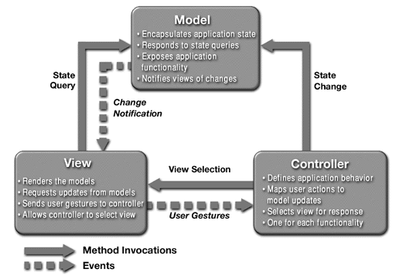
Model-View-Controller Architecture

Slide 18
Implementing MVC with RequestDispatcher
Define beans to represent the data
Use a servlet to handle requests
Servlet reads request parameters, checks for missing and malformed data, etc.
Populate the beans
The servlet invokes business logic (application-specific code) or data-access code to obtain the results. Results are placed in the beans that were defined in step 1.
Store the bean in the request, session, or servlet context
The servlet calls setAttribute on the request, session, or servlet context objects to store a reference to the beans that represent the results of the request
Forward the request to a JSP page
The servlet determines which JSP page is appropriate to the situation and uses the forward method of RequestDispatcher to transfer control to that page.
Extract the data from the beans
The JSP page accesses beans with jsp:useBean and a scope matching the location of step 4. The page then uses jsp:getProperty to output the bean properties (the JSP page does not create or modify the bean)

Slide 19
Request Forwarding Example
public void doGet(HttpServletRequest request, HttpServletResponse response)
throws ServletException, IOException {
String operation = request.getParameter("operation");
if (operation == null) {
operation = "unknown";
}
String address;
if (operation.equals("order")) {
address = "/WEB-INF/Order.jsp";
} else if (operation.equals("cancel")) {
address = "/WEB-INF/Cancel.jsp";
} else {
address = "/WEB-INF/UnknownOperation.jsp";
}
RequestDispatcher dispatcher = request.getRequestDispatcher(address);
dispatcher.forward(request, response);
}

Slide 20
jsp:useBean in MVC vs in Standalone JSP Pages
In MVC, the JSP page should not create the objects
The servlet, not the JSP page, should create all the data objects.
So, to guarantee that the JSP page will not create objects, you should use
<jsp:useBean ... type="package.Class" />
instead of
<jsp:useBean ... class="package.Class" />
The JSP page should not modify the objects
So, you should use jsp:getProperty but not jsp:setProperty.

Slide 21
jsp:useBean Scope Alternative
request
<jsp:useBean id="..." type="..." scope="request" />
session
<jsp:useBean id="..." type="..." scope="session" />
application
<jsp:useBean id="..." type="..." scope="application" />
page
<jsp:useBean id="..." type="..." scope="page" />
or just
<jsp:useBean id="..." type="..." />
This scope is not used in MVC (Model 2) architecture

Slide 22
Request-based Data Sharing
In the Servlet, you create the bean and then dispatch the request:
ValueObject value = new ValueObject(...);
request.setAttribute("key", value);
RequestDispatcher disp = request.getRequestDispatcher ("/WEB-INF/SomePage.jsp");
disp.forward(request, response);
In JSP 1.2:
<jsp:useBean id="key" type="somePackage.ValueObject“ scope="request" />
<jsp:getProperty name="key" property="someProperty" />
In JSP 2.0, you can also use the expression language as follows:
${key.someProperty}
This expression is equivalent to <% = key.getSomeProperty()%>
Exercise: Write the above code for session and application scopes!

Slide 23
RequestDispatcher.forward vs Response.SendRedirect
Response.SendRedirect:
response.sendRedirect("http://www.se432.com/form1");
RequestDispatcher.forward:
RequestDispatcher disp = request.getRequestDispatcher ("/WEB-INF/SomePage.jsp");
disp.forward(request, response);
Distinctions: with sendRedirect:
User sees JSP URL (user sees only servlet URL with RequestDispatcher.forward)
Two round trips to client (only one with forward)
Advantages of sendRedirect
User can visit JSP page separately
User can bookmark JSP page
Disadvantages of sendRedirect
Since user can visit JSP page without going through servlet first, JSP data might not be available
So, JSP page needs code to detect this situation

Slide 24
MVC Example – Bank Account Balances
Bean
BankCustomer
Servlet that populates bean and forwards to appropriate JSP page
Reads customer ID, calls data-access code to populate BankCustomer
Uses current balance to decide on appropriate result page
JSP pages to display results
Negative balance: warning page
Regular balance: standard page
High balance: page with advertisements added
Unknown customer ID: error page

Slide 25
Servlet Code
public class ShowBalance extends HttpServlet {
public void doGet(HttpServletRequest request, HttpServletResponse response) throws ServletException, IOException {
BankCustomer customer = BankCustomer.getCustomer (request.getParameter("id"));
String address;
if (customer == null) {
address = "/WEB-INF/bank-account/UnknownCustomer.jsp";
} else if (customer.getBalance() < 0) {
address = "/WEB-INF/bank-account/NegativeBalance.jsp";
request.setAttribute("badCustomer", customer);
}
RequestDispatcher dispatcher = request.getRequestDispatcher(address);
dispatcher.forward(request, response);
}

Slide 26
NegativeBalance.jsp
<HTML>
<BODY>
<TABLE BORDER=5 ALIGN="CENTER">
<TR><TH CLASS="TITLE">
We Know Where You Live!</TABLE>
<P>
<IMG SRC="/bank-support/Club.gif" ALIGN="LEFT">
<jsp:useBean id="badCustomer“ type="coreservlets.BankCustomer“ scope="request" />
Watch out,
<jsp:getProperty name="badCustomer“ property="firstName" />,
we know where you live.
<P>
Pay us the $<jsp:getProperty name="badCustomer“ property="balanceNoSign" />
you owe us before it is too late!
</BODY>
</HTML>

Slide 27
JSP 2.0 Code (NegativeBalance.jsp)
<BODY>
<TABLE BORDER=5 ALIGN="CENTER">
<TR><TH CLASS="TITLE">
We Know Where You Live!</TABLE>
<P>
<IMG SRC="/bank-support/Club.gif" ALIGN="LEFT">
Watch out,
${badCustomer.firstName},
we know where you live.
<P>
Pay us the $${badCustomer.balanceNoSign}
you owe us before it is too late!
</BODY></HTML>

