Slide 1
Wedding Services Website Presentation
Prepared by: Ghaydaa Bdoor
Orange Coding Academy Masterpiece Project

Slide 2
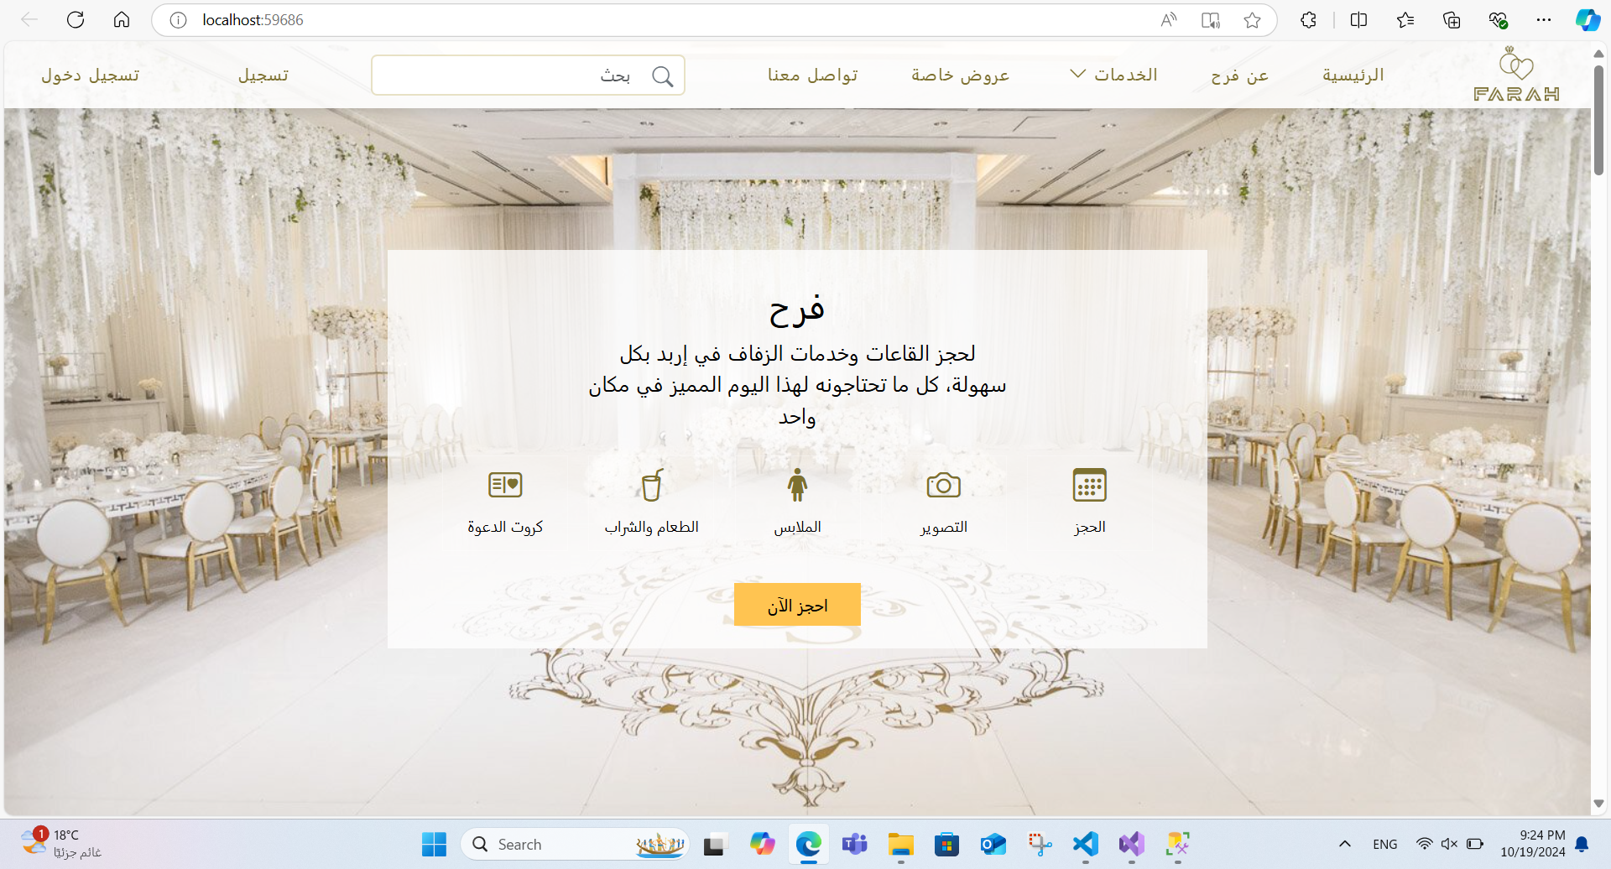

Slide 3
Introduction
My website provides wedding-related services in Irbid, Jordan. It allows users to book wedding venues, photographers, bridal dresses, and design invitation cards. It offers a streamlined experience for couples to organize key aspects of their wedding day.

Slide 4
Services Overview
- Booking Wedding Venues or Farms in Irbid
- Booking Photographers
- Invitation Cards Design
- Booking Bridal Dresses
- Upcoming: Mini Foods for Occasions
Users can create an account, book services, and manage their profiles.

Slide 5
User Experience
- Users can create an account and log in.
- Profile page includes registered information and previously booked services.
- Home page displays the main services and includes About and Contact sections.

Slide 6
Booking Process
For wedding venues:
- Users select a venue from available options.
- Fill a booking form with the desired date and time.
- Admin verifies availability and updates the database.
- If available, users can proceed to PayPal for payment and confirm booking.
- Similar process applies for photographers and bridal dresses.

Slide 7
Invitation Card as a Gift
- Users who book a wedding venue get a free invitation card.
- Choose from available templates on the website.
- Fill in details, and the admin reviews and sends the final card via email.

Slide 8
Business Model
Revenue Streams:
- Service Booking Fees (Venues, Photographers, Dresses)
- Payment through PayPal
- Commission from Vendors
- Upcoming: Food and Drink Services
The platform acts as a marketplace connecting vendors and customers.

Slide 9
Conclusion
This website simplifies wedding planning in Irbid by providing a single platform for booking venues, photographers, dresses, and invitation cards. With additional services like mini foods, it aims to be a comprehensive solution for wedding needs.

